Slide 1
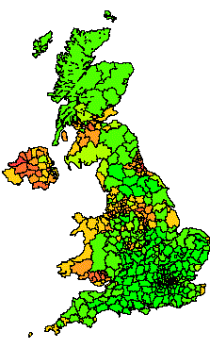
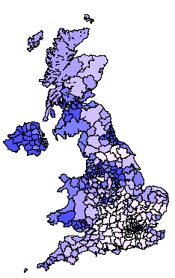
Title
School of Geography
FACULTY OF ENVIRONMENT
Microsimulation:
population reconstruction and an application for household water demand modelling
ESRC Research Award RES-165-25-0032, 01.10.2007- 30.09.2009
What happens when international migrants settle? Ethnic group population trends and projections for UK local areas
Notes:
A Ph.D project as a deliverable from WaND.

Slide 2
School of Geography
FACULTY OF ENVIRONMENT
Introduction
Framework
Basics
Illustration
MSM Review
Statistical Matching
Scenario
Part of EPSRC funded Water Cycle Management for New Developments (WaND): http://www.wand.uk.net/
Teamwork:
MicroWater Sim et al. (2007)
MacroWater Parsons et al. (2007)
Notes:
The aim of WaND (Water Cycle Management for New Developments) is to support the delivery of integrated, sustainable water management for new developments by provision of tools and guidelines for project design, implementation and management.
The modelling work reported here is a part of Work packages, embedded in a research project called WaND (Water Cycle Management for New Developments) (WaND Consortium, 2003). WaND was an EPSRC funded project that researched the sustainability of new developments in water supply and in water demand. In the School of Geography, University of Leeds, Patrick Sim, John Parsons and I were responsible for the Work Package 1 and part of the Work Package 12, supervised by Professors Adrian McDonald and Phil Rees. Work Package 1 projects household populations spatially, which are fed into Work Package 12 for forecasting water demand with scenarios that take into account new developments, water demand management, climate change, policies and regulations, and social values. Sim et al. (2007a) adapted the Microcomponent method for water demand prediction and developed MicroWater (a spreadsheet model) as a user interface for regional water demand forecasting. Parsons et al. (2007) projected aggregated household population and water demand at Local Authority level using a model called MacroWater. Sim and Parsons managed some small field surveys, and designed and parameterised the scenarios. The modelling work reported in this thesis has borrowed much from the WaND research project and feeds key features into a spatial microsimulation model that combines the power of Microcomponent and Scenario methods.

Slide 3
Methods-a
School of Geography
FACULTY OF ENVIRONMENT
Introduction
Framework
Basics
Illustration
MSM Review
Statistical Matching
Scenario
Contents:
Framework for static and dynamic MSM
Basis of MSM
Illustrations of MSM
Reviews of MSM
Data fusion for MSM: statistical matching
Scenarios: dynamic MSM

Slide 4
Methods-b
Framework for static and dynamic MSM
Principal driver of the projection
Population-led models | Housing-led models
Dynamic microsimulation model using cohort-component processes and modelling households and individuals together | Microsimulation of households linked to the changes of housing, from a macro model or direct data source.
Introduction
Framework
Basics
Illustration
MSM Review
Statistical Matching
Scenario

Slide 5
Data-a
School of Geography
FACULTY OF ENVIRONMENT
Introduction
Framework
Basics
Illustration
MSM Review
Statistical Matching
Scenario
Basics of MSM 1: Data
A baseline micro dataset: population ( Individual or Household )
Characteristics: demographic, socio-economic or other project related characteristics such as water use
Parameter data: updating the micro dataset to the future

Slide 6
Data-a
School of Geography
FACULTY OF ENVIRONMENT
Introduction
Framework
Basics
Illustration
MSM Review
Statistical Matching
Scenario
Basics of MSM 2: Simulation process and alignment
Probabilistic Modelling
Person | Death Probability | Monte Carlo Sampling: Random number | Monte Carlo Sampling: Trigger Death
Age = 80 | 50% or 0.5 | 0.4 <= 0.5 | True
 |  | 0.78 < 0.5 | false
Notes:
Probabilistic modelling is the most common technique applied to dynamic population into the future, involving simulating mortality and fertility with the assistance of Monte Carlo simulation. For example, if the probability of dying for a 80-year old male is 0.5 and if a random number (in the range 0 to 1) less than 0.5 is given by executing a random number algorithm, then the person will die, whereas he will be still alive if the random number is more than or equal to 0.5. The probabilities can be achieved in two ways. Transition matrices are the easiest to use though it may be difficult to derive them. For example, mortality rates by age, sex, marital status can be achieved from single published life tables. However, if mortality probabilities further disaggregated by social class and employment are needed, various estimation techniques may be required. In order to incorporate more variables in determining the transition processes, regression may be more preferable. Logistic regressions are commonly applied to derive the transition probabilities from empirical data. For instance, death records can be pulled out from available longitudinal data on which logit regression can be run to produce coefficients for selected determinants such as age, sex, marital status, social class, job and health condition.

Slide 7
Data-a
School of Geography
FACULTY OF ENVIRONMENT
Introduction
Framework
Basics
Illustration
MSM Review
Statistical Matching
Scenario
Basics of MSM 2: Simulation process and alignment
Behavioural Modelling
Survival and hazard functions
Notes:
Behavioural modelling originated from economists’ attempts to update the behaviour of micro units in reaction to the change of institutional characteristics such as a tax policy which might result in reducing labour supply. This kind of dynamic has been classified as second order effects by Bekkering (1995). The first order effects are static effects, which is the objective of a static model, such as the income tax recalculation caused by the changes of tax rates while other variables remain constant. The third order, cyclical effects are illustrated by a dynamic balance of supply and demand (Bekkering 1995). A labour supply that is rising may be caused by a tax policy and then a salary decrease might result in turn. After that demand for labour may be stimulated so that supply will drop. Bekkering (1995) also suggested that it is practically difficult to apply the third order effects in microsimulation models whereas it is easy to analyze these at the meso and macro level. O’Donoghue (2001) noticed that very few dynamic models have designed even the second order effects.
The best example to explain the use of survival and hazard functions in microsimulation is mortality. There are a lot materials in the thesis …………… (Frans Willekens has a better explaination, mine could only illustrate the basic idea

Slide 8
Data-a
School of Geography
FACULTY OF ENVIRONMENT
Introduction
Framework
Basics
Illustration
MSM Review
Statistical Matching
Scenario
Basics of MSM 3: Policy Analysis and Scenarios
Alignment: using macro inputs to alignment the output of a microsimulation in this project
Policy Analysis and Scenarios
Notes:
Alignment
Bækgaard (2002) presents a thorough investigation in which he recoganised that the objective of alignment is to compensate for imperfectness of data and estimation techniques. However, he also reckons that the right way to correct the result of a wrongly designed process is to redesign or adjust the process rather than alignment. Nevertheless, it is still recommended that alignment is able to input additional information for the compensation of the output resulting from insufficient data estimation.
Policy Analysis and Scenarios
Demographic scenarios commonly specify different demographic time series rates to determine the future population such as the gradual decrease of fertility and mortality rates. They could be implemented in microsimulation models in another way. For example, the decrease of fertility rate is caused partly by the increase of female labour participation. Therefore, if the labour market is implemented in a microsimulation model, the labouring process will influence fertility indirectly.
Further, we can go to the final few slides to talk about our own scenarios as an example

Slide 9
Results-a
School of Geography
FACULTY OF ENVIRONMENT
Introduction
Framework
Basics
Illustration
MSM Review
Statistical Matching
Scenario
IIlustrations of population reconstruction for water demand modelling: combinatorial optimisation 1
Micro Samples
ID | Age | Sex
0 | 5 | M
1 | 3 | F
2 | 50 | M
3 | 30 | F
…
999 | 25 | F
1000 | 36 | M
Constraint table:
Total Pop | Age less than 10 | Age over 60
50 | 30 | 20
Notes:
A list of individual sample with age and sex
Looking for 50 persons: 30 persons of less than 10 years old, and 20 persons of over 60 years old
Collecting 50 persons from the list and then swapping some of them iteratively to reach the goal
If there are multiple areas, it becomes a spatial application.
The solution of a collected list of the micro units is optimized for the combination of the targeted demographic, socio-economic and other characteristics in a similar way, so combinatorial optimisation

Slide 10
Results-a
School of Geography
FACULTY OF ENVIRONMENT
Introduction
Framework
Basics
Illustration
MSM Review
Statistical Matching
Scenario
IIlustrations of population reconstruction for water demand modelling: combinatorial optimisation 2
Constraint table:
Total Pop | Age less than 10 | Age over 60
50 | 30 | 20
SelectedSamples
ID | Age | Sex
0 | 3 | M
1 | 6 | F
2 | 25 | M
3 | 39 | F
…
48 | 67 | F
49 | 78 | M
Aggregation of the selected samples
Total Pop | Age less than 10 | Age over 60
50 | 20 | 30
Errors
Total Error | Age less than 10 | Age over 60
20 | 10 | 10
Notes:
A list of individual sample with age and sex
Looking for 50 persons: 30 persons of less than 10 years old, and 20 persons of over 60 years old
Collecting 50 persons from the list and then swapping some of them iteratively to reach the goal
If there are multiple areas, it becomes a spatial application.
The solution of a collected list of the micro units is optimized for the combination of the targeted demographic, socio-economic and other characteristics in a similar way, so combinatorial optimisation

Slide 11
Results-a
School of Geography
FACULTY OF ENVIRONMENT
Introduction
Framework
Basics
Illustration
MSM Review
Statistical Matching
Scenario
IIlustrations of population reconstruction for water demand modelling: combinatorial optimisation 2
Constraint table:
Total Pop | Age less than10 | Age over 60
50 | 30 | 20
SelectedSamples
ID | Age | Sex
0 | 3 | M
1 | 4 | F
2 | 1 | M
3 | 10 | F
…
48 | 67 | F
49 | 78 | M
Aggregation of the selected samples after swapping of some of them
Total Pop | Age less than 10 and Male | Age over 60 and Female
50 | 25 | 25
Errors
Total Error | Age less than 10 | Age over 60
10 | 5 | 5
Notes:
A random swapping some of the selected samples, such as the red color micro units, and a new aggregation can be achieved.
then swapping some of them iteratively to reach the goal, which is usually guided by algorithms such as genetic algorithm or simulated annealing.
If there are multiple areas, it becomes a spatial application.
The solution of a collected list of the micro units is optimized for the combination of the targeted demographic, socio-economic and other characteristics in a similar way, so combinatorial optimisation

Slide 12
Results-a
School of Geography
FACULTY OF ENVIRONMENT
Introduction
Framework
Basics
Illustration
MSM Review
Statistical Matching
Scenario
IIlustrations of population reconstruction for water demand modelling: data for this project
HSAR, ISAR
12 CAS tables
Variables contrained:
Relationship to HRP, Economic Activity, NS-SEC Social Economic Classification,
Level of Highest Qualifications (Aged 16-74), Number of Rooms in Occupied Household Space, Tenure of Accommodation, Term time Address of Students or Schoolchildren , Accommodation Type , Use of Bath/Shower/Toilet , Cars/Vans Owned or Available for Use .
Notes:
For this application, Household and Individual SARs are the micro samples and the contriants are 12 CAS tables:…?
Variables contrained: Ethnic Group for England and Wales (Improved Grouping), Relationship to HRP, Economic Activity (Last Week), NS-SEC Social Economic Classification, Social Grade of Household Reference Person, Marital Status, Person Migration Indicator
Level of Highest Qualifications (Aged 16-74), Number of Rooms in Occupied Household Space, Accommodation Self-Contained , Sex,
Household with Students Away During Term Time, Schoolchild or Student in Full-Time Education, Tenure of Accommodation, Term time Address of Students or Schoolchildren , Accommodation Type , Use of Bath/Shower/Toilet , Cars/Vans Owned or Available for Use

Slide 13
Results-a
School of Geography
FACULTY OF ENVIRONMENT
Introduction
Framework
Basics
Illustration
MSM Review
Statistical Matching
Scenario
IIlustrations of population reconstruction for water demand modelling: A elegant solution for communal establishment
The individuals in communal establishment are simulated look like single person households with the household population
Some constraint tables counts them, some don’t
This approach avoid guessing and extracting the counts from related constraint tables
Notes:
A new approach has been invented to reconstruct the communal establishment population simultaneously with the household population. The approach avoids the pain of guessing and extracting communal establishment population from related constraint tables since there are few CAS tables about communal populations. Further communal populations are very varied. They vary from pensioners living in nursing homes to students living in University Halls, to prisoners resident in jails, to military personnel living on bases and to homeless persons living in hostels.
The approach firstly processes individual SAR communal population to simulate a single person household, which means categorizations of variables in the Individual SAR have to be converted and matched to the Household SAR. The variables processed and constrained are listed in Table 5.9. A flag variable was added to indicate they are members of the communal population. We believe the solution is elegant and painless.

Slide 14
Results-a
School of Geography
FACULTY OF ENVIRONMENT
Introduction
Framework
Basics
Illustration
MSM Review
Statistical Matching
Scenario
Microsimulation review 1: ORCUTT
Basedata: 1973 Current Population Survey
Submodel of DYNASIM: The Family and Earning History Model (Dynamic), its output will be input for Jobs and Benefit History Model (Dynamic), a static imputation model for various variables.
Alignment
A powerful but out of date model
Notes:
DYNASIM uses 1973 Current Population Survey (CPS) as base microdata, The March CPS provides information on the demographic and employment characteristics of individuals surveyed in that month and income and health insurance coverage during the previous calendar year.
Submodel of DYNASIM: The Family and Earning History Model (Monte Carlo Dynamic), its output will be input for Jobs and Benefit History Model (Monte Carlo Dynamic), a static imputation model for various variables.
DYNASIM includes a fairly detailed alignment function, assure that DYNASIM's aggregate predictions accurately past trend and other demographic or macroeconomic forecasts so that the model can be accepted by wider audience.
DYNASIM's focus is on individual person and family behavior. It can be used to simulate
work histories, pension accruals, and retirement behavior. It can analyze policy issues for which information on personal histories is required. Examples of issues suitable for analysis with DYNASIM include social security policy issues such as earnings sharing, pension policy issues such as the effects of changes in participation and vesting requirements on pension benefit receipt and benefit levels

Slide 15
Results-a
School of Geography
FACULTY OF ENVIRONMENT
Introduction
Framework
Basics
Illustration
MSM Review
Statistical Matching
Scenario
Microsimulation review 2: Hägerstrand Migration Model
Population and vacancies evenly distribute over a migration field divided into square cells of equal size
Two type migrants: active and passive
Basic Moving Principle: migrants follow the path of earlier migrants
Notes:
Hägerstrand (1957) developed a multi agent model in order to explore the relationship between social contact and migration. It is a classic and brilliant example of spatial demographic simulation since it was done by hand before computing power could be utilised by researchers.
The model is founded on two key definitions. Firstly, a migration field is devised, in which population and vacancies are evenly distributed, and the area is divided into square cells of equal size. Secondly, migrants are divided into active and passive types. The active migrants can choose a destination in a randomly selected adjacent cell, whereas the passive migrants are stimulated by the active migrants in a way that a passive migrant chooses a new cell where an earlier migrant from the same origin is staying and the attractiveness of all earlier migrants are equal. The second definition means migrants follow the path of earlier migrants which is the principle Hägerstrand intended to examine.

Slide 16
Results-a
School of Geography
FACULTY OF ENVIRONMENT
Introduction
Framework
Basics
Illustration
MSM Review
Statistical Matching
Scenario
Microsimulation review 3: SVERIGE
Spatial dynamic model: single year interval, monte carlo simulation using data derived from TOPSWING
TOPSWING: longitudinal micro data for every one in Sweden georeferenced to squares of 100 * 100 m
Modules: ageing, mortality, fertility, emigration, education, marriage, leaving home etc.
Notes:
The review is based on Holm et al. (2003) and Rephann et al. (2005). SVERIGE is the first national interregional spatial dynamic microsimulation model based on households with individual members, which starts from a unique large socio-economic database, TOPSWING. This database contains longitudinal information about every person living in Sweden between 1985 and 1995 covering the topics of demography, work, family, income, employment, transfers and location. Spatially, the micro units are georeferenced to squares of 100 by 100 metres and then the squares are located in the LARegions system which divides Sweden into 108 different labour market regions. The labour market region is treated in the same way as domestic addresses. The model is built in a closed dynamic discrete time framework which runs in single year intervals and contains modules simulating the processes of ageing, mortality, fertility, emigration, education, marriage, leaving home, divorce, migration, immigration, and employment and earnings.
The model is programmed in C++ to update the characteristics of persons in every simulation year. Monte Carlo simulation is implemented to determine the occurrence of specific events in a person’s life by sampling from estimated transition matrices or probabilities calculated from logistic equations derived from TOPSWING. Some of the changes in characteristics are triggered by predefined rules such as changing the marital status from married to widowed when a partner dies. The use of transition matrices may be illustrated by the immigration module. The immigrants are selected from an immigration pool having 60,000 individuals. The demographic distribution of heads is determined by a constant transition matrix and another transition matrix is used to assign the immigrants to a labour market. Both matrices are derived from the more than 100,000 immigrant records. Four equations are applied to determine the probability of dying. For example, for persons from 25 to 59 year old, the probabilities are calculated by a linear equation with parameters derived from regression analyses using age, sex, education and other variables as predictors.

Slide 17
Results-a
School of Geography
FACULTY OF ENVIRONMENT
Introduction
Framework
Basics
Illustration
MSM Review
Statistical Matching
Scenario
Microsimulation review 4: SimBritain
Reweighting BHPS to fit 1991 SAS by IPF at parliamentary constituency level
Project to 2001, 2011 and 2021 Holt’s linear exponential smoothing for extending the trend from 1971, 1981 and 1991 census SAS
Notes:
SimBritain was developed at University of Leeds initially and at later stage the research team moved to University of Sheffield. The full population of Britain was constructed and modelled in SimBritain at the parliamentary constituency level using data from British Household Panel Survey (BHPS) and 1991 Census small area statistics (SAS). BHPS data were chosen over SAR data even though the BHPS is smaller, since the modellers think that the longitudinal nature of BHPS data is essential to study the social and economic change through time. A pilot model, SimYork, was developed to test different methodologies and combinations of datasets, which micro modelled the population of York city at ward level.
SimBritain is a static spatial micro model which projects the 1991 small area statistics into 2001, 2011 and 2021 employing Holt’s linear exponential smoothing (Holt 2004) to extend the trend from the 1971, 1981 and 1991 Censuses small area statistics into the future. SimBritain then adjusts the weights of BHPS micro data to fit the small area statistics and their projections guided by Iterative Proportional Fitting. The weights are adjusted iteratively by the ratio of the cell values in the aggregation tables of the synthetic population to the corresponding cell values in the corresponding SAS tables until the aggregation converges to the SAS tables. Solutions were experimented to tackle the problem of the York wards populated with non-Northern households in the SimYork project. However, none of them works well hence, so it is suggested by the modeller that it is better to only use the micro data from the same areas or nearby areas.
The linear exponential smoothing is validated by comparing the projected 1991 distribution from 1961-1971-1981 Censuses with the actual 1991 distribution. The modellers suggest that the project method works relatively well for most areas except a few local authorities.

Slide 18
Results-a
School of Geography
FACULTY OF ENVIRONMENT
Introduction
Framework
Basics
Illustration
MSM Review
Statistical Matching
Scenario
MSM - data fusion: statistical matching
Join two micro data based on their common variables, try to match records with the most similar values of the common variables
Micro population (SAR) links to water use patterns (Domestic Consumption Monitor)
Cons: Too few common variables may result in distorted joint distributions (Caution in crosstabulation analysis)

Slide 19
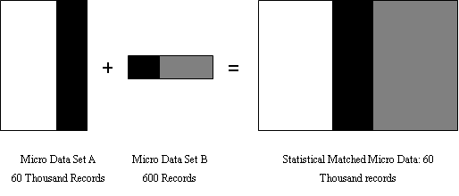
Results-a
School of Geography
FACULTY OF ENVIRONMENT
Introduction
Framework
Basics
Illustration
MSM Review
Statistical Matching
Scenario
MSM - data fusion: statistical matching
Illustration of Statistical Matching: Adapted from Van Der Putten et al. (1995)
Notes:
60 thousand records in data A joined with 600 records in data set B, we have 60 thousand records with all the variables.

Slide 20
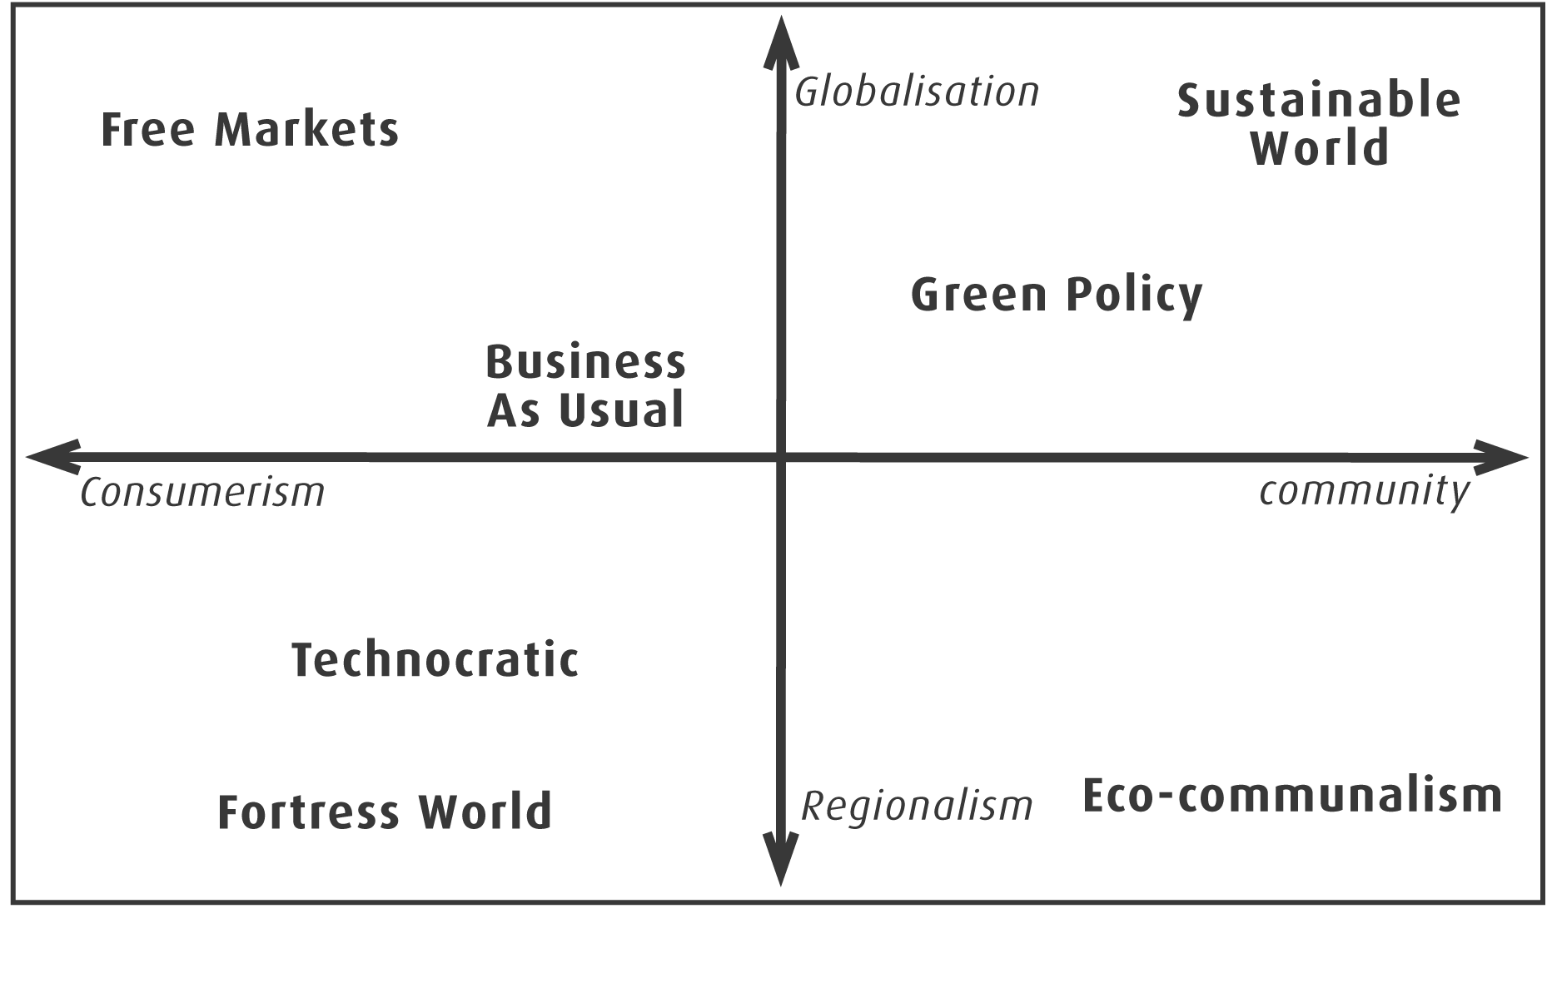
Results-a
School of Geography
FACULTY OF ENVIRONMENT
Introduction
Framework
Basics
Illustration
MSM Review
Statistical Matching
Scenario
MSM – Scenario Dynamic
7 WaND Scenarios, transferred to parameters by Sim et al. (2007) and Parsons et al. (2007)
Notes:
Scenarios are expositions of possible futures rather than a single prediction following the current trend. Scenarios have the advantage of examining the changing forces in shaping the future, judging their diversions from the current trend, and so leading to better preparation strategically for uncertainties and complexities in long term. Further, scenarios can also be treated as a form of sensitivity analysis of the relationship between the changing forces and their outcomes, the possible futures.
The Foresight Futures analysis (DTI, 2002) has served as a principal framework and guidance for the WaND scenarios (Makropoulos et al., submitted) and many other studies, for example Environment Agency (2001). Generally, the Foresight scenarios assumed that the future is shaped by the dynamics of governance, the extents of power sharing between national governments and other levels such as EU or regional governments, and social values, how much people care about others. These two factors as axes build up a coordinate space, in which the WaND consortium has defined 7 scenarios for urban water management, based on the context of the Foresight scenarios, shown in Figure 6.1, sourced from Sim et al. (2007a).
Parsons et al. (2007) and Sim et al. (2007a) adapted the WaND scenarios and added scenarios of Current Policy and High Growth, Low Saving, identified the drivers of water consumption for specifying the scenarios, and finally translated them into settings of the macrocomponents and microcomponents, driving water demand. The drivers of water consumption are housing, climate change, water regulation, technology and social norms. The macrocomponent approach is focussed on the net effects of these drivers, whereas the microcomponent approach needs to set the ownership, frequency of use and volume per use of each microcomponent affected by the drivers. The baseline of the microcomponents was set by sourced data from published works such as Herrington (1996) and case studies, and then forecast into 2031 by translating the WaND scenarios using judgements. Most of the details of the translation can only be obtained in working logs from the WaND team by personal contacts. Further, the Fortress world and Sustainable world for this study area were not implemented for the reasons of their natures of being radical futures and difficulties in forecasting the microcomponents.

Slide 21
Results-a
School of Geography
FACULTY OF ENVIRONMENT
Introduction
Framework
Basics
Illustration
MSM Review
Statistical Matching
Scenario
MSM – Scenario Dynamic
For example, metering penetration rate in 2031 for Thames Gateway, ownership rate of Nine Litre toilet
Variable | Scenario | Scenario | Scenario | Scenario | Scenario | Scenario | Scenario | Scenario
title | BaseYear | BAU | CP | HGLS | FREE | GREEN | TECHNO | ECO
year | 2001 | 2031 | 2031 | 2031 | 2031 | 2031 | 2031 | 2031
climateChangePercentage | 0 | 0.015 | 0.02 | 0.015 | 0.015 | 0.014 | 0.015 | 0.014
MeteringRateForNewHouse | 1 | 1 | 1 | 1 | 1 | 1 | 1 | 1
RecylingInNewHomeHousehold | 0 | 0.002 | 0.01 | 0 | 0.01 | 0.1 | 0.01 | 0.75
MeteringRateForExistingHouse | 0.215 | 0.66 | 0.66 | 0.66 | 0.66 | 0.95 | 0.7 | 0.95
NineLiteToiletOwnshipRateInExistingHouse | 0.62 | 0.3 | 0.25 | 0.25 | 0.3 | 0.27 | 0.3 | 0.25

Slide 22
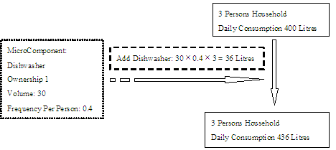
Results-a
School of Geography
FACULTY OF ENVIRONMENT
Introduction
Framework
Basics
Illustration
MSM Review
Statistical Matching
Scenario
MSM – Scenario Dynamic
Monte Carlo sample will dynamic the micro units based on these parameters
Calibration of Ownership: Install a Dishwasher in a 3-person Household

Slide 23
Results-a
School of Geography
FACULTY OF ENVIRONMENT
Introduction
Framework
Basics
Illustration
MSM Review
Statistical Matching
Scenario
MSM – Scenario Dynamic
Output Example:
Per Capita Consumption by MSOA in 2031 from BAU&REC
for Selected social Class-Accommodation Type Combinations

Slide 24
Title
School of Geography
FACULTY OF ENVIRONMENT
Conclusions
A powerful tool to understand population
Modelling at Decision making units so higher precision
Characteristics of micro units can be modelled with their behaviours
Statistical matching can compensate the deficiency of target variables separated in multiple datasets.
ESRC Research Award RES-165-25-0032, 01.10.2007- 30.09.2009
What happens when international migrants settle? Ethnic group population trends and projections for UK local areas
Notes:
Microsimulation is a powerful tool to understand population.
Modelling has been moved to decision making units, the micro units, which can reveal the details masked in their aggregations, which are used by macro modells. So higher precision can be achieved.
Profile characteristics of micro units, which can be link to their behaviours such as water demand, then impacts on the characteristics can be modeled with their behavioiurs.
If data with both the characteristics and the behaviours is not available, statistical matching could be used to join them.

