Slide 1
A Review of Ethnic Population Projection Models
Phil Rees
QMSS2 Summer School
Projection Methods for Ethnicity and Immigration Status
2-9 July 2009
School of Geography, University of Leeds, UK

Slide 2
Outline
Context
Variables used for ethnicity and consequences for the projection model
Ethnic status variability
Modelling decisions
Inputs (examples)
Concluding remarks
References

Slide 3
Context: Ageing linked to Ethnic Change
Third Demographic Transition
Changing UK composition
  UK population increasing at slow rate, 0.64% in 2006-7
  Variation across regions, highest in South around London
  2001-6
    2.7% increase in total population
    0.4% decrease in White British population
    23% increase in not White British population
    2006: 84% White British, 16% not White British
    Highly variable across space:
      More ethnic minorities concentration in cities, in south
      Greatest growth in ethnic minorities outside core areas

Slide 4
Ethnic population projection
Cohort component model
Regional or multiregional structure to choose (dependent on spatial units)
With additional features dependent on the definitions of ethnic status adopted
Just sub-groups or interacting groups? Depends on the ethnic variable

Slide 5
Variables used to capture ethnicity
Country of birth (foreign/native; generation)
Country of citizenship (nationality)
Language (official, minority)
Religion (major, denominations/sects)
Combinations of the above
Self-reported racial or ethnic status
Reference: http://www.ccsr.ac.uk/qmss/seminars/2009-06-03/programme.shtml

Slide 6
Consequences for the projection model: country of birth
Country of birth: entries/exits to foreign born through immigration/emigration, native born can have native, foreign or mixed parentage: see papers by Rogers and colleagues http://www.colorado.edu/ibs/PP/faculty/rogersa/CV.pdf
Often there is no tracking of migration history beyond native born to foreign or mixed parents
Multistate design needed but with restrictions on transitions

Slide 7
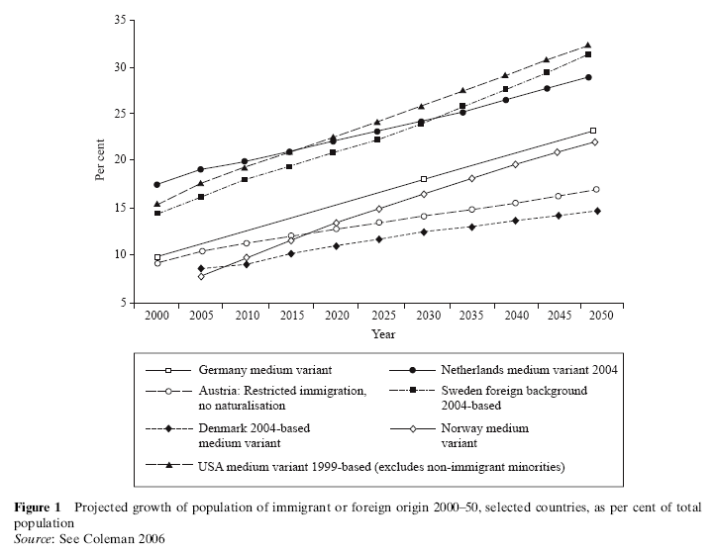
Projected Foreign origin populations in selected European countries:
From Coleman, D. A. (2008) 'New Europe, new diversity', Population Studies, 62:1, 113 - 120

Slide 8
Consequences for the projection model: language
Here the process of inter-generational transmission of parental language(s) is vital
Successive immigrant generations experience language loss as host language is adopted
Bilingualism is characteristic of the second generation but special support is needed to continue it into further generations
Multistate design needed (applications?)

Slide 9
Consequences for the projection model: nationality
Using nationality/citizenship status, transition from foreign citizenship to citizenship of current country of residence is the main flow
People can lose citizenships
The rules governing “naturalization” are complicated and country specific
Some countries recognize that residents can hold more than one citizenship, other countries recognize only one citizenship

Slide 10
Consequences for the projection model: religion
Eric Kaufman, Birkbeck College has projected European populations by religion taking into account both demographic differences between religious groups and the degree of secularisation
See: http://www.uptap.net/project19.html

Slide 11
Consequences for the projection model: self-reported or assigned ethnic status
This is the concept adopted in the UK, the USA, New Zealand. People choose an ethnic category from a list in a census question or write in their own name for their ethnicity, which is assigned by an editing process to one of the pre-defined categories

Slide 12
Consequences for the projection model: self-reported race or ethnicity
Different ways of handling the classifications
  The categories are fixed (e.g. 1991 Census, UK)
  Mixed categories are recognized (e.g. 2001 Census, UK)
  Multi-ticking is allowed and all singles, pairs and triples are recognized (2000 US Census)
  Categories are allowed to overlap

Slide 13
Illustration:
New Zealand & Australia “ethnic” projections
New Zealand Statistics (2005) produce projections for European, Maori, South Pacific and Asian populations
  Innovative feature is that the offspring of mixed marriages/unions are allowed to belong to both groups
  This means that the sum of group projections exceeds the all group projections
  Makes you think about the meaning of the mixed group with multiple identities
Wilson (2006, 2007) constructs a multi-state projection model for the indigenous and non-indigenous populations of the Northern Territory and the Rest of Australia. Has an innovative treatment of births to mixed unions. Full exposition of the methodology using equations (rare in the literature). Well worth “book-marking” for reading in Environment and Planning A

Slide 14
Ethnic definitions: variation over space
ENGLAND AND WALES | SCOTLAND | NORTHERN IRELAND
All Ethnic Groups | All Ethnic Groups | All Ethnic Groups
White: British | White | White
White: Irish | Indian | Irish Travellers
White: Other White | Pakistani and other South Asians | Mixed
Mixed: White and Black Caribbean | Chinese | Indian
Mixed: White and Black African | Others | Pakistani
Mixed: White and Asian |  | Bangladeshi
Mixed: Other Mixed |  | Other Asians
Asian or Asian British: Indian |  | Black Caribbean
Asian or Asian British: Pakistani |  | Black African
Asian or Asian British: Bangladeshi |  | Other Black
Asian or Asian British: Other Asian |  | Chinese
Black or Black British: Black Caribbean |  | Others
Black or Black British: Black African
Black or Black British: Other Black
Chinese or other ethnic group: Chinese
Chinese or other ethnic group: Other Ethnic Group

Slide 15
T
Ethnic definitions: variation over time
1991 census ethnic category | Component 2001 census ethnic categories
White | White: British, White: Irish, White: Other 0.5*Mixed: White and Black Caribbean 0.5*Mixed: White and Black African 0.5*Mixed: White and Asian
Black Caribbean | Black or Black British: Caribbean 0.5*Mixed: White and Black Caribbean
Black African | Black or Black British: African 0.5*Mixed: White and Black African
Black Other | Black or Black British: Other
Indian | Asian or Asian British: Indian 0.5*Mixed: White and Asian*Proportion Indian
Pakistani | Asian or Asian British: Pakistani 0.5*Mixed: White and Asian*Proportion Pakistani
Bangladeshi | Asian or Asian British: Bangladeshi 0.5*Mixed: White and Asian*Proportion Bangladeshi
Chinese | Chinese or Other: Chinese
Other Asian | Asian or Asian British: Other
Other Groups | Chinese or Other: Other Mixed: Other

Slide 16
Proposed questions on ethnicity, national identity and religion for the 2011 Census, England

Slide 17
Modelling decisions in ethnic projection models
You use the apparatus of cohort-component projection (macro- or micro-models)
You need to decide on the ethnic state to state transitions that will be permitted
These will depend on what your ethnicity variable is

Slide 18
Examples of ethnic state transitions
Assume that the groups are separate (most UK work using 1971, 1981 and 1991 censuses)
Assume the groups are separate except for mixed births (current project model)
Include transitions limited transitions (foreign nationality to domestic nationality, but not vice versa) (foreign births only augmented through immigration)

Slide 19
Handling mixed ethnicity
Mother’s ethnicity Child’s ethnicity | White British | White Irish | Other White | White and Black Caribbean | White and Black African
Total | 100.00 | 100.00 | 100.00 | 100.00 | 100.00
White British | 96.85 | 64.29 | 49.67 | 21.04 | 23.50
White Irish | 0.10 | 25.39 | 0.35 | 0.00 | 0.00
Other White | 0.43 | 4.35 | 40.10 | 2.17 | 4.90
White and Black Caribbean | 1.10 | 1.73 | 1.50 | 48.14 | 3.52
White and Black African | 0.29 | 0.75 | 1.59 | 1.96 | 38.85
White and Asian | 0.59 | 1.51 | 2.29 | 0.90 | 0.93
Probability of child’s ethnicity given mother’s ethnicity: computed from 2001 Census

Slide 20
UK work on ethnic population estimates and projections
Source | Spatial units | Ethnic groups | Base | Output | Model
OPCS | Great Britain | NCWP | 1966-1976 | Estimates, Projections | CCM
OPCS | E & W | 5 COB groups | 1981, 1983, 1984 | Estimates | LFS
LRC | GL LBs | 10 ethnic groups | 1991- | Projections | MRM-GL
ONS | UK LAs | 16 ethnic groups | 2001-2007 | Estimates | CCM
Coleman & Scherbov | UK | 4 ethnic groups | 2001-2100 | Projections | CCM
GLA | GL LBs | 10 ethnic groups | 2001-2026 | Projections | MRM-GL
Simpson et al | Various LAs | 5/6/8 ethnic groups | 2001-2021/6 | Projections | POPGROUP
Rees & Parsons | UK regions | 5 ethnic groups | 2001-2020 | Projections | CCM

Slide 21
Inputs to the projection illustrated for the UK
Base populations
Mortality
Immigration
Internal migration
Emigration
Fertility

Slide 22
Base populations
In the UK these are rolled forward from the census (see Large and Ghosh papers)
Some problems: no mortality differences, poor international migration estimates subnationally
Small ethnic fertility differences

Slide 23
Mortality estimates based on limiting long-term illness from the 2001 Census

Slide 24
Life expectancy at birth for males
White British
Asian or Asian British: Pakistani
Chinese
Red = upper quartile Blue = bottom quartile White = middle quartiles

Slide 25
Rank | Ethnic group | Mean e₀ Women | Rank | Ethnic group | Mean e₀ Men
1 | Chinese | 82.1 | 1 | Chinese | 78.1
2 | Other Ethnic | 81.5 | 2 | Other White | 76.9
3 | Other White | 81.3 | 3 | Other Ethnic | 76.2
4 | White British | 80.5 | 4 | Black African | 76.1
 | All groups | 80.5 |  | All group | 76.0
5 | Black African | 80.4 | 5 | White British | 75.9
6 | White Irish | 80.3 | 6 | Indian | 75.5
7 | White-Asian | 80.0 | 7 | Other Asian | 75.2
8 | Other Mixed | 79.9 | 8 | White-Asian | 75.1
9 | Other Asian | 79.5 | 9 | White-Irish | 74.9
10 | White-Black African | 79.5 | 10 | Other Mixed | 74.6
11 | Indian | 79.3 | 11 | Black Caribbean | 74.4
12 | Black Caribbean | 79.1 | 12 | White-Black African | 74.2
13 | White Black Caribbean | 78.7 | 13 | Other Black | 73.4
14 | Other Black | 78.5 | 14 | White-Black Caribbean | 73.4
15 | Bangladeshi | 77.7 | 15 | Pakistani | 73.1
16 | Pakistani | 77.3 | 16 | Bangladeshi | 72.7
Average life expectancies for ethnic groups in England, 2001

Slide 26
Steady shrinkage of women’s lead over men
No shrinkage of the advantage of richer areas over poorer
Life expectancy trends in UK LAs (Wohland and Rees (2009)

Slide 27
The Hoffenheim Effect
Life expectancy trends in UK LAs (Wohland and Rees (2009)

Slide 28
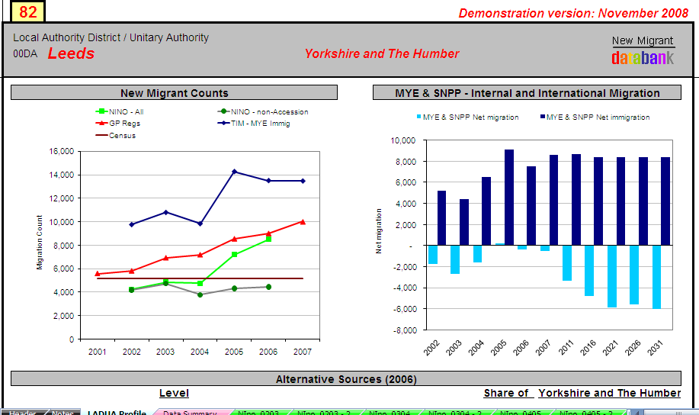
The Leeds effect
From: New Migrant Databank: Boden and Rees 2009

Slide 29
A general classification of local authorities
(Vickers, Rees and Birkin 2003)
Used to examine internal migration trends
(Hussein and Stillwell 2008)

Slide 30
Net internal migration for LA types by seven ethnic groups, 2001 Census

Slide 31
Concluding Remarks
This paper has reviewed the decisions needed when constructing ethnic population projection models and shown some example inputs.
We have reviewed the requirements of robust ethnic projections, which include proper understanding of the ethnic classifications available for use, which determine how the standard cohort-component model must be modified to capture transitions between ethnic statuses.
In choosing a suitable projection model for implementing the projection, it is necessary to understand fully the nature of the migration information available. A trade-off between the ease of computation of single region models and the complexity but greater theoretical rigour of multi-regional models must be arrived at.
But the biggest challenge in many countries, including the UK in particular, is the lack of good data on the components of change. This requires innovative thinking about how proxy data and good statistical methods can be used to supply input variables to the projection.

Slide 32
References: Reviews
Haskey J and Huxstep S. eds. (2002) Population projections by ethnic group: A feasibility study. ONS Studies in Medical and Population Topics, SMPS No.67. London: The Stationery Office. Available at http://www.statistics.gov.uk/downloads/theme_population/SMPS_67_v2.pdf. Accessed 12 May 2007
  Storkey M. (2002) A review of literature on ethnic group projections. Chapter 1, pp.1-15.
  Murphy M. (2002) Consistency in considerations for population projections by ethnic group, and the possible role of microsimulation models. Chapter 2, pp.17-26.
  Rees P. 2002. New models for projecting UK ethnic group populations at national and subnational scales. Chapter 3 pp. 17-26.
  Simpson L. (2002) Estimating methodologies and assumptions for projections: current practice for population projections by ethnic group. Chapter 4, pp. 53-72.

Slide 33
References: GLA papers
Storkey M. (2002) Population projections of different ethnic groups in London, 1991 to 2011. PhD Thesis, University of Southampton. Available: British Library, University of Southampton Library.
Hollis J. and Bains B. (2002) GLA 2001 Round Ethnic Group Population Projections. DMAG Briefing 2002/4. Data Management and Analysis Group, Greater London Authority, London.
Klodawski, E. (2003) Fertility of Ethnic Groups in London. DMAG Briefing 2003/19. Data Management and Analysis Group, Greater London Authority, London.
Hollis, J. (2006) GLA 2006 Round Demographic Projections. DMAG Briefing 2006-32. Data Management and Analysis Group, Greater London Authority, London.
Bains, B. and Klodawski, E. (2006) GLA 2005 Round: Interim Ethnic Group Population Projections. DMAG Briefing 2006/22, November 2006. Data Management and Analysis Group, Greater London Authority, London. Available at: http://www.london.gov.uk/gla/publications/factsandfigures/dmag-briefing-2006-22.pdf. Accessed 7 May 2007.
Rees, P. and Boden, P. (2006) Estimating London’s New Migrant Population. Stage 1 – Review of Methodology. Greater London Authority, London. Available as: http://www.london.gov.uk/mayor/refugees/docs/nm-pop.pdf.

Slide 34
References: Office for National Statistics
Large P. and Ghosh K. (2006a) A methodology for estimating the population by ethnic group for areas within England. Population Trends 123:21-31.
Large P. and Ghosh K. (2006b) Estimates of the population by ethnic group for areas within England. Population Trends 124:8-17.

Slide 35
References: OXPOP
Coleman D. (2006) Immigration and ethnic change in low-fertility countries: A third demographic transition. Population and Development Review 32(3):401–446.
Coleman D and Scherbov S. (2005) Immigration and ethnic change in low-fertility countries – towards a new demographic transition? Presented at the Population Association of America Annual Meeting, Philadelphia. Available at http://www.apsoc.ox.ac.uk/Oxpop/publications%20files/WP29.pdf. Accessed 14 June 2005.

Slide 36
References: Leeds papers
Rees P. (1994) Estimating and projecting the populations of urban communities. Environment and Planning A, 26, 1671-1697.
Rees P. and Butt F. (2004) Ethnic change and diversity in England, 1981-2001. Area 36(2):174-186.
Rees P and Parsons J. (2006) Socio-demographic scenarios for children to 2020. York: Joseph Rowntree Foundation. Available at http://www.jrf.org.uk/bookshop/details.asp?pubID=809..
Rees P. (2006) What is happening to the UK population in a global mobility system? Presented at the ESRC/ONS Public Policy seminar series on demographic change and Government Policy, Third Seminar on: Globalisation, population mobility and the impact of migration on population. London: Royal Statistical Society. Available at http://www.esrc.ac.uk/ESRCInfoCentre/Images/Professor%20Phil%20Rees%20-%20Presentation_tcm6-16198.ppt.
Rees P. (2007) What happens when international migrants settle? Projections of ethnic groups in United Kingdom regions. Chapter 15 in Raymer J. and Willekens F. (ed.) International Migration in Europe: Data, Models and Estimates. John Wiley and Sons, Chichester.

Slide 37
References: Antipodean
Statistics New Zealand (2005) National Ethnic Population Projections 2001 (base)-2021 update. Available at http://www.stats.govt.nz/NR/rdonlyres/D9A5C6F4-ABB3-4C6D-BC9C-8A94C58FA98C/0/nationalethnicpopulationprojections01base21updatehotp.pdf. Accessed 2 January 2007
Wilson T. (2006) Population projections by indigenous status incorporating exogamy and inter-ethnic mobility: a case study of the Northern Territory, Australia. Paper presented at the European Population Conference, University of Liverpool. Submitted to Environment and Planning A as “A multistate indigenous status population projection model, illustrated with an application to the Northern Territory, Australia”.

