Slide 1

Applying geographical clustering methods and identifying individual behaviour with geo-located open micro-blog posts
School of Geography
FACULTY OF ENVIRONMENT
Nick Malleson and Andy Turner
School of Geography, University of Leeds

Slide 2
Outline
Introduction / Motivation
The Data and Study Area
Clustering Methods
Analysis of Individual Behaviour
Creating Behavioural Profiles
Conclusions and Future Work

Slide 3
Introduction
A copy of these presentation slides and our accompanying paper are available online via Andy's conference notes at the following URL:
http://bit.ly/HWOe27

Slide 4
Crowd-Sourced Data for Social Science
“Crisis” in empirical sociology (Savage and Burrows, 2007)
  Traditional surveys are small and occur infrequently
  Often focus on population attributes rather than behaviour
  Often spatially / demographically aggregated
  http://www.guardian.co.uk/p/33p85
Surveys are being superseded by massive, “crowd-sourced” data
  “knowing capitalism” (Thrift, 2005)
  Amazon.com purchasing suggestions
  Supermarket reward cards
  Strong spatial dimension (Goodchild, 2007) e.g. OpenStreetMap – Volunteered Geographic Information
But academia is slow to take advantage
Potential Uses:
  Data could be used to calibrate models in situ (e.g. meteorology models use daily weather data)
  …
Notes:
Savage and Burrows argue that sociologists’ key area of methodological expertise (survey design) is being superseded by new ‘crowd-sourced’ data
Traditional surveys:
- often small, occur infrequently
- often focus on attributes of the population rather than their spatio-temporal behaviour
- are often spatially and/or demographically aggregated – problems identifying individual-level behaviour and with the ecological fallacy
New ‘crowd-sourced’ data are much larger and collected regularly (or continuously)
- e.g. supermarket reward schemes: companies have complete information about their customers so there is no need to conduct surveys to find out what they’re buying
But sociologists are slow to embrace these new forms of data
These types of data could be used to calibrate social science models whilst they are operating.
- E.g. meteorology models use daily weather data to improve their forecasts
Goodchild, M. (2007). Citizens as sensors: the world of volunteered geography. GeoJournal 69, 211–221.
Savage, M. and R. Burrows (2007). The Coming Crisis of Empirical Sociology. Sociology 41(5), 885–899.

Slide 5
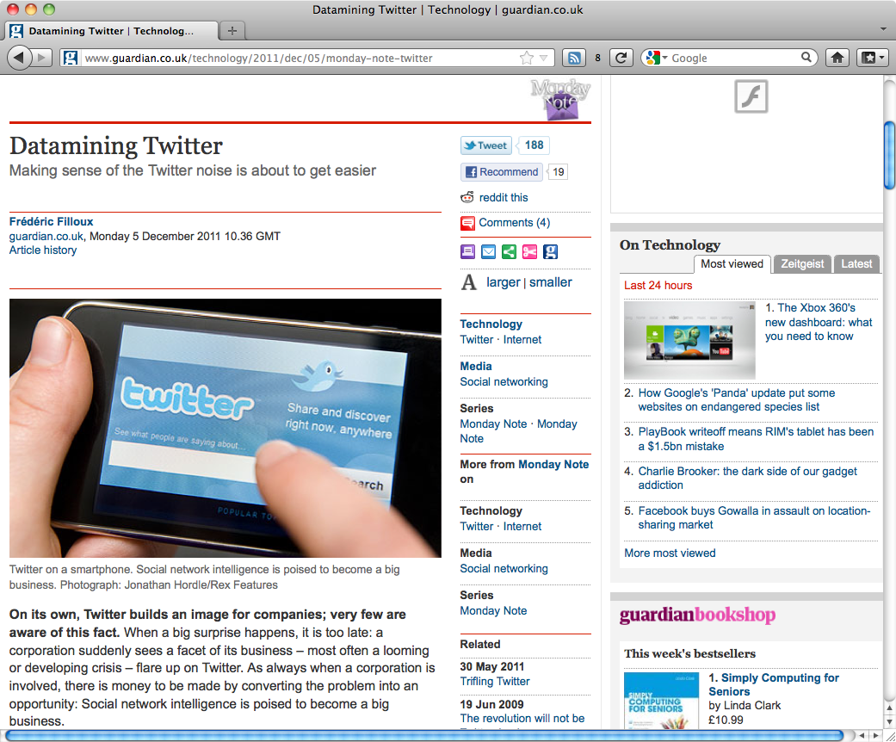
Crowd-Sourced Data for Social Science
“Crisis” in “empirical sociology” (Savage and Burrows, 2007)
  Traditional surveys are small and occur infrequently
  Often focus on population attributes rather than behaviour
  Often spatially / demographically aggregated
  http://www.guardian.co.uk/p/33p85
These are being superseded by massive, “crowd-sourced” data
  “knowing capitalism” (Thrift, 2005)
  Amazon.com purchasing suggestions
  Supermarket reward cards
  Strong spatial dimension (Goodchild, 2007) e.g. OpenStreetMap - Volunteered Geographic Information
But academia is slow to take advantage
Data could be used to calibrate models in situ
e.g. meteorology models use daily weather data
Notes:
Savage and Burrows argue that sociologists’ key area of methodological expertise (survey design) is being superseded by new ‘crowd-sourced’ data
Traditional surveys:
- often small, occur infrequently
- often focus on attributes of the population rather than their spatio-temporal behaviour
- are often spatially and/or demographically aggregated – problems identifying individual-level behaviour and with the ecological fallacy
New ‘crowd-sourced’ data are much larger and collected regularly (or continuously)
- e.g. supermarket reward schemes: companies have complete information about their customers so there is no need to conduct surveys to find out what they’re buying
But sociologists are slow to embrace these new forms of data
These types of data could be used to calibrate social science models whilst they are operating.
- E.g. meteorology models use daily weather data to improve their forecasts
Goodchild, M. (2007). Citizens as sensors: the world of volunteered geography. GeoJournal 69, 211–221.
Savage, M. and R. Burrows (2007). The Coming Crisis of Empirical Sociology. Sociology 41(5), 885–899.

Slide 6
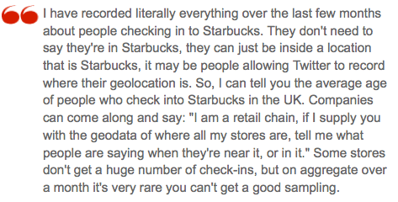
Crowd-Sourced Data for Social Science
“Crisis” in “empirical sociology” (Savage and Burrows, 2007)
  Traditional surveys are small and occur infrequently
  Often focus on population attributes rather than behaviour
  Often spatially / demographically aggregated
  http://www.guardian.co.uk/p/33p85
These are being superseded by massive, “crowd-sourced” data
  “knowing capitalism” (Thrift, 2005)
  Amazon.com purchasing suggestions
  Supermarket reward cards
  Strong spatial dimension (Goodchild, 2007) e.g. OpenStreetMap - Volunteered Geographic Information
But academia is slow to take advantage
Data could be used to calibrate models in situ
e.g. meteorology models use daily weather data
Notes:
Savage and Burrows argue that sociologists’ key area of methodological expertise (survey design) is being superseded by new ‘crowd-sourced’ data
Traditional surveys:
- often small, occur infrequently
- often focus on attributes of the population rather than their spatio-temporal behaviour
- are often spatially and/or demographically aggregated – problems identifying individual-level behaviour and with the ecological fallacy
New ‘crowd-sourced’ data are much larger and collected regularly (or continuously)
- e.g. supermarket reward schemes: companies have complete information about their customers so there is no need to conduct surveys to find out what they’re buying
But sociologists are slow to embrace these new forms of data
These types of data could be used to calibrate social science models whilst they are operating.
- E.g. meteorology models use daily weather data to improve their forecasts
Goodchild, M. (2007). Citizens as sensors: the world of volunteered geography. GeoJournal 69, 211–221.
Savage, M. and R. Burrows (2007). The Coming Crisis of Empirical Sociology. Sociology 41(5), 885–899.

Slide 7
Motivation
A better understanding of urban dynamics through the use of novel social-network data
Calibration / validation of individual-level model
Method
  Determine what a person is doing / talking about
  Develop advanced spatio-temporal (and textual?) clustering tools
Data
  ~1.2M geo-located tweets in the Leeds area

Slide 8
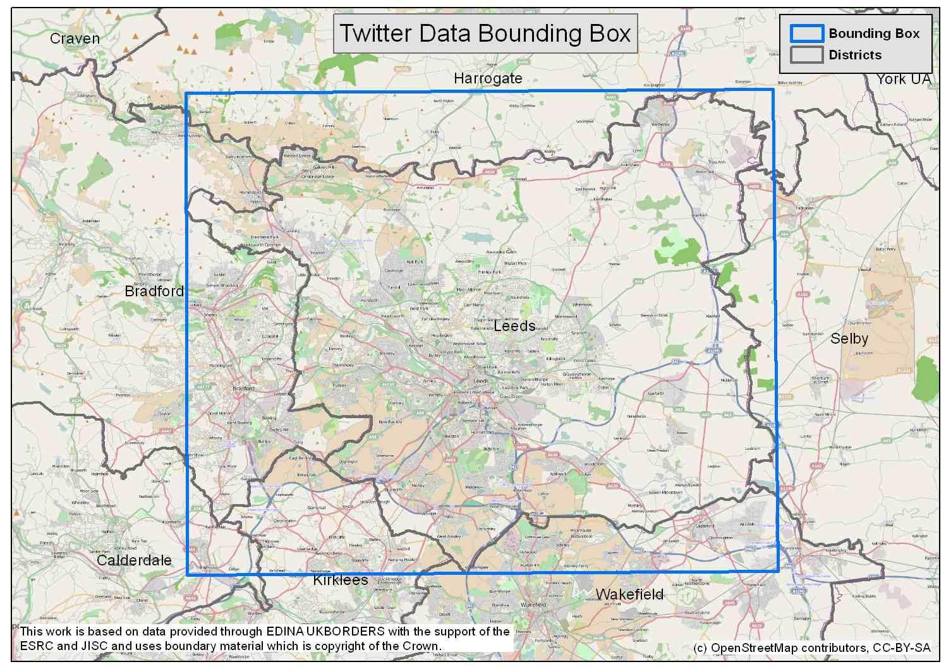
Data and Study Area
Twitter
  Social networking / microblogging service
  Users create public ‘tweets’ of up to 140 characters
  For the most part, tweets are publicly available
  Include information about user, time/date, location, text etc.
  ‘Streaming API’ provides real-time access to tweets
Collected Data
  1.2M geo-located tweets around Leeds (June 2011 – March 2012).
  403,922 Tweets within district
  2,683 individual users
  Highly Skewed (10% of all tweets from 8 most prolific users)
  Filtered non-people

Slide 9
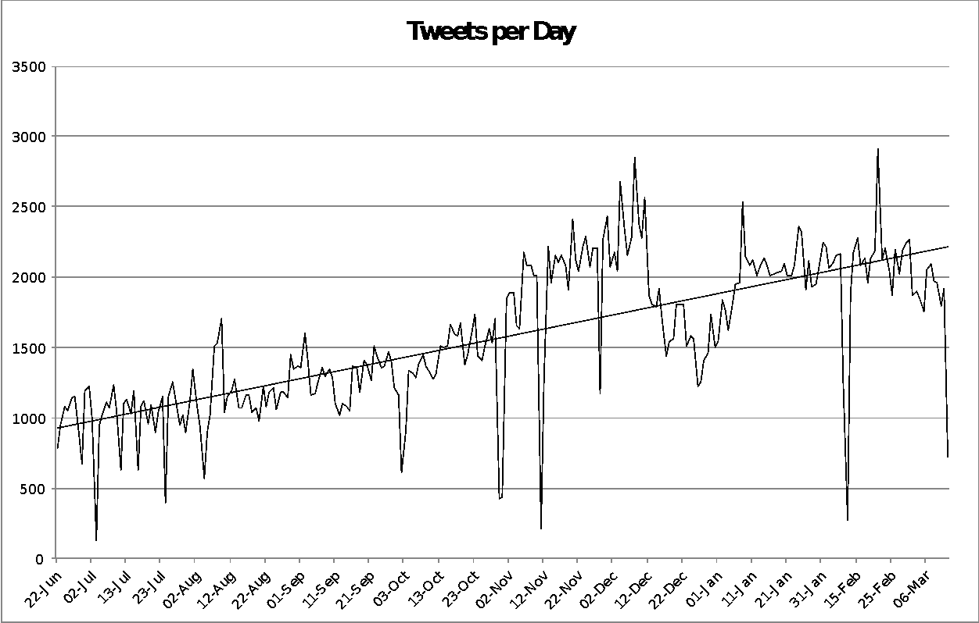
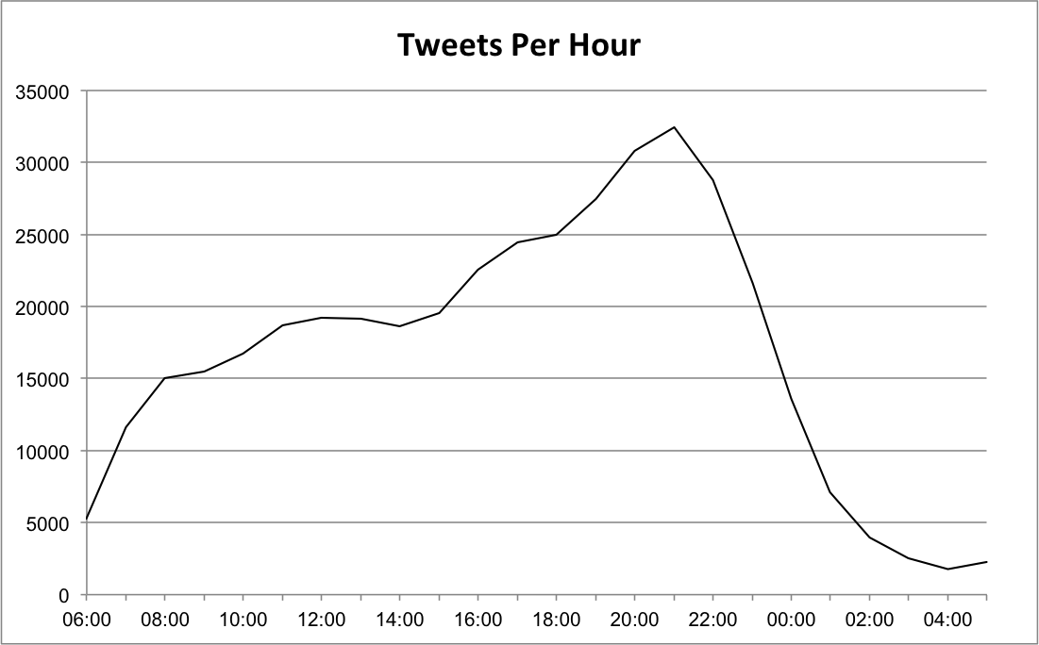
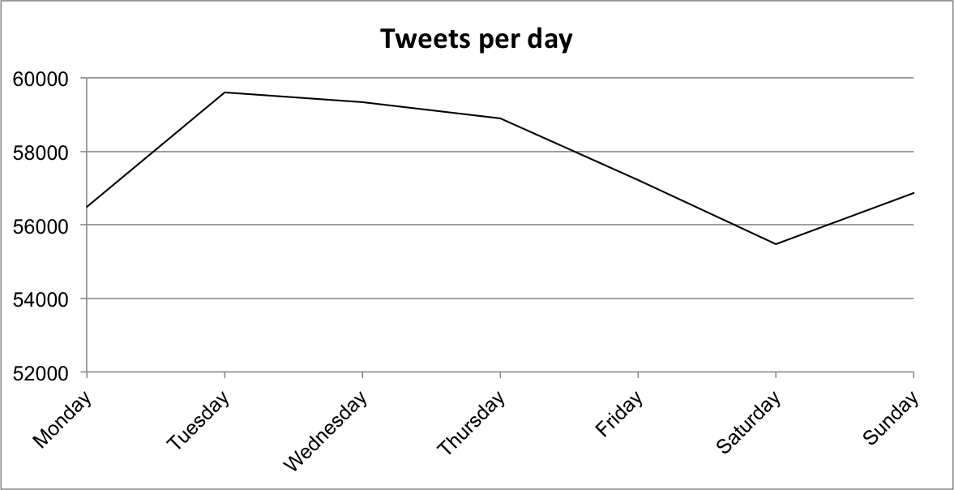
A-Spatial Temporal Trends
Hourly peak in activity at 10pm
Daily peak on Tuesday - Thursday
General increase in activity over time

Slide 10
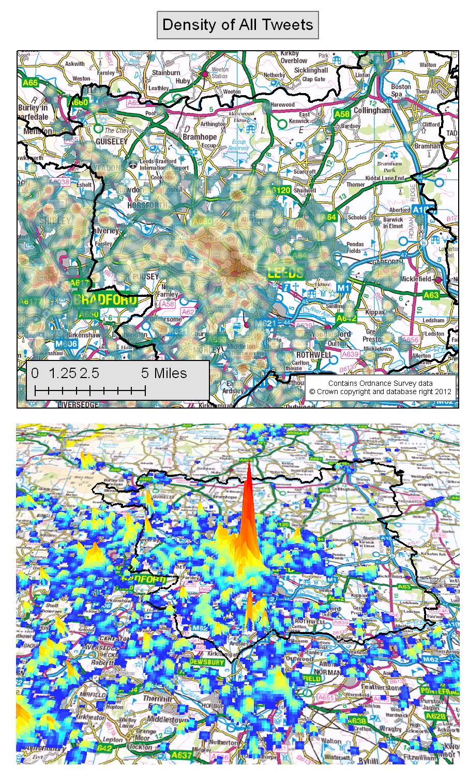
Spatial Overview
Point density appears to cluster around urban centres.
Also able to distinguish roads in non-urban areas
General pattern somewhat distorted by locations of prolific users

Slide 11
Geographical Clustering
Spatial
Might also be temporal
Takes into account two variables
Essentially where one variables is unusually high, given the value of the other variable (which is assumed to have a positively correlated distribution of values)
Notes:
Geographical Clustering
Spatial
Might also be temporal
Takes into account two variables
Essentially where one variables is unusually high, given the value of the other variable (which is assumed to have a positively correlated distribution of values)
"The simplest way of deﬁning a cluster is as a localised excess incidence rate that is unusual in that there is more of some variable than might be expected. Examples would include: a local excess disease rate, a crime hot spot, an unemployment black spot, unusually high positive residuals from a model, the distribution of a plant or surging glaciers or earthquake epicentres, pattern of fraud etc. [...] Pattern detection via the identiﬁcation of clusters is a very simple and generic form of geographical analysis that has many applications in many different contexts..." Openshaw and Turton (1998)
http://web.archive.org/web/20040316070705/http://www.ccg.leeds.ac.uk/smart/gam/gam3.html
Geographical Concentration
A special sort of Geographical Clustering where the expected incidence or the variable for comparison (denominator for the rate) is evenly distributed
Geographical Clustering of Twitter posts
There are some prolific posters and the locations at which they post are concentrated
Where does the pattern of posting density differ most in both absolute and relative terms for different types of posting?
A first look at posts for different times of day
Figure 1 shows the absolute difference between weekend and weekday posts in Leeds where the middle grey shade is zero difference the more white shades are areas with more weekend posting and the darker areas with less weekend posting
Figure 2 shows the absolute difference between afternoon and evening posts in Leeds where the middle grey shade is zero difference the more white shades are areas with more weekend posting and the darker areas with less weekend posting
Mapping where the absolute and relative differences are both large
We can map relative difference and mask off where the absolute difference is above some threshold filter value
Figure 3 Is an example identifying places with many more postings in the evening than in the afternoon
Roads have been added to the picture to give some context
Similarly we can map absolute difference and mask off to only show where relative difference is high
Figure 4 Is a map of the same data as shown in Figure 3
There is a general agreement in the clustering although there are some subtle differences
Some work on Geographical Clustering was revisited recently (Turton and Turner, 2011)
https://docs.google.com/document/d/1rX9XHhAittUF4aMFBKfzqYXkWqrCPK1mdN8bcpT_gO4/edit
We aim to add the methods used to produce the figures shown here as part of the Spatial Cluster Detection Tool made available via:
http://code.google.com/p/spatial-cluster-detection/
A great deal more can be done to look at the spatial patterns in the the twitter data using clustering methods
We are only really scratching the surface as we learn about these data
There are many challenges to analysing this data, not least is the fact that some of the most identifiable concentrations and clusterings are a result of a single prolific use
Still being able to identify them is potentially useful...

Slide 12
Geographical Clustering
"The simplest way of deﬁning a cluster is as a localised excess incidence rate that is unusual in that there is more of some variable than might be expected. Examples would include: a local excess disease rate, a crime hot spot, an unemployment black spot, unusually high positive residuals from a model, the distribution of a plant or surging glaciers or earthquake epicentres, pattern of fraud etc. [...] Pattern detection via the identiﬁcation of clusters is a very simple and generic form of geographical analysis that has many applications in many different contexts..." Openshaw and Turton (1998)
http://web.archive.org/web/20040316070705/http://www.ccg.leeds.ac.uk/smart/gam/gam3.html

Slide 13
Geographical Concentration
A special sort of Geographical Clustering where the expected incidence or the variable for comparison (denominator for the rate) is evenly distributed

Slide 14
Geographical Clustering of Twitter posts
There are some prolific posters and the locations at which they post are concentrated
Where does the pattern of posting density differ most in both absolute and relative terms for different types of posting?
A first look at posts for different times of day

Slide 15
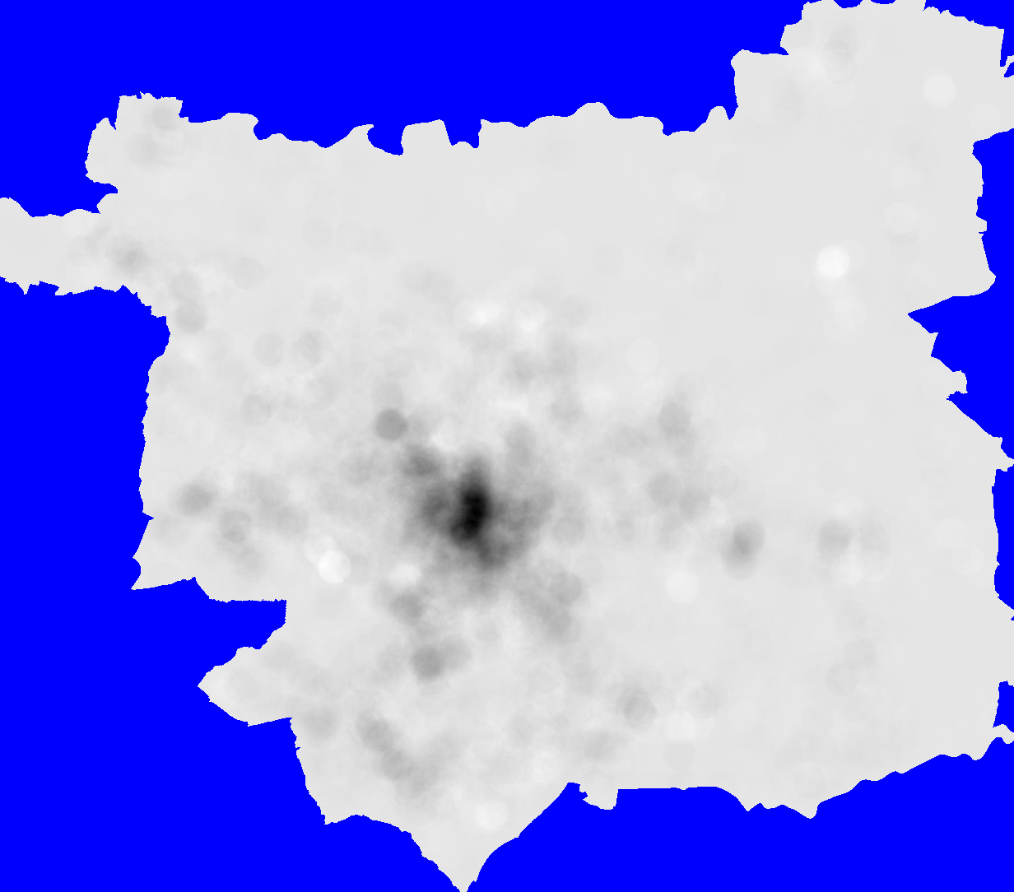
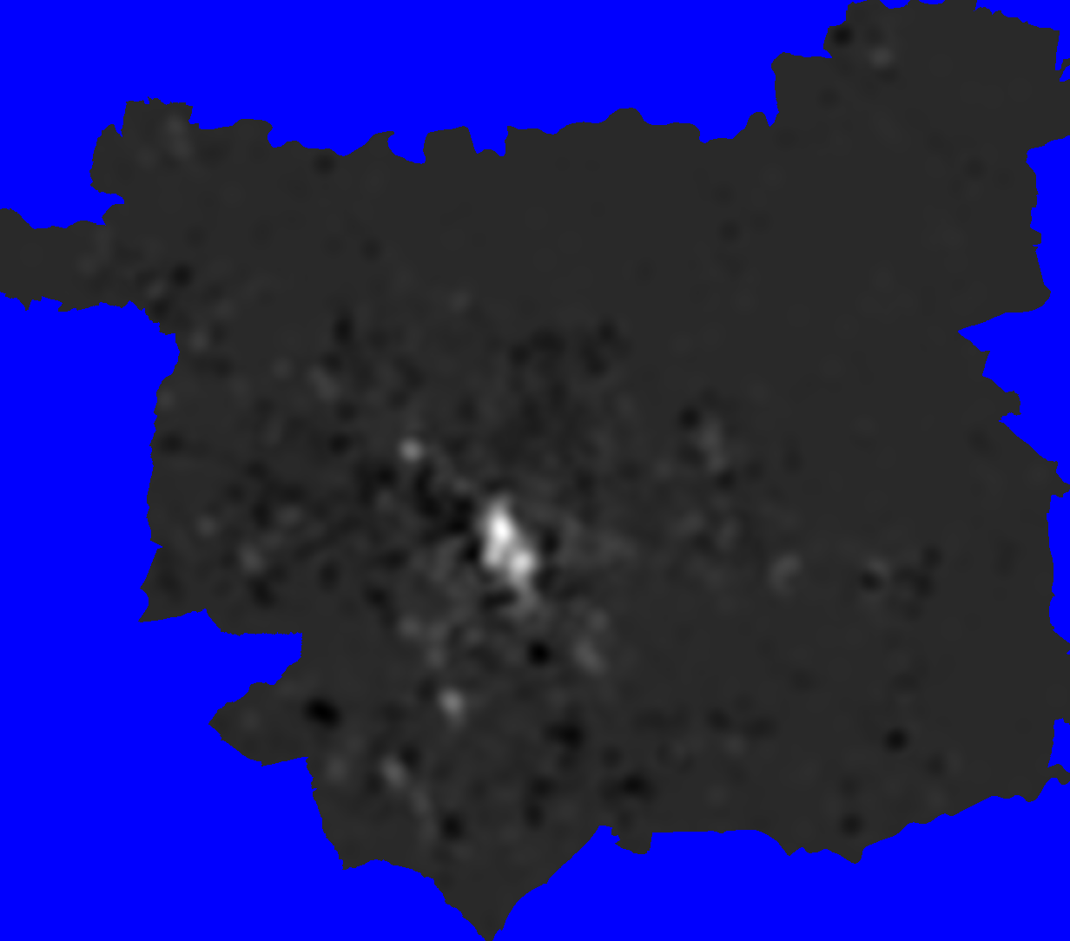
1
Clustering Methods (I)
Geographical clustering
Geographical concentration
Geographical Clustering of Twitter posts
  absolute difference between weekend and weekday posts
  absolute difference between afternoon and evening posts
2
Notes:
Figure 1 shows the absolute difference between weekend and weekday posts in Leeds where the middle grey shade is zero difference the more white shades are areas with more weekend posting and the darker areas with less weekend posting
Figure 2 shows the absolute difference between afternoon and evening posts in Leeds where the middle grey shade is zero difference the more white shades are areas with more weekend posting and the darker areas with less weekend posting

Slide 16
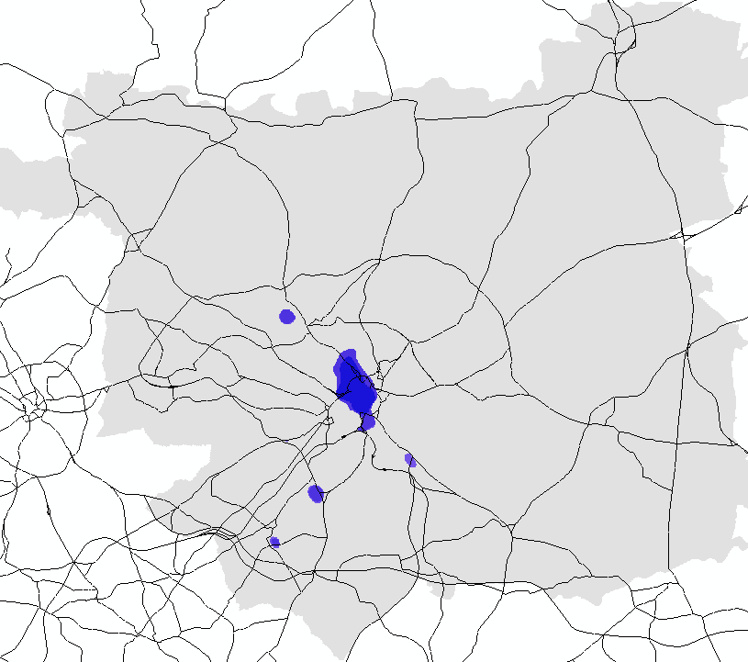
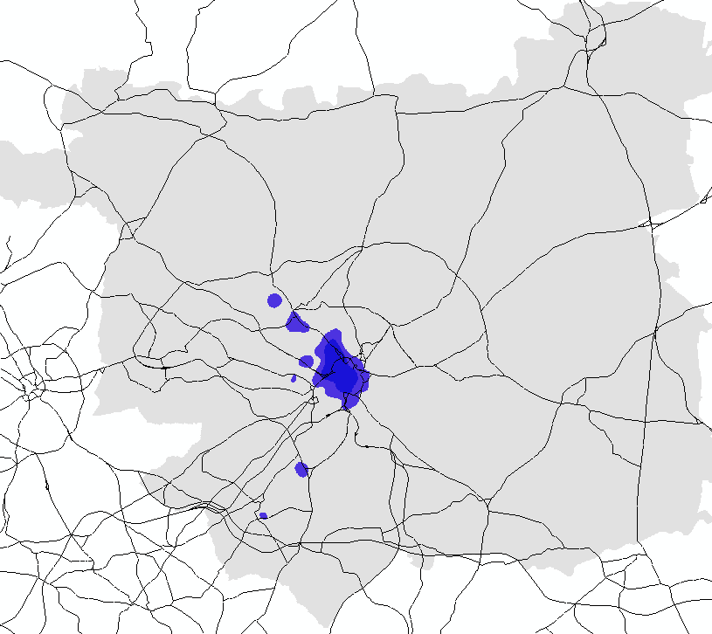
1
Clustering Methods (II)
Geographical Clustering of Twitter posts
  identify places with many more postings in the evening than in the afternoon
  relative difference and mask off where the absolute difference is above some threshold filter value
  absolute difference and mask off to only show where relative difference is high
Further work
  some of the most identifiable concentrations and clusterings are a result of a single prolific use
  being able to identify them is potentially useful...
2
Notes:
Mapping where the absolute and relative differences are both large
We can map relative difference and mask off where the absolute difference is above some threshold filter value
Figure 3 Is an example identifying places with many more postings in the evening than in the afternoon
Roads have been added to the picture to give some context
Similarly we can map absolute difference and mask off to only show where relative difference is high
Figure 4 Is a map of the same data as shown in Figure 3
There is a general agreement in the clustering although there are some subtle differences
pping where the absolute and relative differences are both large
We can map relative difference and mask off where the absolute difference is above some threshold filter value
Figure 3 Is an example identifying places with many more postings in the evening than in the afternoon
Roads have been added to the picture to give some context
Similarly we can map absolute difference and mask off to only show where relative difference is high
Figure 4 Is a map of the same data as shown in Figure 3
There is a general agreement in the clustering although there are some subtle differences
Some work on Geographical Clustering was revisited recently (Turton and Turner, 2011)
https://docs.google.com/document/d/1rX9XHhAittUF4aMFBKfzqYXkWqrCPK1mdN8bcpT_gO4/edit
We aim to add the methods used to produce the figures shown here as part of the Spatial Cluster Detection Tool made available via:
http://code.google.com/p/spatial-cluster-detection/
A great deal more can be done to look at the spatial patterns in the the twitter data using clustering methods
We are only really scratching the surface as we learn about these data
There are many challenges to analysing this data, not least is the fact that some of the most identifiable concentrations and clusterings are a result of a single prolific use
Still being able to identify them is potentially useful...

Slide 17
Clustering collaboration
Some work on Geographical Clustering was revisited recently (Turton and Turner, 2011)
https://docs.google.com/document/d/1rX9XHhAittUF4aMFBKfzqYXkWqrCPK1mdN8bcpT_gO4/edit
We aim to add the methods used to produce the figures shown here as part of the Spatial Cluster Detection Tool made available via:
http://code.google.com/p/spatial-cluster-detection/

Slide 18
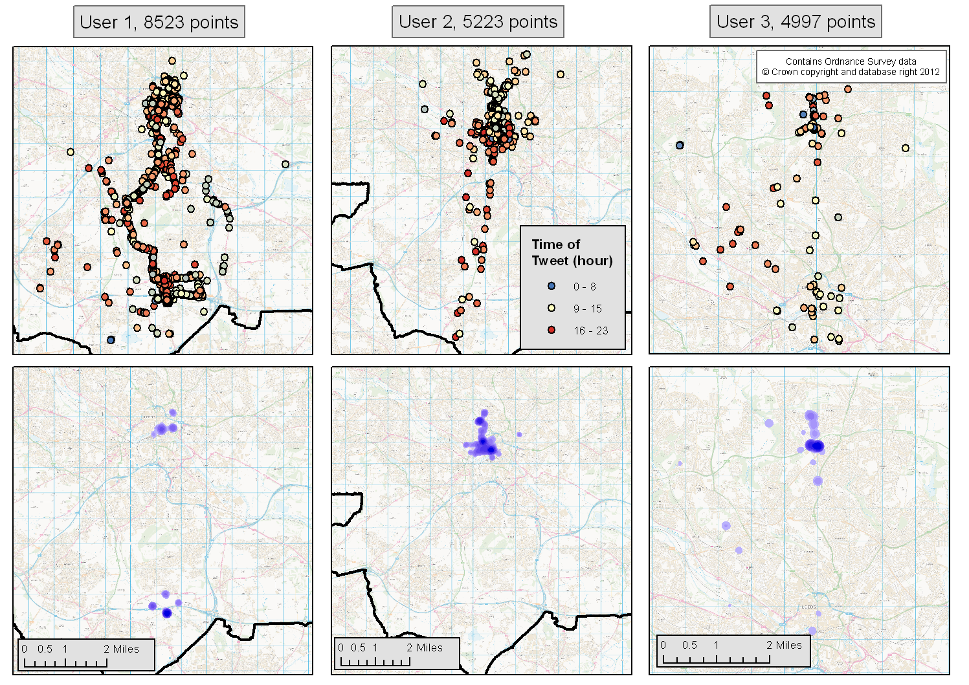
Analysis of Individual Behaviour (I)
As well as analysing aggregate patterns, we can try to identify the behaviour of individual users
Some clear spatio-temporal behaviour (e.g. communting, socialising etc.).
Estimate ‘home’ and then calculate distance at different times
  Journey to work?

Slide 19
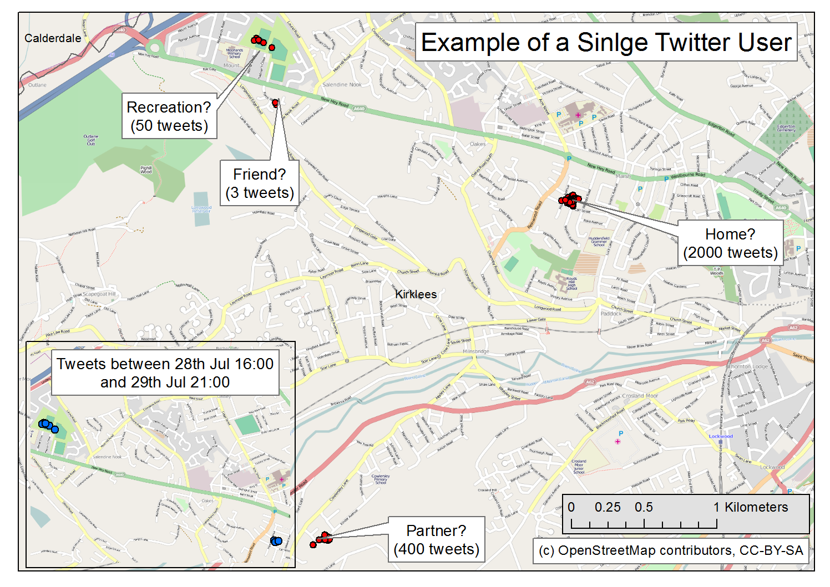
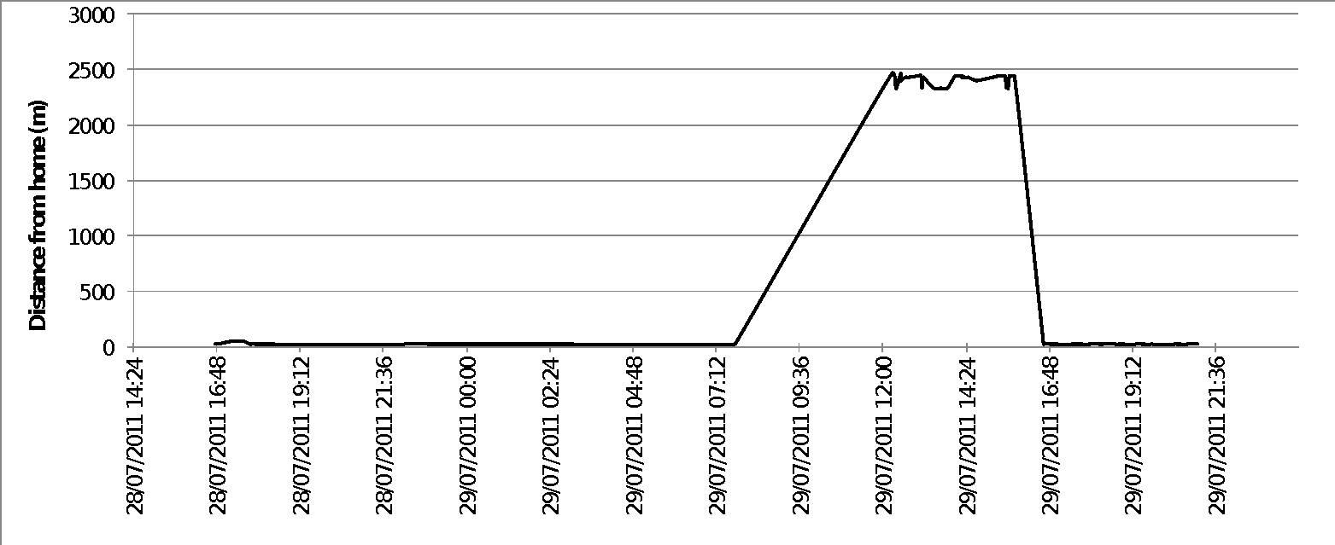
Analysis of Individual Behaviour (II)
Possible to construct profiles of individual behaviour at different times of day?
Could estimate journey times, means of travel etc.
Very useful for calibration of an individual-level model
Notes:
Fortunately, can analyse individual users in detail
- no reliance on aggregate patterns for an understanding of the spatio-temporal dynamics inherent in the data.
For example, user travels somewhere for the day and then goes home again
- journey to work
Possible to estimate average speed of travel for different journeys and hence the type of transport that the user employs.
- estimate car travel time along main road?
- compare journey to bus/train timetables?
Information of this sort would be extremely useful for the calibration of an agent-based simulation.

Slide 20
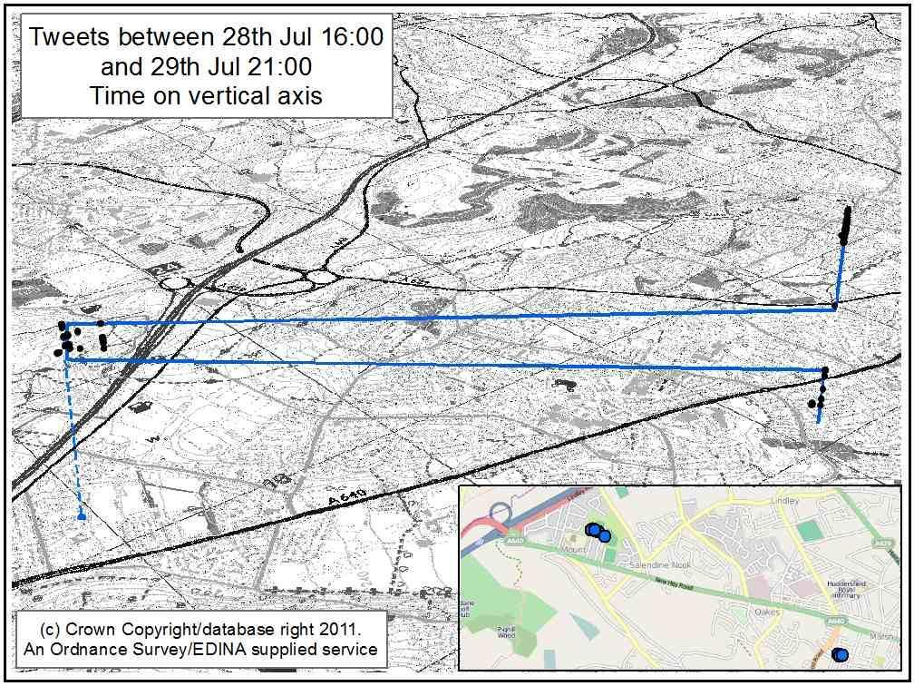
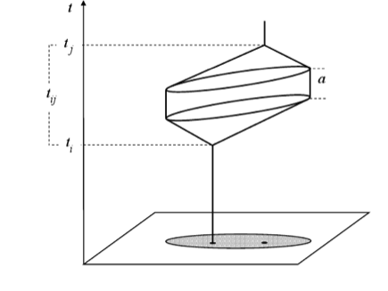
Spatial Behaviour:
the Space-Time Prism
Visualise data in 3D
Clear representation of a ‘space-time path’ (Hägerstrand, 1970)
Test time geography concepts over an entire city?
Source: Miller, H. J. (2004). Activities in Space and Time. In P. Stopher, K. Button, K. Haynes, and D. Hensher (Eds.), Handbook of Transport 5: Transport Geography and Spatial Systems. Pergamon/Elsevier Science.
Notes:
Fortunately, it is possible to analyse individual users in detail without the reliance on aggregate patterns for an understanding of the spatio-temporal dynamics inherent in the data.
Slide shows visualisation of 3D space-time path
Time-geography concepts (Hägerstrand, 1970) are not new, but here we can reveal an explicit observation of the concepts in the crowd-sourced data.
For the first time new data sources associated modelling methods, it possible to think about testing and applying these concepts on a much more universal scale – for example, for an entire city.
Hägerstrand, T. (1970). What about people in regional science? Paper in Regional Science 24, 6–21.
Source for time-space path diagram: Miller, H. J. (2004). Activities in Space and Time. In P. Stopher, K. Button, K. Haynes, and D. Hensher (Eds.), Handbook of Transport 5: Transport Geography and Spatial Systems. Pergamon/Elsevier Science.

Slide 21
Activity Matrices (I)
Once the ‘home’ location has been estimated, it is possible to build a profile of each user’s daily activity
The most common behaviour at a given time period takes precedence
User | 0 | 1 | 2 | 3 | 4 | 5 | 6 | 7 | 8 | 9 | 10 | 11 | 12 | 13 | 14 | 15 | 16 | 17 | 18 | 19 | 20 | 21 | 22 | 23
a | 3 | 0 | 0 | 0 | 0 | 0 | 0 | 0 | 0 | 0 | 0 | 3 | 0 | 0 | 3 | 0 | 3 | 3 | 3 | 3 | 3 | 3 | 3 | 3
b | 3 | 3 | 0 | 0 | 0 | 3 | 3 | 0 | 0 | 0 | 1 | 3 | 1 | 0 | 3 | 0 | 0 | 3 | 3 | 0 | 1 | 3 | 0 | 0
c | 1 | 3 | 0 | 0 | 0 | 0 | 0 | 0 | 1 | 1 | 0 | 1 | 0 | 1 | 0 | 1 | 1 | 1 | 1 | 1 | 1 | 1 | 1 | 1
d | 0 | 0 | 0 | 0 | 0 | 0 | 0 | 0 | 0 | 1 | 0 | 0 | 3 | 0 | 3 | 1 | 1 | 1 | 1 | 1 | 1 | 1 | 1 | 1
e | 0 | 0 | 0 | 0 | 0 | 0 | 0 | 0 | 0 | 0 | 0 | 0 | 0 | 0 | 0 | 0 | 0 | 0 | 0 | 0 | 0 | 0 | 0 | 0
f | 1 | 0 | 0 | 0 | 0 | 3 | 3 | 3 | 3 | 3 | 3 | 3 | 3 | 3 | 3 | 3 | 3 | 1 | 3 | 3 | 3 | 1 | 1 | 1
g | 0 | 0 | 0 | 0 | 0 | 0 | 0 | 0 | 3 | 3 | 0 | 0 | 1 | 3 | 0 | 0 | 0 | 0 | 3 | 3 | 3 | 0 | 3 | 0
h | 0 | 0 | 0 | 0 | 0 | 0 | 0 | 3 | 3 | 0 | 0 | 0 | 3 | 0 | 0 | 0 | 0 | 0 | 0 | 0 | 0 | 0 | 0 | 0
i | 0 | 0 | 0 | 0 | 0 | 0 | 0 | 0 | 0 | 0 | 0 | 0 | 0 | 0 | 0 | 1 | 1 | 1 | 0 | 0 | 0 | 0 | 0 | 0
‘Raw’ behavioural profiles
Interpolating to remove no-data
At Home
Away from Home
No Data
User | 0 | 1 | 2 | 3 | 4 | 5 | 6 | 7 | 8 | 9 | 10 | 11 | 12 | 13 | 14 | 15 | 16 | 17 | 18 | 19 | 20 | 21 | 22 | 23
a | 3 | 3 | 3 | 3 | 3 | 3 | 3 | 3 | 3 | 3 | 3 | 3 | 3 | 3 | 3 | 3 | 3 | 3 | 3 | 3 | 3 | 3 | 3 | 3
b | 3 | 3 | 3 | 3 | 3 | 3 | 3 | 3 | 3 | 1 | 1 | 3 | 1 | 3 | 3 | 3 | 3 | 3 | 3 | 3 | 1 | 3 | 1 | 1
c | 1 | 3 | 3 | 3 | 3 | 1 | 1 | 1 | 1 | 1 | 1 | 1 | 1 | 1 | 1 | 1 | 1 | 1 | 1 | 1 | 1 | 1 | 1 | 1
d | 1 | 1 | 1 | 1 | 1 | 1 | 1 | 1 | 1 | 1 | 1 | 3 | 3 | 3 | 3 | 1 | 1 | 1 | 1 | 1 | 1 | 1 | 1 | 1
e | 1 | 1 | 1 | 1 | 1 | 1 | 1 | 3 | 3 | 3 | 3 | 3 | 3 | 3 | 3 | 3 | 3 | 3 | 1 | 1 | 1 | 1 | 1 | 1
f | 1 | 1 | 1 | 3 | 3 | 3 | 3 | 3 | 3 | 3 | 3 | 3 | 3 | 3 | 3 | 3 | 3 | 1 | 3 | 3 | 3 | 1 | 1 | 1
g | 3 | 3 | 3 | 3 | 3 | 3 | 3 | 3 | 3 | 3 | 3 | 1 | 1 | 3 | 3 | 3 | 3 | 3 | 3 | 3 | 3 | 3 | 3 | 3
h | 1 | 1 | 1 | 1 | 3 | 3 | 3 | 3 | 3 | 3 | 3 | 3 | 3 | 3 | 3 | 3 | 3 | 3 | 1 | 1 | 1 | 1 | 1 | 1
i | 1 | 1 | 1 | 1 | 1 | 1 | 1 | 3 | 3 | 3 | 3 | 3 | 3 | 3 | 3 | 1 | 1 | 1 | 1 | 1 | 1 | 1 | 1 | 1

Slide 22
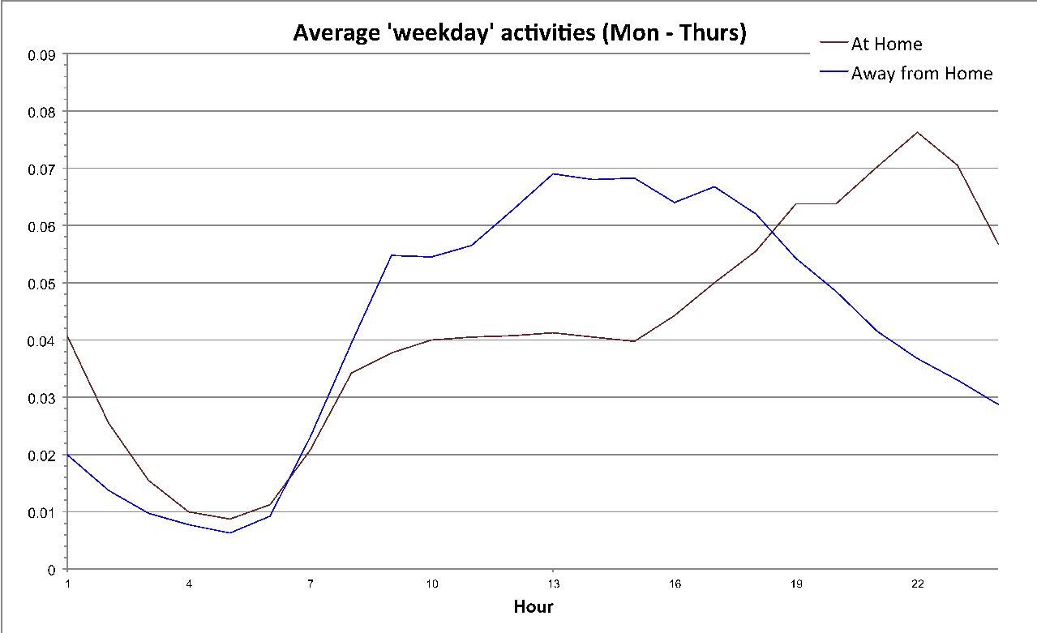
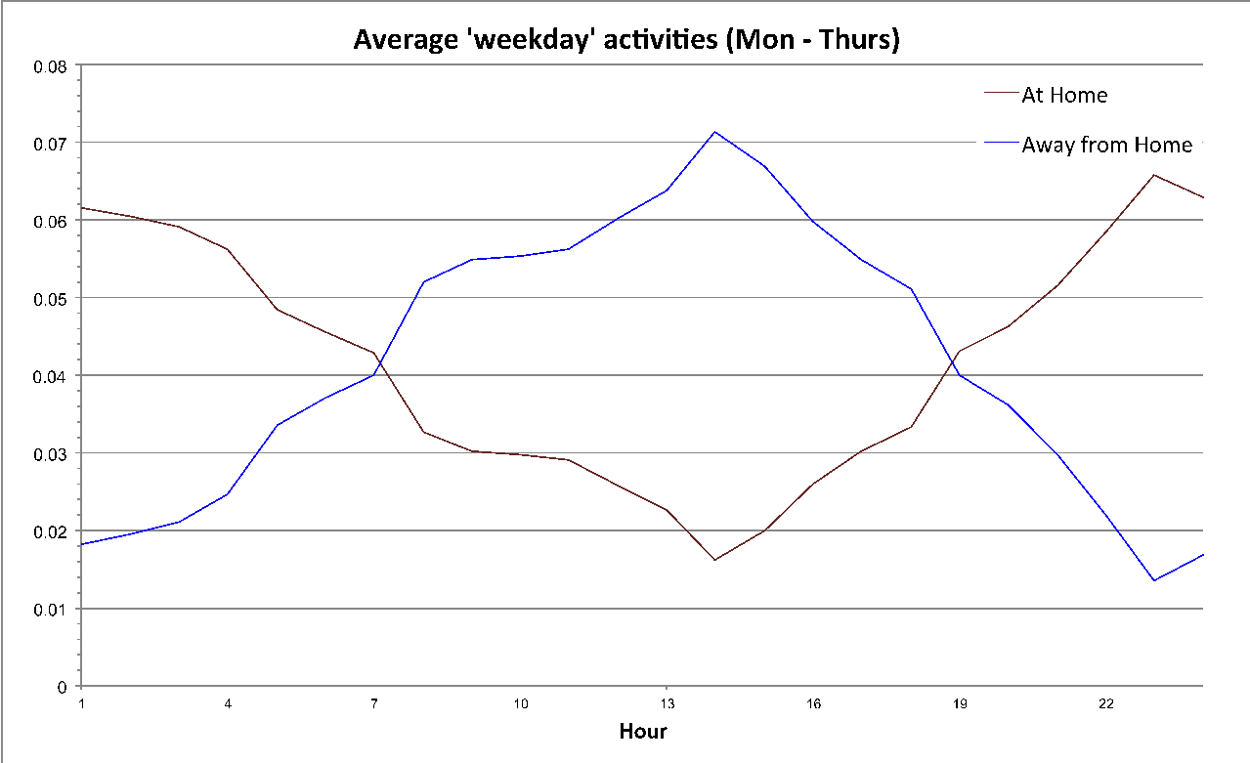
Activity Matrices (II)
Overall, activity matrices appear reasonably realistic
  Peak in away from home at ~2pm
  Peak in at home activity at ~10pm.
Overall, activity matrices appear reasonably realistic
Next stages:
  Develop a more intelligent interpolation algorithm (borrow from GIS?)
  Spatio-temporal text mining routines to use textual content to improve behaviour classification

Slide 23
Towards an Agent-Based Model of Urban Dynamics
1 – Generate synthetic population
  Previous research has created spatially referenced synthetic population for the study area using census data
  Richly specified attributes including gender, ethnicity, marital status, employment, etc
2 – Create agents
  Rules to determine behaviour can be parameterised from individual characteristics (e.g. employment, home location etc).
3 – Calibrate with crowd-sourced data
  Identify which agents have similar characteristics to users in the data
  Calibrate agent behaviours to match data

Slide 24
Conclusions
Aim: A better understanding of urban dynamics through the use of novel social-network data
Patterns in the data have a distinct resonance with theoretical concepts
  Can detect intra-urban movement patterns
  This level of data usually very difficult to obtain
Main problem: data bias
  Who isn’t tweeting?
Ethical issues
  Usually participants give permission for the study – not feasible with crowd-sourced data
  Data is publicly available but do users understand what they have made available?
Notes:
Novel aspect of this research is working towards calibration of a model using crowd-sourced data
Patterns in the data have a distinct resonance with the theoretical frameworks of behavioural geography and time geography.
- we have shown that constrained intra-urban movement patterns, e.g. from home to work to shop and home again, and so on, can be detected and illustrated.
- usually this data would be very difficult to obtain – a small numer of participants would need to be equipped with location-sensing devices and monitored over time
Ethical issues
- Usually participants give permission for the study – not feasible with crowd-sourced data
- Data is publicly available but do users understand what they have made available?
Social network analysis

Slide 25
Future Work
More advanced clustering methods
A great deal more can be done to look at the spatial patterns in the the twitter data using clustering methods
We are only really scratching the surface as we learn about these data
There are many challenges to analysing this data, not least is the fact that some of the most identifiable concentrations and clusterings are a result of a single prolific use
Still being able to identify them is potentially useful...
Improved identification of behviour
“Spatio-temporal text mining”
  Methods to classify text based on spatio-temporal location as well as textual content
In situ model calibration
Notes:
Novel aspect of this research is working towards calibration of a model using crowd-sourced data
Patterns in the data have a distinct resonance with the theoretical frameworks of behavioural geography and time geography.
- we have shown that constrained intra-urban movement patterns, e.g. from home to work to shop and home again, and so on, can be detected and illustrated.
- usually this data would be very difficult to obtain – a small numer of participants would need to be equipped with location-sensing devices and monitored over time
Ethical issues
- Usually participants give permission for the study – not feasible with crowd-sourced data
- Data is publicly available but do users understand what they have made available?
Social network analysis

Slide 26
References
Goodchild, M. (2007). Citizens as sensors: the world of volunteered geography. GeoJournal, 69, 211–221
Miller, H. J. (2004). Activities in Space and Time. In P. Stopher, K. Button, K. Haynes, and D. Hensher (Eds.), Handbook of Transport 5: Transport Geography and Spatial Systems. Pergamon/Elsevier Science.
Savage, M., & Burrows, R. (2007). The Coming Crisis of Empirical Sociology. Sociology, 41(5), 885–899.
Thrift, N. (2005) Knowing Capitalism. London: Sage.

Slide 27
Thank you
A copy of these presentation slides and our accompanying paper will be available online via Andy's conference notes at the following URL:
  http://bit.ly/HWOe27
More information
  Andy Turner
    http://www.geog.leeds.ac.uk/people/a.turner/
  Nick Malleson
    http://www.geog.leeds.ac.uk/people/n.malleson/
    Blog: http://nickmalleson.co.uk/blog/
Notes:
Novel aspect of this research is working towards calibration of a model using crowd-sourced data
Patterns in the data have a distinct resonance with the theoretical frameworks of behavioural geography and time geography.
- we have shown that constrained intra-urban movement patterns, e.g. from home to work to shop and home again, and so on, can be detected and illustrated.
- usually this data would be very difficult to obtain – a small numer of participants would need to be equipped with location-sensing devices and monitored over time
Ethical issues
- Usually participants give permission for the study – not feasible with crowd-sourced data
- Data is publicly available but do users understand what they have made available?
Social network analysis

