Slide 1
Programming for Geographical Information Analysis: Core Skills
Dr Andy Evans
Rachael Oldroyd
Notes:
Welcome to the course. You’ll find extra information in these note sections below each slide.

Slide 2
What’s the big idea?
You will become a Python programmer.
You will learn to solve complex problems using programming.
You will understand the major elements of the most significant computer programming languages.
You will understand how programming works as a real world process.
We shall, in short, become Über-Geeks, finely honed Code Warriors, the Elite of Scientists. Desired by the rich, admired by the poor.
Notes:
This course will, first and foremost, introduce the Python programming language to you. Python is a modern and powerful computing language, well built for data analysis.
As part of this, we’ll look at examples and practicals which will help you to think computationally – that is, to think in a way that allows you to solve problems using a logical framework that translates into code.
However, what this course will also do is teach you about computing languages more generally; it will balance a solid grounding in generic programming issues with “Pythonic” approaches specific to Python. Python is actually easy to cut and paste together without necessarily understanding it, but that then doesn’t help if you need to pick up alternative languages. Only when you can smoothly transition between languages can you call yourself a fully fledged programmer, so we’ll take the course slowly, and cover Python in a way that allows you to understand how a wide variety of languages work.
Finally, we’ll cover how programming works in the real world: the kinds of ways people approach programming and some of the current big trends in programming, so when you hear the latest buzzwords, you know what they mean in practice.

Slide 3
What doesn’t kill you makes you stronger
You will learn the patience of the Buddha.
You will learn that you are not a machine, you’re a real live human boy/girl.
Notes:
Learning to computer program is not easy. This course will probably take more effort than any other course you’ve done. If you’re on the course to learn a new skill, however, although it is hard, it will also be one of the most satisfying things you’ll have done.
Almost anyone can program if they are dedicated to learning it, but it takes everyone a different amount of time before it ‘clicks’. Up until that time, it is really really horrible. After that time it is highly rewarding. Trust us, you can get there. Once you’re fully institutionalised, you’ll even find it fun.

Slide 4
The course
The first few lectures will look at the basics of the language.
We’ll then look at reading and writing files and doing more sophisticated analyses using other people’s code within your program.
Lectures 1-6;9: Core language.
Lectures 7,8,10: Code to do specific stuff.
Lecture 11: Coding in the real world.
Notes:
You can find out more about the course on the course website.

Slide 5
Assessment
Weekly practicals will build up into a portfolio of work online, the presentation and extra content of which is worth 30%.
Major project worth 70%.
Notes:
We’ll start discussing the projects in lecture 9.

Slide 6
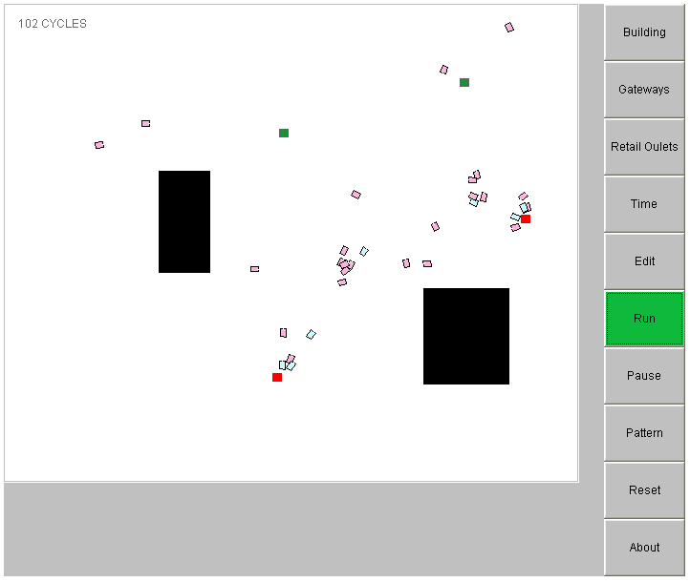
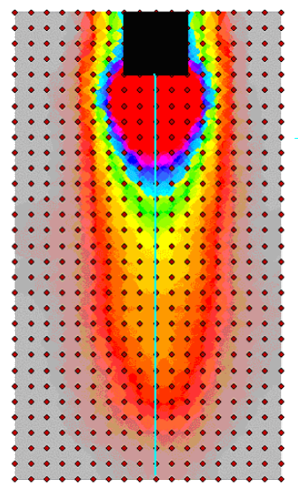
Assessment
The final projects will solve some geographical problem:
  Disease spread;
  Strategic modelling;
  Government coverups;
  Titanic icebergs etc.etc.
Notes:
The type of project is reasonably flexible, if you have some ideas of your own.

Slide 7
Information
On the VLE:
  All the lectures, with extensive notes, and all the practicals.
  Extra practice pieces.
  FAQs.
  The course outline.
  Recommended text books.
  Useful links mentioned in the lectures.
Notes:
We’ll visit the site in Practical One.

Slide 8
This Lecture
Introduction
Core programming:
What is programming?
History of languages and Python
Pythonic goodness: The Python Philosophy
Running code
Thinking computationally: How to Code / Algorithms
Real World Coding: Open Source Software
Notes:
Each week, we’ll cover some core material of use to all programmers, but with Python as the example language.
We’ll then talk about how Python handles the issue in a way that is ‘Pythonic’ – the concise and clear.
We’ll also have a section on current programming practice, and another on how to approach problems from a computational viewpoint.
Each unit, the size of these sections will vary, and sometimes they’ll be put within practicals or given as homework, but we’ll try to cover these areas each unit.

Slide 9
What is Programming?
Telling a computer what to do, using a language you write in simple text files or at a command prompt.
With it, you can do anything a computer can do.
Re-run analyses without having to push a series of buttons and menus each time.
Re-run analyses with variations; for example, on a series of files.
Build analyses which aren't in standard software available 'out of the box’.
Build analyses into workflows or interfaces for non-experts.
Notes:
As you can see from the above example, Python looks like a mix of English and mathematical notation.

Slide 10
What is Programming?
value = 2
answer = 4 + value
if answer > 0 :
print (answer)
Code is written in text files called the source code (sometimes “src”). In Python’s case, each command is on a new line.
The code has a specific syntax along with keywords and operators that have specific meanings for the computer. Here if is a control flow keyword: it controls the flow of the program as it runs based on some condition.
One or more files (often written by different people) work together to make a program.
Notes:
When programmers talk about syntax, they mean the structuring of the sequence of terms that is necessary in any given location to get a program to work. Computer languages have a very specific grammar that you absolutely can’t vary away from if you want the computer to understand you. Part of learning the language is learning this grammar.
Keywords are words like “if” that have specific meanings and can’t be used for anything else (for example, in the above, we couldn’t say “if = 2” but we could say “bob = 2”. Operators are symbols that do something to one or two or more values. For example “+” is an operator that adds the two numbers either side of it. Finally, we may want to use pre-existing code written by other people; for example, “print” here, is code that sends text to the standard output (by default usually the screen).

Slide 11

Why Python?
It’s easy to use.
It’s (largely) Operating System (OS) independent.
It has a great community and lots of code to help with analysis.
It is built into a wide range of software as a scripting language.
It is one of the top three languages most desired by employers.
Learning about it in depth will teach you about other languages.
Notes:
Most programs have to be rewritten depending on whether it’s going to run on a Windows machine, or a Mac, or a UNIX box. Python is the kind of language which runs on pretty much anything. While there are some elements that take a bit of spanner-work to get working on some operating systems, in general the core language and popular libraries run on pretty much any popular OS.
GIS manufacturers are increasingly aware that people don’t want to write programs just for a single GIS package – they want to integrate GIS into existing applications and environments. Because of this they have moved away from their own programming languages like ArcInfo’s AML (Arc Macro Language) and let users program in languages like Python within their GIS.
We asked alumni, and every Master’s student who did programming with us said we should be teaching Python.
Python Trademark statement:
https://www.python.org/psf/trademarks/

Slide 12
A brief history of programming:
Low Level Languages
1930’s Alan Turing first thought about programmable machines that had flexible uses.
1940’s First properly flexible computers – programmed in binary code ‘First Generation Languages’, for example ‘1000 1001 1101 0000 0100 1000 1001 1000 0000 0010 0000 0001 1101 1000’.
Early 1950’s ‘Second Generation Languages’ – used simple ‘machine language’ or ‘assembler’ codes to represent operations, like ‘mov eax, 4 move ebx, 2 add eax,ebx’ for ‘4 add 2’.
These are sometimes called Low Level Languages as they are close to the details by which the computer works: they have low levels of abstraction.
Notes:
Binary coding represents all operations the computer should do, and the numbers and letters it needs for communicating with people, in the forms of ones and zeros., for example 100010011101001010001001100000100000000111011000 may mean ‘add 2 and 2’. Ultimately this is how all computers see stuff. Why would we want to know this? Because sometime we want to alter numbers or images using the binary code stored in the computer directly. For example, if we want to reverse all the colours in an image, the easiest way we can do this in in binary.
First generation languages are sometimes called ‘Machine Code’.
Second generation languages are sometimes called ‘Assembler’.
Second generation and higher languages need changing back into binary so the machine can read it. This is done by a compiler or interpreter.
In fact, the examples give above are a slight cheat, but close enough to give the idea. The machine code is the “2 plus 2” section of x86 CISC assembler, and the binary a somewhat mocked up (if fairly reasonable) version of the equivalent binary, but you get the idea.

Slide 13
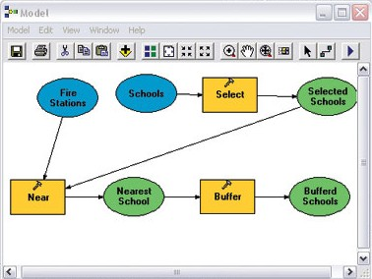
A brief history of programming:
High Level Languages
Mid 1950’s Third Generation Languages: in a human readable form, e.g. ‘4 + 2’.
Fourth Generation Languages try to let people describe what they want to do, without complicating things with how they’re done. Fifth Generation Languages centre on describing what a problem solution looks like and getting a computer to find it.
Such languages hide how the computer works, and are therefore called High Level Languages.
Python is a high level, third generation language.
Notes:
Third generation languages started with FORTRAN, which is still used today, mainly for scientific calculations. It’s very good at fast mathematics, but very bad for almost anything else. Most people use it because they’ve nicked old code off someone else and can’t be bothered rewriting it.
Other popular third generation languages are C++, FORTRAN, and Java.
To a certain extent Visual Basic is moving in a Fourth generation direction. ArcGIS 9.0 introduced a fourth generation programming method for Arc.

Slide 14
Converting code to binary
A compiler is used to convert human language code into binary code once. The binary code (sometimes called native code) can then be run as many times as you like. It is essentially unreadable by humans but only runs on a specific Operating System (and sometimes chip type).
An interpreter runs the source code directly every time, either by compiling it to a binary, or bytecode – an unreadable intermediate that runs in a virtual machine / runtime environment associated with the interpreter (these run the code but also protect the underlying OS from being disrupted by the code).
Python is an interpreted bytecode producing language. This means you generally have to distribute the source code, but it will work on any machine with an interpreter.
Notes:
A complier is used to convert human language code into binary code once. The binary code can then be run as many times as you like. The advantage for companies is that it is hard to work out how the software is constructed. The disadvantage is they need developers for each operating system. Interpreted code will work on anything with an interpreter, but has to be sent by source (though, actually, there are also compilers for many interpreted languages). Some interpreted languages (like Java) will allow you to save the generated bytecode and distribute that as a half-way solution.

Slide 15
Third generation languages: imperative vs declarative
Imperative Languages are traditionally the most popular. They are used to form sets of statements that are read in sequence from top to bottom, which change the state of the computer (for example, the data held). As we’ll see, these encourage user interactions setting off a chain of events.
value = 2
answer = 4 + value
print (answer)
State is held in spaces inside the computer memory with label attached so we can talk about them: so-called “variables”. For example, the label “value” above is assigned the number “2”. The label “answer” is assigned the evaluation of the expression 4 + value.
Notes:
Languages are traditionally divided into Imperative and Declarative languages. We’ll look at declarative languages in a bit.
Imperative languages were the most popular form for decades, as they are intuitive to write, and work well with systems that interact with users as user preferences can be dumped into variables for constant reference.
Expressions are chunks of code that resolve to in some kind of answer. For example, in the equation 5 = 2 + 3, the “2 + 3” bit is an expression.

Slide 16
Goto
Programs rarely want to run from top to bottom: they want to skip around depending on what is going on (for example, if a file exists or is missing).
At first, people used a control flow keyword called goto to jump around to line numbers:
10: if file missing goto 20
15: read file goto 25
20: exit program
25: print file
With big programs, this resulted in spaghetti code.
(Pseudocode, not Python)
Notes:
Goto was finally killed off by Edgar Dijkstra, with a 1968 paper: Go To Statement Considered Harmful (March 1968; Communications of the ACM (CACM)) http://www.cs.utexas.edu/users/EWD/ewd02xx/EWD215.PDF
Though it took many years to die off.
Pseudocode is not code that runs, but indicative code-like text that conveys the idea of code that might be developed by replacing the pseudocode with real code.

Slide 17
Procedures
People moved to Procedural Programming, which had named chunks of code called procedures that you could jump to, and would return with the answers to questions.
Procedures are sometimes called methods, functions, routines, subroutines (varies by language and use).

Slide 18
text = input("Type a number to add to four")
value = int(text)
answer = 4 + value
print (answer)
Here input is a procedure that displays some text and returns something typed by the user, int takes this typed text and returns a number, and print is code that prints stuff on screen and returns nothing.
Notes:
The above is Python.

Slide 19
Declarative Languages
Declarative Languages usually describe the end point first and the program works to get there.
One subset of these are Functional Languages where one passes one procedure to another in ever more complex nesting in order to calculate some end result defined by the first layer of nesting.
Generally stateful elements like variables are discouraged; the code is constructed from expressions rather than full statements.
Notes:
To return to declarative languages… some declarative languages are also Fifth Generation Languages, though frequently they are not as they involved coding. The general idea is the same though – to describe what you want to end up with, and work from that to generate the solution.

Slide 20
text = input("Type a number to add to four")
value = int(text)
answer = 4 + value
print (answer)
print (
4 + int(
input(
"Type a number to add to four“
)
)
)
Generally stateful elements like variables are discouraged; the code is constructed from expressions rather than full statements.
Notes:
In the above, for example (which is a functional version of the original shown in grey), we start with the fact that we want to print something, and work down adding code to generate the components of the solution. Note, in particular, that we have got rid of the stateful elements – the variables. There is no record of the answers beyond their use (so called “side effects”). This cuts out the opportunity for code elsewhere to alter the state of the solution in error, but also makes coding much harder.
It doesn’t especially matter if you don’t follow this now, we will come back to it.

Slide 21
Python
Functional languages are increasingly popular as everything is contained within the nesting; this means it can be split up easily so different nests run on different processors on machines with more than one processor (which is usual now) – we’ll come back to this.
Python is a third generation imperative language, but with functional bits.
Such hybrids are generally the direction of travel.
Notes:
Most languages are converging on something which is a mix of functional and imperative programming. For example, R, a functional language, comes across as very imperative, whereas Java, which is very imperative by tradition, has introduced many functional elements. Other declarative programming styles have had less effect.

Slide 22
Object Oriented Languages
With most languages procedures are generally all in one file. This resulted in very large files.
Object Oriented (or sometimes in the UK “Orientated”) Languages build bits of code called ‘Objects’ which can hold data and do specific things with it. Once they’re done, they pass the data on to another Object. Each Object has its own text file associated with it.
Objects are gathered in Libraries (code doing similar jobs), Systems (code providing services to other code), or Applications (stand alone software).
Example Objects
Notes:
If it’s not obvious why you wouldn’t want to write all the instructions in one file, Windows XP has 40 Million lines of code in it (http://en.wikipedia.org/wiki/Source_lines_of_code).
If you want an example of an Object, then look at any Window’s program menu – each item on the menu may just look like text, but it’s actually an Object which does some specific job for you.
Plainly menu elements do a job. But they also store information, e.g. the text to display on themselves for a given language. This is something we’ll come back to later in the course.
Don’t worry about the details of Object Orientated Programming now, we’ll go into it in more detail later.

Slide 23
Example
import tkinter
def run():
pass
root = tkinter.Tk()
menu = tkinter.Menu(root)
root.config(menu=menu)
model_menu = tkinter.Menu(menu)
menu.add_cascade(label="Model", menu=model_menu)
model_menu.add_command(label="Run model", command=run)
tkinter.mainloop()
Notes:
So, here’s the code that would make the example on the previous slide in Python.
Note how little code it takes, and how (with the exception maybe of add_cascade) you can kind of understand what it does without really knowing too much about how it does it. These are two key reasons people like Object Orientated programming languages.

Slide 24
Example
import tkinter
def run():
pass
root = tkinter.Tk()
menu = tkinter.Menu(root)
root.config(menu=menu)
model_menu = tkinter.Menu(menu)
menu.add_cascade(label="Model", menu=model_menu)
model_menu.add_command(label="Run model", command=run)
tkinter.mainloop()
Python is a third generation, imperative, procedural, object oriented language.
The “dot operator” is used to say “look inside this object and find this code (in this case a procedure).
Notes:
Every time you see the dot operator, it is object orientation working.

Slide 25
Scripting languages vs System Programming Languages
Languages can finally be split between:
Systems (or Application) Programming Languages:
used for developing full systems, and…
Scripting Languages, which:
tie together other software (glue languages),
are used inside other applications for
simple programming (extension languages), or
are used to manage systems (control languages).
Notes:
This distinction was made by John Ousterhout and is therefore known as “Ousterhout’s Dichotomy”.
John Ousterhout (1998) "Scripting: Higher Level Programming for the 21st Century" IEEE Computer magazine. http://www.tcl.tk/doc/scripting.html

Slide 26
Scripting languages vs System Programming Languages
Generally scripting languages are interpreted (which helps with running inside other software) and hide away complicated code making them easy to learn, but traditionally reducing the ability to do complex jobs and making code had to optimise for speed.
Again, the two are converging: Python is traditionally a scripting language, but gives good access to complicated underlying computing, and undergoes continual optimisation. Much of the time it invisibly calls native code written in C, a very efficient language.
Notes:
As Ousterhout pointed out, the issue is that scripting languages are generally easy to use but lack ability (because they are so abstracted from low level computing, which means hiding functionality you might want) and are slow, whereas systems languages are complicate to write, but fast and powerful.
These days, however, we see a convergence of power and speed, with many so-called scripting languages like Python, offering good access to low level computing if it is needed, and being optimised for processing speed. Equally, Systems languages are picking up on many of the good points of scripting languages, offering objects that hide way complicated issues.

Slide 27
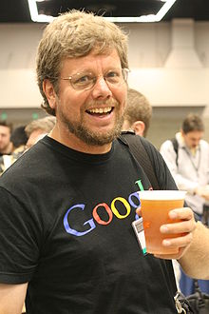
Brief History of Python
Developed initially by Guido van Rossum.
Worked as part of the ABC language development team in the 1980s: a teaching language with a syntax that encouraged clarity, conciseness, and easy data structure use, taking a lot from a language called SETL (SET Language) developed in the late 1960s. Also influenced by Modula; Amoeba; C++.
Developed Python as a successor; first release 1991. Named after Monty Python.
Python 2 released in 2000: added a few elements of modernisation and opened out development to a full community effort.
Python 3 released in 2008: not back-compatible with Python 2. Python 2 end of life set now at 2020.
We are now on Python 3.6.
Notes:
In actual fact, there’s much in SETL which is more obviously related to Python than in ABC.
Image from WikiCommons:
https://commons.wikimedia.org/wiki/File:Guido_van_Rossum_OSCON_2006.jpg
For more background, see:
https://docs.python.org/3/faq/general.html#why-was-python-created-in-the-first-place

Slide 28
Language change
Generally language designers go to extreme lengths to ensure code is back-compatible (i.e. new changes don’t break old code just because it doesn’t include new features).
They may deprecate (advise that features are dead), but they won’t break stuff.
This is because there is lots of legacy code (old but vital code) hanging around, and people need time (often decades; and money) to revise it.
While they have tried to keep as much as possible working, there’s too much change in Python 3 to make it back-compatible with Python 2.

Slide 29
Python 2 vs Python 3
For example, displaying text on the screen went from this:
print "hi"
To this:
print ("hi")
This means there are still libraries (and coders) that hold to Python 2 (and probably always will). Other people are slowly developing replacements (for both!).
We will teach Python 3. You will need the Python 3 download.
We will talk about the differences at the end of the course, and how to set up a machine that runs both.

Slide 30
What’s in a program?
Variables : labels attached to data (including text and other bits of code)
Delimiters: things like "()" that structure the code.
Operators: things like “+” that act with variables.
Keywords: words that can only be used to mean specific things (like the word “if” and can't be used for variable names.
Expressions: combinations of variables, keywords, and operators that evaluate to a value.
These are built up into statements telling the computer what to do.
Notes:
So, that’s the history lesson. However, we’ve also covered a lot of the major components in programs and what they do. Let’s have a revision of those.

Slide 31
What’s in a program?
Statements are structured into programs using:
Line breaks: in Python, each new line is generally a new statement.
Control flow keywords: keywords (like if and goto – not that Python has goto) that control the flow of the code.
Delimiters: for example “:” and tabbing are used to structure code in Python and tell the computer where a statement fits into the overall control flow. Really line breaks are a kind of punctuation.
Procedures: separate chunks of code that run and return answers (or nothing) to the code that calls them.
Objects: code cut off into its own file for doing a specific job.
Libraries: a collection of different objects doing similar jobs.
Notes:
What we’re going to do is cover these sequentially across this core skills course.

Slide 32
This Lecture
Introduction
Core programming:
What is programming?
History of languages and Python
Pythonic goodness: The Python Philosophy
Running Python
Thinking computationally: How to Code / Algorithms
Real World Coding: Open Source Software

Slide 33
Pythonic Goodness: The Python Philosophy
Guido highlights a number of rules that were key when designing Python; the most important of which are probably:
Things should be as simple as possible, but no simpler.
Don’t bother users with details that the machine can handle.
Don’t try for perfection because “good enough” is often just that.
Borrow ideas from elsewhere whenever it makes sense.
These have resulted in a language which is, to reuse author Luciano Ramalho’s phrase: “Clear, Concise, and Effective”.
Notes:
Guido van Rossum (2009) “Python's Design Philosophy” The History of Python http://python-history.blogspot.co.uk/2009/01/pythons-design-philosophy.html
Luciano Ramalho (2015) “Fluent Python: Clear, Concise, and Effective Programming” O'Reilly Media

Slide 34
Pythonic Goodness: Pythonic Code
We shall teach you standard code that is transferable to other languages, but each lecture we’ll also highlight “pythonic” ways of doing things that are more concise and elegant (though not always clearer until you’re a Python reader).
Here’s two ways to print the even numbers in the 5 and 10 times tables:
for counter1 in {5, 10}:
for counter2 in {1,2,3,4,5,6,7,8,9,10}:
if (counter1 * counter2) % 2 == 0 :
print (counter1 * counter2)
print(list(a*b for a in {5,10} for b in range(1,11)
if not (a*b % 2)))
Notes:
Of the two examples, the bottom one is more “Pythonic” as it uses much less text, and uses a whole bunch of efficient stuff in the background. For Python fans, this is also a much easier read. For non-Python fans, it looks like crazy magic. One has, therefore, to be aware of one’s audience.
Note, also, that the second examples should be all on one line.

Slide 35
This Lecture
Introduction
Core programming:
What is programming?
History of languages and Python
Pythonic goodness: The Python Philosophy
Running Python
Thinking computationally: How to Code / Algorithms
Real World Coding: Open Source Software

Slide 36
Running Python
Once we’ve written our Python, we need to run / execute it.
For this, we need to Python interpreter, the virtual machine, and the standard library, which contains code ancillary to the core language that you might want to use (for example for exploring file systems).
In addition, we may want to install additional libraries. The office Python Package Index ('PyPI') lists over 100,000 third party 'packages'(which is close to the same thing – we'll discuss the difference later in the course).
You can manually download both the core language and additional libraries and manually install them. However, it can prove quite complicated to do so.
Notes:
You can download the standard Python from:
https://www.python.org/
The PyPI is at:
https://pypi.python.org/pypi
More information on standard installs at:
https://docs.python.org/3/using/index.html

Slide 37
Anaconda
Instead, we use Anaconda: a distribution that includes all the core language elements, plus installs of all the important scientific libraries, plus a whole load of software to make our lives easier.
You can download it here, if you need it:
https://www.continuum.io/downloads
Anaconda includes Conda, software for managing libraries and coding environments. Although you can actually use Conda to switch between Python 2 and 3 easily, make sure you download the version defaulting to 3.6.
Notes:
We’ll talk about switching later in the course.

Slide 38
Running python files
In Windows, double-click should run. If not, associate the file suffix with python.exe (which will show a command prompt) or (better for users) python.exe, which won’t.
For standard install, this is python3.exe.
For *nix and Macs, add shebang line to very top file; will then start automatically when control-clicked:
#! /usr/bin/python
Notes:
https://docs.python.org/3/using/windows.html#shebang-lines

Slide 39
Running the interpreter old skool
You can write Python in any text editor that will produce text in the format UTF-8. When we do this, we’ll use the software Notepad++ (see website for info on Macs and other Linux distros).
Write the Python, and save it with the suffix “.py” (not “.txt or .txt.py”).
To run the Python, move to the directory where you’ve saved the file, and type:
> python filename.py
Where “filename” is whatever you used as a filename when you saved it. Generally, when discussing general syntax, we’ll put things you need to replace with proper code in italics. “>” at the start of a line will mean a standard command prompt.
Notes:
Notepad++
https://notepad-plus-plus.org/
On Macs and other Linux, you can use textedit or Leafpad, but make sure you set the save type with the former to “text” or “txt”, not “RTF” (which, bizarrely, is a Microsoft text format with extra complications the interpreter won’t like). Instead of a command prompt, use the terminal (which is the same thing, pretty much).
For details of how to check you’ve not saved files as .txt or .txt.py, see the course website.

Slide 40
Integrated Development Environments
Generally, programmers use an IDE when coding. This is text editing software that adds coding functionality, including:
Syntax colouring
Line numbers
Push button running
Error identification and help
Autocomplete of keywords and procedure names
GUI building help
Anaconda comes with a number of IDEs, including IDLE, the standard IDE which comes with Python, and Spyder (Scientific PYthon Development EnviRonment), a popular IDE. We’ll look at these in the first practical.

Slide 41
Read–Eval–Print loop (REPL)
One major difference between Scripting and Systems Languages is the ability to run interactively at a prompt (though Systems languages are converging on adding this).
REPL capable languages have an associated prompt that sets up an environment recording variable values, and allow you to type one line at a time to do jobs. These are read, evaluated, and the answers printed to the screen.
If you type python at the command prompt (which is itself a REPL environment), you open the Python REPL prompt. It looks like this:
>>>
From now on, if you see this, it means the command is to be typed in a Python REPL prompt.

Slide 42

Jupyter
One especially good use of Python’s REPL abilities is Jupyter Notebooks.
Jupyter integrates REPL languages into a text document so that you can both have text, images, hyperlinks etc. and code that runs.
A good foundation for literate programming.
This means you can describe code, but also that you can build code into scientific papers etc. To re-run the analysis, just rerun the code.
These are now accepted by many journals as online appendices.
You may see these called iPython Notebooks – the name was changed when they added the option for other REPL languages (including R).
They can be saved as Notebooks, PDFs, and webpages.
Notes:
Logo copyright statement:
https://github.com/jupyter/governance/pull/22

Slide 43
Debugging
However you run the code, there may be issues with it that the interpreter will flag. We can distinguish between
Compilation time errors: errors associated with problems with syntax.
Import time errors: errors associated with finding other code the software uses
Runtime errors: errors associated with the logic of the program.
The interpreter will give you a description of what has gone wrong and where. Your job is then to fix the issue. You then need to run the interpreter again. You repeat this process until the program will run.
This isn’t because you can’t program; this is programming.
Programming is 50% writing code and 50% fixing it.
Notes:
There are two things to remember:
Programming is the art of telling something very very stupid how to do things. Computers have all the intelligence of an earthworm – you are smarter than them – don’t forget this. You just have to learn to talk down to them in terms they understand.
When you start programming your programs won’t work. You’ll probably have hundreds of errors. This isn’t because you’re a bad programmer and can’t program. This is because this is what programming is: it’s 50% writing code, and 50% fixing problems. All that happens as you become a better coder is that the easy problems get fixed as you write the code, and harder ones appear to take their place. You know you’re a coder the moment that you’re institutionalised to the point you enjoy solving these problems. In the meantime, remember that problems arise because you’re a human being, not a computer, and be glad of it.

Slide 44
This Lecture
Introduction
Core programming:
What is programming?
History of languages and Python
Pythonic goodness: The Python Philosophy
Running Python
Thinking computationally: How to Code / Algorithms
Real World Coding: Open Source Software

Slide 45
Computational Thinking
Programming is the art of describing how to do very complicated things to a very stupid computer in very simple steps.
The more you think like a computer, the easier it will be.
You need to be ultra-exact about what you type: capitals, punctuation, etc. Computers cannot interpolate or guess, and have a very rigorous syntax. As you become more precise, compilation errors will drop.
You also need to approach coding logically, building up the components you need to do a job and breaking the solution down into manageable tasks: what we call “computational thinking”.

Slide 46
Computational Thinking: Algorithms
The initial outline for the processing done is called an ‘algorithm’, it’s a bit like a recipe.

Slide 47
How to calculate the mean of three numbers
Get 3 numbers.
Sum the numbers.
Divide the sum by 3.
Print the result.
Notes:
As you can see, algorithms are all about getting the order of things right. This is much of the skill involved in computer programming. For example, if you want to mail someone a present, you have to buy the present and have a box ready before you send it. This may sound dumb to the point of pointlessness, but when people come to write computer programs you’d be surprised how many people try and send empty boxes, or send the box before they’ve bought the present. When you’re first starting out, algorithms are very important for helping with this problem. Later on, you’ll find that other people publish algorithms that describe how to solve particular, and very complex, problems. You can see a list of the top ten here…
http://oldweb.cecm.sfu.ca/personal/jborwein/algorithms.html
Don’t worry – we won’t be using any of them!

Slide 48
Computational Thinking: How to code
First, write the algorithm into your text file as comments (these are lines starting # that the computer doesn’t process – blocks of lines can start and end """).
Next, pick a line to work up as code.
Write the code a line, or couple of lines, at a time. Compile and test the code every couple of lines. Baby steps mean you won’t end up with 100 errors at once and you’ll know where the errors are.
Think ‘how can I test this is working properly?’ as each line goes in.
Notes:
Comments are human readable text to make it clear how the program works and what it does. The computer doesn’t interpret them as code.
How could we test this code as we built it up?
Here’s your first Python code – it implements this algorithm. See if you can understand it, and note how the algorithm is written into the code. It’s usual to write down the algorithm as comments (which the computer doesn’t run) and build the code around it.
#
# Program to calculate the mean of three numbers
# Author: Andy Evans
#
#Get 3 numbers.
numberOne = 7
numberTwo = 23
numberThree = 42
# Sum the numbers.
sum = numberOne + numberTwo + numberThree
# Divide the sum by 3.
result = sum/3
# Print the result.
print (result)

Slide 49
Computational Thinking: How not to code
Don’t just start writing without thinking through how the program is roughly structured. Compile regularly.
Don’t ignore errors – they won’t go away, and they’ll just make everything wrong. If you get an error you can’t see, try cutting back chunks of code until you have something simple that works, then add it back in, a line at a time.
That said, if you get very stuck and no help is immediately forthcoming, think about cutting out the problematic code and replacing it temporarily with something simpler. For example, if you can’t work out how to open a file and read in data, just write the data directly into the program and work on something clearer until you can find someone to help.

Slide 50
The Coding Community
No one codes from scratch; it would be counterproductive to ignore the mass of experience available to draw on.
The first thing to do (if you’re not being assessed for the work!) is to see if someone else has already done it and made their work available.
But also, there are plenty of good forums where people will post useful examples, or answer questions (Stack Overflow is especially good – but please don’t ask questions without talking to us first).
https://stackoverflow.com/
It’s not called a coding community for nothing.
Notes:
https://stackoverflow.com/questions/tagged/python

Slide 51
This Lecture
Introduction
Core programming:
What is programming?
History of languages and Python
Pythonic goodness: The Python Philosophy
Running Python
Thinking computationally: How to Code / Algorithms
Real World Coding: Open Source Software

Slide 52
Real World Programming:
Open Source Software
One way people make code available for others is by making it “Open Source”.
Open Source means the core code is available for people to study, adapt, and distribute. The originator maintains copyright and ownership, but licences others to use the code in this way. The details of what these generalities mean in practice is controlled by a licence.
Python was built on a solid Open Source basis from version 2. The core implementation is CPython, but others can and have implemented other versions.
There are various different Open Source Software licences validated by the Open Source Initiative…
Notes:
See: Raymond, Eric S. (1999). The Cathedral and the Bazaar: Musings on Linux and Open Source by an Accidental Revolutionary. O'Reilly Media.

Slide 53

Some key licences
GNU General Public License (GPL):
Permission to copy, adapt, distribute
Artistic License 2:
Permission to copy, adapt, distribute, provided it is clear where the original resides and you allow changes to be rolled into the original.
Attribution Assurance License:
Assures attribution.
Full list:
https://opensource.org/licenses/alphabetical
Notes:
Trademark guidelines:
https://opensource.org/trademark-guidelines

Slide 54
Using OSS
Open Source Licenses make code freely available (in the sense of putting it out there for others to use) and freely available (in the sense of not costing anything).
Different licenses have different requirements and protection. You must make sure you match the licensing requirements.
Moreover, for our courses, we want to see that you can write code yourself, so a) we have limits on the amount of others’ code you can use and b) we have limits on automated code production (code produced by other software). Please see the assessments pages for more details. At the end of the day, you’re here to learn to code, not learn to give the appearance of being able to code.

Slide 55
Repositories
Websites or online directories where you can work as a team on code simultaneously (with functions for resolving conflicts).
Often also have version control (allowing you to roll back to previous versions).
A number are free to use if you Open Source your code.

Slide 56
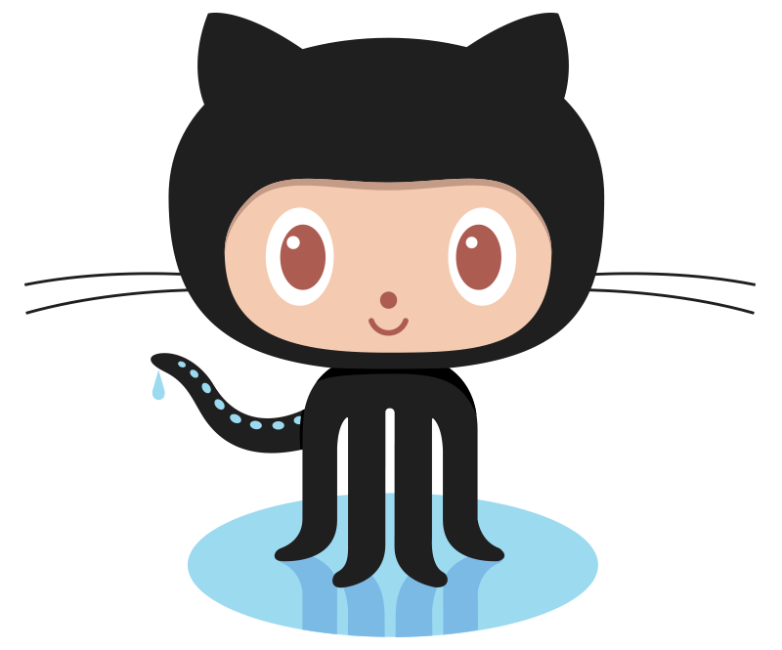
Repositories
Most well known and used is GitHub, based on the Git system designed for managing the Linux kernel code.
GitHub also allows you to build your own website or blog. Masses of space (though they generally don’t like big binary files like video or commercial file formats).
Notes:
GitHub’s logo is the “OctoCat”.
Yes, Git is named after “Git” the insult. Unfortunately.
Logo copyright statements:
https://github.com/logos

Slide 57
Further info
Documentation on the standard library is at:
https://docs.python.org/3/library/index.html
The Python Enhancement Proposals (PEPs):
https://www.python.org/dev/peps/
The language reference is at:
https://docs.python.org/3/reference/index.html
The official tutorial is at:
https://docs.python.org/3/tutorial/index.html
but it assumes experience in other languages.
Python Wiki:
https://wiki.python.org/moin/

Slide 58
This Lecture
Introduction
Core programming:
What is programming?
History of languages and Python
Pythonic goodness: The Python Philosophy
Running Python
Thinking computationally: How to Code / Algorithms
Real World Coding: Open Source Software

Slide 59
Practical
Run our first Python program.
Open and try Spyder.
Open and try Jupyter.
Start building an online portfolio with GitHub pages.

