Slide 1
Programming for Geographical Information Analysis: Core Skills
Coding for Real

Slide 2
This lecture
Structuring code
Design patterns
Testing
The development process
Programming culture
Stuff not covered

Slide 3
Structure
We saw early on the importance of algorithms, but what about structuring our code?
What's the best way to structure a larger project made of several files?

Slide 4
Structure we’ve seen
Clauses
Blocks (Functions; Classes)
Exception handling
Modules
Packages
How do we judge where code should go?

Slide 5
Coupling and Cohesion
Good OO design calls for LOOSE coupling and HIGH cohesion.
Coupling is the degree to which two classes 'know about each other'.
Just uses unobfuscated methods: low coupling.
Uses internal code, e.g. internal variables: high coupling.
Cohesion is the purpose of the class. Is it well focused?
We can talk about accessing a class through its methods that haven't been mangled: its "interface".

Slide 6
Coupling
Close coupling causes issues for code maintenance.
  Enhancement or bug fixes to a class should be possible without impacting the interface of methods it presents.
  Assumption is that changes will not impact anywhere else, why should it if the interface has not changed.
  A close coupled class means if part of the code changed, the alteration has an undetected impact.
Close coupling limits code reuse because you can’t just separate off one class.

Slide 7
Cohesion
Classes and packages with high cohesion have a well defined purpose.
They are:
  Easier to maintain.
  Less likely to require frequent changes.
  Easier to reuse in multiple projects / applications.
  Tend to be simpler to follow for other developers.
  Generally have a well defined interface.

Slide 8
High Cohesion Loose Coupling
Remember when designing a class or package:
  Define the purpose and don't let that creep.
  Keep the inner variables of the class protected.
  Think about how you want other classes to interact with this class and define its interface accordingly.
  Ask yourself, how easy would this class or package be to reuse in another project?

Slide 9
Main script
Ideally this just wants to be class method calls, or, at worse, function calls. These should describe the story of the code, for example:
io = IO()
processor = Processor()
data = io.read_data("data.txt")
new_data = processor.process(data)
io.write_data(new_data, "new_data.txt")
This is "Self-documenting code"; it needs no comments to tell the story.

Slide 10
Structure we’ve seen
Clauses
Blocks (Functions; Classes)
Exception handling
Modules
Packages
GUIs
Others we haven’t: threads/concurrency, parallelisation, other programs.

Slide 11
Getting processor time
Usually a program will take over the processor once and run through the code a line at a time in one go.
However, you can force the processor to split up and run several copies of the same bit of code.
Each runs in its own processor “thread” of execution.
For example, you might want a web server to have one thread for each person accessing files so you can send the right file back to the right person, even though lots of requests are being made simultaneously.

Slide 12
Threads
Generally managed by the threading library:
https://docs.python.org/3/library/threading.html
Issues generally centre on shared resources / thread-to-thread communication.
Nice starting tutorial at:
https://en.wikibooks.org/wiki/Python_Programming/Threading

Slide 13
Efficiency
In many languages, threading a program will allow chunks of it to run on separate processor units in the computer.
However, the standard CPython implementation allows only one thread (the thread holding the Global Interpreter Lock or GIL) at a time to access objects.
This means multi-threaded programs aren't generally more efficient, unless they are slowed by elements outside the GIL system, such as I/O or processing done in some libraries like numpy.
For details, see:
https://wiki.python.org/moin/GlobalInterpreterLock

Slide 14
Parallel Supercomputing
Split up a program so it runs on multiple computers ("parallelize" or "parallel program" it).
For example, each computer does the calculation for a different geographical area.
A good starting point are the books on the reading list.

Slide 15
Starting other programs
To run other programs and read and write from and to them, use the subprocess library:
https://docs.python.org/3/library/subprocess.html
import subprocess
program = subprocess.Popen("program", stdin=subprocess.PIPE, universal_newlines=True)
program.stdin.write("Hello World") # Not on Windows unless program reads stdin.

Slide 16
Structure we’ve seen
Clauses
Blocks (Functions; Classes)
Exception handling
Modules
Packages
Threads / Parallelisation
Other programs
GUIs
Where do we get advice?

Slide 17
This lecture
Structuring code
Design patterns
Testing
The development process
Programming culture
Stuff not covered

Slide 18
Design Patterns
"Design Patterns" or, more usually just "Patterns", are standard ways of solving a software problem that people come across again and again. They aren’t specific to Python, or any other language.
They save us having to reinvent solutions.
The most influential book in the field was Design Patterns – Elements of Reusable Software by the “Gang of Four” Gamma, Helm, Johnson and Vlissides (1995).

Slide 19
The Gang of Four Patterns
They gave 23 patterns with C examples.
Creational Patterns – classes to make stuff.
  The Factory, Abstract Factory, Singleton, Builder, and Prototype.
Structural Patterns – software architecture.
  The Adapter, Bridge, Composite, Decorator, Façade, Flyweight and Proxy.
Behavioural Patterns – which classes do what.
  The Chain of Responsibility, Command, Interpreter, Iterator, Mediator, Memento, Observer, State, Strategy, Template, and Visitor.

Slide 20
Patterns we’ve seen
Iterator
Decorators (wrappers, not Python decorators)
Factory (class that quietly produces the right subclass of something)

Slide 21
Why Use Patterns?
Industry standard methods of doing something, therefore other programmers will understand your code.
They encapsulate solutions so you can get on with more tricky things.
They’ll give you a deeper understanding of why Python is the way it is.
They’re the advice of top experts with years of experience – they’ll teach you a lot about good Object Orientated software design.

Slide 22

Book
This book will certainly help you think like an OOProgrammer. However, the examples are written in Java (shouldn't be too bad to convert).
A good starting point for Python is Andrei Boyanov's post "Python Design Patterns: For Sleek And Fashionable Code" which gives a realistic overview of which patterns are needed in Python
https://www.toptal.com/python/python-design-patterns

Slide 23
Summary
Good Object Orientated code structure encourages robust and reusable software.
Read up on patterns: they’ll teach you about good program style, and help solve major issues.

Slide 24
This lecture
Structuring code
Design patterns
Testing
The development process
Programming culture
Stuff not covered

Slide 25
Unit Testing
A way to ensure that methods have the desired ‘behaviour’
  Decide on behaviour
  Write tests
  Write code to satisfy tests
Time consuming
Produces robust code
Future maintenance is easier
Notes:
When designing a method we should decide on the behaviour the method should display in both correct functionality and also in unexpected circumstances.
Once behaviour has been designed tests are designed and written to test that behaviour under particular conditions.
Only when the complete test suite is finished do you start to write the code to satisfy the tests.
The benefits of this approach is the robust nature of the code and the ease of making future changes. It also works well with continuous integration as a development process because it is immediately obvious when a code change ‘breaks’ a build.
The main drawback to this approach is the upfront time and effort in designing and developing the tests. This tends to be about 75% of development time and can be a significant financial overhead.

Slide 26
Other tests
Stress testing
Alpha/Beta releases
Usability
Regression testing
Software testing

Slide 27
Summary
Good code structure centres on building to interfaces: are the inputs and outputs to methods and classes reliable, and do they respond well if things go wrong.
Get this right, and you’ll minimise bugs.
Unit testing formalises this.
However, also test usability and go through alpha and beta test releases.

Slide 28
This lecture
Structuring code
Design patterns
Testing
The development process
Programming culture
Stuff not covered

Slide 29
Development Processes
Considerable debate exists around how best to manage software development.
Most proposed ‘processes’ have a parentage in the ‘Waterfall Model’; roughly:
Requirements
Design
Coding
Testing
Installation
Maintenance
Like a good many parents who try their best, its children have nothing good to say about it.

Slide 30
Critiques
Largely focused on the fact that software was never fully completed, but always being re-visited at different scales. In particular, it is unhelpful not to go back to users and consult once a basic system is drafted.
Popular alterative is Iterative and Incremental development, where, after initial Requirements are outlined, there is a cycling through the development units, taking important and high-risk elements first.
This is sometimes combined with the Waterfall model as the ‘Iterfall model’. Experience suggests the broad sweep of this matches with single coders's natural inclinations.

Slide 31
New processes
Based on the Iterative and avoiding the over-management of the Waterfall method: Agile software development processes include:
Rational Unified Process
Extreme Programming
Kanban and SCRUM for communication
Short development sprints
Continuous Integration
Main issue is to concentrate on user needs.
Notes:
Kanban and SCRUM are widely used for communication between large development teams. Taken from process design research:
Kanban Toyota – Japanese for ticket, have swim lanes on a board and the aim is to move tickets from a backlog across a board as quickly as possible in an accepted area. Every 2 weeks or so a ‘Product Owner’ will either accept or reject development progress against a ticket.
SCRUM is a way of making sure the whole development team knows what is going on, normally a ten minute stand up meeting around a Kanban board highlighting progress, issues and blockers so that everyone in the team is aware if they are needed to progress a particular ticket.
Key to most of these development techniques is a short development sprint which puts the user in the driving seat and ensures critical must-have development is completed first. It also provides continuous feedback for the development team.
Continuous integration ensures that all developers integrate their code, rather than having two developers working in isolation producing modules that will not work together.

Slide 32
UML
An intrinsic part of the development process.
From: Use Cases
Through: Class Diagrams
To: Activity Diagrams

Slide 33
Initial consultation
User consultation is a vital part of development.
Users should be consulted first. If the users don’t like your software, you’re sunk.
Find out what people expect to get from the system before adding extras. If it helps draw UML User Case diagrams.
User Cases can be used to break a large project up into smaller bits. Do the most difficult important bits first if possible!
However, watch for "feature creep".
Notes:
User consultation should be at the center of the process, as its driving force.

Slide 34
Usability testing
When you think you have a bit users are interested in up and running, test its ‘usability’.
Sit your users down with the software and get them to play with it.
It’s useful to set them common tasks to do.
See how long they take to do stuff, and what they do that’s unexpected. Some companies use mirrored windows.
Remember, users don’t make mistakes - it’s your fault if you lead them the wrong way!

Slide 35
Development stages
Refining user requirements.
Dividing code (e.g. by important high-risk functions first).
Keeping users informed.
Development.
Usability testing.
Bug hunting.
Refactoring.
Alpha and Beta testing.
Releases.
Deciding on the next set of functions to tackle.
Increasingly releases tackle a few functions on a short timescale rather than major releases with a longer gap ("Release Early and Release Often": “RERO”).

Slide 36
Summary
Always design assuming the user…
  Will experiment rather than read the manual.
  Will base these experiments on what they expect to find.
Always base the software design around what the user wants.
Always test the user’s opinions and the usability as you develop.

Slide 37
Licensing
Different options on a spectrum:
Open source.
Maintenance contracts.
Open standards.
Community built.
Freeware.
Adware.
Commercial.

Slide 38
Installing
Broadly speaking, you have five levels of distribution:
Send them the Python files to run / package as a zip.
Add a .bat or .sh file to run the files.
Produce a proper distribution with a setup.py file to install at the command line.
Upload to PyPi and configure for online installation through pip.
Build a binary for a specific operating system.

Slide 39
Distributing and installing
The starting point for either of the two more complicated options is:
https://packaging.python.org/
Chances are, this is all you'll need.
For more complicated projects, there's:
https://setuptools.readthedocs.io/en/latest/
Which works with:
https://docs.python.org/3/library/distribution.html
See also
https://docs.python.org/3/distributing/index.html

Slide 40
Executables
If you actually want to produce compiled versions for a specific operating system, see:
https://docs.python.org/3/tutorial/appendix.html#executable-python-scripts
https://docs.python.org/3/faq/programming.html#how-can-i-create-a-stand-alone-binary-from-a-python-script

Slide 41
Internationalisation
You may also want to consider internationalising your code (for example, responding to different locations with different interface text). The starting point for this is:
https://docs.python.org/3/library/gettext.html#internationalizing-your-programs-and-modules
https://docs.python.org/3/library/locale.html

Slide 42
Summary
Getting a strong project outline at the start will help you resource a project, as will having a clear delimitation of coding activities.
However, project frameworks need to have flexibility built in to cope with project evolution. Start with an ordered list of functionalities, but consult with users frequently.
Look into formal software development processes if you have to work with teams.

Slide 43
This lecture
Structuring code
Design patterns
Testing
The development process
Programming culture
Stuff not covered

Slide 44

Computer Ethics
Rapidly growing field:
Traditional elements:
Privacy and data protection
Copyright and Piracy
Software supplier responsibilities
Newer:
Big Data use
Robotic ethics
Control by computers
Integrating computers into our worldview
A good starting point for the newer stuff is Floridi et al.:

Slide 45
Women in computing
In the war, approximately 75% of employees at Bletchley Park were women, and many worked with the computational machines, or were human 'computers'.
In the US in 1984, 37.1% computing degrees were to women; by 2010-11 it was 12%.
In Britain in 2014 only 13% of computing students were women, and 3% of IT and computing engineers.
A case study in the issues around gender and computing includes the fallout from PyCon Santa Clara in 2013 in which a overheard joke resulted in both perpetrator and complainant being fired from their jobs.
Notes:
https://en.wikipedia.org/wiki/Women_in_Bletchley_Park
https://www.gadgette.com/2016/04/15/women-in-tech-history-bletchley-park/
https://www.computerworlduk.com/careers/women-studying-computer-science-in-uk-universities-is-declining-3621040/
https://en.wikipedia.org/wiki/Gender_disparity_in_computing
https://en.wikipedia.org/wiki/BCSWomen
https://arstechnica.com/tech-policy/2013/03/how-dongle-jokes-got-two-people-fired-and-led-to-ddos-attacks/

Slide 46
Women in computing
Big push at school level to address this.
Organisations like Code First: Girls are looking for volunteer trainers.
http://www.codefirstgirls.org.uk/
BCSWomen Specialist Group of the British Computer Society push for cultural and employment change
http://www.bcs.org/category/8630
Notes:
https://en.wikipedia.org/wiki/Women_in_Bletchley_Park
https://www.gadgette.com/2016/04/15/women-in-tech-history-bletchley-park/
https://www.computerworlduk.com/careers/women-studying-computer-science-in-uk-universities-is-declining-3621040/
https://en.wikipedia.org/wiki/Gender_disparity_in_computing
https://en.wikipedia.org/wiki/BCSWomen

Slide 47
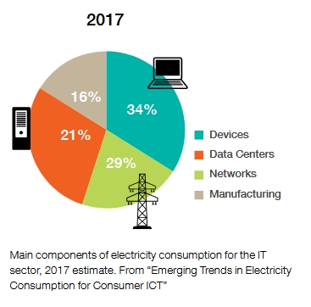
Environmental impact
Electricity usage (hardware; air conditioning; data transmission).
Production of hardware (standard raw materials; rare earth materials; power).
Waste disposal.
Hard to calculate total resource uses.
In general, the larger cloud based companies are trying to move to 100% renewables which also makes total unrenewable energy hard to estimate.
Greenpeace place the total energy value between 7 and 12% of total electricity usage.
Notes:
Emerging trends in electricity consumption for consumer ITC.
http://vmserver14.nuigalway.ie/xmlui/handle/10379/3563

Slide 48
What can we do as coders?
Make efficient software that runs fast.
Minimise code size so it runs on smaller computers.
Reduce video download where possible.
Encourage the use of offline solutions but don't offload on to printing.
Train people so they solve problems quicker with less resources.
Turn off computers when not used (or put into efficient sleep mode if not).
Use cloud suppliers with a renewable energy policy.

Slide 49
Good sources
The "Dirty Bits" project blog of Nathan Ensmenger (Indiana University):
http://homes.soic.indiana.edu/nensmeng/enviro-compute/index.html
http://homes.soic.indiana.edu/nensmeng/bio.html
Greenpeace:
http://www.greenpeace.org/usa/global-warming/click-clean/
Other:
https://www.thegreengrid.org/ (industry group)
Notes:
Ingrid Burrington (2015) The Environmental Toll of a Netflix Binge. The Atlantic [online] https://www.theatlantic.com/technology/archive/2015/12/there-are-no-clean-clouds/420744/ Accessed 1/10/2017

Slide 50
This lecture
Structuring code
Design patterns
Testing
The development process
Programming culture
Stuff not covered

Slide 51
Special types
Objects and operators built into the language but used only in modules:
Ellipsis (also “…”): used chiefly in slices in modules like numpy.
@ Used as an operator in some maths packages.

Slide 52
Type annotations (only at class and module level)
def ascii_char(num: int) -> str:
return chr(int)
These give the appearance of manifest typing, but can be checked only by outside code-checking software.
Notes:
https://www.python.org/dev/peps/pep-0484/

Slide 53
Efficiency
https://docs.python.org/3/faq/programming.html#my-program-is-too-slow-how-do-i-speed-it-up
https://wiki.python.org/moin/PythonSpeed/PerformanceTipsp

Slide 54
Python 2 to 3
Converting 2 to 3:
https://docs.python.org/3/library/2to3.html
If you need a particular python version or library, use a virtual environment:
https://docs.python.org/3/tutorial/venv.html
or Conda:
http://www.wilsonsayreslab.org/blog/2015/10/26/managing-multiple-python-environments-using-anaconda
https://conda.io/docs/user-guide/tasks/manage-environments.html

Slide 55
Other languages
C++ / C / Java / JavaScript / C# / VB.Net / Scala: "C" Family. Broadly speaking more formal languages than Python, with more restrictions to prevent errors including manifest typing. Typical Java:
import java.util.Vector;
public static void main (String args[]) {
Vector v = new Vector();
double sum = 0;
for (int i = 0; i < 10; i++) {
double a = Math.random()*10.0;
sum += a
v.add(a)
}
System.out.println("sum = " + sum);
}

Slide 56
Other useful languages
(In vague order of usefulness)
JavaScript (Web programming)
PHP (Backend web processing)
Java (General programming; Android)
C++ (General programming; joining the godhead)
C (Hardware programming)
R (Statistics)
VBA (Visual Basic for Applications)
VB.Net / C# (Windows programming)
Perl (Largely superseded by PHP)
Swift / Objective C (Mac programming languages)
Ruby (More OOP Python-like language)
MatLab (Maths processing)
Fortran (frequently used for mathematically intense science)
(…though there's no good reason for it)
Prolog (Logic programming)
Groovy / Scala (Python-like language / Java-like language that run on the Java platform)
Lisp / Haskell (Semi-historical lambda-based/functional languages)
Smalltalk (Semi-historical OOP language)

Slide 57
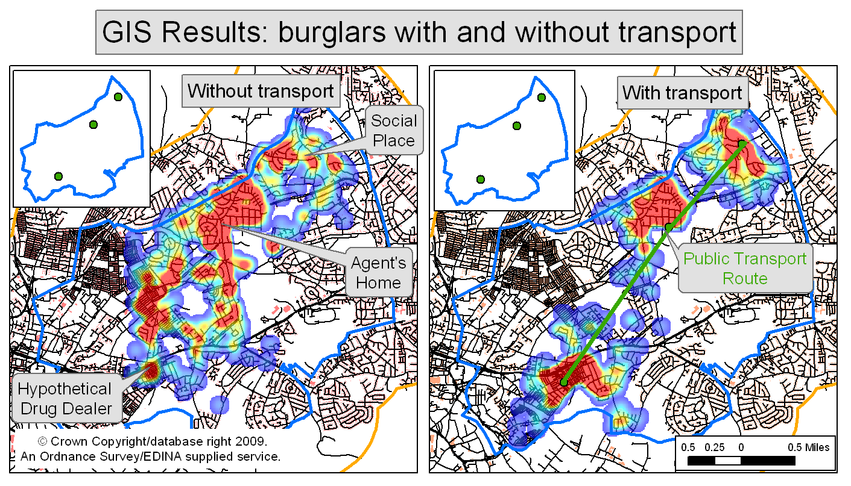
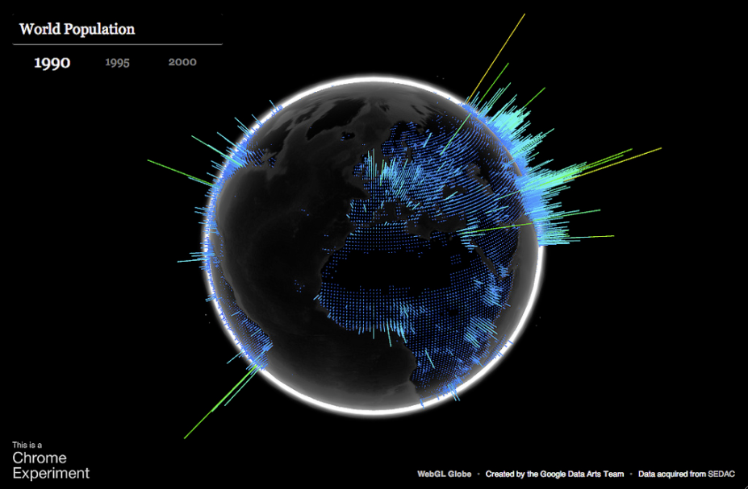
Advanced course: “advanced” as in “progress”, not “difficulty”.
Programming ArcGIS
Database connectivity
Using analysis libraries
Visualising data
Supercomputing
Building an artificial intelligence for predictive modelling.
Notes:
http://www.ditii.com/2011/05/05/visualizing-geographic-and-google-search-data-with-the-webgl-globe-and-search-globe/

Slide 58
Further information
The course website for subjects we’ve covered:
  All the lectures.
  Examples, practice pieces, and useful links.

Slide 59
Other info
https://docs.python.org/3/howto/index.html
See also recipes in docs
http://www.geog.leeds.ac.uk/courses/computing/

Slide 60
Main thing
Practice!

