Slide 1
Modelling
Dr Andy Evans
Notes:
In this lecture we'll look at modelling.

Slide 2
  Modelling
  Examples:
  Cellular Automata
  Agent-based models
  The modelling process

Slide 3
What are models?
Hypothetical or Theoretical statement of how a system works, ignoring “accidental” influences.
Physical recreation of the same using scaled objects and applying the same processes.
Computer recreation of the same using virtual objects and applying virtual processes.
Notes:
The first thing we need to clear up is what scientists mean when they say they have a model of the world. ‘Model’ can encompass a large number of things, from very abstract ‘this is how we think this system hangs together’, through physical recreations of the world using simplified objects (for example, modelling avalanches with ping-pong balls), to complicated computer models of the entire globe (or larger). Here, when we say “model” we mean the latter type of model, but even this is a very broad set of representations.

Slide 4
Why model?
Prediction:
  Future
  Past (backcasting)
Testing our knowledge is complete.
    Emergence (how simple processes give us complicated patterns)
Holding our knowledge in a framework.
Notes:
The most obvious reason for modelling is prediction, usually, though not always, of the future. This is a fine reason, but most modelling system aren’t yet up to producing good models of the future (whatever scientists may say). However, there are other reasons for modelling. One is to see how the system works currently. As we don’t have brains the size of small planets, we can’t see the ramification of simple elements of systems. Quite often, systems display emergence – simple processes give us very complicated results, that can appear to us as patterns we weren’t expecting (either very complicated ones, or very simple ones). It is very hard for us to track the causes of things – having a model that reproduces system-level behaviour from smaller scale behaviour at least gives us confidence we’ve captured the system well and gives us an experimental sandbox which we can play with the system inside. The other reason is that models give us a way of holding and manipulating complicated information about the world.

Slide 5
Virtual model types
Analytical models
Mathematical equation.
Logical
Logic models; fuzzy logic; etc.
Iterative models
Finite element models; agent-based models
Statistical models
Regression equations; Bayesian nets; etc.
Notes:
Model form is classically driven by the tractability of the questions asked against mathematical techniques.
If the problem can be solved by a single, solvable mathematical equation, great! We have a “analytical” model solution. An example might be the distance between to points in geographical space. We know the single analytical solution to this (Pythagoras’ equation). We can construct quite complex sets of mathematical relationships, and can do the same with logical statements.
However, some systems don’t have an analytical solution, for example, because the conditions at one point in time affect the state of the system in the next point in time (though some of these do have analytical solutions, most don’t), or because there is some random element injected into the system as it evolves. These need iterative solutions, where the system evolves over a series of steps. These often represent steps in time, but they don’t have to – for example, they may represent the evolution of the system towards a form that is like we’d expect an analytical solution to look like.
Finally, some systems may be too hard to understand or include so much randomness, that the only way to understand them is to represent them statistically and utilise the probabilities that they will be in any given state.

Slide 6
Verisimilitude
Abstract models:
Simplified objects
Subset of processes
Thought experiments
Verify that core processes are appropriate
Alternative is to try and model everything accurately.
Is this possible in systems that don’t have closure?
Notes:
One of the first questions we need to ask when thinking about models is the level of abstraction. We can run models with a simplified set of processes, or subset of processes, as though experiments, to see what would happen if we alter very simple axioms of a system. Or we can run with a fuller set of processes, but with a simplified set of objects (like a simple, abstract grid geography). Both are useful in the verification stage of model development.
Verification is the process of checking that model logic is correct. With very simple models this can be done using logic/mathematics, but for our kinds of model this is pretty much impossible at the moment. We therefore have to look at how a model works at a simple level and on a simple geography.
Finally, we can try and model the full system of maximum complication. People have different feelings about whether this is possible, as most real world systems are not “closed” – that is, it is hard to say which variables are important, as lots of things accidentally affect systems (what though, do we mean by ‘accidentally’? When does an accident become and important influence?).
On models as though experiments, see:
Di Paolo, E. A., Noble, J. and Bullock, S. (2000) Simulation models as opaque thought experiments. In: Seventh International Conference on Artificial Life, pp. 497-506, MIT Press, Cambridge, MA. http://eprints.ecs.soton.ac.uk/11455/

Slide 7
Model scale
Aggregate models
  Regression
Disaggregate models
  Range from area processing to individual-based
Individual elements
  Finite-element models
  Agent-based models
Notes:
The next thing to consider is scale. We can range from the very aggregate to the very detailed.

Slide 8
Individual level modelling
Aggregate representation was good when it all had to be done in our heads.
Now we have power for individual representation, i.e. as we understand the world.
We struggle to understand emergence – how simple rules of individuals end up in complicated system behaviour.
Notes:
For over two and a half thousand years, we’ve built our models in our heads, and maths has developed to make this easy. However, now, for the first time, we can do things better.
Of course, just because individual-level models match our understanding of the world, and are therefore clearer, it may not be the best representation.

Slide 9
Emergence
May seem subjective (how to do recognise “complicated”, why worry about other scales?)
But subjective aggregate elements have a big effect (e.g. inflation rates affect interest rates)
Systems of small scale elements that combine to make large scale systems in unclear ways are called complex.
Individual-level models are a useful way of exploring complexity.

Slide 10
  Modelling
  Examples:
  Cellular Automata
  Agent-based models
  The modelling process
Notes:
Individual-level models are a) often the best way to model systems; b) the latest and greatest thing in modelling; c) relatively easy to understand. Given this, let's look at two types of individual-based model, CAs and ABMs, as examples. This will help when we come to look more generally at the modelling process later.

Slide 11
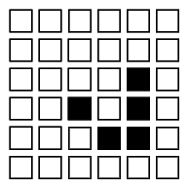
Cellular Automata (CA)
Can be used for simulation but much much more.
Essentially a grid of cells which may be different states dependant on the conditions around them.
Each cell has a rule base determining how it reacts.
For example,
  if a cell has less than two neighbours it dies,
  if it has more than two it reproduces and the neighbouring cells come alive.
Can be used for searches, modelling crowds, ecosystems etc.

Slide 12
One dimensional CA
Simplest CA: a line of cells.
Each cell has a number of states it can be in, depending on the state of its neighbours and itself at the last time step.
Usually drawn as a line of cells, with each line below each other being another time step.
Simple rules can generate complex emergent behaviour.
Notes:
At this point you should do the 1D CA exercise on the handout associated with this lecture.

Slide 13
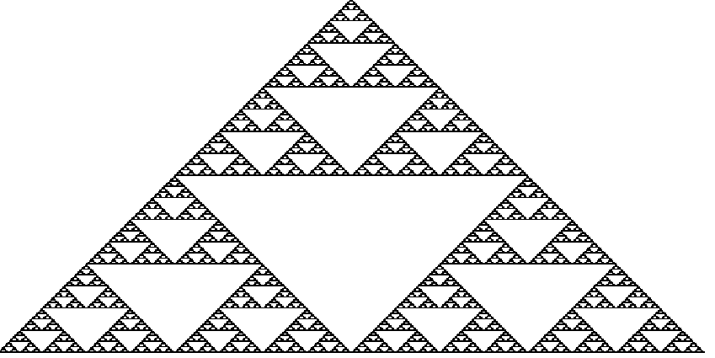
Emergence
From the simple rule: if both neighbours the same as you, go white else go black.
Notes:
The figure above (which is that generated by the 1D CA on the handout) is pretty much identical to a fractal form called the “Sierpinski Gasket”. Another way you can form the shape is by taking a triangle and replacing all the corners with triangles a third the size, and repeating the operation.
http://www.cut-the-knot.com/ctk/Sierpinski.html
The generation of this complex shape from a simple rule seems unlikely, but this kind of development is characteristic of a number of simple systems.
The figure is from the excellent book The Computational Beauty of Nature, by Gary William Flake.
http://www.amazon.co.uk/exec/obidos/ASIN/0262561271/
http://www-mitpress.mit.edu/books/FLAOH/cbnhtml/
The book covers much of the material covered in this course (fractals, AI, neural nets, CAs, Genetic Algorithms), but isn’t recommended as a “light read”. If you’re prepared to put in the hours on the (actually very basic) maths, it covers some astonishing ground, and you don’t actually need to know anything before you start as even the maths is explained.
If you can’t read the notice on the bottom it says “Figure from The Computational Beauty of Nature: Computer Explorations of Fractals, Chaos, Complex Systems, and Adaptation. Copyright © 1998-2000 by Gary William Flake. All rights reserved. Permission granted for educational, scholarly, and personal use provided that this notice remains intact and unaltered. No part of this work may be reproduced for commercial purposes without prior permission from the MIT Press.”

Slide 14
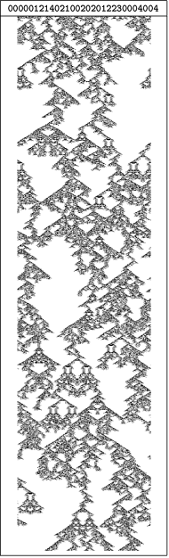
One dimensional CA
Steven Wolfram classified CAs into…
Class 1 always end in the same stable state.
Class 2 settle into repeat patterns.
Class 3 chaotic / white noise patterns.
Class 4 complex patterns of near repetition with movement.
Shows the wide range of natural patterns that could develop from simple rules.
Notes:
Note that just because a natural pattern looks like one generated from simple rules, it doesn’t follow that it is. To make that assumption would be a bit like saying “I own two pot plants, and there are two people next door: because they have the same number they must be caused by the same thing”.
Again, if you can’t read the notice on the bottom it says “Figure from The Computational Beauty of Nature: Computer Explorations of Fractals, Chaos, Complex Systems, and Adaptation. Copyright © 1998-2000 by Gary William Flake. All rights reserved. Permission granted for educational, scholarly, and personal use provided that this notice remains intact and unaltered. No part of this work may be reproduced for commercial purposes without prior permission from the MIT Press.”

Slide 15
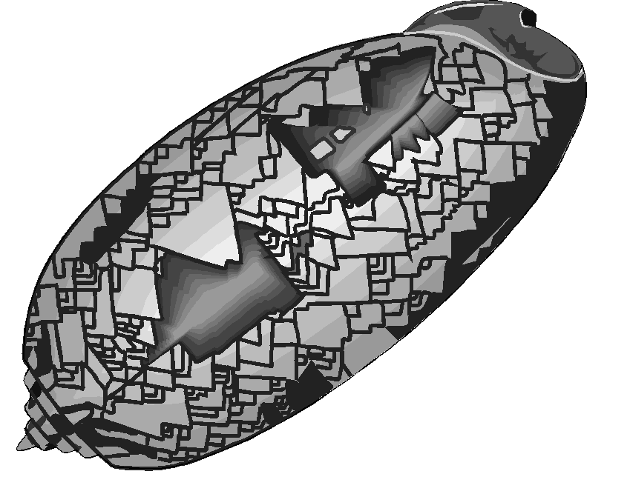
One dimensional CA uses
While they show that complex patterns can emerge from simple rules, this isn’t necessarily happening.
However, we can use them to see if our simple rules develop complex patterns, and how resistant they are to perturbations to the starting conditions.
E.g. crowd flow, street development, river networks.
Notes:
Notice how the shell in Gary Flake’s picture above looks somewhat like the 1D CA problem you worked through. Can we say the same processes are working at a chemical level to produce this pattern? Well, no, but we can at least say they might be.
As with previous slides, the picture carries the following notice: “Figure from The Computational Beauty of Nature: Computer Explorations of Fractals, Chaos, Complex Systems, and Adaptation. Copyright © 1998-2000 by Gary William Flake. All rights reserved. Permission granted for educational, scholarly, and personal use provided that this notice remains intact and unaltered. No part of this work may be reproduced for commercial purposes without prior permission from the MIT Press.”

Slide 16
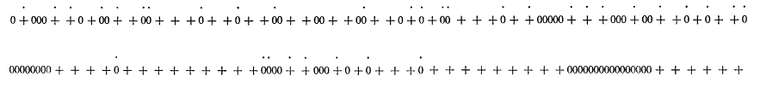
The Schelling Model
Thomas Schelling (Harvard) looked at racial segregation using a 1D CA.
Found that even if people were willing to live in areas made up of 50% other skin colours, segregation would develop.
1D CA. Cells either + or 0 (“black” or “white”).
If neighbourhood > 50% of another colour, move to nearest area this isn’t true.
Notes:
Models of Segregation (in Strategic Theory and Its Applications, Thomas C. Schelling (1969) The American Economic Review, Vol. 59, No. 2, Papers and Proceedings of the Eighty-first Annual Meeting of the American Economic Association. (May, 1969), pp. 488-493.
http://links.jstor.org/sici?sici=0002-8282%28196905%2959%3A2%3C488%3AMOS%3E2.0.CO%3B2-S
Schelling felt that 50% was a mild preference. Of course, now we might thing that no preference is 'mild'.

Slide 17
Two + dimensional CA
Real power in geography comes from having two dimensions.
Grid of cells that interact.
Complex behaviour emerges that includes movement like a multi-cellular organism.
John von Neumann (1966) came up with the idea.
John Conway (late 60’s) “Game of Life” simplified it and gave it purpose.
Notes:
The classic paper in CA is…
Neumann von, John (1966), Theory of Self-Reproducing Automata, University of Illionois Press, Champain, IL
You can find a summary at…
http://cba.mit.edu/events/03.11.ASE/docs/VonNeumann.pdf
You can find an explaination of Conway’s Game of Life, with animations, at…
http://en.wikipedia.org/wiki/Conway%27s_Game_of_Life
At this point you should have a go at the Game of Life experiments on the handout associated with this lecture.

Slide 18
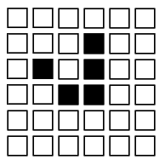
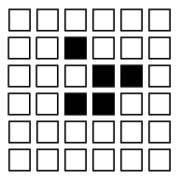
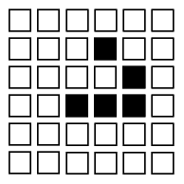
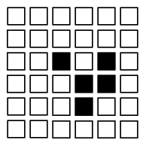
The Game of Life
Game of Life
If dead, and alive neighbours = 3 → Alive
If alive, and alive neighbours < 2 → Die of loneliness
If alive and alive neighbours > 3 → Die of overcrowding
Otherwise, stays as it is.
Notes:
Look at this slide as a presentation to see the animation.
You can run different creatures here… https://playgameoflife.com/
This site also gives the rules, thus…
For a space that is 'populated':
Each cell with one or no neighbors dies, as if by loneliness.
Each cell with four or more neighbors dies, as if by overpopulation.
Each cell with two or three neighbors survives.
For a space that is 'empty' or 'unpopulated'
Each cell with three neighbors becomes populated.
There are some examples on the handout you can try.

Slide 19
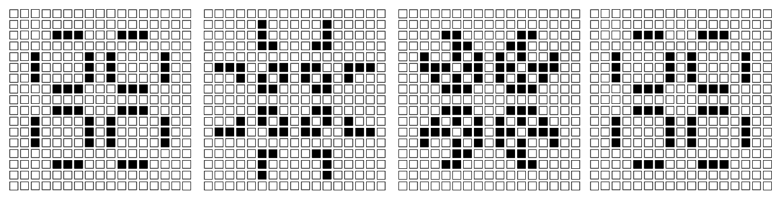
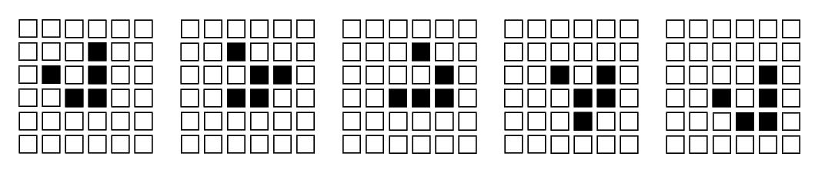
Two dimensional Game of Life CA
In two dimensions, over time, some CA cell combinations form moving or periodically repeating multi-cellular organisms.
Notes:
If you did the handout experiments, you’ll realise that some CA combinations stay the same over time, some are periodic, and some move (in that order on the handout).
The top example shows a figure known as a “glider”. It moves one square diagonally every five time steps. The figure below is an example of a periodic CA combination. It returns to its starting state after three moves.
A great CA program which can be used to make the Game of Life is “Boppers” by Rudy Rucker. You can download a free version at…
http://www.mathcs.sjsu.edu/faculty/rucker/boppers.htm
Again, if you can’t read the caption, it says: “Figure from The Computational Beauty of Nature: Computer Explorations of Fractals, Chaos, Complex Systems, and Adaptation. Copyright © 1998-2000 by Gary William Flake. All rights reserved. Permission granted for educational, scholarly, and personal use provided that this notice remains intact and unaltered. No part of this work may be reproduced for commercial purposes without prior permission from the MIT Press.” It’s pretty super nice of them to allow us poor academics to use them, so I’m glad to draw attention to it.

Slide 20
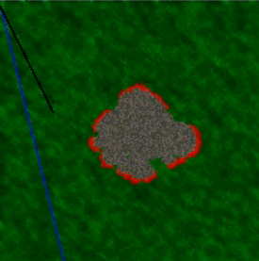
Classic two dimensional CA uses
Modelling forest fires.
Modelling animal and plant systems.
Finding routes through mazes / landscapes etc.
Notes:
CAs can very simply be applied to some systems. A good example is forest fires. Each cell is given some fuel, and the rule is basically "if you're next to a fire, catch fire, and burn until the fuel is gone". Obviously you can also include probability to represent wind direction etc. Such models are used by real firefighters to predict fire spreads.
http://www.youtube.com/watch?v=RVcya3Tg5QU
CAs used in bush/forest fire research…
http://www.worldscinet.com/ijmpc/08/0802/S0129183197000175.html
The forest fire animation is originally from…
http://www.csc.fi/math_topics/Movies/CA.html

Slide 21
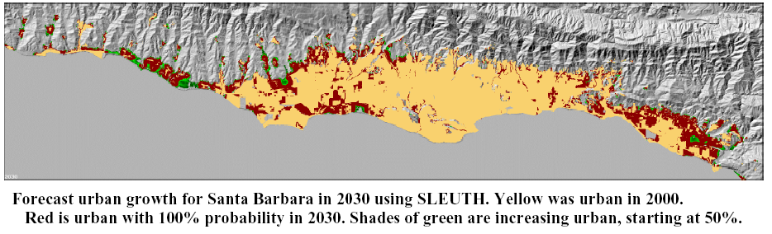
Other uses
SLEUTH Model of Keith Clarke (Santa Barbara).
Uses CA to investigate urban growth.
  Uses current urban areas, slope, transport, landuse, exclusions.
  Grows cities.
Used to study “what if?” scenarios.
Essentially a whole new way of looking at urban form.
Gigalopolis: http://www.ncgia.ucsb.edu/projects/gig/
Notes:
For a good introduction, overview and example of using CAs to model cities see…
Deal, B. and Fournier, D.F. ‘Ecological Urban Dynamics and Spatial Modeling’ Construction Engineering Research Laboratory , University of Illinois.
http://www.rehearsal.uiuc.edu/NSF/report/Sstarlogo2000.html
See also Batty, M. (1992) ‘Urban Modeling in Computer-Graphic and Geographic Information System Environments’ Environment and Planning, B, 19, p.678-708.
http://www.envplan.com/epb/abstracts/b19/b190663.html
In addition, ex-CASA researcher Paul Torrens has an online paper that outline some related work…
Working Paper 28: How Cellular Models of Urban Systems Work (1. Theory) - Paul M.Torrens
http://www.casa.ucl.ac.uk/how_ca_work.pdf

Slide 22
The lessons of CA
Perfect fidelity (representation) isn’t necessary to model the world.
Simple rules can lead to realistic and complex behaviour.
These can be quite robust – missing information can turn out to be irrelevant to generating patterns, and they can often survive changes (eg. forest fire models can skip a blank cell).
However, representing the world as fixed and movement by state-changes seems wrong. Why not move the objects?

Slide 23
Intelligent Agents
In part evolved from CAs.
Essentially free moving cells or programs that intelligently interact with each other and their environment.
One of the most important was Robert Axelrod’s 1980 cooperation competition.
Notes:
Why Axelrod’s competition was too early and stripped down to really fit into Intelligent Agents as such, it is a simple and early example of the way the technology was going. Axelrod set up a computational environment of competing or cooperating software programmes, and looked at which was most successful at gaining computational resources.

Slide 24
Axelrod’s competition
Imagine you’re an agent.
  If you cooperate with another agent, you get a moderate reward.
  Alternatively, if they’re suckered into cooperating with you, and you stab them in the back, you get a massive reward.
  However, if you both stab each other in the back, you get very little.
The competition invited people to put in agents with different behaviours to see who won after hundreds of rounds.
Consistently it was “Tit-for-tat”. Starts off cooperating but punishes backstabbers.
This competition was later run with intelligent 2D CAs.
Notes:
Axelrod’s competition is a repeated version of the Prisoner’s Dilemma. The idea is the people submitted several different kinds of behavioural rules, and the rules were allowed to fight it out over hundreds of runs of the Prisoner’s Dilemma to see which one came out best. It’s like seeing who would be most successful in an environment of lots of different types of people. It looks at whether we can “breed” social ethics simply by the interplay of competition and cooperation.

Slide 25
Coding an Agent
Agent Class
  Has an update method called each iteration, eg. move(), trade().
  Has a position.
  Has a list of all other agents and can get their position.
  Can communicate with other agents if necessary.
Environment Class
  Has environmental conditions.
  Calls the agents to update.
Agents might, for example, trade with their nearest neighbours.
Notes:
We've seen in the core course how to build a basic agent. The above summarises this. For an Artificial Life, they're surprisingly easy to build.

Slide 26
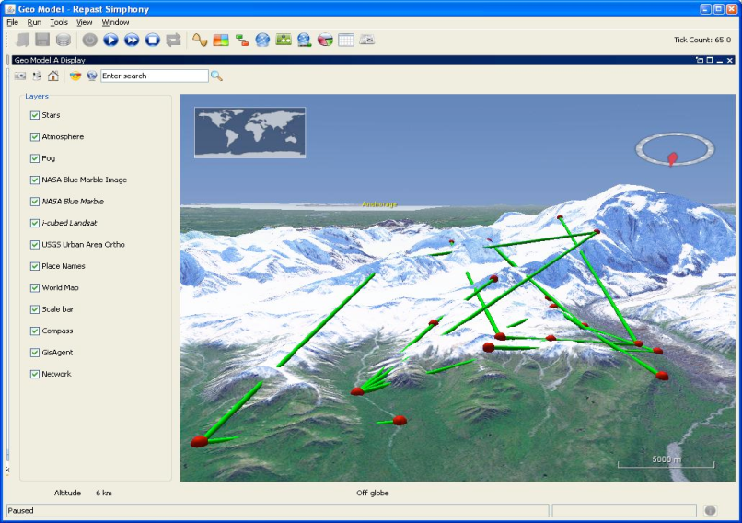
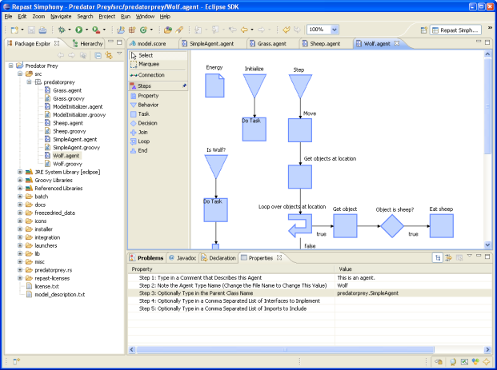
ABM Frameworks
What are they?
  Pieces of software to help people build ABMs
They often include:
A framework of basic agent types.
Environments with functions for dealing with different types of space (e.g. networks)
Schedulers (for timing agent actions)
Options for parameter sweeps and calibration.
Notes:
While we built ours from scratch, there are toolkits to help you build agent based systems.

Slide 27
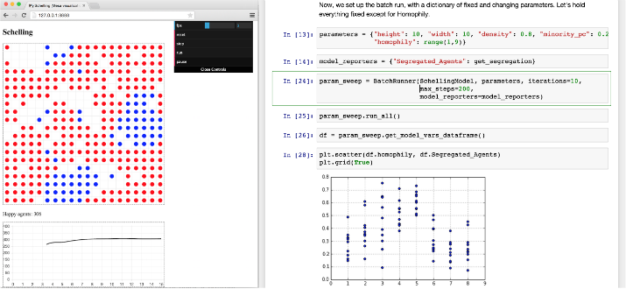
Commonly Used Platforms
It has to be said, most are in Java, which is a much clearer Object Oriented language (ABM map excellently onto Object Oriented languages):
Netlogo: http://ccl.northwestern.edu/netlogo/
Repast: http://repast.sourceforge.net/
MASON: http://cs.gmu.edu/~eclab/projects/mason/
However, for Python there is MESA:
https://pypi.python.org/pypi/Mesa/
In general the trade is ease
against flexibility.
Notes:
Generally speaking, you tend to find with frameworks that they provide nice functionality (for example, zoomable maps), but you trade that against having to build things their way, which often isn't how you'd want to do it (and can get in the way).
Railsback, Steven F., Steven L. Lytinen, and Stephen K. Jackson. 2006. Agent-based Simulation Platforms: Review and Development Recommendations. Simulation 82:9.
Tobias, Robert, and Carole Hofmann. 2004. Evaluation of free Java-libraries for social-scientific agent based simulation. Journal of Artificial Societies and Social Simulation 7(1). http://jasss.soc.surrey.ac.uk/7/1/6.html
http://www.swarm.org/wiki/Tools_for_Agent-Based_Modelling
The image is from the MESA website.

Slide 28
  The modelling process:
  Preparing to model
  Verification
  Calibration/Optimisation
  Thinking machines
  Validation
  Sensitivity testing and dealing with error
Notes:
So, let's look in a little more detail at the modelling process.

Slide 29
Preparing to model
What questions do we want answering?
Do we need something more open-ended?
Literature review
what do we know about fully?
what do we know about in sufficient detail?
what don't we know about (and does this matter?).
What can be simplified, for example, by replacing them with a single number or an AI?
Housing model: detail of mortgage rates’ variation with economy, vs. a time-series of data, vs. a single rate figure.
It depends on what you want from the model.
Notes:
The model needs to have a purpose (though this may not be answering a specific question).
It then needs to be built around this purpose, within the constraints of the data available.
KIS: Keep It Simple should be at least one drive, but not always at the expense of what Bruce Edmonds (Mancester) calls KID: Keep It Descriptive.
The balance of these two depends on the data and purpose – for example, for a housing model, one could tie the mortgage rate to an international economic model or just make it a static number – it depends what is important.

Slide 30
Data review
Outline the key elements of the system, and compare this with the data you need.
What data do you need, what can you do without, and what can't you do without?

Slide 31
Data review
Model initialisation
Data to get the model replicating reality as it runs.
Model calibration
Data to adjust variables to replicate reality.
Model validation
Data to check the model matches reality.
Model prediction
More initialisation data.
Notes:
You’re going to need as much data as you can get your hands on – enough to do all the above, ideally.
Lack of data is still a serious issue with geographical models.

Slide 32
Model design
If the model is possible given the data, draw it out in detail.
Where do you need detail.
Where might you need detail later?
Think particularly about the use of interfaces to ensure elements of the model are as loosely tied as possible.
Start general and work to the specifics. If you get the generalities flexible and right, the model will have a solid foundation for later.
Notes:
The first thing to do is get a large piece of paper, and try and draw out all the model components and the data they will need.

Slide 33
Model design
Agent
Step
Person
GoHome
GoElsewhere
Thug
Fight
Vehicle
Refuel
Notes:
By building up a set of generic classes and objects, you remove detail to only where it is needed.

Slide 34
  The modelling process:
  Preparing to model
  Verification
  Calibration/Optimisation
  Thinking machines
  Validation
  Sensitivity testing and dealing with error
Notes:
Once you have your model on paper, it is a process of "just" building it in Python. As long as you've carefully thought it through and got the object structure well worked out, this shouldn't be too complicated. You then have to show that your model is worthwhile, which is a more involved process.

Slide 35
Verification
Does your model represent the real system in a rigorous manner without logical inconsistencies that aren't dealt with?
For simpler models attempts have been made to automate some of this, but social and environmental models are waaaay too complicated.
Verification is therefore largely by checking rulesets with experts, testing with abstract environments, and through validation.
Notes:
For more on automatic verification see Wooldridge (2009) An Introduction to MultiAgent Systems.

Slide 36



Verification
Test on abstract environments.
Adjust variables to test model elements one at a time and in small subsets.
Do the patterns look reasonable?
Does causality between variables seem reasonable?
Notes:
The squares are from early model runs of Alison Heppenstall’s petrol model, testing basic price diffusion.
Heppenstall, A.J., Evans, A.J. and Birkin, M.H. (2005) 'A Hybrid Multi-Agent/Spatial Interaction Model System for Petrol Price Setting' Transactions in GIS, 9 (1), 35-51

Slide 37
Model runs
Is the system stable over time (if expected)?
Do you think the model will run to an equilibrium or fluctuate?
Is that equilibrium realistic or not?
Notes:
Heppenstall, A.J., Evans, A.J. and Birkin, M.H. (2006) 'Using Hybrid Agent-Based Systems to Model Spatially-Influenced Retail Markets' Journal of Artificial Societies and Social Simulation, 9, 3. http://jasss.soc.surrey.ac.uk/9/3/2.html
The figures show the petrol model in the above paper responding to different events. You can see that it generally returns to an equilibrium, but a different one, after perturbation.

Slide 38
  Preparing to model
  Verification
  Calibration/Optimisation
  Thinking machines
  Validation
  Sensitivity testing and dealing with error

Slide 39
Parameters
Ideally we’d have rules that determined behaviour:
If AGENT in CROWD move AWAY
But in most of these situations, we need numbers:
if DENSITY > 0.9 move 2 SQUARES NORTH
Indeed, in some cases, we’ll always need numbers:
if COST < 9000 and MONEY > 10000 buy CAR
Some you can get from data, some you can guess at, some you can’t.

Slide 40
Calibration
Models rarely work perfectly.
  Aggregate representations of individual objects.
  Missing model elements
  Error in data
If we want the model to match reality, we may need to adjust variables/model parameters to improve fit.
This process is calibration.
First we need to decide how we want to get to a realistic picture.

Slide 41
Model runs
Initialisation: do you want your model to:
evolve to a current situation?
start at the current situation and stay there?
What data should it be started with?
You then run it to some condition:
some length of time?
some closeness to reality?
Compare it with reality (we’ll talk about this in a bit).

Slide 42
Calibration methodologies
If you need to pick better parameters, this is tricky. What combination of values best model reality?
Using expert knowledge.
  Can be helpful, but experts often don’t understand the inter-relationships between variables well.
Experimenting with lots of different values (parameter sweep).
    Rarely possible with more than two or three variables because of the combinatoric solution space that must be explored.
Deriving them from data automatically.
Notes:
Combinatorics just refers to the number of combinations that are necessary in this case.

Slide 43
Solution spaces
A landscape of possible variable combinations.
Usually want to find the minimum value of some optimisation function – usually the error between a model and reality.
Local minima
Global minimum
(lowest)
Optimisation of
function
Potential solutions
Notes:
Ideally we want to find the global minimum, which represents the “best” solution, but without having to try every single variation of the solutions.
Why? Well imagine our model has just three variables with 10 potential values. That’s 1000 different potential sets of variables. If our model takes a hour to run, that’s 41 days runtime. And most models are much more complicated than that.
To do this we first have to decide on our “optimisation function” – what it is we want to minimise. We can then try different solutions and see which minimises our function. For example, our function might be the error between a model and the real world.

Slide 44
Calibration
Automatic calibration means sacrificing some of your data to generating the optimisation function scores.
Need a clear separation between calibration and data used to check the model is correct or we could just be modelling the calibration data, not the underlying system dynamics (“over fitting”).
To know we’ve modelled these, we need independent data to test against. This will prove the model can represent similar system states without re-calibration.
Notes:
Calibration does the same thing as fitting a curve to data points on a graph. We don’t want a curve that passes through absolutely every point, as we except the underlying system is better represented by a line that misses some points that represent natural variation from the “true” picture.

Slide 45
Heuristics (rule based)
Given we can’t explore the whole space, how do we navigate?
Use rules of thumb. A good example is the “greedy” algorithm:
“Alter solutions slightly, but only keep those which improve the optimisation”.
Optimisation of
function
Variable values
Notes:
Generally we need some way of exploring this space using rules of navigation that work to find an optimal solution. One example of this is the “greedy” algorithm.

Slide 46
Example: Microsimulation
Basis for many other techniques.
An analysis technique on its own.
Simulates individuals from aggregate data sets.
Allows you to estimate numbers of people effected by policies.
Could equally be used on tree species or soil types.
Increasingly the starting point for ABM.

Slide 47
How?
Combines anonymised individual-level samples with aggregate population figures.
Take known individuals from small scale surveys.
  British Household Panel Survey
  British Crime Survey
  Lifestyle databases
Take aggregate statistics where we don’t know about individuals.
  UK Census
Combine them on the basis of as many variables as they share.
Notes:
“Lifestyle databases” are the databases produced by things like store cards.

Slide 48
MicroSimulation
Randomly put individuals into an area until the population numbers match.
Swap people out with others while it improves the match between the real aggregate variables and the synthetic population.
The more aggregate variables we try and match, the less likely a combination of individuals will match perfectly with all of them, but swapping will get closer.
Use these to model direct effects.
  If we have distance to work data and employment, we can simulate people who work in factory X in ED Y.
Use these to model multiplier effects.
  If the factory shuts down, and those people are unemployed, and their money lost from that ED, how many people will the local supermarket sack?
Notes:
If you want to learn more about Microsimulation, there’s also a lecture online by Dimitris Ballas at…
http://www.geog.leeds.ac.uk/research/presentations/01-1/1.ppt or
http://www.geog.leeds.ac.uk/research/presentations/01-1/
Say, for example, you have shopping habits on an individual level for an area, and census variables at ward level. In Microsimulation you try and combine the two to estimate a realistic population, for example, at postcode level. In part this is done by redistributing individuals until the statistics match the statistics for the levels you do have data at. If you know a ward has 10 percent long term ill, you want to distribute people at the postcode level so that they add up to 10 percent at the ward level. Dimitris’ talk introduces the techniques for doing this (which includes the use of search techniques such as Simulated Annealing) and centres on the practical applications of Microsimulation in running policy-based “What if?” models on the population. For example, “how will the geographical distribution of job seekers change if we close a given factory?”. Dimitris also outlines the future for simulations, including the use of CA and Agents in Microsimulations and global models.
Some useful papers by Dimitris include…
Ballas D, Clarke G P, (2000), GIS and microsimulation for local labour market analysis, Computers, Environment and Urban Systems, vol. 24, pp. 305-330.
http://www.sciencedirect.com/science?_ob=ArticleURL&_udi=B6V9K-403W3V0-3&_user=65461&_coverDate=07%2F01%2F2000&_rdoc=3&_fmt=full&_orig=browse&_srch=%23toc%235901%232000%23999759995%23190518!&_cdi=5901&_sort=d&_acct=C000005458&_version=1&_urlVersion=0&_userid=65461&md5=01ba3cc7a0082ab0738dcdf0756b39b1
Dimitris Ballas and Graham Clarke (1999) Modelling the local impacts of national social policies: A Microsimulation Approach Paper presented at the 11th European colloquium on Theoretical and Quantitative Geography, Durham, UK, 3rd-7th September 1999.
http://www.geog.leeds.ac.uk/papers/99-2/index.pdf
Dimitris Ballas, Graham Clarke, and Ian Turton (1999) Exploring Microsimulation Methodologies for the Estimation of Household Attributes Paper presented at GeoComp99, Mary Washington College, Virginia, USA, 25th-28th July 1999
http://www.geog.leeds.ac.uk/papers/99-11/99-11.pdf

Slide 49
Heuristics (rule based)
“Alter solutions slightly, but only keep those which improve the optimisation”.
Finds a solution, but not necessarily the “best”.
Local minima
Global minimum
(lowest)
Stuck!
Optimisation of
function
Variable values
Notes:
The problem with the greedy algorithm is that if we follow the algorithm as given, never allowing our solution to be kept if the result is worse than the last one, we can see that the function being optimised can get trapped in local minima, for example, where the word “stuck” is in the diagram above. It can’t get out of this dip without first getting worse.

Slide 50
Meta-heuristic optimisation
Randomisation
Simulated annealing
Genetic Algorithm/Programming
Notes:
We therefore need algorithms that work with this greedy heuristic to improve it.

Slide 51
Typical method: Randomisation
Randomise starting point.
Randomly change values, but only keep those that optimise our function.
Repeat and keep the best result. Aims to find the global minimum by randomising starts.
Notes:
The simplest is just repeatedly to restart the process from different points, but this takes a long time and doesn’t use the information built up during the search.
For example, Openshaw’s Automated Zoning Proceedure tries to get around the local minima problem by throwing a random set of starting points at the optimisation-zoning scheme solution space.
Openshaw, S. (1977) ‘A geographical solution to scale and aggregation problems in region-building, partitioning, and spatial modelling’ Transactions of the Institute of British Geographers 2, p.459-72.
http://www.rgs.org/trans/77024/77024003.pdf
Openshaw, S. (1978) ‘An empirical study of some zone design criteria’ Environment and Planning A 10, p.781-794.
Openshaw, S. (1978) ‘An optimal zoning approach to the study of spatially aggregated data’ In Masser I, Brown PJB (eds) ‘Spatial representation and spatial interaction’ Boston MA, Martinus Nijhoff, p.95-113.
Another technique like AZP is GRASP (Greedy Randomised Adaptive Search Procedure). For more information on GRASP see Mauricio Resende’s webpage…
http://www.research.att.com/~mgcr/
The algorithm proceeds by steepest descent (or some other greedy, i.e. irreversibly optimising, method), but at each step you randomly select from the best choices.

Slide 52
Simulated Annealing (SA)
Based on the cooling of metals, but replicates the intelligent notion that trying non-optimal solutions can be beneficial.
As the temperature drops, so the probability of metal atoms freezing where they are increases, but there’s still a chance they’ll move elsewhere.
The algorithm moves freely around the solution space, but the chances of it following a non-improving path drop with “temperature” (usually time).
In this way there’s a chance early on for it to go into less-optimal areas and find the global minimum.
But how is the probability determined?
Notes:
The two main papers in the early field of Simulated Annealing were…
Metropolis, N., Rosenbluth, A.W., Rosenbluth, M. N., Teller, A.H. and Teller, E., Equations of State Calculations by Fast Computing Machines, J. Chem. Phys. 21, 1087- 1092, 1958.
Kirkpatrick, S., Gerlatt, C. D. Jr., and Vecchi, M.P., Optimization by Simulated Annealing, Science 220, 671-680, 1983.
For other descriptions of SA see…
http://csep1.phy.ornl.gov/CSEP/MO/NODE28.html#SECTION00051000000000000000
http://www.npac.syr.edu/REU/reu94/ramoldov/proposal/section3_2.html

Slide 53
The Metropolis Algorithm
Probability of following a worse path…
P = exp[ -(drop in optimisation / temperature)]
  (This is usually compared with a random number)
Paths that increase the optimisation are always followed.
The “temperature” change varies with implementation, but broadly decreases with time or area searched.
Picking this is the problem: too slow a decrease and it’s computationally expensive, too fast and the solution isn’t good.
Notes:
For more information on SA and some code, see…
http://www.taygeta.com/annealing/simanneal.html
An addition and development…
Simulated Tempering
http://www.npac.syr.edu/REU/reu94/ramoldov/proposal/section3_3.html
P decreases with drop, increases with temperature.
The graph above shows probability over time, with temperature dropping from 100 at t=1 to 0 at t=10, with a optimisation drop of 10 each time.

Slide 54
Genetic Algorithms (GA)
In the 1950’s a number of people tried to use evolution to solve problems.
The main advances were completed by John Holland in the mid-60’s to 70’s.
He laid down the algorithms for problem solving with evolution – derivatives of these are known as Genetic Algorithms.
Notes:
One of the most popular techniques is the Genetic Algorithm.
The first papers on Genetic Algorithms include…
Holland, J.H. (1973) ‘Genetic algorithms and the optimal allocation of trials’ SIAM Journal on Computing, 2(2), p.88-105.
Holland, J.H. (1974) ‘Erratum: Genetic algorithms and the optimal allocation of trials’ SIAM Journal on Computing, 3(4), p.326.
You can find an introduction to Holland’s work at…
http://www.brunel.ac.uk:8080/depts/AI/alife/ga-holla.htm

Slide 55
The basic Genetic Algorithm
Define the problem / target: usually some function to optimise or target data to model.
Characterise the result / parameters you’re looking for as a string of numbers. These are individual’s genes.
Make a population of individuals with random genes.
Test each to see how closely it matches the target.
Use those closest to the target to make new genes.
Repeat until the result is satisfactory.
Notes:
The problem or target is usually a function to optimise or a set of target data to model – for example, you might want to produce a predictive equation for the relationship between a river’s level and daily rainfall. You might have data that’s pairs of both values. This is known as the “training data”, and replicating this with an equation is the target. At each step you’d use the training data rainfall to predict the river level and compare this prediction with the associated training value for the level. Once you’ve got your equation out of the GA, you can then chuck away the target data and predict new levels from rainfall.

Slide 56
A GA example
Say we have a valley profile we want to model as an equation.
We know the equation is in the form…
y = a + b + c² + d³.
We can model our solution as a string of four numbers, representing a, b, c and d.
We randomise this first (e.g. to get “1 6 8 5”), 30 times to produce a population of thirty different random individuals.
We work out the equation for each, and see what the residuals are between the predicted and real valley profile.
We keep the best genes, and use these to make the next set of genes.
How do we make the next genes?

Slide 57
Inheritance, cross-over reproduction and mutation
We use the best genes to make the next population.
We take some proportion of the best genes and randomly cross-over portions of them.
16|85 16|37
39|37 39|85
We allow the new population to inherit these combined best genes (i.e. we copy them to make the new population).
We then randomly mutate a few genes in the new population.
1637 1737
Notes:
Cross-over vaguely matches the part played by sexual reproduction in biological evolution.
At this point you should have a go at a few runs of a GA by hand – see the handout for this week. On your own, you’re unlikely to come up with a solution super fast, but you should see some improvement after six or seven rounds.

Slide 58
Other details
Often we don’t just take the best – we jump out of local minima by taking worse solutions.
Usually this is done by setting the probability of taking a gene into the next generation as based on how good it is.
The solutions can be letters as well (e.g. evolving sentences) or true / false statements.
The genes are usually represented as binary figures, and switched between one and zero.
E.g. 1 | 7 | 3 | 7 would be 0001 | 0111 | 0011 | 0111

Slide 59
Thinking machines
Such optimisation algorithms are also a key component of adding flexible intelligence to ABM.
To understand how, we need to understand how agents make decisions.

Slide 60
  The modelling process:
  Preparing to model
  Verification
  Calibration/Optimisation
  Thinking machines
  Validation
  Sensitivity testing and dealing with error
Notes:
So, let's look in a little more detail at the modelling process.

Slide 61
Thinking in AI
Agent based systems and other AI can contain standard maths etc.
But their real power comes from replicating how we act in the real world: assessing situations, reasoning about them, making decisions, and then applying rules.
Reasoning: “if a café contains food, and food removes hunger, a café removes hunger”
Rules: “if my hunger is high, I should go to a café”
Notes:
Generally if we’re considering acting in an intelligent manner, we want to assess our situation and knowledge, and act on the basis of it. We can therefore divide up the decision process into reasoning and the implementation of rules, which involves decision making.

Slide 62
Reasoning
Reasoning is the remit of “brain in a box” AI.
Useful for:
  Developing rulesets in AI.
  Interpreting requests from people (Natural Language Processing).
  Developing new knowledge and replicating sentience.
Notes:
By “brain in a box” AI, I mean what people usually consider AI to involve – that is, making intelligent machines, rather than applying useful chunks of nature to problems.

Slide 63
Reasoning
Programming languages developed in the late 60’s / early 70’s offered the promise of logical reasoning (Planner; Prolog).
These allow the manipulation of assertions about the world:
“man is mortal” and
“Socrates is a man” leads to
“Socrates is mortal”
Assertions are usually “triples” of
subject-predicate [relationship]-object.
In general, turning this into genuine understanding of the world an flexible decision making is very hard.
Notes:
By and large, unless you explicitly want to just program logic, Prolog is not an appropriate language for general programming. There are, however, interfaces for working with Prolog in Python, see:
http://en.wikipedia.org/wiki/Prolog#Interfaces_to_other_languages
We saw another option when we looked at Natural Language Processing.

Slide 64
Thinking for agents
Building up fixed rulesets is somewhat easier.
These can be mathematical, probabilistic, or if-else based (and others).
They can include learning elements based on, for example, genetic algorithms. The learning elements will generally adjust parameters within the rules.

Slide 65
Rulesets
Most rules are condition-state-action like:
“if hunger is high go to café”
Normally there’d be a hunger state variable, given some value, and a series of thresholds.
A simple agent would look at the state variable and implement or not-implement the associated rule.

Slide 66
How do we decide actions?
Ok to have condition-state-action rules like:
“if hunger is high go to café”
And
“if tiredness is high go to bed”
But how do we decide which rule should be enacted if we have both?
How do real people choose?

Slide 67
Picking rules
One simple decision making process is to randomly choose.
Another is to weight the rules and pick the rule with the highest weight.
Roulette Wheel picking weights rules then picks probabilistically based on the weights using Monte Carlo sampling.
How do we pick the weights? Calibration? Do we adjust them with experience? For example, with a GA?
We may try and model specific cognitive biases:
http://en.wikipedia.org/wiki/List_of_cognitive_biases
Anchoring and adjustment: pick an educated or constrained guess at likelihoods or behaviour and adjust from that based on evidence.

Slide 68
Reality is fuzzy
Alternatively we may wish to hedge our bets and run several rules.
This is especially the case as rules tend to be binary (run / don’t run) yet the world isn’t always like this.
Say we have two rules:
if hot open window
if cold close window
How is “hot”? 30 degrees? 40 degrees?
Language isn’t usually precise…
We often mix rules (e.g. open the window slightly).

Slide 69
Fuzzy Sets and Logic
Fuzzy Sets let us say something is 90% “one thing” and 10% “another”, without being illogical.
Fuzzy Logic then lets us use this in rules:
E.g. it’s 90% “right” to do something, so I’ll do it 90% - opening a window, for example.

Slide 70
Fuzzy Sets
We give things a degree of membership between 0 and 1 in several sets (to a combined total of 1).
We then label these sets using human terms.
Encapsulates terms with no consensus definition, but we might use surveys to define them.
1
Membership
function
Cold
Hot
0.5
Degree of membership
0
20
40
Degrees
17° = 15% cold + 85% hot
Notes:
It goes without saying that fuzziness is not the same a probability. A fuzzy member is both things, a probability gives a measure that something might be one thing or another.
We might construct these sets by asking 1000 people what they consider to be “young”.
A lot of work on fuzzy systems was done by Bart Kosko…
http://sipi.usc.edu/~kosko/

Slide 71
Fuzzy Logic models
We give our variables membership functions, and express the variables as nouns (“length”, “temperature”) or adjectives (“long”, “hot”).
We can then build up linguistic equations (“IF length long, AND temperature hot, THEN openWindow”).
Actions then based on conversion schemes for converting from fuzzy percentages of inputs to membership functions of outputs.
Notes:
Fuzzy Logic tutorial
http://www.seattlerobotics.org/encoder/mar98/fuz/flindex.html

Slide 72
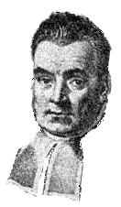
Bayesian Networks
Of course, it may be that we see people in one state, and their actions, but have no way of replicating the rulesets in human language.
In this case, we can generate a Bayesian Network.
These gives probabilities that states will occur together.
This can be interpreted as “if A then B”.
They allow you to update the probabilities on new evidence: "A" happens, and if we see "B", we can increase the probability or "if A then B" (or reduce it if we don't see "B").
They allow you to chain these “rules” together to make inferences.
Notes:
A slightly more complex way of looking at sequences of probabilistic events is with Bayesian Statistics, particularly where two events may be associated.
Bayesian statistics are used in a number of fields, not just for modelling proposed causal relationships. Chiefly they’re used for looking at what the probability of something happening is after something else has occurred. They’re often used for exploring solution spaces – for example, if one solution is found not to be viable, Bayesian statistics may tell you what the probabilities therefore are of other solutions being right.
Bayesian statistics are named after their discoverer, the Reverend Thomas Bayes, an eighteenth century English mathematician.
http://www-groups.dcs.st-andrews.ac.uk/~history/Mathematicians/Bayes.html

Slide 73
Bayesian Networks
In a Bayesian Network the states are linked by probabilities, so:
If A then B; if B then C; if C then D
Not only this, but this can be updated when an event A happens, propagating the new probabilities by using the new final probability of B to recalculate the probability of C, etc.

Slide 74
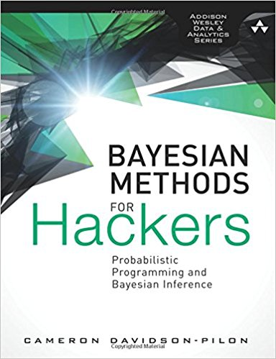
Bayesian stats
Good introduction for programmers is:
Cameron Davidson-Pilson, Bayesian Methods for Hackers.

Slide 75
Expert Systems
All these elements may be brought together in an “Expert System”.
These are decision trees, in which rules and probabilities link states.
Forward chaining: you input states and the system runs through the rules to suggest a most scenario of action.
Backward chaining: you input goals, and the system tells you the states you need to achieve to get there.
Don’t have to use Fuzzy Sets or Bayesian probabilities, but often do.
Notes:
Software:
Free demo and tutorials: http://www.expertise2go.com/
OpenExpert: http://openexpert.org/
Lists of commercial and freeware tools:
http://www.kbsc.com/rulebase.html
http://www.pcai.com/web/ai_info/expert_systems.html

Slide 76
Picking rules
However, ideally we want a cognitive framework to embed rule-choice within.
Something that embeds decision making within a wider model of thought and existence.

Slide 77
Belief-Desire-Intention
We need some kind of reasoning architecture that allows the agents to decide or be driven to decisions.
Most famous is the Belief-Desire-Intention model.
Beliefs – facts about the world (which can be rules).
Desires – things the agent wants to do / happen.
Intentions – actions the agent has chosen, usually from a set of plans.
Driven by Events, which cascade a series of changes.

Slide 78
Decision making
BDI decisions are usually made by assuming a utility function. This might include:
whichever desire is most important wins;
whichever plan achieves most desires;
whichever plan is most likely to succeed;
whichever plan does the above, after testing in multiple situations;
whichever a community of agents decide on (eg by voting)
Desires are goals, rather than more dynamic drivers.
Notes:
For more information on BDI, see “An Introduction to MultiAgent Systems” mentioned at the end of the slides.

Slide 79
The PECS model
Similar model is PECS – more sophisticated as it includes internal drivers:
Physis – physical states
Emotional – emotional states
Cognitive – facts about the world
Social status – position within society etc.
On the basis of these, the agent plans and picks a behaviour.
Ultimately, though, these are decided between by a weighted utility function.
Notes:
PECS is more closely aligned to social simulations. For more details, see:
Urban, C. (2000) PECS: A Reference model for the simulation of multi-agent systems. In R. Suleiman, K. G. Troitzsch and N. Gilbert, editors, Tools and Techniques for Social Science Simulation. Physica-Verlag, Heidelberg.
Urban, C. and Schmidt, B (2001) PECS – Agent-Based Modelling of Human Behaviour. AAAI Technical Report FS-01-02. http://www.aaai.org/Papers/Symposia/Fall/2001/FS-01-02/FS01-02-027.pdf

Slide 80
Thinking for agents
Ultimately we have to trade off complexity of reasoning against speed of processing.
On the one hand, behaviour developed by a GA/GP would be dumb, but fast (which is why it is used to control agents in games).
On the other, full cognitive architecture systems which try to replicate the brain, like Soar, CLARION, and Adaptive Control of Thought—Rational (ACT-R) are still not perfect, and take a great deal of time to set up.
Notes:
Soar, CLARION, and ACT-R all essentially aim to provide a sophisticated model of how human cognition works. You can find out more at their websites:
http://sitemaker.umich.edu/soar/home
http://www.cogsci.rpi.edu/~rsun/clarion.html
http://act-r.psy.cmu.edu/ (see also the Java version: http://jactr.org/)

Slide 81
  Preparing to model
  Verification
  Calibration/Optimisation
  Thinking machines
  Validation
  Sensitivity testing and dealing with error

Slide 82
Validation
Can you quantitatively replicate known data?
Important part of calibration and verification as well.
Need to decide on what you are interested in looking at.
Visual or “face” validation
eg. Comparing two city forms.
One-number statistic
eg. Can you replicate average price?
Spatial, temporal, or interaction match
eg. Can you model city growth block-by-block?

Slide 83
Validation
If we can’t get an exact prediction, what standard can we judge against?
Randomisation of the elements of the prediction.
eg. Can we do better at geographical prediction of urban areas than randomly throwing them at a map.
Doesn’t seem fair as the model has a head start if initialised with real data.
Business-as-usual
If we can’t do better than no-change prediction, we’re not doing very well.
But, this assumes no known growth, which the model may not.

Slide 84
Visual comparison
Notes:
Plenty of papers do a simple visual comparison. There’s nothing especially wrong with this at its best – the human eye is good at some patterns. However, it is also back at others. It’s also not very quantitative.
Here we see model results and real data from:
Heppenstall, A.J., Evans, A.J. and Birkin, M.H. (2003) 'Application of a hybrid multi-agent model to petrol prices (Word doc)' Proceedings of the Regional Science Association International: British and Irish Section, 33rd Annual Conference. http://www.geog.leeds.ac.uk/papers/03-1.doc
the model appears to capture the urban-rural change well.

Slide 85
Comparison stats: space and class
Could compare number of geographical predictions that are right against chance randomly right: Kappa stat.
Construct a confusion matrix / contingency table: for each area, what category is it in really, and in the prediction.
Fraction of agreement = (10 + 20) / (10 + 5 + 15 + 20) = 0.6
Probability Predicted A = (10 + 15) / (10 + 5 + 15 + 20) = 0.5
Probability Real A = (10 + 5) / (10 + 5 + 15 + 20) = 0.3
Probability of random agreement on A = 0.3 * 0.5 = 0.15
 | Predicted A | Predicted B
Real A | 10 areas | 5 areas
Real B | 15 areas | 20 areas
Notes:
See:
Robert A. Monserud and Rik Leemans (1992) Comparing global vegetation maps with the Kappa statistic . Ecological Modelling, 62 (4), 275-293 http://dx.doi.org/10.1016/0304-3800(92)90003-W
S. Sousa, S. Caeiro and M. Painho, (2002) Assessment of Map Similarity of Categorical Maps Using Kappa Statistics, ISEGI, Lisbon. http://www.igeo.pt/servicos/Cdi/biblioteca/PublicacoesIGP/esig_2002/papers/p079.pdf
You can experiment with Kappa, here:
http://terpconnect.umd.edu/~dchoy/thesis/Kappa/
ArcGIS software:
http://arcscripts.esri.com/details.asp?dbid=16795
R (vcd package)
http://cran.r-project.org/web/packages/vcd/index.html
http://cran.r-project.org/web/packages/vcd/vcd.pdf

Slide 86
Comparison stats
Equivalents for B:
Probability Predicted B = (5 + 20) / (10 + 5 + 15 + 20) = 0.5
Probability Real B = (15 + 20) / (10 + 5 + 15 + 20) = 0.7
Probability of random agreement on B = 0.5 * 0.7 = 0.35
Probability of not agreeing = 1- 0.35 = 0.65
Total probability of random agreement = 0.15 + 0.35 = 0.5
Total probability of not random agreement = 1 – (0.15 + 0.35) = 0.5
κ = fraction of agreement - probability of random agreement
probability of not agreeing randomly
= 0.1 / 0.50 = 0.2

Slide 87
Comparison stats
Tricky to interpret, however - there's no real objective feel for what a 'good' score should be.
κ | Strength of Agreement
< 0 | None
0.0 — 0.20 | Slight
0.21 — 0.40 | Fair
0.41 — 0.60 | Moderate
0.61 — 0.80 | Substantial
0.81 — 1.00 | Almost perfect
Notes:
The table is from: Landis, J.R. and Koch, G.G. (1977) The measurement of observer agreement for categorical data. Biometrics, 33, 159-174.
The Map Comparison Toolkit: http://www.riks.nl/mck/

Slide 88
Comparison stats
The problem with kappa stats is that you are predicting in geographical space and time as well as categories.
Which is a better prediction, right category, slightly out in geography, or a close category in the right place?
Notes:
Is it better to get the class almost right, in the right place, or the class right, but in the wrong place?
For example, this might be urban housing – does it matter that the prediction is a little out geographically.
None give a good Kappa.

Slide 89
Comparison stats
The solution is a fuzzy category statistic and/or multiscale examination of the differences (Costanza, 1989).
Scan across the real and predicted map with a larger and larger window, recalculating the statistics at each scale. See which scale has the strongest correlation between them – this will be the best scale the model predicts at?
The trouble is, scaling correlation statistics up will always increase correlation coefficients.
Notes:
Alex Hagen-Zanker (2009) An improved Fuzzy Kappa statistic that accounts for spatial autocorrelation. International Journal of Geographical Information Science, 23 (1), 61-73 http://www.informaworld.com/smpp/content~db=all?content=10.1080/13658810802570317

Slide 90
Correlation and scale
Correlation coefficients tend to increase with the scale of aggregations.
  Robinson (1950) compared illiteracy in those defined as in ethnic minorities in the US census. Found high correlation in large geographical zones, less at state level, but none at individual level. Ethnic minorities lived in high illiteracy areas, but weren’t necessarily illiterate themselves.
More generally, areas of effect overlap:
Road accidents
Dog walkers
Notes:
The classic studies on correlation coefficients varying with scale are…
Robinson, W.S. (1950) ‘Ecological correlations and the behaviour of individuals’ American Sociological Review, 15, 351-357.
http://links.jstor.org/sici?sici=0003-1224%28195006%2915%3A3%3C351%3AECATBO%3E2.0.CO%3B2-R
Gehlke, C.E. and Biehl, H. (1934) ‘Certain effects of grouping upon the size of correlation coefficients in census tract material’ Journal of the American Statistical Association, 29 Supplement, 169-170.
http://links.jstor.org/sici?sici=0162-1459%28193403%2929%3A185%3C169%3ACEOGUT%3E2.0.CO%3B2-M
In the example above, it may be that the geographical areas associated with dog walkers are completely different, or, it may be that dog walkers only cause a very small amount of accidents, but the correlation will improve as more and more of the two are aggregated together.

Slide 91
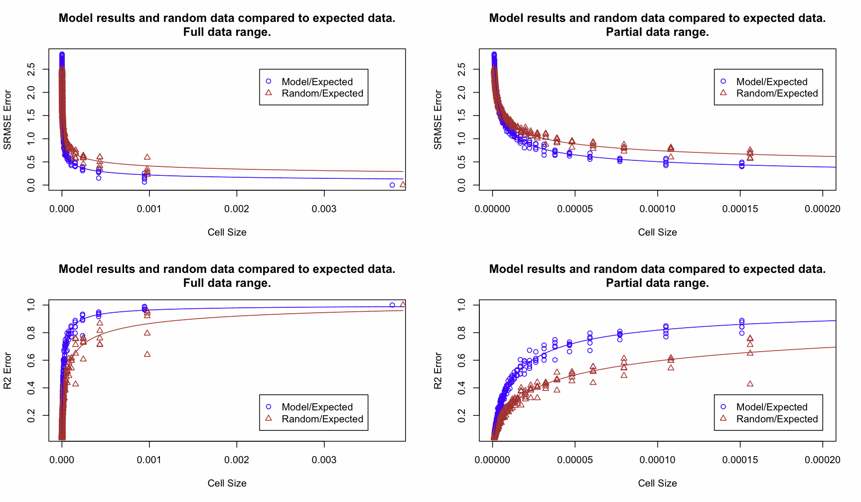
Comparison stats
So, we need to make a judgement – best possible prediction for the best possible resolution.
Notes:
The graphs are from Nick Malleson’s PhD. He compares the multiscale statistic against a randomised dataset as the kappa-equivalent, to see whether the model does better than this “worse case scenario”.

Slide 92
Comparison stats: Graph / area-to-area flows
For models of flows, make an origin-destination matrix for model and reality, enumerating the flows between origins and destinations.
Compare the two using some difference statistic.
Only problem is all the zero origins/destinations, which tend to reduce the significance of the statistics, not least if they give an infinite percentage increase in flow.
Knudsen and Fotheringham (1986) test a number of different statistics and suggest Standardised Root Mean Squared Error is the most robust.
Notes:
Knudsen DC & Fotheringham AS (1986) Matrix Comparison, Goodness-of-Fit, and Spatial Interaction Modeling. International Regional Science Review 10: 127–147. http://irx.sagepub.com/cgi/content/abstract/10/2/127
William R. Black (1991) A note on the use of correlation coefficients for assessing goodness-of-fit in spatial interaction models. Transportation, 18 (3), 199-206. http://www.springerlink.com/content/gl627356v48x7133/

Slide 93
  Preparing to model
  Verification
  Calibration/Optimisation
  Thinking machines
  Validation
  Sensitivity testing and dealing with error

Slide 94
Errors
Model errors
Data errors:
Errors in the real world
Errors in the model
Ideally we need to know if the model is a reasonable version of reality.
We also need to know how it will respond to minor errors in the input data.
Notes:
Errors in an initial dataset could, under chaotic behaviour, expand to make the predictions theoretically useless.

Slide 95
Sensitivity testing
Tweak key variables in a minor way to see how the model responds.
The model maybe ergodic, that is, insensitive to starting conditions after a long enough run.
If the model does respond strongly is this how the real system might respond, or is it a model artefact?
If it responds strongly what does this say about the potential errors that might creep into predictions if your initial data isn't perfectly accurate?
Is error propagation a problem? Where is the homeostasis?
Notes:
Sensitivity testing allows us to assess how sensitive a model is to minor errors in the input data and parameters.

Slide 96
Monte Carlo testing
If the model is deterministic, one run will be much like another.
If the model is stochastic (ie. includes some randomisation), you’ll need to run in multiple times.
In addition, if you’re not sure about the inputs, you may need to vary them to cope with the uncertainty: Monte Carlo testing runs 1000’s of models with a variety of potential inputs drawn from the distributions seen in reality, and generates probabilistic answers.

Slide 97
Finally…
Models aren’t just about prediction.
They can be about experimenting with ideas.
They can be about testing ideas/logic of theories.
They can be to hold ideas.
Notes:
Finally, remember that models aren't just about prediction.

Slide 98
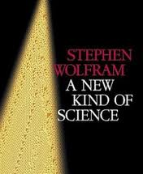

Further info
Steven Wolfram “A new kind of science”
A major project applying CAs to Life, the Universe and Everything.
Flake (2000) The Computational Beauty of Nature: Computer Explorations of Fractals, Chaos, Complex Systems, and Adaptation.
Notes:
For more information on CAs, especially the mathematical foundations laid down by Wolfram and how they fit in with computers, see Wolfram’s website…
http://www.stephenwolfram.com/
You can also find details of his much-hyped, but excellent looking, book there.
http://www.amazon.co.uk/exec/obidos/ASIN/1579550088/

Slide 99
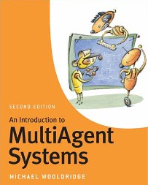
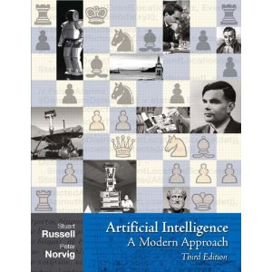
Further reading
Michael Wooldridge (2009) “An Introduction to MultiAgent Systems” Wiley (2nd Edition)
MAS architectures, BDI etc.
Stuart Russell and Peter Norvig (2010) “Artificial Intelligence: A Modern Approach” Prentice Hall (3rd Edition)
Neural nets, Language Processing, etc.
Notes:
http://aima.cs.berkeley.edu/

