Slide 1
Databases
Dr Andy Evans
Notes:
In this part we'll look at using Python and databases.

Slide 2
  Python and Databases
  SQL
  ORMs
Notes:
We'll first look at how Python interacts with databases. We'll then look at SQL, the language of relational databases, before finally we look at how we can avoid thinking about databases at all.

Slide 3
Databases
Structured persistent data stores.
Oracle
MySQL
MS SQL Server
PostgreSQL ("Postgres")
Access (~format used by Arc Geodatabases)
Notes:
Databases are software and file systems for structuring data in a persistent (i.e. stays between sessions) manner, such that it is easy for retrieval and search (and therefore analysis). Some of the more well known are listed on the slide.

Slide 4
Types
Flat file / NoSQL: key-value pairs simplest; rows of data with an ID. More complex modern versions include document-oriented databases, where values are, e.g. XML documents structured for optimal searches, sometimes using a graph to structure the relationships.
Relational: multiple tables (multiple rows of data with ID) linked, for example, ID (person's name) in one table is a value in another (e.g. households with people). Linking allows data to be extracted across tables (e.g. address of a person). Tables will usually be structured to some schema, which optimises the database for some purpose, e.g. Online Analytical Processing (OLAP).
Notes:
The simplest form of database is a flat file containing data. Given that you usually want to find unique records, even if data is repeated in them (the house a person lives in, even if it is shared), the next stage is to have flat files, but unique IDs associated with each piece of data. This gives us a key-value system, where we can look up a value based on a key. The key can be a word or number, or anything, but is usually unique so you can look up the value by unique key. Such structures, when built and used in a program, are often called a hashtable, as the key is produced by a "hash" function - that is, one that generates a unique key based on some input that can't easily be replicated using the same process and other data.
Flat file key-value databases are sometimes called NoSQL databases, because they are too simple to use SQL, the language of databases we'll look at a little later (there are other types of NoSQL databases though). That is not to say that all flat-file databases are simple. They tend to be thought of as pre-relational databases, because they were invented earlier than relational databases (we'll talk about these shortly), but infact they are still used for simple parameter saving in code, and, perhaps more importantly, they are at the core of some quite sophisticated types of databases which are now coming back into fashion, including document-oriented databases, which are documents stored in a XML format that is optimised for search. Such databases are often also "graph databases" - that is, the documents within them are related to each other using a searchable and structured 'graph' (i.e. network of connections).
Relational databases are the most popular form of database. These involve storing data in multiple tables, each with several columns and rows. Each row has at least one column containing data that is unique to each row and acts as an ID. Tables are linked together by rules that say one data column's values in a table can be found in another table and used to look up associated data. So, for example, if a person's name appears in a table of addresses as HOMEOWNER and in a table of gas company customers as BUYER we can link the two datasets to see which addresses are associated with which gas company.
By pre-cooking such rules, we can structure the datasets into a schema, which is then ready to be queries for particular types of data. See, for example:
https://en.wikipedia.org/wiki/Star_schema
and
https://en.wikipedia.org/wiki/Online_analytical_processing

Slide 5
Types
Object oriented databases: contents held as objects.
These may be full OO database, or Object Relational Mapping (ORM) databases, where software converts objects in an access language (like Python) into complicated relational database tables without the coder having to understand how.
Distributed file systems: Big Data management systems like Hadoop (and its programming side MapReduce), which distribute the data around multiple machines/cloud systems and the parallelise search execution. Generally very efficient, scalable, and fault-tolerant.
(Nice resource here: https://www.oreilly.com/learning/hadoop-with-python)
Notes:
Relational databases are fine, but suffer in two ways: firstly they are limited in the types of data they tend to store and the way they are accessed, and secondly they don't scale especially well, despite a great many advances over the years in search optimisation. Because of this, new database formats have arisen.
Object oriented databases store data as objects in a hierarchical inheritance structure, mapping onto object oriented code directly. An intermediate position is Object Relational Mapping (ORM) databases, which are relational databases that have a management interface such that they appear object oriented to code on the outside, but objects are translated into tables invisibly internally.
Distributed file systems are databases that work in parallel in the programming sense. That is, the database is split up across multiple computers and search routines designed to be optimal with this structure. Each machine searches only a small part of the data, making searches very efficient and scalable. These are common for big data.

Slide 6
Database access
Bespoke APIs for software built into/with Python.
Bespoke APIs for external software.
Generic database communication for internal and external software.
Notes:
In terms of accessing persistent data in databases, we have three broad options: with software built into the Python standard library, we can have a bespoke API. Equally, we could have this for software not built into the standard library. Finally, we could have a standardised API that all software matches up with. We'll see examples of each.

Slide 7
Python
Python comes with libraries for working with:
dbm: DBM (DataBase Manager): A POSIX system pre-relational NoSQL database which stores single key-value relationships for fast access.
sqlite3: SQLite: A lightweight database system for building into applications (e.g. Firefox)
Neither require a separate database acting as a server as both access the local disk directly.
Notes:
Python comes with two libraries for interacting with databases as standard.
dbm is a library for interacting with a flat file key-value NoSQL system written initially for UNIX but now built into Python for all systems. This is a very simple database for, for example, parameter storage between sessions.
Python also comes with SQLite, a very simple database that utilises a subset of SQL and which generates a single database file. It's size and ease of use means it is a popular choice (beyond Python - it works in lots of languages) for storing application data.
More at:
https://www.sqlite.org/
With many enterprise databases, the database needs to be up and running as a server service before anyone can communicate with it. Neither of these databases require either sophisticated database management software or for anything to be running before the databases is called.

Slide 8
Database access
Bespoke APIs for software built into/with Python.
Bespoke APIs for external software.
Generic database communication for internal and external software.
Notes:
Let's look in turn at our three options.

Slide 9
dbm
# Open with read/write/create permissions
with dbm.open('database', 'c') as db:
db['key'] = 'value'
db.get('key', 'default return')
Only takes strings, and stores them as bytes.
Useful for quickly storing and looking up dictionaries, user preferences, internationalisation translations for GUIs.
Module version a little slow, but can connect to external versions if installed.
However, remember it is simple to save (and edit) dictionaries as JSON files using the json library.
Notes:
In terms of a bespoke API for software built into the standard library, dbm fits the bill well. The data setting and getting methods map exactly onto standard Python associated with objects, the only difference here being that it is set up for writing to and reading from files. The downside is that it's old-school structure means it only works with strings (which it stores as bytes). Nevertheless, as a quick option for storing parameters or GUI labels etc., it makes a good option. Although Python has its own implementation, you can use local (faster) implementations if you are on the right kind of machine (Linux, for example); the library has functions for discovering if this is the case.

Slide 10
Database access
Bespoke APIs for software built into/with Python.
Bespoke APIs for external software.
Generic database communication for internal and external software.
Notes:
In terms of bespoke APIs for external databases software, perhaps the most useful example is the sets of libraries for dealing with Excel.

Slide 11
Excel
Some software has its own libraries to connect.
Anaconda comes with four different libraries for reading/writing Excel files, for example. Good option is openpyxl.
import openpyxl
workbook = openpyxl.load_workbook("data.xlsx")
sheets = workbook.get_sheet_names()
sheet = workbook.get_sheet_by_name(sheets[0])
cell = sheet['A1'] # alternatively sheet.cell(row=1, column=1)
value = cell.value
address = cell.coordinate # returns "A1"
sheet["A5"] = "=SUM(A1, A4)" # Set as equation; not comma separated
workbook.save('data2.xlsx')
Notes:
Note that some people don't regard Excel as a database because it isn't a relational database - it's a spreadsheet system with interlinking code. Nevertheless, it does persistently store data in a management system, so we'll give it the benefit of the doubt.
Anaconda comes with non-standard libraries for connecting to (and writing) Excel spreadsheets. Note that with Excel, there is a difference between older format .xls files, and newer .xlsx files: we'll deal with the latter here, but there are alternative libraries for the former.
Above is example code from openpyxl, which works with .xlsx files. The first six lines show how to open a sheet and get a value out.

Slide 12
Looping
for row in sheet['A1':'ZZ300']:
for cell in row
Also:
sheet.iter_rows(min_row=1, max_row=5, min_col=1, max_col=5)
sheet.iter_cols(min_row=1, max_row=5, min_col=1, max_col=5)
Can use the following to convert numbers to cell address:
height = sheet.max_row
width = sheet.max_column
cell.get_column_letter(1)
cell.column_index_from_string('A')
Notes:
Alternatively, you can iterate through a set of cells row by row. The top example shows the simplest method, which uses iterators. However, this requires knowing the addresses with letter-number names. If you just have numbered coordinates, use iter_rows and iter_cols.
At the bottom of the slide are some useful functions that help when utilising these looping functions.

Slide 13
Supports
Using number formats
Using formulae
Merging / Unmerging cells
Inserting images
Folding columns
Graphs
Styling
Note that if saved it will only save the elements it recognises, so don't save over original.
Note that it will read formulas if these are in cells, not data (there is an option for this but it doesn't work well.
For data, use pandas.read_excel()
https://pandas.pydata.org/pandas-docs/stable/generated/pandas.read_excel.html
Notes:
openpyxl supports a very wide range of Excel functionalities. However, it is worth noting its limitations. It only recognises and builds certain elements: for example, embedded images don't work so well; so you need to be careful not to save over the original file, or those elements will be filtered out of it.
Secondly, note that it won't generally re-calculate equations and will read cells containing equations as containing equations, not data. There are some options for exploring the results of equations that have run in the past, but these are limited and not guaranteed to represent the current sheet. Although not as good with Excel generally, pandas can be used to get at data that would otherwise be equations:
https://stackoverflow.com/questions/23350581/openpyxl-1-8-5-reading-the-result-of-a-formula-typed-in-a-cell-using-openpyxl

Slide 14
Database access
Bespoke APIs for software built into/with Python.
Bespoke APIs for external software.
Generic database communication for internal and external software.
Notes:
Finally, let's look at the generic ways of accessing databases. These are most appropriate for standard database systems.

Slide 15
Software connections
Bespoke APIs are ok, but a more generic solution would be useful. One obstacle is the language software is written in.
Software can be written in many different languages.
Languages can represent even basic data types in different ways.
We therefore need something to do the translation.
Notes:
To understand database connectivity, we really need to understand basic software-to-software communication.

Slide 16
Inter-process communication
To communicate we can:
  Ensure everyone uses the same type of compiled code : PythonVM, JVM, .Net
  Ensure everyone uses the same types of objects and give some way of invoking methods in a OS framework: COM, Simple Object Access Protocol (SOAP).
  Supply software that can translate the binary code of one into the binary code of the other : ORM, CORBA, bridge drivers
Notes:
To communicate between languages and processes we can:
Make sure we're working in the same environment once code is converted into binary.
Ensure that the objects sent between code have the same format: for example, the same way of storing numbers as bits, or use XML text (like SOAP https://en.wikipedia.org/wiki/SOAP).
Use intermediate software that translates, for example, one way of storing numbers as binary to another.
In general, with databases, we tend to use the latter, though there are variations.

Slide 17
Translation drivers
For Python Database communication we have various options:
  Python → database with Python interface/driver.
  dbm
  Python → standard protocol [PC or Network] → database that accepts standard protocols.
  Python Database API Specification
  Python → standardized driver → database
  ODBC (Open Database Connectivity)
Notes:
If we're going to communicate with a database specifically, we thus have three options:
If we use a Python database (e.g. the Python dbm), we can use Python to communicate with it directly.
If we have a standard for data structures, we can use this with databases that except this standard.
Finally, we can use a piece of translating software that knows both our standards and those of the databases.
In both the latter two, chances are that we'll need *some* translating software, as we'll need to convert binary data representations between Python and the software, so really the distinction is whether the translation is done by a driver (that is a piece of software supplied by the database) or independently of both the Python and the database.

Slide 18
  Python Database API Specification
PEP 249 - Python Database API Specification v2.0
Each database company matched the DB-API 2.0 API.
sqlite3 matches this specification (though the database is more limited as to what it will return in some cases).
Notes:
The standard for talking between Python and databases is the DB-API, outlined in PEP 249.
Many database companies supply drivers that you can connect with from Python and that accept DB-API function calls, translating these to whatever the database is waiting for.
https://www.python.org/dev/peps/pep-0249/
sqlite3 does this for the SQLite built into Python (pretty much - the functions return the right objects, but as we'll see, some variables are empty).

Slide 19
General process
Import the driver library
Open the connection
Build a cursor
Issue SQL
Loop through results
Close the connection
Notes:
The general process for using the DB-API is above. Note that we use a cursor, as you do in other database-organised systems such as ArcGIS. SQL is the language of relational databases, which we'll come to later.
The first thing is getting hold of the appropriate driver, which usually comes as a Python library.

Slide 20
Database drivers
If the manufacturer supplied a Python driver, you should be able to load it.
https://wiki.python.org/moin/DatabaseInterfaces
Includes: MySQL, Oracle database, SQL Server, PostgreSQL, Access
Anaconda can integrate PostgreSQL, leveldb, Sybase, Teradata
https://docs.anaconda.com/anaconda/packages/pkg-docs
Install depends on library:
python setup.py install (from downloaded and unzipped directory)
pip install libraryname
conda install libraryname
Generally you just have to import the driver library to use the driver.
import mysql.connector
Notes:
The Python wiki has an extensive list of drivers for the most popular databases.
Anaconda also has versions that can be installed - most don't come with the Anaconda install, but they can be downloaded and installed with the conda installation software. Otherwise you can use the install options listed above - instructions (for example, what to call the library in the above) should be on the driver download page or a nearby installation page.

Slide 21
sqlite3
conn = sqlite3.connect('database.sqlite')
c = conn.cursor()
c.execute("CREATE TABLE Results (address text, burglaries integer)")
c.execute("INSERT INTO Results VALUES ('Queen Vic',2)")
conn.commit()
conn.close()
Supports: NULL (None), INTEGER (int), REAL(float), TEXT(str), BLOB(bytes).
SQL supported: https://www.sqlite.org/lang.html
conn.rollback() : Rolls back to last commit.
sqlite3.connect(':memory:') : Makes a temp database in memory.
Notes:
Here, then, is how we connect to and use the DB-API with sqlite. The code opens a database (making it if it doesn't exist), makes a table, and then inserts one piece of data into it. Note that the code with capitalised terms inside it is SQL. A few things:
If you need to but quotes inside quotes, use single and double quotes to prevent ending the string, or put everything in triple quotes of either type.
Sqlite supports the major DB-API types except DATETIME. The types in parentheses are the Python types they map to.

Slide 22
Metadata
Find table names:
c.execute
("SELECT name FROM sqlite_master WHERE type='table';")
Find column names
c = conn.execute('SELECT * FROM tablename')
for description in c.description:
print(description[0]) # Name - note that [1]…[6] are Nones.
Notes:
One useful thing to be able to find in databases is metadata about the tables. Here's two pieces of code to do this, with thanks to the people on these stackoverflow pages:
https://stackoverflow.com/questions/82875/how-to-list-the-tables-in-an-sqlite-database-file-that-was-opened-with-attach
https://stackoverflow.com/questions/7831371/is-there-a-way-to-get-a-list-of-column-names-in-sqlite

Slide 23
Retrieving data
for row in c.execute('SELECT * FROM Results ORDER BY burglaries'):
print(row)
Can also loop manually with:
c.rowcount
c.fetchone() # single row
c.fetchall() # list of rows
Various options for pre-cooking compound statements.
Notes:
To read data, use an SQL query to SELECT it. SELECT * selects all columns for return.
Here we get all the Results table columns, and order the rows returned by the number of burglaries.
Here you see the use of the c.execute as an iterator. You can also manually get the count of the rows returned from the query, and get each next row by calling fetchone(), or you can get them all at once.
There are also a variety of options in sqlite for pre-cooking SQL queries: see the sqlite3 library webpages.

Slide 24
Beyond SQLite
SQLite isn't a full database, so DB-API has slightly more in it.
Supports DATETIME objects encapsulating dates and times.
Fuller support for cursor.description: SQLite only supports the first list element (column names). The full API suggests: name; type_code; display_size; internal_size; precision; scale; null_ok.
Supports the calling of procedures stored in the databases, and a more sophisticated commit system.
Notes:
The key elements that are different between sqlite3 and a full implementation of DB-API are listed above.
cursor.description describes each column in the results. Results with 3 columns would have 3 lists, and the first element in the list would be the name of the column (up to the first space, if there are spaces in the name). SQLite just returns these names; the full DB-API includes the other details listed above.
The full API also supports the calling of Python and other procedures stored in the database (modern databases can often store code to run on the server-side to improve efficiency and capability).

Slide 25
Connection parameters
Can pass in user, password, and if the database is online, host as IP address and database.
conn = mysql.connector.connect(
user='username',
password='password',
host='127.0.0.1',
database='employees')
Notes:
Full database systems often need to be accessed online with a username and password. The above DB-API code shows how to do this.

Slide 26
ODBC
(Open Database Connectivity)
Use where no driver available.
On Windows, Driver Manager keeps a list of data sources.
ODBC Driver Manager opens a driver that communicates with a database when requested.
Python-ODBC bridge used to ask the Driver Manager to open a driver connection.
https://wiki.python.org/moin/ODBC
https://wiki.python.org/moin/ODBCDrivers (Commercial)
Notes:
So, this is all well and good, but what do we do if there's no driver?
There is a more universal solution, which is to go through an ODBC system. ODBC is a universal system for communicating with databases. There is a Python to ODBC driver, and most databases supply ODBC to database drivers. This provides an ODBC bridge between Python and any implementing database. Python wiki supplies a list of drivers for major databases (note that many of these are commercial). You can also get ODBC drivers for some things you wouldn't think of as databases, but which can be treated as databases - for example, social media websites: see the wiki for details.

Slide 27
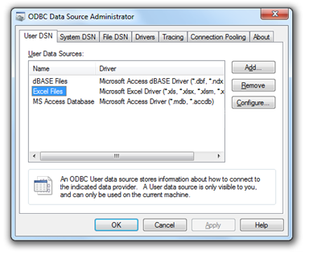
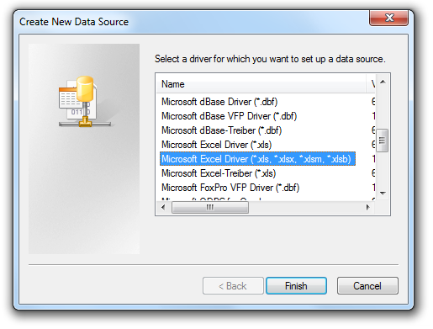
ODBC Data Source Manager
Driver managers in Windows and Mac.
Windows: odbcad32.exe
Notes:
In Windows, ODBC is dealt with through the ODBC manager, which allows us to set up ODBC sources by name, which we can then communicate with.
Here we see the process for setting up Excel as a data source.

Slide 28
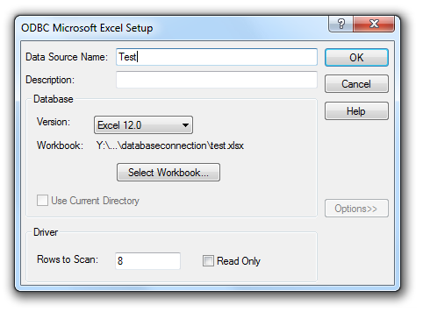
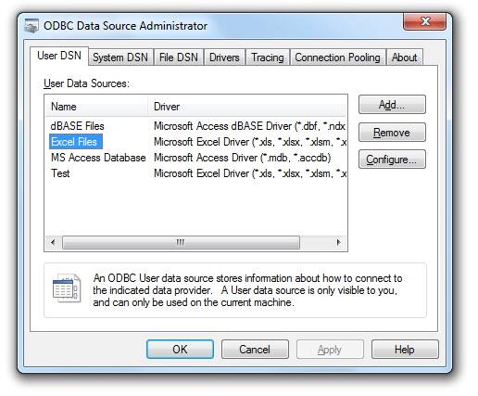
ODBC Data Source Manager
Give the source a name
and (for Excel) select the workbook.
Note under “Options>>” that the default is “Read Only”.

Slide 29
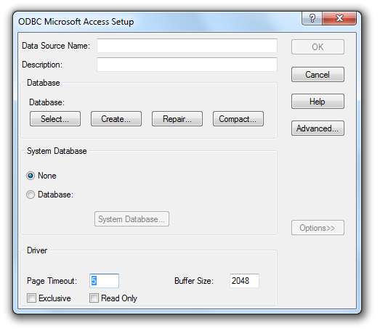
Access
The same kinds of options, but some additional ones for databases.
Under “Advanced” you can set default passwords to use.
Notes:
Here we see the difference between Excel and the more fully database office product, Access.

Slide 30
ODBC Pros
Common to most machines and driver supplied.
As long as the ODBC data is uptodate, you can refer to the database by name, not location.
ODBC Cons
Rather inefficient:
Program → Bridge → Driver → Database
ODBC was meant to be a stop-gap and is a bit hit and miss.
Issues with Strings and Access. On Excel and text, see also: http://support.microsoft.com/kb/178717
Notes:
There are some significant downsides to ODBC, not least the lack of efficiency of having to go through another piece of software. Direct drivers are generally better.

Slide 31
Security
If security is likely to be an issue, for example, because the database will be web-based, you need to understand attacks against databases.
Generally, see:
http://www.geog.leeds.ac.uk/courses/postgrad/web/web-based-gis/materials.html
You should use parameter substitution (where checked variables are injected into queries as tuples, rather than allowing queries to be directly created):
https://docs.python.org/3/library/sqlite3.html (search for "injection attack")

Slide 32
  Python and Databases
  SQL
  ORMs
Notes:
So, let's now have a brief look at SQL, the language of databases.

Slide 33
SQL
(Structured Query Language)
ISO Standard for database management.
Allows creation, alteration, and querying of databases.
Broadly divided into:
Data Manipulation Language (DML) : data operations
Data Definition Language (DDL) : table & database operations
Often not case-sensitive, but better to assume it is.
Commands therefore usually written UPPERCASE.
Some databases require a semi-colon at the end of lines.
Notes:
SQL (pronounced S.Q.L. or "sequel") is the chief language of databases, most noticeably relational databases. As a language it falls in to the declarative language family, though you'd not generally notice this.
Although broadly divided into data operations and structural operations, in practice the two are used together.
There are subtle variations in the implementations of SQL; best to try queries out on a test database before relying on them.
SQL and database management is a whole course in itself, so here we'll touch briefly on a few key elements. A good source for further tutorials is the w3Schools site:
http://www.w3schools.com/sql/

Slide 34
Creating Tables
CREATE TABLE tableName (
col1Name type,
col2Name type
)
List of datatypes at:
http://www.w3schools.com/sql/sql_datatypes.asp
CREATE TABLE Results (
Address varchar(255),
Burglaries int
)
Note the need to define String max size.
Notes:
Note the difference between the SQL version of the datatypes and the DB-API version.

Slide 35
SELECT command
SELECT column, column
FROM tables in database
WHERE conditions
ORDER BY things to ordered on
SELECT Addresses
FROM crimeTab
WHERE crimeType = burglary
ORDER BY city
Notes:
Note that selections only return the columns you ask for.

Slide 36
Wildcards
* : All (objects)
% : Zero or more characters (in a string)
_ : One character
[chars] : Any character listed
[^charlist] or [!charlist]
: Any character not listed
E.g. Select all names with an a,b, or c somewhere in them:
SELECT * FROM Tab1 WHERE name LIKE '[abc]%'
Notes:
You can utilise different wildcards within queries. LIKE is used with the % and _ wildcards.
The query here returns any string starting a, b, or c.

Slide 37
Case sensitivity
If you need to check without case sensitivity you can force the datatype into a case insensitive character set first:
WHERE name = 'bob' COLLATE SQL_Latin1_General_CP1_CI_AS
Alternatively, if you want to force case sensitivity:
WHERE name = 'Bob' COLLATE SQL_Latin1_General_CP1_CS_AS
Notes:
Caveat lector; case sensitivity varies massively with database:
http://aspadvice.com/blogs/ssmith/archive/2007/09/30/Case-Sensitive-or-Insensitive-SQL-Query.aspx
http://sqlskills.com/BLOGS/KIMBERLY/post/The-perils-of-case-insensitive-data-%28and-our-life-in-tangent-land%29.aspx
http://www.sqlskills.com/BLOGS/KIMBERLY/post/Follow-on-post-to-The-perils-of-case-insensitive-data-%28and-our-life-in-tangent-land%29.aspx
http://www.sqlserverclub.com/articles/understanding-sql-server-collation-sequences.aspx

Slide 38
Counting
Can include count columns.
Count all records:
COUNT (*) AS colForAnswers
Count all records in a column:
COUNT (column) AS colForAnswers
Count distinct values:
COUNT(DISTINCT columnName) AS colForAnswers
SELECT crimeType, COUNT(DISTINCT Address) AS HousesAffected FROM crimes

Slide 39
Joining tables
Primary key columns: Each value is unique to only one row.
We can join two tables if one has a primary key column which is used in rows in the other:
SELECT Table1.columnA, Table2.columnB
FROM Table1
JOIN Table2
ON Table1.P_Key=Table2.id
Table1
P_key | columnA
1 | A
2 | B
3 | C
Table2
P_key | columnB | id
a | HH | 1
b | GG | 1
c | YY | 3
A | HH
A | GG
C | YY
Notes:
Joining tables is the key function that makes a database a relative database, and is key to relative database analysis. The JOIN here links Table1 and Table2 by the fact that P_key in Table1 is the same data as id in Table2. So, the row "A" in Table1, which has a P_key 1, is linked wherever a "1" appears in Table2's id column, that is, the rows containing HH and GG. As we've asked for Table1.columnA and Table2.column back, those are the columns we get back in our final table.

Slide 40
Altering data
Two examples using UPDATE:
UPDATE Table1
SET column1 = ‘string’
WHERE column2 = 1
UPDATE Table1
SET column1 = column2
WHERE column3 = 1
Notes:
Update is used to change cells.

Slide 41
SQL
Introductory tutorials:
http://www.w3schools.com/sql/default.asp
Notes:
As noted, this is only a very brief introduction. A more extensive tutorial can be found on the w3Schools site.

Slide 42
  Python and Databases
  SQL
  ORMs
Notes:
Having looked at SQL, it is perhaps worth having a very brief look at how to avoid it in Object Oriented Programming.
We noted earlier that databases can be Object Oriented, in which case they have their own API. You can also use a ORM (Object Relational Mapping) manager. This translates objects invisibly into tables in relational databases in a way that means you never have to worry about it - you just load and save objects.

Slide 43
Python ORMs
(Object Relational Mapping)
http://www.sqlalchemy.org/
http://peewee.readthedocs.io
from peewee import *
db = SqliteDatabase('people.db')
class Person(Model):
name = CharField()
class Meta:
database = db
db.create_tables([Person])
bob = Person(name='Bob')
bob.save()
bob.delete_instance()
db.close()
ORMs convert objects to standard relational database tables without worry.
See examples for how to link tables:
http://peewee.readthedocs.io/en/latest/peewee/quickstart.html
Also has built in SQL functions.
Notes:
Popular ORMs include SQLAlchemy (which is a bigger system but which includes a popular ORM manager) and the lightweight peewee, an example of which is shown here. The full quickstart website (listed above) includes how to link different classes, such that one class can reference another as a variable, and how to store the relationship in the database.

