Slide 1
addins
Dr Andy Evans
Notes:
Welcome to the course. You’ll find extra information in these note sections below each slide.
http://desktop.arcgis.com/en/analytics/python/

Slide 2
Addins
Addins are GUI elements we can add that respond to user-driven GUI events.
Button : Icon on toolbar.
Tool : Changes mouse operations.
Combo box : Dropdown list and editable box.
Toolbar : For grouping AddIns.
Menu : Dropdown and right-click.
Tool palette : Floating container for other AddIns.
Application extension : Additional functionality within, e.g. Arc extensions.
(Python doesn't have Dockable window : Floating window that can be locked into the GUI cf. Java / C++.)

Slide 3
Events
As well as GUI events, Application Extension addins give:
startup(self) activeViewChanged(self) mapsChanged(self) newDocument(self) openDocument(self) beforeCloseDocument(self) closeDocument(self) beforePageIndexExtentChange(self, old_id) pageIndexExtentChanged(self, new_id) contentsChanged(self) spatialReferenceChanged(self) itemAdded(self, new_item) itemDeleted(self, deleted_item) itemReordered(self, reordered_item, new_index) | onEditorSelectionChanged(self) onCurrentLayerChanged(self) onCurrentTaskChanged(self) onStartEditing(self) onStopEditing(self, save_changes) onStartOperation(self) beforeStopOperation(self) onStopOperation(self) onSaveEdits(self) onChangeFeature(self) onCreateFeature(self) onDeleteFeature(self) onUndo(self) onRedo(self)
Notes:
http://desktop.arcgis.com/en/arcmap/latest/analyze/python-addins/extension-class.htm

Slide 4
Addins vs scripts
Addins have:
More sophisticated GUI elements, such as drop-down comboboxes.
The ability to communicate between addins, linking several GUI elements together.
The ability to respond to Arc events beyond the GUI with application extensions.

Slide 5
Form
zip file, with a .esriaddin extension
Contains:
config.xml : metadata describing the addin
Python files
Other resources needed : e.g. data, images
XML is a bit like HTML but more formal.
Use the addin wizard to edit the XML and make changes to properties.

Slide 6
Making an AddIn
Rather than writing the config.xml ourselves, and zipping it up manually with the Python files, there’s a wizard to help.
This does all the basic Python module generation for us, and prepares the file.
Details for installing the wizard on the website.

Slide 7
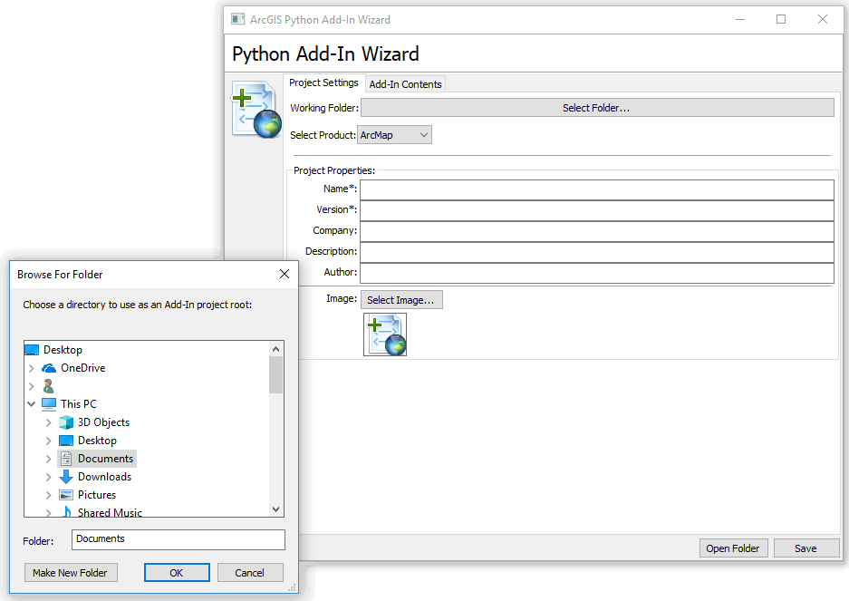

Slide 8
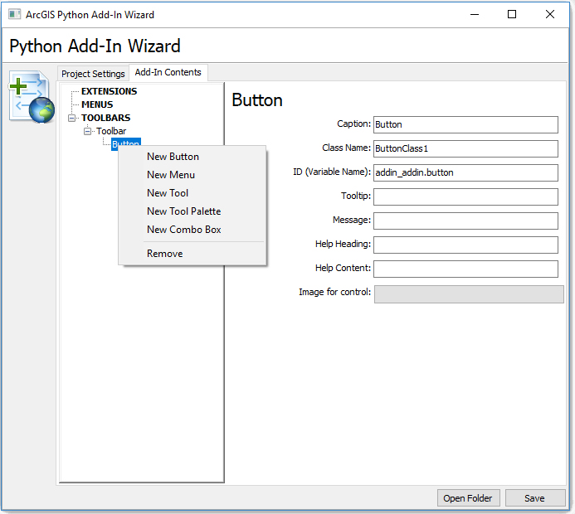

Slide 9
What the wizard produces
Main elements:
An install directory containing the Python file.
Adjust this to add functionality.
makeaddin.py: file to build the zip file
This needs to run in Python 2, and produces:
projectname.esriaddin
the addin file.
There are also options for adding resource directories containing data, images, etc.

Slide 10
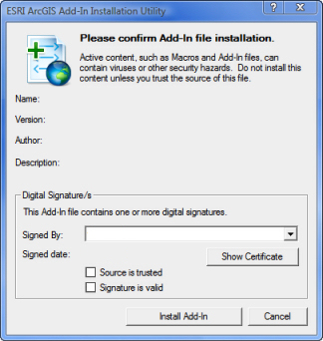
Installing
Zip file is put into
M:\ArcGIS\Addins\Desktop10.4\
or
%USERPROFILE%\Documents\ArcGIS\AddIns\Desktop10.4
There are easy install options: double clicking on the addin will bring up a wizard to install it.

Slide 11
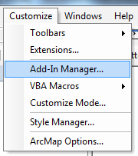
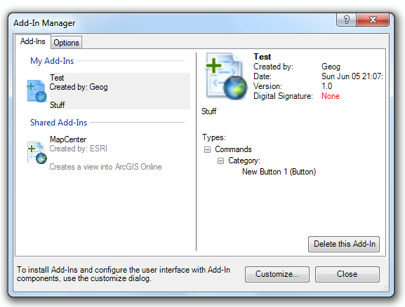
Addin manager

Slide 12
Rebuilding
You can open the project again to add extra addins: it will back up the old copy.
Remember, once you change the code, you need to rebuild the zip file and reinstall.
You'll need to reboot Arc to see the changes if it is open.
If there's a syntax error, the addin will appear as a red "stop" sign.

Slide 13
Managing AddIns
Admin Registry Keys (regedit.exe)
HKEY_LOCAL_MACHINE\SOFTWARE\ESRI\Desktop10.4 \ Settings
BlockAddIns
0 - Load all.
1 - Load signed only.
2 - Load ESRI only.
3 - Load from administrator folders only.
4 - Do not Load any Add-Ins.
AddInFolders
AdminAddInLock - stop tampering with these.

Slide 14
Digital signatures
More on demanding digital signatures at:
http://desktop.arcgis.com/en/arcmap/latest/analyze/python-addins/digitally-signing-add-ins.htm

Slide 15
Communicating between addins
ID set up in addin wizard can be used as a variable name to communicate with other addins.
The wizard adds a prefix, but if the addin components are in the same addin you shouldn't use it.
Don't use the same ID for different components.

Slide 16
Enabling GUI components
class MyButton(object):
def __init__(self):
self.checked = False # i.e. pushed (buttons only)
self.enabled = True
Can set for other tools based on ID:
if (arcpy.Exists("results.shp")):
process_button.enabled = True

Slide 17
pythonaddins module
Addins have access to the pythonaddins module:
OpenDialog(): to choose one or more GIS datasets.
SaveDialog(): to save data
GPToolDialog(): run geoprocessing tool dialog box.
MessageBox()
GetSelectedTOCLayerOrDataFrame()
GetSelectedCatalogWindowPath()
ProgressDialog()
(Actually, although undocumented, so do all internal script tools.)

Slide 18
MessageBox()
mb_type code | Message Box Type
0 | OK only
1 | OK/Cancel
2 | Abort/Retry/Ignore
3 | Yes/No/Cancel
4 | Yes/No
5 | Retry/Cancel
6 | Cancel/Try Again/Continue

Slide 19
ProgressDialog()
with pythonaddins.ProgressDialog as dialog:
dialog.title = "Progress so far"
dialog.description = "Doing something."
dialog.animation = "File"
for i in range(100):
dialog.progress = i
# Do something here.
if dialog.cancelled:
raise Exception("Issue has occurred")

