Slide 1
Programming for Geographical Information Analysis: Advanced Skills
Dr Andy Evans
Notes:
Welcome to the course. You’ll find extra information in these note sections below each slide.

Slide 2
What’s the big idea?
Move from Programmers to Analysts.
Learn the major branches of data storage, manipulation, and processing.
Introduction to scientific modelling.
Build you into Gods of the technosphere, able to see green code streaming across the landscape and shoot fiery lasers of code from your eyes.

Slide 3
Syllabus and Assessment
Probably…
Arcpy
SQL
Numpy/Pandas/GeoPandas
Natural Language Processing
Machine Learning
ABM+
Parallel programming
Data
Analysis
Modelling

Slide 4
Syllabus and Assessment
Online portfolio of practicals: 30%
Independent project: 70%

Slide 5
Programming Arc

Slide 6
Programming ArcGIS
ArcGIS: Most popular commercial GIS.
Out of the box functionality good, but occasionally:
You need to repeat tasks many times
You need a new tool
You need to make a series of tools work together
You need to simplify a series of tasks for users
In which case, you need to program ArcGIS directly.

Slide 7
ArcObjects Framework
ArcGIS is made from chunks of code:
The ArcObjects Framework
You have programmatic access to these chunks within ArcGIS, and outside ArcGIS provided Arc is installed on the machine.
If you pay, you can also use ArcEngine, which is these chunks, but made available for use in other applications.

Slide 8
Programming options
Programming options include:
Model builder
Python window
Python Scripting
Python/VB.Net/Java/C++ Addins
Java/C++ Extensions
Other, less used/dying options include:
Arc Macro Language
VBA
Notes:
http://desktop.arcgis.com/en/arcmap/latest/extensions/tracking-analyst/124-applying-a-custom-vb-action-to-a-real-time-layer.htm
http://desktop.arcgis.com/en/system-requirements/latest/arcobjects-sdk-system-requirements.htm

Slide 9
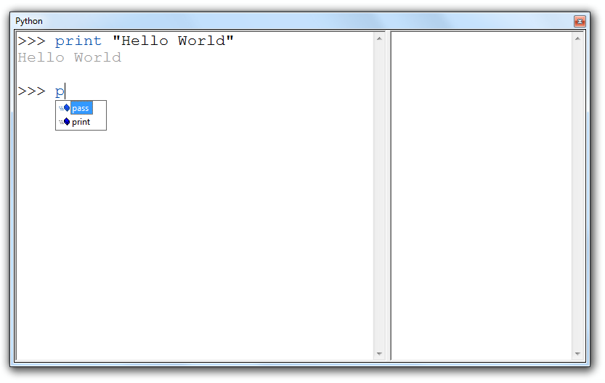
Python Window
Was limited to the Geoprocessing Framework within ArcObjects. Processes (ArcObject Tools) that implement IGPProcess interface.
Now wider, but still not full ArcObjects Framework.
Notes:
The python window can run very simple lists of commands, essentially replacing the command line of ArcWorkstation, the old command-line driven version of Arc.

Slide 10
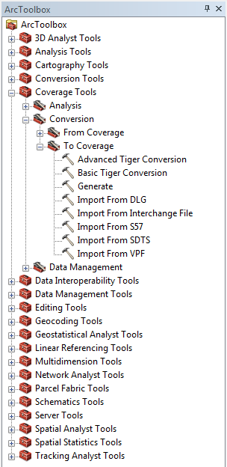
ArcToolbox
You can run the same kinds of tools with GUIs from ArcToolbox.
Stores Tools, but also Models and Scripts.
A Model is a set of tools joined together.
A Script is a text file containing instructions, including instructions to run tools as you might have in the python window.
Notes:
You can run the same sort of tools from their own wizards from within ArcToolbox. What we really need, however, is to run tools together, and multiple times.
As it happens, there is a system for doing that – it’s called “ModelBuilder”.

Slide 11
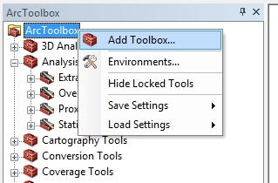
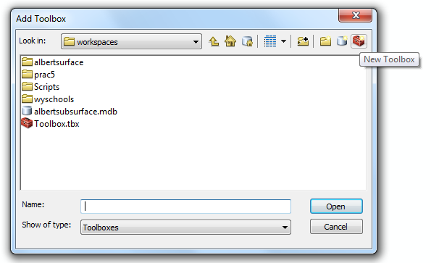
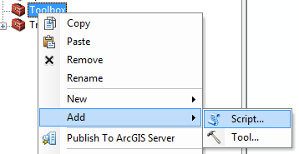
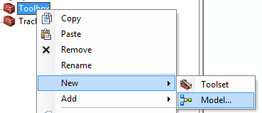
Scripts and Models
Need to be added to a new toolbox.

Slide 12
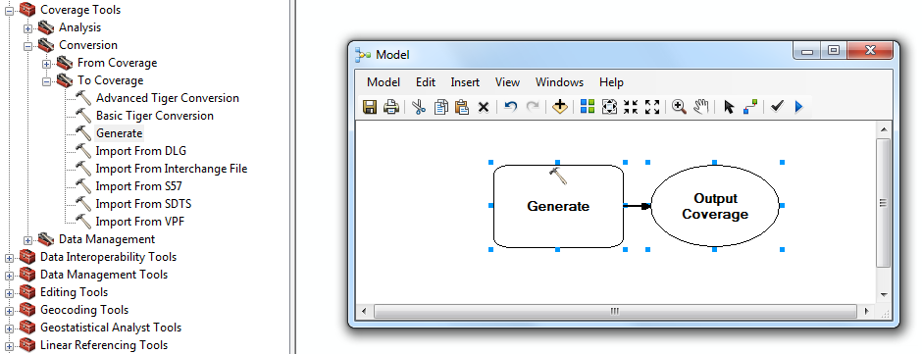
ModelBuilder
Fourth generation programming language:
Drag in visual representations hiding advanced code inside.
Drag tools in from ArcToolbox

Slide 13
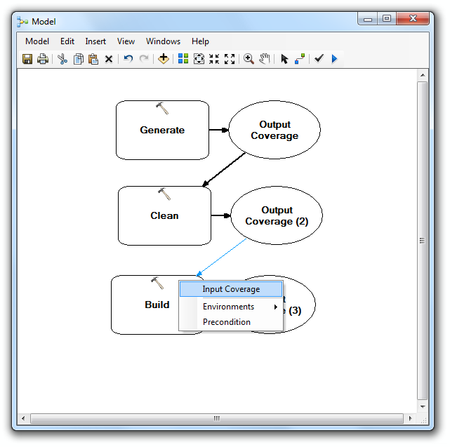
ModelBuilder
Link together by clicking on the two model elements with the connection tool.
Choose the variable to connect on.

Slide 14
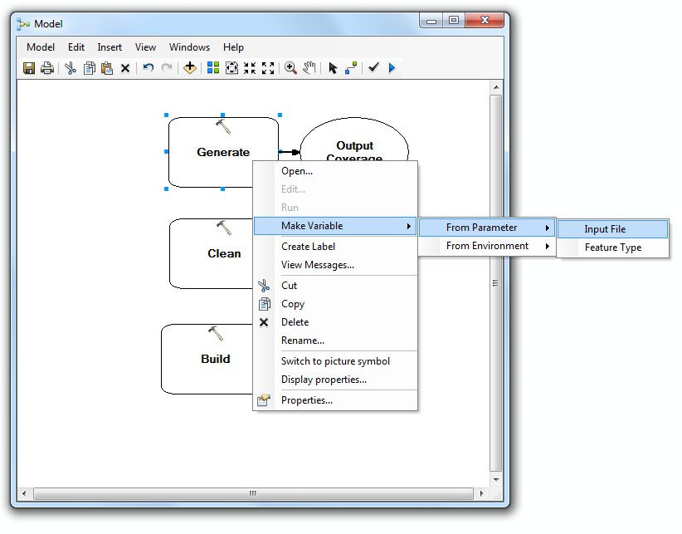
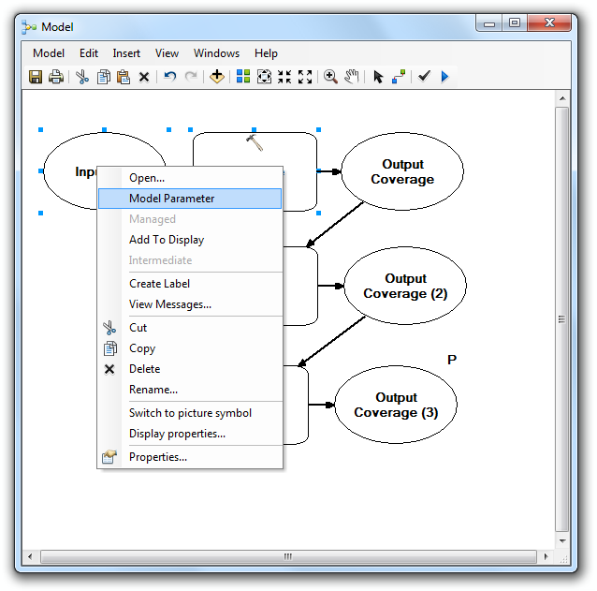
ModelBuilder
Start model with an input file.
Make inputs and outputs parameters (get a “p” next to them). Users asked for these.

Slide 15
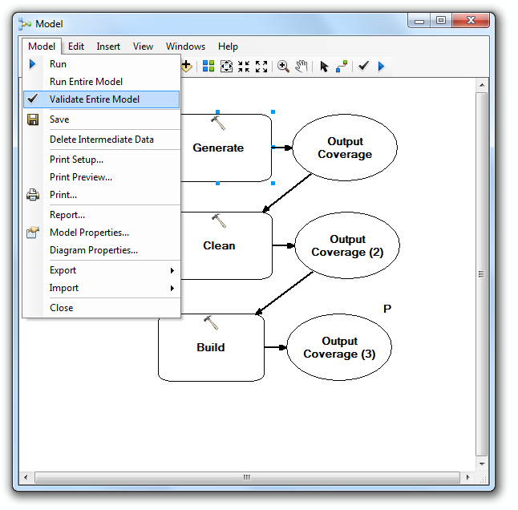
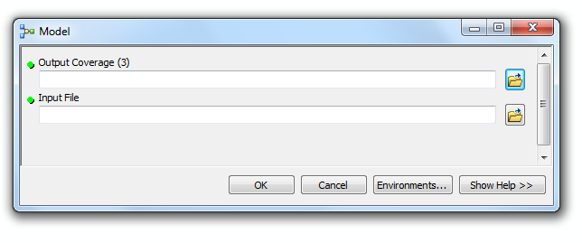
Modelbuilder
Validate – inputs and outputs ok
Run – click on model
Variables defined as parameters appear in model wizard.

Slide 16
Scripts
# ---------------------------------------------------------------------------
# buildScript.py
# Created on: 2012-01-13 17:38:48.00000
# (generated by ArcGIS/ModelBuilder)
# Usage: buildScript <Output_Coverage__3_>
# Description:
# ---------------------------------------------------------------------------
# Set the necessary product code
# import arcinfo
# Import arcpy module
import arcpy
# Script arguments
Output_Coverage__3_ = arcpy.GetParameterAsText(0)
# Local variables:
Input_File = ""
Output_Coverage = ""
Output_Coverage__2_ = ""
# Process: Generate
arcpy.Generate_arc(Input_File, Output_Coverage, "LINES")
# Process: Clean
arcpy.Clean_arc(Output_Coverage, Output_Coverage__2_, "", "", "POLY")
# Process: Build
arcpy.Build_arc(Output_Coverage__2_, "", "")
Python text files
import arcpy
Output_Coverage__3_ = arcpy.GetParameterAsText(0)
Input_File = ""
Output_Coverage = ""
Output_Coverage__2_ = ""
arcpy.Generate_arc(Input_File, Output_Coverage, "LINES")
arcpy.Clean_arc(Output_Coverage, Output_Coverage__2_, "", "", "POLY")
arcpy.Build_arc(Output_Coverage__2_, "", "")

Slide 17
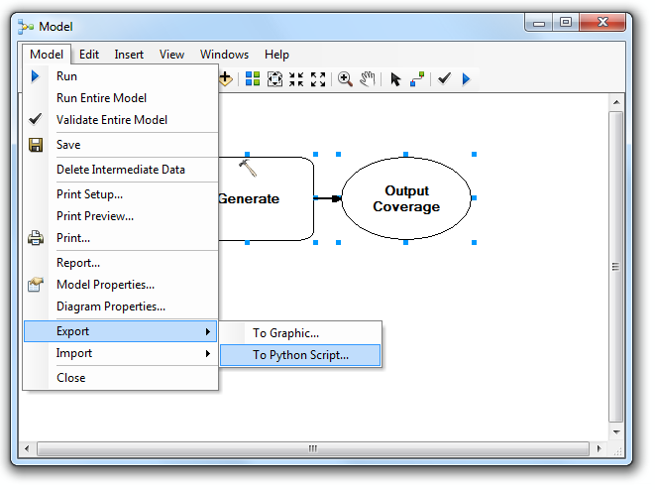
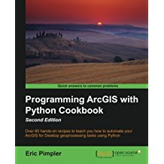
Scripts
Not a lot of info on them.
Best option is to export a model to see how it works.
Best bet for documentation is to search Help for “geoprocessing scripts”.

Slide 18
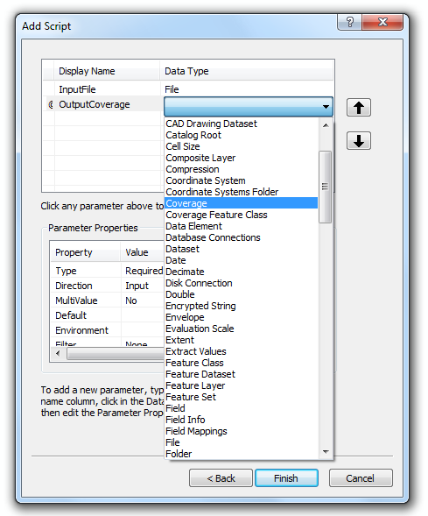
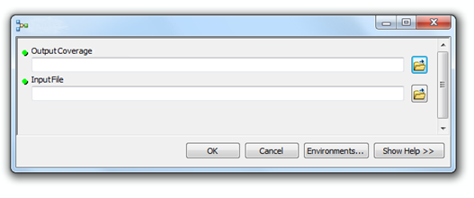
Adding Scripts
Need to set up parameters to pass into functions.
These listed when you make a script, or under its properties.
Then in script use:
arcpy.GetParameterAsText(0)

Slide 19
AML: The Arc Macro Language
A simple programming language in a text file.
  Interpreted not compiled.
  Runs in the order that commands, directives, etc. appear in the program.
A way to automate tedious tasks in ArcGIS.
A way to write (“old skool”) interfaces.
Not really needed now, but lots of legacy code around.
Notes:
AML was the traditional language of ArcWorkstation, but it still runs as a scripting language in ArcDesktop.
For more on ArcWorkstation and AML, see the extra notes in the Using GIS course.
http://desktop.arcgis.com/en/arcmap/latest/analyze/creating-tools/using-amls-with-script-tools.htm

Slide 20
The older programming languages
AML was much better supported in ArcGIS 9.2+ than in 8.x:
  there are no restrictions on the kinds of scripts you can run (previously it was just ones that ran in Arc, not ArcPlot etc.)
However, AML is an essentially dead language.
See Using AML with script tools in Help to see how to integrate running an AML file.
The old ArcView 3.x has its own language: “Avenue”.
This doesn’t run in ArcGIS 8.x.+
Notes:
AML is the latin of the GIS world, while Avenue is completely dead.
http://desktop.arcgis.com/en/arcmap/latest/analyze/creating-tools/using-amls-with-script-tools.htm

Slide 21
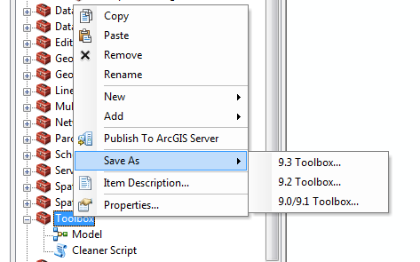
Saving tools
Toolboxes can be saved independently.
Or you can save your map and use it as a template. Just save it to:
<install drive>:\Program Files\ArcGIS\Desktop10.4\MapTemplates
Or, if you alone want to use it:
%APPDATA%\ESRI\Desktop10.4\ArcMap\Templates

Slide 22
Python
Direct access to ArcObjects Framework inside and outside Arc.
Ability to add components to the GUI.
Ability to communicate with external applications.
Advantages: much greater control and depth; nice addin model.
Disadvantages: not always obvious how to get a job done; doesn't have complete access to ArcObjects in the way Java or C++ do.
Notes:
These methods are all very well and good, but they are limited in the tools they can access and the external code they can access. Therefore we’ll be looking at how to integrate a higher level language into Arc. With Python we gain all the above advantages.

Slide 23
Next set of lectures
Week 16:
Tues / Thurs: Arc programming

