Slide 1
UML
The Unified Modelling Language.
A way of drawing code overviews so that it's understood by any programmer.
Usually part of a software development 'process'.
UML is an overview. Once developers have seen your UML, they’ll look at your documentation (next lecture) for more information.
Can be converted into raw code using some Computer Aided Software Engineering (CASE) tools.
Notes:
UML is not a replacement for documentation.

Slide 2
Why have an overview standard?
In industry code tends to be part of much larger projects with multiple programmers working on it.
Therefore we need standard overviews so that…
We can see whether an application can be made and how many people we’ll need to work before we start coding.
We can see where our code fits in when we start.
We can see how to use other people’s objects.
If you spontaneously combust, others can pick up your work easily.

Slide 3
Parts of UML
There are several types of model in the UML. Which one you use, and how you look at it, will depend on what you’re trying to do.
The secret is to use what’s useful.
Types of diagram…
Use Cases (What are the uses someone [or thing] may want from our software).
Class Diagrams (What are the different relationships between Classes).
Sequence Diagrams (What order does stuff happen in).
State/Activity Diagrams (What are Classes like over time).
Notes:
Don’t get too hung up on using the whole specification.

Slide 4
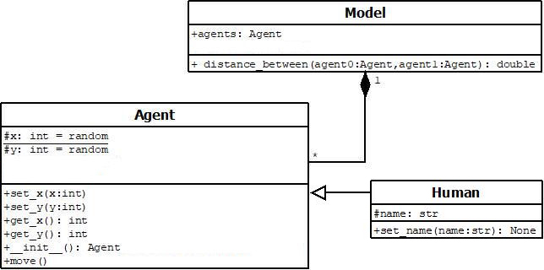
The Class Diagram
-/+/# = private/public/protected (all public in Python, though might use # for semi-protected variables)
Diamond-line means Agent is dependent for its life on Model. There's one model and multiple Agents.
Solid arrow is inheritance from a class/abstract class. Interfaces have dashed arrows and are written:
<<Point>>
Abstract classes are either light font or, more usually, italics.
Variables at top, methods at bottom.

Slide 5
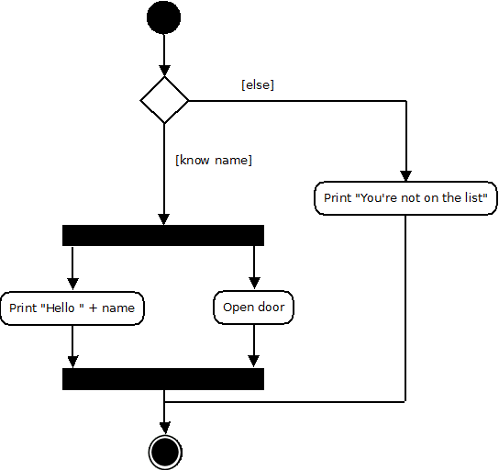
Activity Diagram
Replacement for older flowcharts.
Beginning and end marked by circles
(end by a double circle).
Diamonds for decisions.
Parallel code marked by bars.

