Slide 1
Computational issues with modelling
High Performance Computing
Parallel programming
Distributed computing architectures
Notes:
So, what kinds of systems do we run this kind of code on?

Slide 2
Issues with architecture
Is there going to be a lot of communication?
Can you cope with security issues?
What skills do you need?
Do you have the computing resources?
What other services do you want?
Do you want a permanent resource?
Notes:
When considering the kind of system to run your program on, you need to think about a few issues.

Slide 3
Communication and Processing speed
Different computing components have different speeds:
Central Processing Units can now process >7000 MIps
Typical RAM read speeds are ~3000 Mbps.
Typical hard-drive reading speeds are 700 Mbps.
Hence we don’t want to read hard-drives, and RAM speed limits us.
However, what limits local computation is bus speeds:
Typical System Bus transfer rates are ~1000 Mbps.
Typical IO Bus for hard-drives run at 133 Mbps.
Notes:
Communication levels are key. Low communication levels (as in batch distribution) allow greater flexibility. To understand the impact of communication on our architectural choices we have to think about the speed at which processing is done.
If we look at the processing and memory retrieval itself, we can see that RAM is much faster than hard-drive access, and CPUs can generally run faster than RAM can supply data (MIps is millions of instructions per second – an instruction potentially containing a number of bytes; MBps is millions of bits per second).
However, the real bottlenecks are the communications between components. This varies even on a single motherboard (the base on which most computer components sit or are connected to). The connections between elements are called “buses”. The System Bus connects the CPU and memory. Already we can see that this limits the data transfer from the RAM to the CPU. IO Buses sit between the CPU and devices like hard-drives. The typical hard-drive IO Bus runs much slower than a hard-drive can be read.
This is why we don’t want to write to the hard-drive if we can help it – writing here is almost 2 orders of magnitude slower than the CPU can process data.
Central Processing Units can now process >7000 million instructions per second.
Typical RAM read speeds are ~3000 million bits per second.
Typical System Bus transfer rates are ~1000 million bits per second.
Typical hard-drive reading speeds are 700 million bits per second.
Typical IO bus for harddrives run at 133 million bits per second.
Typical home network runs at 1.6Mbps
Typical ethernet connection runs at 10Mbps
Typical fast ethernet runs at 100Mbps
Recommended reading:
http://computer.howstuffworks.com/motherboard.htm
http://computer.howstuffworks.com/microprocessor.htm
http://www.webopedia.com/DidYouKnow/Hardware_Software/2005/computer_bus.asp

Slide 4
Latency and Location
However, distributed computing relies on network speeds, or bandwidth.
Theoretical values, however, are altered by the processing time needed for management, and sometimes by the distance and network form between exchanges. This gives us the network latency – the speed it generally works at.
Notes:
However, the real problem with distributed computing is that some of it is done over the network.

Slide 5
Latency and Location
Typical home network runs at 1.6Mbps.
Typical Ethernet connection on a Local Area Network (LAN) runs at 10Mbps.
Typical fast Ethernet runs at 100Mbps.
i.e. at best the same as hard-drive access.
We therefore want to minimise computer-to-computer communications and minimise the distance between computers, ideally ensuring they are all on a Fast Ethernet LAN.
Notes:
Typically a home network runs three orders of magnitude slower than a CPU will process. At best we might get it up to an order of magnitude less, with fast Ethernet connections.
What this means is that is we have high communication levels, these are best done on a LAN, or, even better, on a single machine where we only have to worry about bus speeds.
Not that MBp is Mega Bytes per second, while Mbp is Mega bits per second.

Slide 6
Speedup
One would expect that doubling the processors would halve the time.
However, as Amdahl's law points out, this is limited by the speed of the non-parallelisable component, and this is particularly key in locking algorithms and those with high communication overheads.
In general, parallelisation doesn’t speed up models.
Infact, if we use communication across high-latency connections, there can be a slow-down in processing.
We therefore generally parallelise models to make them possible, not faster.
Notes:
Though if we’re hitting memory limits, this may slow programs as the OS struggles to find running space, so dividing the memory use across nodes may also speed up the program compared with running the full model on one PC.

Slide 7
Security
In general MPI-style coding allows outside code to contact each PC and run arbitrary Java.
This needs a good firewall around, but not between, the PCs with strong security measures.
Generally, with Beowulf setups, the machine-to-machine communications are encrypted and validated using Secure Shell (SSH), because Beowulf machines tend to use the LINUX OS:
http://en.wikipedia.org/wiki/Secure_Shell
But it depends on your software, MPJ Express for Windows, for example, relies more on an external firewalls.

Slide 8
Skills
Other than MPJ Express, a lot of these systems run on Unix-like OSs like Linux.
Useful to get familiar with these.
Command line driven, but with various different “shells” on the same machine.
Tend not to have lettered hard-drives, but instead space “mounted” as directories.
Learning:
Mac-OS is a Unix-based system, and you can access the command line using the Terminal app.
http://www.virtualbox.org/ allows you to run Linux on a PC.
Notes:
The alternative for running Linux temporarily is to boot into it from a USB stick:
http://www.techradar.com/news/computing/pc/how-to-run-linux-from-a-usb-drive-496211
http://www.linuxliveusb.com/
http://www.pendrivelinux.com/

Slide 9
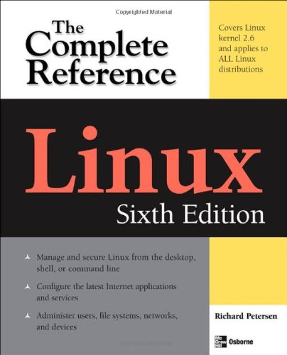
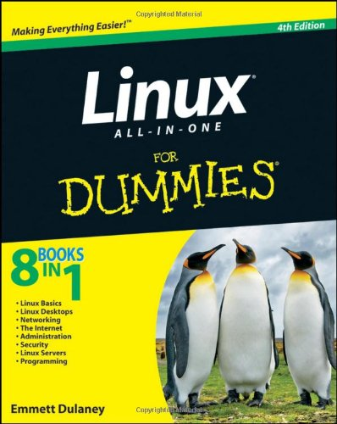
Linux Books
Richard Petersen (2008) Linux: The Complete Reference.
Generally a good starting point.
Emmett Dulaney (2010) Linux All-in-One For Dummies.
Includes LAN and security setup.
Basic tutorial at:
http://www.ee.surrey.ac.uk/Teaching/Unix/
Notes:
A lot of Linux books tend to jump into some pretty horrible details quite rapidly. If you’re starting out, you’ll probably want something that gets you up and running in a safe way. The ‘For Dummies’ book seems to do a good job of it. The complete reference is less for beginners, but equally doesn’t go into huge depth, so it’s a middle-range reference that’s good for most things.

Slide 10
Volunteer computing
Most fully Peer-to-Peer software is written bespoke and not so useful for processing as need a central node to report to.
Easiest option for more centralised distribution is the Berkeley Open Infrastructure for Network Computing (BOINC):
http://boinc.berkeley.edu/trac/wiki/ProjectMain
BOINC client fetches jobs from a server and runs it on a local application. It then returns the result. Client runs as a screensaver or on spare CPU cycles.

Slide 11
Volunteer computing
Large numbers of computers at low hardware cost (+ low maintenance etc.)
High latency, so low communication/data transfer, high processing, jobs good.
Person investment high as needs to have good looking interface and run reliably. BOINC suggest ~3 person-months:
1 month experienced sys admin;
1 month of a programmer;
1 month of a web developer
+ then 50% person to maintain it over project lifetime.

Slide 12
Multi-core machines / GPUs
It's possible now to buy multicore machines with large amounts of memory (generally Linux machines, as traditionally Windows machines had memory maximums).
However, these can be expensive.
Increasingly common is to instead use graphics cards. Graphics Processing Units generally have much more power and many more cores (often hundreds) for a very cheap cost.

Slide 13
GPUs
The downside is that software needs writing in special languages, for example OpenCL.
One option is Theano (comes with Anaconda), a compiler that will compile Python maths and array operations especially for GPUs such that they can be called very efficiently from standard Python.
http://deeplearning.net/software/theano/
If you have a graphics card (or more than one - you can build banks of them) and need to do intensive array/matrix operations, this is a good option.

Slide 14
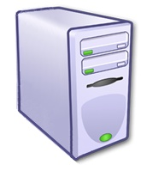
Beowulf
In general, while we’d distinguish Beowulf by being a cluster of PCs dedicated to parallelisation surrounded by a specific firewall, there’s little difference between that and a Windows cluster running MPJ (though you can run MPJ on much more sophisticated architectures).
Beowulf clusters have the great advantage of being cheap, easy to set up, and under local control. They are also on a LAN.
You need to buy the PCs though, and make sure of their security and management.
Limited in other resources they connect to.

Slide 15
Grid Computing
More general than Beowulf (includes some things like BOINC and web-services), but tends in practice to be a formal architecture.
A group of networked resources, including data servers, service providers, secure gateways, etc. managed by a consortium.
Jobs timetabled/allocated to processors using middleware, e.g. the Globus Toolkit.
Makes batch distribution simple: just load up the model on multiple processors. You can then have a single program that collates the end results.

Slide 16
Grid
Generally maintained and secured by a consortium who own the machines.
Low(ish) cost of entry.
Good connectivity with resources.
Share processing/memory with other people, so you need to wait for space to run stuff.

Slide 17
Running on ‘The Grid’
Because GRID's are shared between multiple users, they use 'job submission' systems. You submit your program to a queue and wait your turn.
The larger the job (in terms of number of cores and amount of memory requested) the longer you usually have to wait.
Although it is possible to ask for an interactive session, it is normal to write a script to define the job.
Each user has a resource limit (e.g. total number of CPU time). If you go over this you have to ask for / pay for more time. (Using the Leeds grid 'Arc2' is free for end-users).
For more information about getting access to the GRID at Leeds, email Andy or Nick Malleson.

Slide 18
Cloud computing
Large scale processor farms with associated data storage and services.
You rent as much power and space as you need ‘elastically’.
Popular versions include Amazon Elastic Compute Cloud (Amazon EC2) :
http://aws.amazon.com/ec2/
Usually get a virtual machine you can work with (e.g. Amazon Machine Image (AMI) system). This may include virtual clusters for HPC:
http://aws.amazon.com/hpc-applications/
Nice video at: http://www.youtube.com/embed/YfCgK1bmCjw
Notes:
Note that hardware “virtualisation” refers to the process whereby one (or more) machine(s) pretend to be a different piece of hardware running a different OS. This can be a single machine running several different OSs, but in the case of cloud computing is more usually a bank of machines working as a flexible collective.

Slide 19
Costs
Typical Amazon costs for Linux (Windows a bit more):
Small (Default) $0.090 per Hour. 1.7 GB memory 1 EC2 Compute Unit (1 virtual core with 1 EC2 Compute Unit) 160 GB instance storage 32-bit or 64-bit platform Extra Large $0.720 per Hour 15 GB memory 8 EC2 Compute Units (4 virtual cores with 2 EC2 Compute Units each) 1,690 GB instance storage 64-bit platform There are also additional costs for I/O and extra storage (although these aren't much).
You can start/stop the machines and should generally only pay when in use.
Notes:
Nick has given the costs above.
Amazon cloud costs (from http://aws.amazon.com/ec2/pricing/ with instance definitions here http://aws.amazon.com/ec2/instance-types/) running Linux (Windows is a bit more expensive). The machines are easy to start up and shut down, so you should only pay while they're in use.
Nick also notes that you can apply for Amazon sponsorship which gets you free resources – the form takes about 30 mins to fill in and can get you several thousand dollars worth of resources for something useful.

Slide 20
Cloud computing
Very low entry cost, though you don’t own the machines.
Flexible resource levels.
Someone else maintains and secures the machines.
Usually not connected directly to useful resources.
You don’t know what they are doing with your data, and usually they are hosted outside your country, which may cause data-protection issues.
Latency between machines can vary, though it is often possible to request machines local to each other.

Slide 21
Issues with architecture
Is there going to be a lot of communication?
LAN Beowulf (or bus-connected supercomputer).
Can you cope with security issues?
If not, Grid or Cloud.
What skills do you need?
If not Linux, then Beowulf-lite MPJ on a Windows cluster.
Do you have the computing resources?
If not, Volunteer system, Grid or Cloud.
What other services do you want?
If many, probably Grid.
Do you want a permanent resource?
If not, Volunteer, Grid, or Cloud.
Notes:
When considering the kind of system to run your program on, you need to think about a few issues.

Slide 22
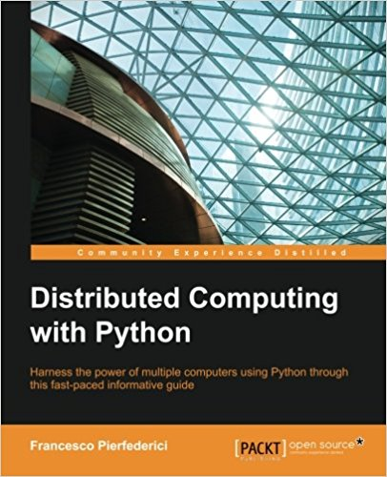
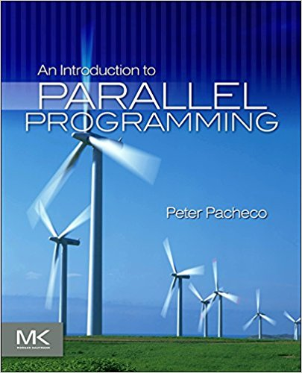
Further info
A really good book that introduces threads, concurrent.futures, and celery, and gives a detailed look at setting up Amazon cloud computing is:
Francesco Pierfederici (2016) Distributed Computing with Python.
It doesn't cover MPI. For this, the MPI4Py docs are good. You could also check out a general MPI book, as the API and issues are roughly similar, and you'll need to get a C version running in the background. A good one is:
Peter Pacheco (2011) An Introduction to Parallel Programming (update on Parallel Programming with MPI? C++ code, but fine).

