Slide 1
Parallel Programming
Dr Andy Evans

Slide 2
A few terms from standard programming
Process: a self-contained chunk of code running in its own allocated environment.
Thread: a lightweight sub-process; a semi-independent chunk of a program separated off from other elements.
Processor: chip doing processing. One Processor may have multiple Cores. A PC might have multiple Central Processing Units (~processor plus other bits), but will undoubtedly have multiple Cores these days.
Core: a processing unit usually only capable of running a single Process at a time (though can have others on hold). Usually a single core machine can appear to run more than one Process by quickly switching between processes, though more recently have multiple Hardware Threads (HW Threads) to support effective use and/or multiple processes/threads essentially as virtual cores.
Asynchronous programming: calling code that will, at some point get back to us, rather than calling it in strict order.
Concurrent programming: programming using multiple threads and/or multiple cores; on a single machine or multiple specialised machines.
Notes:
First some terms from standard programming that are useful to know. You’ll remember that we covered Threads briefly in the Core Programming course.

Slide 3
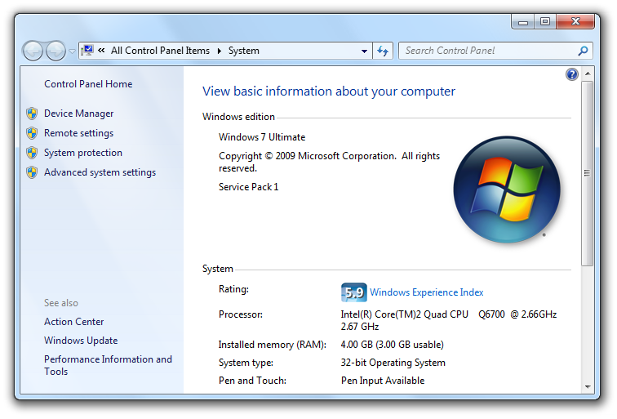
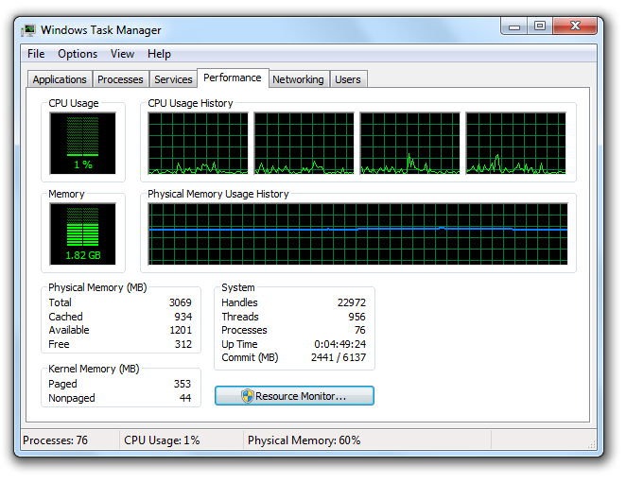
How to check processor/core numbers
My Computer → Properties
Right-click taskbar → Start Task Manager (→ Resource Monitor in Win 8)
With Python:
multiprocessing.cpu_count()
Notes:
It may be useful to know how many processors/cores you have and how they are load balancing. To check for processors, look at the My Computer properties, which lists the processors you have on your machine. It may also say something like it is a “quad core”, which means the chip has four cores. To see the number of available cores, and check their processing load balance, look at Windows’ Task Manager.

Slide 4
Computational issues with modelling
High Performance Computing
Parallel programming
Distributed computing architectures
Notes:
So, we’ll start by looking at some of the issues with modelling on PCs.

Slide 5
The frontier of modelling
Individual level modelling is now commonplace.
Data is in excess, including individual-level data.
Network speeds are fast.
Storage is next to free.
So, what is stopping us building a model of everyone/thing in the world?
Memory.
Processing power.

Slide 6
Memory
To model with any reasonable speed, we need to use RAM.
Sex: 1bit (0 = male; 1 = female)
1 bit = 1 person
1 byte = 8 people
1Kb = 1024 x 8 = 8192 people
1Mb = 1,048,576 x 8 = 8,388,608 (1024²x8) people
1 Gb = 1,073,741,824 x 8 = 8,589,934,592 people
Seems reasonable then. Typical models running on a PC have access to ~ a gigabyte of RAM memory.
Notes:
Writing to disks takes a long time, programmatically. To keep runtimes down to something reasonable we really need to stick to writing to Random Access Memory – the chips built into your computer’s motherboard. We can read data from these at ~an order of magnitude faster than hard drives (we’ll look at this in detail later).
The above shows how we might store the sex of a range of people. We can pretty easily store the sex of the world's population on a PC.

Slide 7
Memory
Geographical location (⁰ ′ ″ ‴N &W): 8 ints = (for example) 256 bits
1 Gb = 33,554,432 people
This isn’t including:
The fact that we need multiple values per person.
That we need to store the running code.
Maximum agents for a PC ~ 100,000 — 1,000,000.
Notes:
In general, however, we want more than one 1bit variables, we need tens of variables of several bytes each. In addition we need resources to manage those. These limit the size of our models on a single PC.

Slide 8
Processing
Models vary greatly in the processing they require.
a) Individual level model of 273 burglars searching 30000 houses in Leeds over 30 days takes 20hrs.
b) Aphid migration model of 750,000 aphids takes 12 days to run them out of a 100m field.
These, again, seem ok.
Notes:
In addition to memory space, calculations also take processing time (informally "power").
Malleson, N., See, L.M., Evans, A.J. and Heppenstall, A.J. (2010) 'Implementing comprehensive offender behaviour in a realistic agent-based model of burglary' Simulation, 0(0): 1-22
Parry, H., Evans, A.J., and Morgan, D. (2006) 'Aphid population dynamics in agricultural landscapes: an agent-based simulation model' Ecological Modelling, Special Issue on Pattern and Processes of Dynamic Landscapes, 199 (4), 451-463.
Parry, H. and Evans, A.J. (2008) 'A comparative analysis of parallel processing and super-individual methods for improving the computational performance of a large individual-based model' Ecological Modelling, 214 (2-4), 141-152

Slide 9
Processing
However, in general models need multiple runs.
Models tend to be stochastic: include a random element so need multiple runs to give a probabilistic distribution as a result.
Errors in inputs mean you need a distribution of inputs to give a reasonable idea of likely range of model outputs in the face of these errors.
Notes:
While one model run might be fine, we have to remember that we often need multiple runs.

Slide 10
Monte Carlo testing
Where inputs have a distribution (error or otherwise), sample from this using Monte Carlo sampling:
Sample such that the likelihood of getting a value is equal to its likelihood in the original distribution.
Run the model until the results distribution is clear.
Estimates of how many runs are necessary run from 100 to 1000s.
Notes:
This is especially true where our model inputs might range across several values in reality. In this case we often want to generate a set of models encompassing that range (weighted for the more probable values) to see what the range of outputs might be.
For and introduction, see:
Evans, A.J. (2012) 'Uncertainty and Error'. In Heppenstall, A.J., Crooks, A.T., See, L.M., and Batty, M. (2011) 'Agent-Based Models of Geographical Systems'. Springer.

Slide 11
Identifiability
In addition, it may be that multiple sets of parameters would give a model that matched the calibration data well, but gave varying predictive results. Whether we can identify the true parameters from the data is known as the identifiability problem. Discovering what these parameters are is the inverse problem.
If we can’t identify the true parameter sets, we may want to Monte Carlo test the distribution of potential parameter sets to show the range of potential solutions.

Slide 12
Equifinality
In addition, we may not trust the model form because multiple models give the same calibration results (the equifinality problem).
We may want to test multiple model forms against each other and pick the best.
Or we may want to combine the results if we think different system components are better represented by different models.
Some evidence that such ‘ensemble’ models do better.

Slide 13
Processing
a) Individual level model of 273 burglars searching 30000 houses in Leeds over 30 days takes 20hrs.
100 runs = 83.3 days
b) Aphid migration model of 750,000 aphids takes 12 days to run them out of a 100m field.
100 runs = 3.2 years
Ideally, models based on current data would run faster than reality to make predictions useful!
Notes:
All this adds up; we often want to do thousands of runs. However, even hundreds of runs can be a problem.

Slide 14
Issues
Models can therefore be:
Memory limited.
Processing limited.
Both.
Notes:
What goes for models goes for other kinds of computation as well. For example, certain image processing tasks can be very intensive.

Slide 15
Solutions
If a single model takes 20hrs to run and we need to run 100:
a) Somehow cut down the number of runs needed.
b) Batch distribution: Run models on 100 computers, one model per computer. Each model takes 20hrs. Only suitable where not memory limited.
c) Parallelisation: Spread the model across multiple computers so it only takes 12mins to run, and run it 100 times.
Notes:
As many of our models are memory limited and batch distribution is relatively simple, we’ll talk about parallelisation more in this lecture.
Of course, there is also a gradient here – some programs may run in batch mode but have a parallel component to pull together the results.

Slide 16
Computational issues with modelling
High Performance Computing
Parallel programming
Distributed computing architectures

Slide 17
Supercomputers vs. Distributed
Supercomputers: very high specification machines.
Added multiple processors to a single machine with high speed internal connections. Note that most PCs now have more than one processor and/or core.
Distributed computing: Several computers work together.
Either formally connected or through apps that work in the background.
Strictly includes any networked computing jobs including Peer-to-Peer (P2P) services.
Informal includes: Napster (Distributed Data); SETI@Home (Distributed Processing; see Berkeley Open Infrastructure for Network Computing [BOINC]); Skype; Spotify.

Slide 18
Flynn’s taxonomy
SISD: Single Instruction, Single Data stream
MISD: Multiple Instruction, Single Data stream
SIMD: Single Instruction, Multiple Data stream
Each processor runs the same instruction on multiple datasets.
Each processor waits for all to finish.
MIMD: Multiple Instruction, Multiple data stream
Each processor runs whatever instructions it likes on multiple data streams.
SPMD: Single Process/program, Multiple Data
Tasks split with different input data.
Notes:
In general there are lots of different architectures that could be used for parallel processing, depending on how we break things up. Flynn’s taxonomy is a description of the broad types. With most geographical models we’re interested in MIMD and SPMD architectures.
Modern CPUs often utilise different elements within themselves; so, for example, many now have SIMD components that will apply a single instruction to arrays of data very efficiently.
Sadly this taxonomy isn’t named after the TRON character, but rather: http://en.wikipedia.org/wiki/Michael_J._Flynn

Slide 19
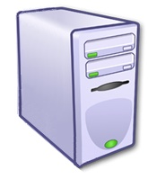
Beowulf
Formal MIMD architectures include Beowulf clusters. Built from cheap PCs, these revolutionised the cost of HPC.
Generally one PC with a monitor acts as ‘node zero’ collating and displaying results.
Other nodes can write to their own drives and a network space (Shared Memory Model).
Notes:
We’ll look at some other architectures later. A very common architecture is the Beowulf Cluster. Though as a physical object it is fast being superseded by cloud based systems, these often are used to replicate Beowulf-like systems using virtual machines (we'll look at this later).

Slide 20
Parallelisation
Split the model up so bits of it run on different machines. End result then collated.
Two broad methods of parallelisation which play out in Flynn’s taxonomy, but also at the model level:
Data parallelisation
Divide the data the model works with into chunks, each processor dealing with a separate chunk (in our case, we usually divide the geography up).
Task parallelisation
Each processor has all the data, but the task is split up (in the case of an ABM, the agents might be divided up – though whether this is task or data division depends on the agents).
Notes:
While there are fields where you can also split by time, in geography systems tend to change state by Markov processes – that is, the state at time = x determines the state at time = x+1. In general, the fact that we are modelling such causal systems dictate that events have to happen in sequence. There are some exceptions, but these are few, and tend to be treated either statistically or analytically.

Slide 21
Which?
If memory limited, you have to divide the memory-heavy components, even if this slows the model. Sometimes it is better to get a model running slowly than not at all.
Otherwise, whichever reduces communication between processors – this is usually the slowest process.
If agents local and static, then divide geography.
If agents move lots but don’t communicate, then divide agents.
Unfortunately, most models have agents that move and communicate so at some point you’ll have to move agents between geography slabs or communicate with agents on other nodes.

Slide 22
Case Study
Sometimes you need to think closely about the data transferred to get out of this issue.
Memory limited model: how to model millions of Aphids attacking agricultural land?
Aphids move a mix of long and short distances (Lévy flight), random but skewed by wind.
Long flights take place when density of aphids are high, so we can’t reduce the number of agents.
i.e. model needs all of geography on one node, but also all agents need to know about all other agents (i.e. communicate with other agents).
Seems problematic.
Notes:
Parry, H., Evans, A.J., and Morgan, D. (2006) 'Aphid population dynamics in agricultural landscapes: an agent-based simulation model' Ecological Modelling, Special Issue on Pattern and Processes of Dynamic Landscapes, 199 (4), 451-463.
Parry, H. and Evans, A.J. (2008) 'A comparative analysis of parallel processing and super-individual methods for improving the computational performance of a large individual-based model' Ecological Modelling, 214 (2-4), 141-152

Slide 23
Case Study
Let’s say we run the model on 10 nodes, each with the whole geography but we split up the aphids.
We might think that 100 aphids need 99 communications each to find out where all the other aphids are (i.e. 9,900 communications per step).
But, actually, they only need the density raster on each node. i.e. at most, each node needs to communicate with each other node once per step (10 x 9 communications).
Actually, if we get node zero to request and send out the total aggregate density, each node only needs to communicate with node zero (i.e. 10 sends and 10 receives).
Managed to model 1 million aphids at an equivalent speed to 100,000 aphids on one processor.

Slide 24
Issues with parallelisation
Message passing overheads if we need our machines to talk.
Need to lock shared data when being altered. This can result in thundering herd problems, where a number of processes want access to resources and use up processing power negotiating that and then putting non-successful processes to sleep.
Need to carefully plan shared variables to prevent race hazards, where the order of variable changes determines their proper use.
Load balancing (how to most efficiently distribute the processing and data).
Synchronisation/Asynchronisation of code timings to avoid detrimental blocking (one free processor waiting on another), particularly deadlock (where all the processors are waiting for each other).

