Slide 1
Computer Ethics
Rapidly growing field:
Traditional elements:
Privacy and data protection
Copyright and Piracy
Software supplier responsibilities
Newer:
Big Data use
Robotic ethics
Control by computers
Integrating computers into our worldview
A good starting point for the newer stuff is Floridi et al.:

Slide 2
Women in computing
In the war, approximately 75% of employees at Bletchley Park were women, and many worked with the computational machines, or were human 'computers'.
In the US in 1984, 37.1% computing degrees were to women; by 2010-11 it was 12%.
In Britain in 2014 only 13% of computing students were women, and 3% of IT and computing engineers.
A case study in the issues around gender and computing includes the fallout from PyCon Santa Clara in 2013 in which a overheard joke resulted in both perpetrator and complainant being fired from their jobs.
Notes:
https://en.wikipedia.org/wiki/Women_in_Bletchley_Park
https://www.gadgette.com/2016/04/15/women-in-tech-history-bletchley-park/
https://www.computerworlduk.com/careers/women-studying-computer-science-in-uk-universities-is-declining-3621040/
https://en.wikipedia.org/wiki/Gender_disparity_in_computing
https://en.wikipedia.org/wiki/BCSWomen
https://arstechnica.com/tech-policy/2013/03/how-dongle-jokes-got-two-people-fired-and-led-to-ddos-attacks/

Slide 3
Women in computing
Big push at school level to address this.
Organisations like Code First: Girls are looking for volunteer trainers.
http://www.codefirstgirls.org.uk/
BCSWomen Specialist Group of the British Computer Society push for cultural and employment change
http://www.bcs.org/category/8630
Notes:
https://en.wikipedia.org/wiki/Women_in_Bletchley_Park
https://www.gadgette.com/2016/04/15/women-in-tech-history-bletchley-park/
https://www.computerworlduk.com/careers/women-studying-computer-science-in-uk-universities-is-declining-3621040/
https://en.wikipedia.org/wiki/Gender_disparity_in_computing
https://en.wikipedia.org/wiki/BCSWomen

Slide 4
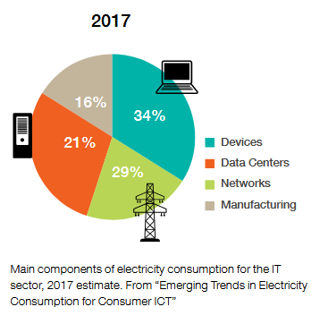
Environmental impact
Electricity usage (hardware; air conditioning; data transmission).
Production of hardware (standard raw materials; rare earth materials; power).
Waste disposal.
Hard to calculate total resource uses.
In general, the larger cloud based companies are trying to move to 100% renewables which also makes total unrenewable energy hard to estimate.
Greenpeace place the total energy value between 7 and 12% of total electricity usage.
Notes:
Emerging trends in electricity consumption for consumer ITC.
http://vmserver14.nuigalway.ie/xmlui/handle/10379/3563

Slide 5
What can we do as coders?
Make efficient software that runs fast.
Minimise code size so it runs on smaller computers.
Reduce video download where possible.
Encourage the use of offline solutions but don't offload on to printing.
Train people so they solve problems quicker with less resources.
Turn off computers when not used (or put into efficient sleep mode if not).
Use cloud suppliers with a renewable energy policy.

Slide 6
Good sources
The "Dirty Bits" project blog of Nathan Ensmenger (Indiana University):
http://homes.soic.indiana.edu/nensmeng/enviro-compute/index.html
http://homes.soic.indiana.edu/nensmeng/bio.html
Greenpeace:
http://www.greenpeace.org/usa/global-warming/click-clean/
Other:
https://www.thegreengrid.org/ (industry group)
Notes:
Ingrid Burrington (2015) The Environmental Toll of a Netflix Binge. The Atlantic [online] https://www.theatlantic.com/technology/archive/2015/12/there-are-no-clean-clouds/420744/ Accessed 1/10/2017

