Slide 1
Modelling
Examples:
Cellular Automata
Agent-based models
The modelling process
Notes:
Individual-level models are a) often the best way to model systems; b) the latest and greatest thing in modelling; c) relatively easy to understand. Given this, let's look at two types of individual-based model, CAs and ABMs, as examples. This will help when we come to look more generally at the modelling process later.

Slide 2
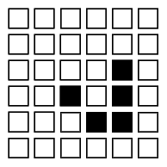
Cellular Automata (CA)
Can be used for simulation but much much more.
Essentially a grid of cells which may be different states dependant on the conditions around them.
Each cell has a rule base determining how it reacts.
For example,
if a cell has less than two neighbours it dies,
if it has more than two it reproduces and the neighbouring cells come alive.
Can be used for searches, modelling crowds, ecosystems etc.

Slide 3
One dimensional CA
Simplest CA: a line of cells.
Each cell has a number of states it can be in, depending on the state of its neighbours and itself at the last time step.
Usually drawn as a line of cells, with each line below each other being another time step.
Simple rules can generate complex emergent behaviour.
Notes:
At this point you should do the 1D CA exercise on the handout associated with this lecture.

Slide 4
Emergence
From the simple rule: if both neighbours the same as you, go white else go black.
Notes:
The figure above (which is that generated by the 1D CA on the handout) is pretty much identical to a fractal form called the “Sierpinski Gasket”. Another way you can form the shape is by taking a triangle and replacing all the corners with triangles a third the size, and repeating the operation.
http://www.cut-the-knot.com/ctk/Sierpinski.html
The generation of this complex shape from a simple rule seems unlikely, but this kind of development is characteristic of a number of simple systems.
The figure is from the excellent book The Computational Beauty of Nature, by Gary William Flake.
http://www.amazon.co.uk/exec/obidos/ASIN/0262561271/
http://www-mitpress.mit.edu/books/FLAOH/cbnhtml/
The book covers much of the material covered in this course (fractals, AI, neural nets, CAs, Genetic Algorithms), but isn’t recommended as a “light read”. If you’re prepared to put in the hours on the (actually very basic) maths, it covers some astonishing ground, and you don’t actually need to know anything before you start as even the maths is explained.
If you can’t read the notice on the bottom it says “Figure from The Computational Beauty of Nature: Computer Explorations of Fractals, Chaos, Complex Systems, and Adaptation. Copyright © 1998-2000 by Gary William Flake. All rights reserved. Permission granted for educational, scholarly, and personal use provided that this notice remains intact and unaltered. No part of this work may be reproduced for commercial purposes without prior permission from the MIT Press.”

Slide 5
One dimensional CA
Steven Wolfram classified CAs into…
Class 1 always end in the same stable state.
Class 2 settle into repeat patterns.
Class 3 chaotic / white noise patterns.
Class 4 complex patterns of near repetition with movement.
Shows the wide range of natural patterns that could develop from simple rules.
Notes:
Note that just because a natural pattern looks like one generated from simple rules, it doesn’t follow that it is. To make that assumption would be a bit like saying “I own two pot plants, and there are two people next door: because they have the same number they must be caused by the same thing”.
Again, if you can’t read the notice on the bottom it says “Figure from The Computational Beauty of Nature: Computer Explorations of Fractals, Chaos, Complex Systems, and Adaptation. Copyright © 1998-2000 by Gary William Flake. All rights reserved. Permission granted for educational, scholarly, and personal use provided that this notice remains intact and unaltered. No part of this work may be reproduced for commercial purposes without prior permission from the MIT Press.”

Slide 6
One dimensional CA uses
While they show that complex patterns can emerge from simple rules, this isn’t necessarily happening.
However, we can use them to see if our simple rules develop complex patterns, and how resistant they are to perturbations to the starting conditions.
E.g. crowd flow, street development, river networks.
Notes:
Notice how the shell in Gary Flake’s picture above looks somewhat like the 1D CA problem you worked through. Can we say the same processes are working at a chemical level to produce this pattern? Well, no, but we can at least say they might be.
As with previous slides, the picture carries the following notice: “Figure from The Computational Beauty of Nature: Computer Explorations of Fractals, Chaos, Complex Systems, and Adaptation. Copyright © 1998-2000 by Gary William Flake. All rights reserved. Permission granted for educational, scholarly, and personal use provided that this notice remains intact and unaltered. No part of this work may be reproduced for commercial purposes without prior permission from the MIT Press.”

Slide 7
The Schelling Model
Thomas Schelling (Harvard) looked at racial segregation using a 1D CA.
Found that even if people were willing to live in areas made up of 50% other skin colours, segregation would develop.
1D CA. Cells either + or 0 (“black” or “white”).
If neighbourhood > 50% of another colour, move to nearest area this isn’t true.
Notes:
Models of Segregation (in Strategic Theory and Its Applications, Thomas C. Schelling (1969) The American Economic Review, Vol. 59, No. 2, Papers and Proceedings of the Eighty-first Annual Meeting of the American Economic Association. (May, 1969), pp. 488-493.
http://links.jstor.org/sici?sici=0002-8282%28196905%2959%3A2%3C488%3AMOS%3E2.0.CO%3B2-S
Schelling felt that 50% was a mild preference. Of course, now we might thing that no preference is 'mild'.

Slide 8
Two + dimensional CA
Real power in geography comes from having two dimensions.
Grid of cells that interact.
Complex behaviour emerges that includes movement like a multi-cellular organism.
John von Neumann (1966) came up with the idea.
John Conway (late 60’s) “Game of Life” simplified it and gave it purpose.
Notes:
The classic paper in CA is…
Neumann von, John (1966), Theory of Self-Reproducing Automata, University of Illionois Press, Champain, IL
You can find a summary at…
http://cba.mit.edu/events/03.11.ASE/docs/VonNeumann.pdf
You can find an explaination of Conway’s Game of Life, with animations, at…
http://en.wikipedia.org/wiki/Conway%27s_Game_of_Life
At this point you should have a go at the Game of Life experiments on the handout associated with this lecture.

Slide 9
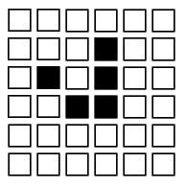
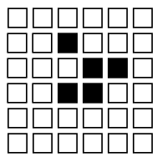
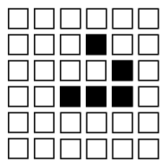
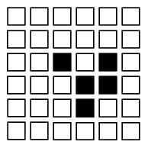
The Game of Life
Game of Life
If dead, and alive neighbours = 3 → Alive
If alive, and alive neighbours < 2 → Die of loneliness
If alive and alive neighbours > 3 → Die of overcrowding
Otherwise, stays as it is.
Notes:
Look at this slide as a presentation to see the animation.
You can run different creatures here… http://www.bitstorm.org/gameoflife/
This site also gives the rules, thus…
For a space that is 'populated':
Each cell with one or no neighbors dies, as if by loneliness.
Each cell with four or more neighbors dies, as if by overpopulation.
Each cell with two or three neighbors survives.
For a space that is 'empty' or 'unpopulated'
Each cell with three neighbors becomes populated.
There are some examples on the handout you can try.

Slide 10
Two dimensional Game of Life CA
In two dimensions, over time, some CA cell combinations form moving or periodically repeating multi-cellular organisms.
Notes:
If you did the handout experiments, you’ll realise that some CA combinations stay the same over time, some are periodic, and some move (in that order on the handout).
The top example shows a figure known as a “glider”. It moves one square diagonally every five time steps. The figure below is an example of a periodic CA combination. It returns to its starting state after three moves.
A great CA program which can be used to make the Game of Life is “Boppers” by Rudy Rucker. You can download a free version at…
http://www.mathcs.sjsu.edu/faculty/rucker/boppers.htm
Again, if you can’t read the caption, it says: “Figure from The Computational Beauty of Nature: Computer Explorations of Fractals, Chaos, Complex Systems, and Adaptation. Copyright © 1998-2000 by Gary William Flake. All rights reserved. Permission granted for educational, scholarly, and personal use provided that this notice remains intact and unaltered. No part of this work may be reproduced for commercial purposes without prior permission from the MIT Press.” It’s pretty super nice of them to allow us poor academics to use them, so I’m glad to draw attention to it.

Slide 11
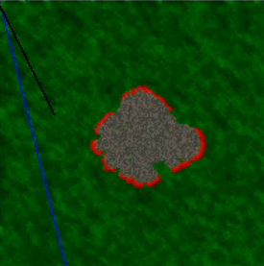
Classic two dimensional CA uses
Modelling forest fires.
Modelling animal and plant systems.
Finding routes through mazes / landscapes etc.
Notes:
CAs can very simply be applied to some systems. A good example is forest fires. Each cell is given some fuel, and the rule is basically "if you're next to a fire, catch fire, and burn until the fuel is gone". Obviously you can also include probability to represent wind direction etc. Such models are used by real firefighters to predict fire spreads.
http://www.youtube.com/watch?v=RVcya3Tg5QU
CAs used in bush/forest fire research…
http://www.worldscinet.com/ijmpc/08/0802/S0129183197000175.html
CAs used in ecology modelling (applet)…
http://www.stensland.net/java/erin.html
The forest fire animation is originally from…
http://www.csc.fi/math_topics/Movies/CA.html

Slide 12
Other uses
SLEUTH Model of Keith Clarke (Santa Barbara).
Uses CA to investigate urban growth.
Uses current urban areas, slope, transport, landuse, exclusions.
Grows cities.
Used to study “what if?” scenarios.
Essentially a whole new way of looking at urban form.
Gigalopolis: http://www.ncgia.ucsb.edu/projects/gig/
Notes:
For a good introduction, overview and example of using CAs to model cities see…
Deal, B. and Fournier, D.F. ‘Ecological Urban Dynamics and Spatial Modeling’ Construction Engineering Research Laboratory , University of Illinois.
http://www.rehearsal.uiuc.edu/NSF/report/Sstarlogo2000.html
See also Batty, M. (1992) ‘Urban Modeling in Computer-Graphic and Geographic Information System Environments’ Environment and Planning, B, 19, p.678-708.
http://www.envplan.com/epb/abstracts/b19/b190663.html
In addition, ex-CASA researcher Paul Torrens has an online paper that outline some related work…
Working Paper 28: How Cellular Models of Urban Systems Work (1. Theory) - Paul M.Torrens
http://www.casa.ucl.ac.uk/how_ca_work.pdf

Slide 13
The lessons of CA
Perfect fidelity (representation) isn’t necessary to model the world.
Simple rules can lead to realistic and complex behaviour.
These can be quite robust – missing information can turn out to be irrelevant to generating patterns, and they can often survive changes (eg. forest fire models can skip a blank cell).
However, representing the world as fixed and movement by state-changes seems wrong. Why not move the objects?

Slide 14
Intelligent Agents
In part evolved from CAs.
Essentially free moving cells or programs that intelligently interact with each other and their environment.
One of the most important was Robert Axelrod’s 1980 cooperation competition.
Notes:
Why Axelrod’s competition was too early and stripped down to really fit into Intelligent Agents as such, it is a simple and early example of the way the technology was going. Axelrod set up a computational environment of competing or cooperating software programmes, and looked at which was most successful at gaining computational resources.

Slide 15
Axelrod’s competition
Imagine you’re an agent.
If you cooperate with another agent, you get a moderate reward.
Alternatively, if they’re suckered into cooperating with you, and you stab them in the back, you get a massive reward.
However, if you both stab each other in the back, you get very little.
The competition invited people to put in agents with different behaviours to see who won after hundreds of rounds.
Consistently it was “Tit-for-tat”. Starts off cooperating but punishes backstabbers.
This competition was later run with intelligent 2D CAs.
Notes:
Axelrod’s competition is a repeated version of the Prisoner’s Dilemma. The idea is the people submitted several different kinds of behavioural rules, and the rules were allowed to fight it out over hundreds of runs of the Prisoner’s Dilemma to see which one came out best. It’s like seeing who would be most successful in an environment of lots of different types of people. It looks at whether we can “breed” social ethics simply by the interplay of competition and cooperation.

Slide 16
Coding an Agent
Agent Class
Has an update method called each iteration, eg. move(), trade().
Has a position.
Has a list of all other agents and can get their position.
Can communicate with other agents if necessary.
Environment Class
Has environmental conditions.
Calls the agents to update.
Agents might, for example, trade with their nearest neighbours.
Notes:
We've seen in the core course how to build a basic agent. The above summarises this. For an Artificial Life, they're surprisingly easy to build.

Slide 17
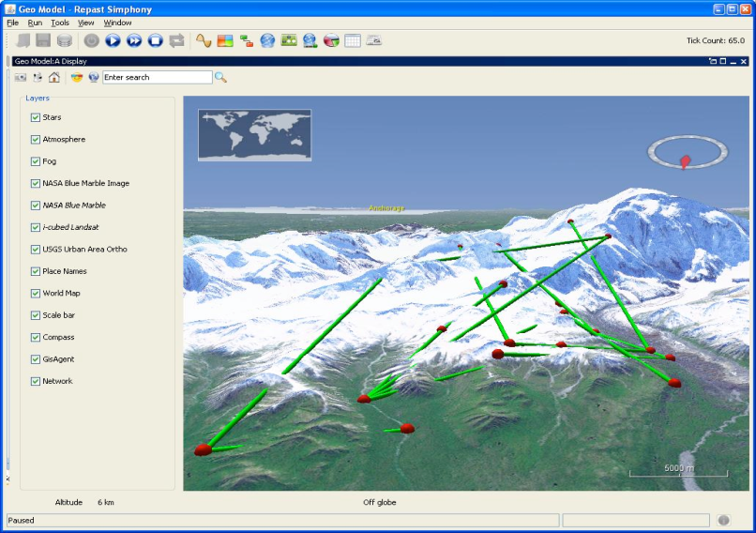
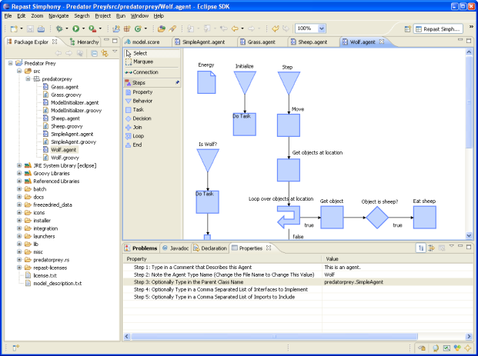
ABM Frameworks
What are they?
Pieces of software to help people build ABMs
They often include:
A framework of basic agent types.
Environments with functions for dealing with different types of space (e.g. networks)
Schedulers (for timing agent actions)
Options for parameter sweeps and calibration.
Notes:
While we built ours from scratch, there are toolkits to help you build agent based systems.

Slide 18
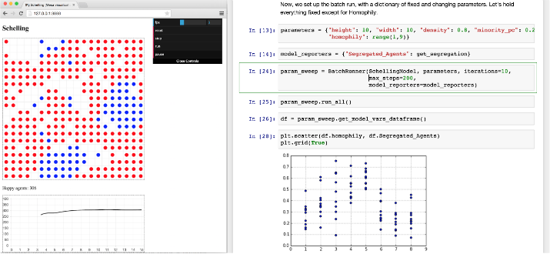
Commonly Used Platforms
It has to be said, most are in Java, which is a much clearer Object Oriented language (ABM map excellently onto Object Oriented languages):
Netlogo: http://ccl.northwestern.edu/netlogo/
Repast: http://repast.sourceforge.net/
MASON: http://cs.gmu.edu/~eclab/projects/mason/
However, for Python there is MESA:
https://pypi.python.org/pypi/Mesa/
In general the trade is ease
against flexibility.
Notes:
Generally speaking, you tend to find with frameworks that they provide nice functionality (for example, zoomable maps), but you trade that against having to build things their way, which often isn't how you'd want to do it (and can get in the way).
Railsback, Steven F., Steven L. Lytinen, and Stephen K. Jackson. 2006. Agent-based Simulation Platforms: Review and Development Recommendations. Simulation 82:9.
Tobias, Robert, and Carole Hofmann. 2004. Evaluation of free Java-libraries for social-scientific agent based simulation. Journal of Artificial Societies and Social Simulation 7(1). http://jasss.soc.surrey.ac.uk/7/1/6.html
http://www.swarm.org/wiki/Tools_for_Agent-Based_Modelling
The image is from the MESA website.

