Slide 1
This lecture
Introduction to arcpy
Debugging
Using arcpy

Slide 2
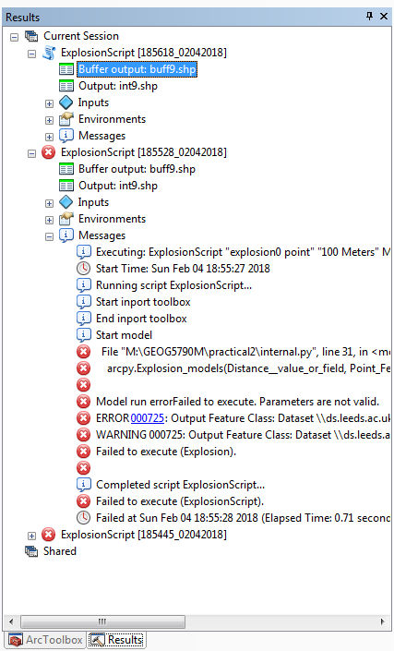
Debugging
Scripts with an issue will be marked with a broken script icon. Addins with syntax errors will appear as a red stop sign.
Debugging messages are often sent to the Python Window (so keep open).
print() also usually writes to the Python Window.
Debugging messages for geoprocessing tools will go to their dialog.
Debugging information will also go to the results window (usually hidden).

Slide 3
Errors
When something goes wrong with an arcpy component, it generates arcpy.ExecuteError exceptions.
When something goes wrong with a geoprocessing tool, it generates messages - indeed, they also generate messages when working.
Geoprocessing messages are subdivided into the following levels of severity:
0: general messages
1: non-critical warnings
2: critical errors
In Arc, geoprocessing messages get diverted to the screen, so it is rarely necessary to deal with them separately, but in external scripts this kind of thing helps:
except arcpy.ExecuteError:
print(arcpy.GetMessages())
# or
print(arcpy.GetMessages(2))

Slide 4
Messages
The geoprocessing dialog appears whenever tools run, including script tools.
You can write to this with:
arcpy.AddMessage(messageString)
arcpy.AddWarning(messageString)
arcpy.AddError(messageString)
arcpy.AddIDMessage(message_severity, message_ID, argument1, argument2)
Notes:
http://desktop.arcgis.com/en/arcmap/latest/analyze/creating-tools/writing-messages-in-script-tools.htm

Slide 5
Pattern for raising your own errors
A common pattern used by ESRI in the docs (and quite nice) is this quick and easy way of checking your own stuff is working ok with an empty exception class:
class MyException(Exception):
pass
try {
# stuff
if (condition):
raise MyException("message")
except MyException:
# do stuff

Slide 6
Python traceback
As arcpy error messages don't always include information about the Python itself (such as the erroneous linenumber) it can be useful to explicitly get the stacktrace using the sys and traceback libraries when something goes wrong:
tb = sys.exc_info()[2]
tbinfo = traceback.format_tb(tb)[0]
print(tbinfo)
# or
arcpy.AddError(tbinfo)
Notes:
http://desktop.arcgis.com/en/arcmap/latest/analyze/python/error-handling-with-python.htm

Slide 7
Emergency treatment
In the (unlikely) scenario you destroy Arc to the point it won't reboot, there are various options for resetting it.
The easiest is to delete the new map template at:
%APPDATA%\Roaming\ESRI\Desktop10.x\ArcMap\Templates\Normal.mxt
Rename it, and Arc will rebuild it.
Other options at:
https://my.usgs.gov/confluence/display/EGIS/Resetting+your+ArcGIS+application+profile

