Slide 1
Current Challenges in Agent Based Modelling of Social and Ecological Systems
Andy Evans
Notes:
So, Jon (Ward) invited me to say something about the challenges faced currently by Agent Based Modellers. I should say, up front, that this is, by necessity, a personal view, by which I mean that it is, at least in part, an expression of my own ignorance, in the sense that I’m pretty sure that some solutions exist outside of the ABM community (if not in it), and, indeed, wilful ignorance, in that in some cases I know this to be a fact. Nevertheless, I’m going to outline my personal problems with ABM, in part as a cathartic admission of incompetence, and in part because, having spent some 15 years or so building such models, and reviewing papers in the area, I’m not sure we understand the problems, let alone the solutions, and it is good to draw them together in one place. My hope is, at least, that at the end of the talk a few people might have some solutions to some of the issues, given the diversity of this audience.
So, to our first problem…

Slide 2
Dennett’s Law of Messianic Models
In any given discussion of a large socio-economic grant application, some cocky so-and-so will sooner or later say that what the project needs is an Agent Based Model.
Notes:
The first issue I’d like to highlight is best captured by what I call “Dennett’s Law of Messianic Models”, after a comment by a friend on Facebook. Here, I paraphrase: I can’t recall whether my good friend Dennett was more or less polite. The point is that ABM are simultaneously simple to build, and look very impressive. This leads to a great many models being generated where simple common sense would tell one the answer, if, indeed, an answer is needed. I’ll come back to why this is an issue towards the end of the talk, but for the moment let us try to follow a more worthy path and elaborate what questions our models are intended to answer, because if we understand what kinds of questions we want to answer, we delimit the set of challenges we must, or may not, have to face.

Slide 3
What are we trying to achieve?
What kinds of interactions make society/environment better or worse?
How do we understand these interactions?
What can we do about it?
Notes:
In general a great many of the issues associated with ABM are issues associated with science more generally, especially complex systems science. In short:
What is going on?
How certain can we be about it?
What the heck can we do about it?

Slide 4
Why ABM?
What kinds of interactions make society/environment better or worse?
“Better or worse” usually assessed in aggregate, interactions usually individual.
How do we understand these interactions?
Data usually in aggregate, interactions usually individual.
What can we do about it?
Policies usually aggregate, but impacts are felt by individuals.
Notes:
One of the problems we have in answering these questions about the world is that they mix up a large number of viewpoints on systems which also work at multiple scales.
Because Agent-based models work by utilising multiple individuals in a way that can be assessed in aggregate like a natural system, ABM are well placed to resolve many of these issues which play out less well, dare I say it, in traditional treatments like statistics or qualitative studies on their own.
Nevertheless, in attempting to straddle these scales and systems, utilising data from multiple scales and viewpoints, tensions arise that lead to many of the chief challenges ABM modellers face.
Perhaps, at this point, it would be helpful to imagine what the perfect agent-based model might look like to help us solve these problems.

Slide 5
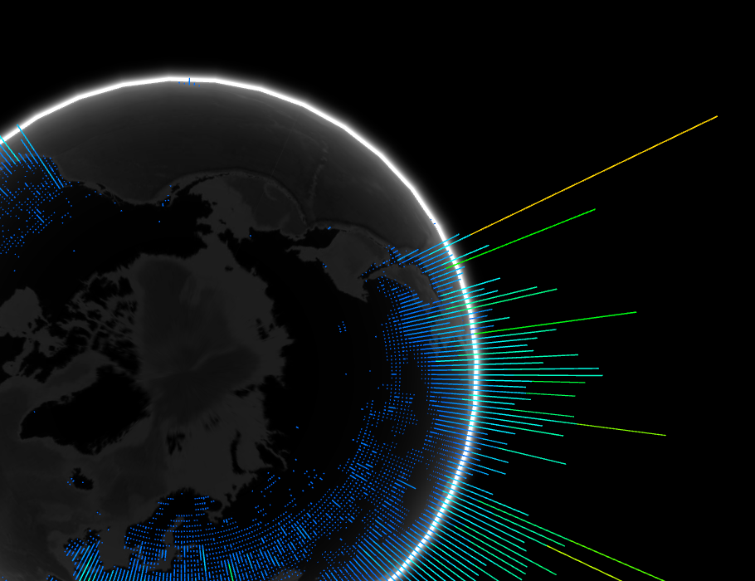
Models now
Notes:
Globe from: http://globe.chromeexperiments.com/
Let us imagine a global socio-economic or ecological model, in which every individual is modelled (perhaps easier to imagine for people than ecologically). Let us imagine we can make fast predictions about the state of a global system, based on the status quo, or policy modelling, akin to Global Climate Models. Let’s call this “The Divine Model”, because in would give us an omnipotent view of the world, and the ability to test arbitrary adjustments to it – in silico.
What challenges would have to be conquered in order to move from where we are now, to this “Divine” Model. Let us not forget that some 50 or so years ago, the people building General Circulation Models would not have imagined the current models in this area would be possible, so… aspirations.

Slide 6
The modelling process
Behavioural identification
Model construction
Model calibration
Model validation and error assessment
Model use and reuse
Notes:
It is perhaps simplest to describe the challenges by thinking through the modelling process.
Assuming that we have a good justification for modelling, we might see this as the broad modelling sequence.

Slide 7
The modelling process
Behavioural identification
Model construction
Model calibration
Model validation and error assessment
Model use and reuse

Slide 8
Behavioural identification
ABM generally start from behavioural rules understood at the individual level.
Nevertheless, many are culturally specific and the data is very sparse and admits multiple interpretations.
Conversely, we have plenty of aggregate data.
Can we move from such patterns to rulesets?

Slide 9
Notes:
As example, here is some data from the PhD of one of my ex-students, Alison Heppenstall. In the early 2000s, Alison studied petrol price fluctuations -- somewhat ironically, as neither of us drove at the time, and we both detest cars. Anyhow, petrol prices, as you may know, are set in part by price promises that often guarantee that local stations won’t be beaten within some radius. However, stations also have to cope with changes to the price of oil. This results in a dynamic system whereby, very broadly, each morning stations set some price based on the commodity prices and then look around within some radius at what their neighbours’ prices are, and adjust accordingly the next day. Here, the video shows the ‘weather map’ of price fluctuations over a couple of weeks or so, data between the stations interpolated to give some visualisation of the price gradients.
Alison’s PhD looked at modelling the system assuming some simple rules and calibrating to those. In a sense this is an investigatory process, deriving information from the data, but, of course, we decided the rules beforehand. A more challenging question (not to underestimate Alison’s achievements in this matter), is whether the actual rules can be derived from the data – where are we missing understanding?

Slide 10
Observed Burglary Hotspots
Notes:
We can certainly recognise when we don’t have the right rules. Indeed, this is one of the advantages to rule-based models.
Here, for example, is some burglary data for Leeds which was used by another PhD student of mine and Alison’s, Nick Malleson. Nick produced what is still the finest ABM model for predicting the location of crime. His model was built on a variety of crime theories, and was very detailed with real data. It did a very good job of predicting crime locations (within 2 or 3% of actual numbers for most areas) but singularly failed to predict the hotspot at the bottom of the map above. Nick went back to the local police to enquire about it, and found that this hotspot was associated with crimes of intimidation, crimes not captured by standard crime theories around burglary.
As such, it is clear that where a rule model does well, it is often more interesting where it fails, revealing missing rules.
Nevertheless, this is not the same as *deriving* rules from the data.

Slide 11
For The Divine Model, it would be nice if we could derive behaviours from the data.
It would be nice if we could derive rules in terms of:
linguistic descriptions;
animal drives;
the transfer of information or materials;
from aggregate data.

Slide 12
This isn’t quite the same as simple statistical regression, as this is just an simplified description of one set of data using another rather than a complex combination of drives and decision making.
Nevertheless, at the moment, even simple correlations are beyond us, save in a very restricted subset of examples. The non-linearities in our systems are very problematic.
Given this, it is hard to allocate causality, let alone identify the form of that causality.
Notes:
Here, think back to the map of the petrol prices. How would be derive behaviour even of the stations reacting to each other over various distances from this?

Slide 13
Behavioural identification: what we lack
Cross-scale viewpoints for linking important/emergent patterns with behaviour.
The ability to track complicated behavioural similarities in space-time and where they match in one but not the other.
The ability to recognise apparent action at a distance, especially non-linear causality.
Notes:
On the first, we have telescopes and microscopes, but nothing much between. This should be tractable by running models backwards and forwards in an investigatory manner to identify when patterns become important, and then drilling down into the individual data.
With the latter, it is clear that in non-linear systems, even very small fluctuations in one variable across a field might cause very large variations in another, allowing for patterns that look like action at a distance. How would be recognise this?

Slide 14
Crowd sourcing data
How do we encourage it? (Can we promise some kind of immortality?)
How do we store it (OpenCyc/RDF-style tuplets? Rules? Emulator?)
How do we protect people?
Notes:
Perhaps one solution for The Divine Model is to crowd source the data – asking people to input some of their behaviours and beliefs. But how might we encourage this? I’ve said before, not entirely seriously, but now, perhaps more practically, one thing we could do is offer people access to their agents, either as bots for replacing themselves in mundane tasks, or as ghosts, to live on after them.

Slide 15
The modelling process
Behavioural identification
Model construction
Model calibration
Model validation and error assessment
Model use and reuse

Slide 16
How do we construct the “correct” model?
What do we mean by “correct”? Most complete? Most parsimonious? Most practical? Most elucidatory?
How do we decide what is an agent – how do we avoid this constraining future use?
<<Interface>>
Agent
<<Interface>>
DoomedToBeWrong
PoorModellerWeepWeep
Notes:
So, what should our Divine Model look like?
To a degree, working out the correct agents is made similar by the methodologies of Object Orientated Abstraction, which gives some protection – though this is hard in Netlogo, the most popular modelling suite.
There is a tendency to believe ABM should be “pure”, but occasionally we need global variables, because global variables have an affect in the real world (e.g. interest rates).

Slide 17
Model form
Given equifinality, that multiple models may produce the same results, how do we tell if we have the right one for predictions?
GLUE methodology: essentially throw lots of models at it and prune (either models or components).
Notes:
Generalised likelihood uncertainty estimation, developed by Keith Bevin, as an example of dealing with equifinality.

Slide 18
Missing stuff
How do we recognise we have missing components/hidden variables?
Populations can be inferred, but harder to infer interactions, which may be a non-linear result of density.
Latent variable methods can be utilised on hidden variables, but, again, assumes relatively simple relationships between missing variables and observables.

Slide 20
Practical computing
Individual level model of 273 burglars searching 30000 houses in Leeds over 30 days took 20hrs.
Aphid migration model of 750,000 aphids took 12 days to run them out of a 100m field.
Where models are taking days to run (and we may need to run thousands) practical computing is important.

Slide 21
Practical computing
High inter-agent communication and high movement around modelled environments that need data processing makes parallelisation difficult.
Generally a tradeoff of cognitive processing vs number of agents. How can we scale cognition (emulators?)

Slide 22
The modelling process
Behavioural identification
Model construction
Model calibration
Model validation and error assessment
Model use and reuse

Slide 23
How done now
Parameter sweeps.
Finger crossing.
Literature.
Experts.
Optimisation heuristics.

Slide 24
Calibration to a dataset
Usually one-shot.
Match data for one time period.
Frequently this is assessed with a one-number statistic.
And now predict…

Slide 25
Data traditional limit.
Now, though, near-instant streaming of all kinds of data.
Much more potential for using on-the-fly calibration to constrain errors.

Slide 26
Dynamic Data Assimilation
Essentially make an ensemble of predictions.
Work out which matches when data comes in.
Use adjusted good model/s as starting point for next prediction.

Slide 27
Recalibration
Issue is often identifying when current calibrations are likely to do a bad job, and recalibration needed.
Hybrid models, where behaviours adjusted in different contexts.
More intelligent models, where agents learn as they go on (which isn’t quite the same as dynamic data assimilation, as it assumes learning realistic and match with reality still needs constraining).

Slide 28
The modelling process
Behavioural identification
Model construction
Model calibration
Model validation and error assessment
Model use and reuse
Notes:
It is perhaps simplest to describe the challenges by thinking through the modelling process.
Assuming that we have a good justification for modelling, we might see this as the broad modelling sequence.

Slide 29
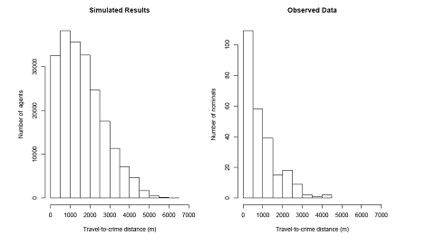
Validation
What scale (usually tradeoff between model resolution and quality)?
What does this look like across time as well as space?
What variables do we need to look at?

Slide 30
Error
Assumption in complex non-linear systems is that standard error propagation is unlikely to look great, if, indeed, possible.
Often assessed (if it is) using Monte Carlo testing, broadly throwing in a realistic variety of inputs and/or parameter values and looking at the range of outputs.
The outputs are often assessed against one-number metrics. However, as we discussed under model construction, model error in rule based systems might mean a much broader range of things.

Slide 31
Is tracking the propagation of error actually crazy? We have trackable objects acting by rules in a way that avoids some of the issues associated with mathematical aggregations linked non-linearly.
Can we attach error descriptions to individual objects. What are the limits then (associated with floating point accuracy?)?
Can we attached variables and importance to an object. What would this look like? How do we express that an object is part of an emergent pattern over space-time?
What would a new mathematics based on objects rather than aggregations look like?

Slide 32
Homeostatic elements
We tend to ignore homeostatic elements that keep systems from chaotic behaviour in reality:
Negotiation
Averaging
Buffering
Etc. Rule based systems can cope with these much more explicitly.

Slide 33
The modelling process
Behavioural identification
Model construction
Model calibration
Model validation and error assessment
Model use and reuse

Slide 34
Model use
Models, like all language, are elaborate networks of metaphors for the world, and are nothing but a grand glass bead game unless they have practical use.
How do we cope with predictive feedbacks/the Lucas critique (that some model parameters assumed invariant are actually impacted by policy)?

Slide 35
However, we have to be aware of the McNamara fallacy – that measurable things are the only important things. If we want to talk about models to policy makers, how do we resolve this conflict to avoid encouraging them in this? Can we model “lived experience”?
ABM very much of its time, and e.g. dynamic data assimilation ties into a raft of modern trends: increase in individualised policy (car insurance that knows whether you speed; healthcare that knows if you run), increased individualism, rise of neo-liberal market-based control.

Slide 36
Ethics of modelling people
The paradox for uneasy predictees.
The Fallacy of the Consistent Individual.
Francesco Francavilla
Notes:
If people are acting on model predictions, more accurate predictions are surely better than weak predictions that erroneously represent us, and which we might want to contest.
However, more accurate predictions could reproduce data we consider to be private and wouldn’t, ourselves, release.
Although we side-step the ecological fallacy by modelling at the individual level, we generally assume that people remain the same and are predictable on the basis of past behaviour.
This may seem so well supported as to not be a fallacy, but is it a fair assumption in the case of an ex-convict trying to go straight?
Do we have a right not to be individually predicted based on past behaviour?
Uniformitarianism

Slide 37
Dennett’s Law of Messianic Models… revisited
Managing literature and model reuse/replication now a real problem.
Some generic model description frameworks (ODD: Overview, Design concepts, and Details; UML: Unified Modeling Language; Foundation of Intellligent Physical Agents), but none really abstract behaviour in a transferable way.
Some good online model stores (OpenABM of Computational Modeling for SocioEcological Science Net (CoMSES Net) for example).

Slide 38
Five key challenges:
Can we recognise variable interaction in non-linear systems across space and time?
Can we derive rule-based behaviour from aggregate data?
Can we crowd-source behaviour, and use it to constrain models dynamically?
Can we track error and emergence through our models in the same way we track objects?
Can models play a part in a more agile, but more compassionate and environmentally aware, society?

Slide 39
Advantages of ABM in understanding non-linear systems
Verisimilitude, which makes representing the world using familiar and representation-flexible methods simple.
Objects have histories, allowing us to move on from Markovian behaviours and track entities through the evolution of the model.
Is “The Divine Model” possible?

Slide 40
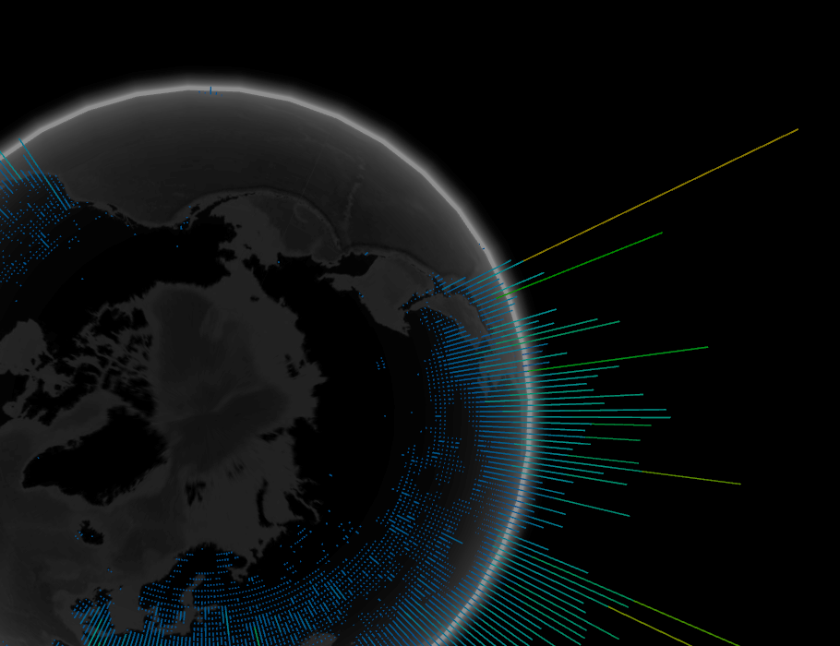
Models now
More info:
http://www.geog.leeds.ac.uk/people/a.evans/
http://www.geog.leeds.ac.uk/courses/other/programming/summer-school/
Thanks: Fellow staff and students, including
Jon Ward; Alison Heppenstall; Hazel Parry; Tok Kongmuang; Bokhwan Kim; Nick Malleson; René Jordan; Dan Olner.
Notes:
Globe from: http://globe.chromeexperiments.com/
Let us imagine a global socio-economic or ecological model, in which every individual is modelled (perhaps easier to imagine for people than ecologically). Let us imagine we can make fast predictions about the state of a global system, based on the status quo, or policy modelling, akin to Global Climate Models. Let’s call this “The Divine Model”, because in would give us an omnipotent view of the world, and the ability to test arbitrary adjustments to it – in silico.
What challenges would have to be conquered in order to move from where we are now, to this “Divine” Model. Let us not forget that some 50 or so years ago, the people building General Circulation Models would not have imagined the current models in this area would be possible, so… aspirations.

Slide 41
Space-time
We generally assume behaviours work out over the same space (structure/resolution) and time (beat/Markovian properties).
While models can cope with a different beat and geography, when we analyse behaviours in aggregate, the assumption often isn’t examined.
Notes:
These issues are then complicated further by variations in the scale and beat of the systems under examination.

Slide 42
How do we construct the “correct” model?
Over-commitment to “pure” agent models.
To what degree are some things not modellable by an object orientated view of the world
(e.g. fuzzy geographical areas; other sorities issues).
Notes:
To a degree, working out the correct agents is made similar by the methodologies of Object Orientated Abstraction, which gives some protection – though this is hard in Netlogo, the most popular modelling suite.
There is a tendency to believe ABM should be “pure”, but occasionally we need global variables, because global variables have an affect in the real world (e.g. interest rates).

Slide 43
What is the relationship between model parameters and reality?
Massively parameterised models might fit lots of things. However, they can’t fit *anything*.
Models are a dialogue between the world and scientists. Calibration tells you something about how the world is if it matches your model. It is an investigatory tool.

