Slide 1
Implementing Dynamic Data Assimilation in the Social Sciences
Andy Evans
Centre for Spatial Analysis and Policy
With: Jon Ward, Mathematics; Nick Malleson, CSAP; Andy Newing, CSAP

Slide 2
The Problem
Societies very complex.
They are also reactive to information about themselves.
This makes predictive modelling complicated.
We’d like to predict policy impacts, but we’d also like to design more reactive policies.
Modelling also about understanding – how much some variable affects society.

Slide 3
Two social science models
Spatial Interaction Models
Two+ source populations in space.
Two+ sink locations.
Allocate flows using gravity model.
Distance decay and attractiveness usually calibrated in some way.

Slide 4
Examples
Calculating change in market share after a new supermarket built.
Estimating best location for a new hospital.

Slide 5
Agent-Based Models
Individual level.
Agents interact with environment and each other.
Model behaviour and decision making.

Slide 6
Example
Exploring and predicting burglary
Agents are burglars.
Environment is a city.
Behaviour is from crime theory.
Predict crime locations.
Analyse where crime theory fails to predict correctly.

Slide 7
Agent-Based Models
Structure based on verisimilitude, rather than constraint to one model form.
Connect individual behaviour to aggregate patterns.
Avoid the Ecological Fallacy.
Notes:
The advantages of ABM. The Ecological Fallacy is assuming an individual matches a group description because they live in an area where that group dominates.

Slide 8
Models
Data hungry.
Calibrated (by sweep, hand, or automatically).
Compared with validation data.
Initialised with data.
One-shot iterative solutions, or run to generate a history until some time-step or stopping condition.
Notes:
Some details of how ABM are set up and run.
One element of this is calibration – that is, adjusting the model so it better matches the real world.

Slide 9
Calibration
Rise of Big Data means more opportunities for calibration.
Also, continual recalibration as models run.
Notes:
Traditionally ABM ran once and made a prediction of some system state. Now, however, we have streamed data about individuals (for example, mobile phone location), which means potentially we could engage with continual calibration and model improvement.

Slide 10
Dynamic Data Assimilation
Used in meteorology and hydrology to constrain models closer to reality.
Nonlinear models predict near future well, but diverge over time.
Either:
Restart model with new (real or closer) starting data every so often.
Or:
Adjust parameters in the model to better match reality predicted.
Or both.

Slide 11
How?
Models usually hand calibrated, or parameter sweeps.
Sometimes calibrated with Genetic Algorithms.
Run 50 models, work out which parameters are best, use these as the starting point for automatically generating some new models. Repeat.
Heavy on model runs – may require hundreds or thousands of runs.

Slide 12
Ensemble Kalman Filters
Runs a distribution of models – less than GAs (?)
As data comes in…
Shifts model state (starting conditions and parameters) closer to something that would have given good predictions, based on error.
Use relationships between inputs, outputs, and parameters to develop a mechanism to adjust these model states.
Uses the new states as the starting conditions for the next iteration.

Slide 13
Maths
While a lot has been published on EKF, it is largely tied into the maths of the models.
Unfortunately, they don’t match up with, e.g. ABM.
Weather models generally based on differential equations, with functions generally linearised mathematically.
ABM generally based on behavioural rules (e.g. if-this-then) and generally therefore entrenchedly non-linear.

Slide 14
Maths
Dis-entangling the EKF from the model maths is tricky as we’re applying it to a model type that it wasn’t developed for.
Useful to have a mathematician on board.

Slide 15
Seedcorn funds
Holed up in a workshop centre for three days.
Cranked through:
Understanding the practical issues.
Understanding each other’s vocabulary.
Building some initial software.

Slide 16
Model
Rapidly gave up on Spatial Interaction Models, as most weren’t convinced on the practical applications. ABM more interesting!
Built a ‘toy’ ABM to experiment.

Slide 17
Model: Cops and Robbers
Robbers will take gold from other robbers they meet, but also take it from the environment (banks).
Cops will take gold from robbers, and then arrest them, removing them from the model.
Both move randomly.
Gold collected by cops over time is therefore dependent on the density of cops, robbers, and banks.

Slide 18
Model
Ran to generate data we knew the parameters of, then looked at estimating parameters.
In two days, basically had model, parameter sweeper, and an optimiser.
However, this was static (single-shot) optimisation, rather than DDA.
https://github.com/MassAtLeeds/DataAssimilation

Slide 19
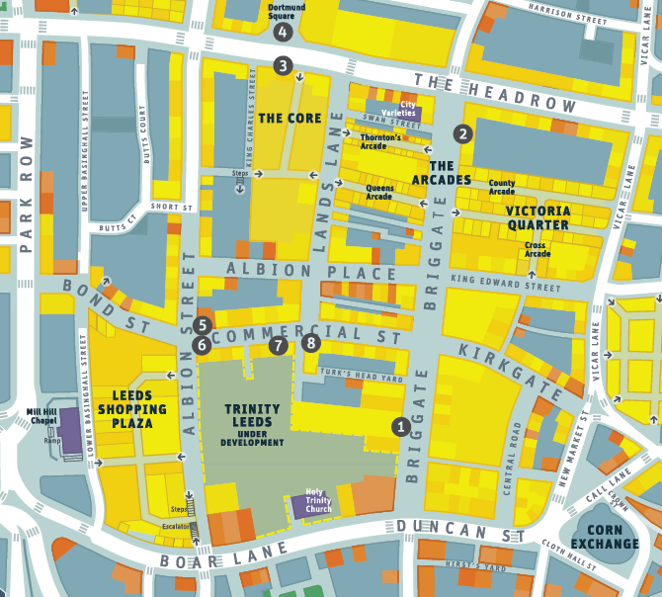
Model II: Urban population
Model to look at the number of people in Leeds.
Calibrated and constrained by hourly footfall data from CCTV.

Slide 20
Model II
Proper Ensemble Kalman Filter.
Did an ok(ish) job, in that it worked.
Needs moving from a model of a single CCTV area to a wider range of inputs that could constrain the model.
Also needs moving to a ‘Object Oriented’ model (at the moment it is and ABM, but in a rather procedural form in Matlab).

Slide 21
Future work
Build EKF in an Object Oriented model, then compare critically the handling of non-linearities compared with alternatives.
Algorithm analysis of power vs model runs for EKF vs Genetic Algorithms.
More detailed work on getting EKF and/or GAs to respond the chaotic bifurcation – what qualifies as a change large enough to warrant restarting calibration?
Model pruning – rather than looking at parameters, can we filter out unsuitable models / model components.

Slide 22
Other issues: Ethics
But, unlike hydrology or meteorology, here, as we get closer to real-time data, we are dealing with real-time data about individuals.
As we get closer to removing the Ecological Fallacy, we get closer to real people.

Slide 23
More info
http://www.geog.leeds.ac.uk/people/a.evans/
http://www.maths.leeds.ac.uk/index.php?id=263&uid=1316
https://github.com/MassAtLeeds/DataAssimilation

