Slide 1
Understanding and preventing crime: A new generation of simulation models
Nick Malleson and Andy Evans
Notes:
Abstract
Crime is driven by a complicated mix of environmental, social, and
psychological factors. These factors vary substantially from
person-to-person and, importantly, from place-to-place. Traditional
crime modelling methods, that treat people and the environment at an
aggregate level, struggle to represent peoples’ individual-level
behaviour and relate this to specific elements of the environment.
Agent-based models (ABM), which concentrate on individual-level
behaviours, are making considerable advances on this front, particularly
in burglary crimes where the geography of crime has a strong control.
These models can be used to run scenarios and attempt to predict the
changes in crime distribution as a response to crime-reduction
initiatives. This presentation will introduce some of the developments
in agent-based computer simulation, detail the application of agent
models to the crime system - with reference to a real urban regeneration
scheme in Leeds - and discuss the future for such modelling.

Slide 2
Project Background
Started as a PhD/MSc Project
  “Build and agent-based model which we can use to predict rates of residential burglary”
Individual-level (person, household).
Predict effects of physical/social changes on burglary.
Ongoing relationship with Safer Leeds CDRP
  Provide essential data.
  Expert knowledge supplement criminology theory.
Notes:
You can find out more about the early work in:
Kongmuang, C., Clarke, G.P., Evans, A.J. and Ballas, D. (2005) Modelling Crime Victimisation at Small-Area Level Using a Spatial Microsimulation Technique, Proceedings of the RSAIBIS 35th Annual Conference, 17th-19th August 2005
Kongmuang, C., Clarke, G.P., Evans, A.J. (2005) A Spatial Microsimulation Approach to Modelling Crime Proceedings of the British Society of Criminology Conference 2005, Leeds, UK, 12th-14th July 2005.
Or, most easily:
Kongmuang, C., Clarke, G.P., Evans, A.J. and Jin, J. (2006) SimCrime: A Spatial Microsimulation Model for the Analysing of Crime in Leeds. Working Paper. The School of Geography, University of Leeds
http://eprints.whiterose.ac.uk/4982/
Malleson, N., A.J. Evans, and T. Jenkins (2009). An agent-based model of burglary. Environment and Planning B: Planning and Design 36, 1103–1123.
http://www.envplan.com/abstract.cgi?id=b35071

Slide 3
Theoretical Background
Crimes are local in nature.
Routine Activities Theory
  convergence in space and time of a motivated offender and a victim in the absence of a capable guardian.
Crime Pattern Theory
  people will commit crimes in areas they know well and feel safe in;
  everyone has a cognitive map of their environment;
  anchor points shape these “activity spaces”.
Need to work at the level of the individual
Notes:
You can find out more about the early work in:
Kongmuang, C., Clarke, G.P., Evans, A.J. and Ballas, D. (2005) Modelling Crime Victimisation at Small-Area Level Using a Spatial Microsimulation Technique, Proceedings of the RSAIBIS 35th Annual Conference, 17th-19th August 2005
Kongmuang, C., Clarke, G.P., Evans, A.J. (2005) A Spatial Microsimulation Approach to Modelling Crime Proceedings of the British Society of Criminology Conference 2005, Leeds, UK, 12th-14th July 2005.
Or, most easily:
Kongmuang, C., Clarke, G.P., Evans, A.J. and Jin, J. (2006) SimCrime: A Spatial Microsimulation Model for the Analysing of Crime in Leeds. Working Paper. The School of Geography, University of Leeds
http://eprints.whiterose.ac.uk/4982/
Malleson, N., A.J. Evans, and T. Jenkins (2009). An agent-based model of burglary. Environment and Planning B: Planning and Design 36, 1103–1123.
http://www.envplan.com/abstract.cgi?id=b35071

Slide 4
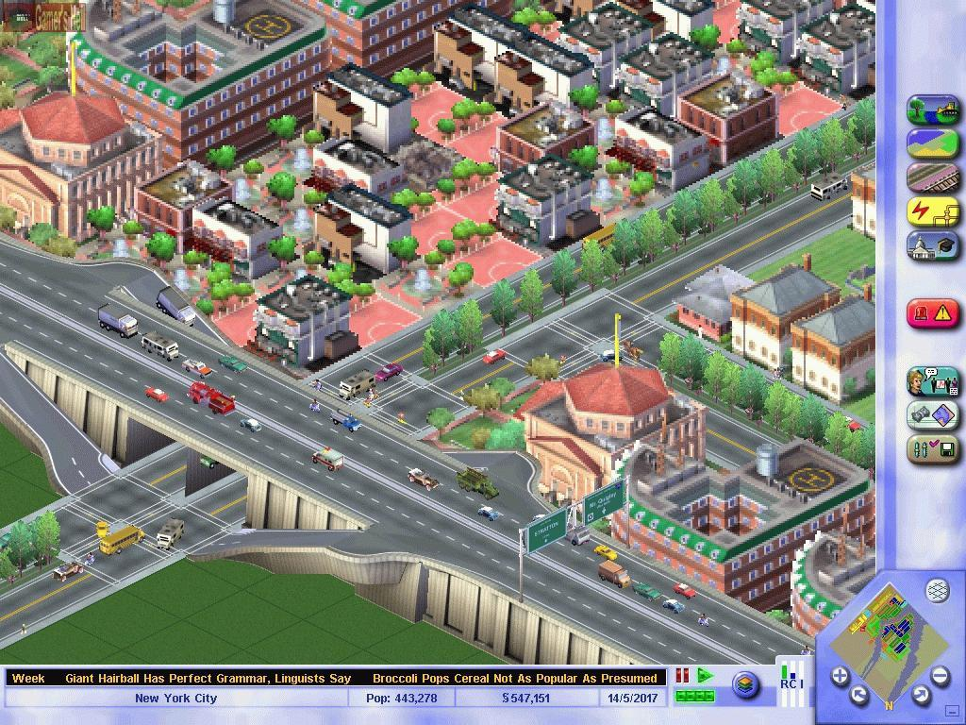
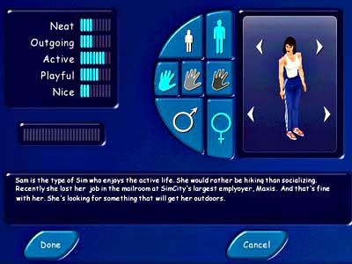
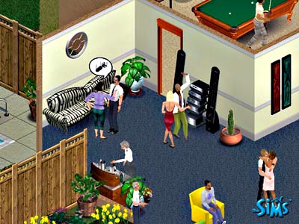
Agent-Based Modelling (ABM)
Autonomous, interacting agents
Represent individuals or groups
Situated in a virtual environment
Notes:
You can find out more about the early work in:
Kongmuang, C., Clarke, G.P., Evans, A.J. and Ballas, D. (2005) Modelling Crime Victimisation at Small-Area Level Using a Spatial Microsimulation Technique, Proceedings of the RSAIBIS 35th Annual Conference, 17th-19th August 2005
Kongmuang, C., Clarke, G.P., Evans, A.J. (2005) A Spatial Microsimulation Approach to Modelling Crime Proceedings of the British Society of Criminology Conference 2005, Leeds, UK, 12th-14th July 2005.
Or, most easily:
Kongmuang, C., Clarke, G.P., Evans, A.J. and Jin, J. (2006) SimCrime: A Spatial Microsimulation Model for the Analysing of Crime in Leeds. Working Paper. The School of Geography, University of Leeds
http://eprints.whiterose.ac.uk/4982/
Malleson, N., A.J. Evans, and T. Jenkins (2009). An agent-based model of burglary. Environment and Planning B: Planning and Design 36, 1103–1123.
http://www.envplan.com/abstract.cgi?id=b35071

Slide 5
Advantages of ABM (i)
More “natural” for social systems than statistical approaches.
Can include physical space / social processes in models of social systems.
Designed at abstract level: easy to change scale.
Bridge between verbal theories and mathematical models.

Slide 6
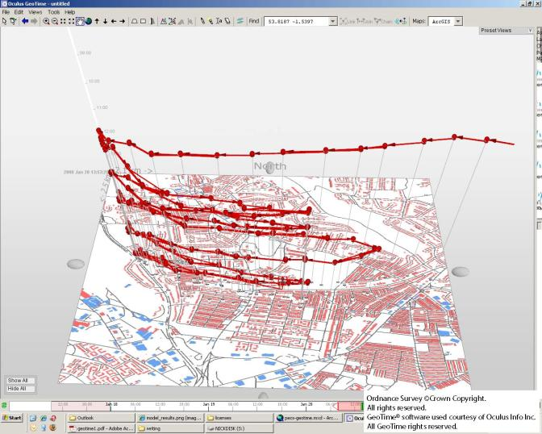
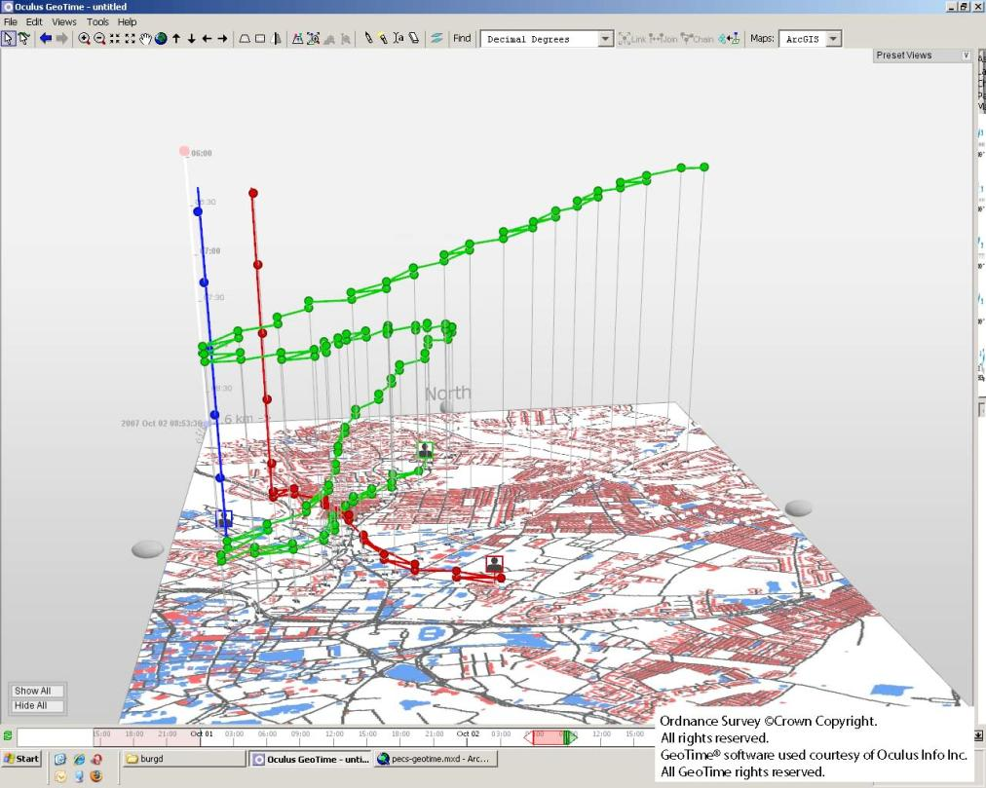
Advantages of ABM (ii)
Dynamic history of system

Slide 7
Disadvantages of ABM
Single model run reveals a theorem, but no information about robustness.
  Sensitivity analysis and many runs required.
Computationally expensive.
Small errors can be replicated in many agents.
“Methodological individualism”.
Modelling “soft” human factors.

Slide 8
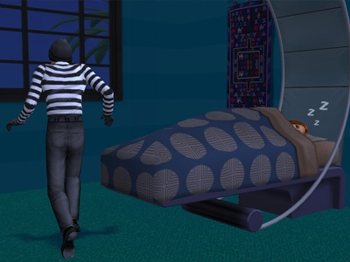

An Example Agent-Based Model of Burglary
Virtual Environment
  Physical objects: houses, roads, bars, busses etc.
  Social attributes: “communities”
  Virtual victims and guardians
Virtual Burglar Agents
  Use criminology theories/findings to build realistic agent behaviour

Slide 9
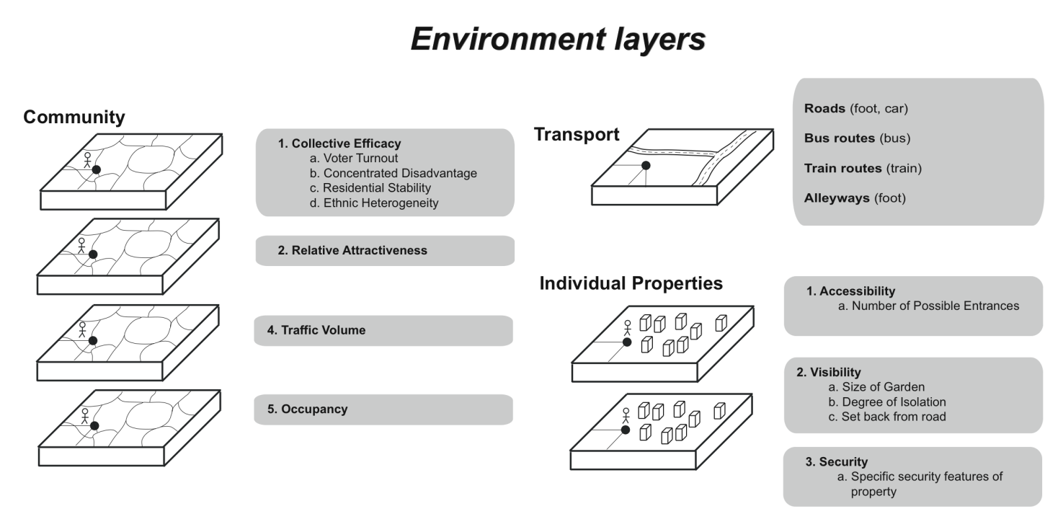
The Environment – layers
Notes:
Environment
- use criminology to identify what is important to include in the virtual environment
- too complex to include *every* person in the city, can simulate presence of victims/guardians
- include everything that will affect burglars’ decisions about where to burgle and whether or not to commit an individual burglary
Community layers – simulate activities of victims and guardians
- incorporate all the aspects of a neighbourhood/community which will affect the behaviour of “burglars”
- nosy neighbours, neighbourhood watch schemes, broken windows
Individual properties – the houses which can be burgled
- physical features associated with properties which might increase/decrease their burglary risk
- e.g. Door left open, alarm, dog, back door hidden from neighbours
Transport layers – how the offender moves around the city
- walk/drive/train etc.

Slide 10
The Burglars
Needs
  “Lifestyle”, Sleep, Drugs
Cognitive map of environment
Decision process leads to burglary

Slide 11
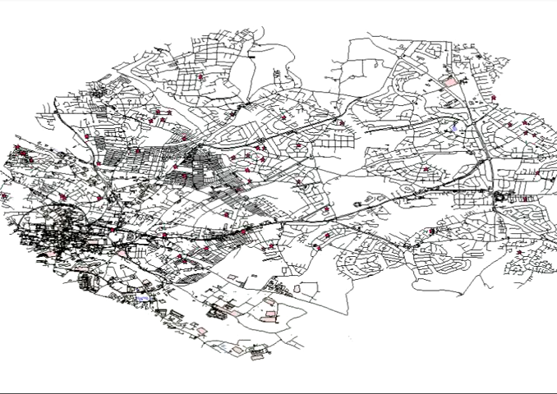

Slide 12
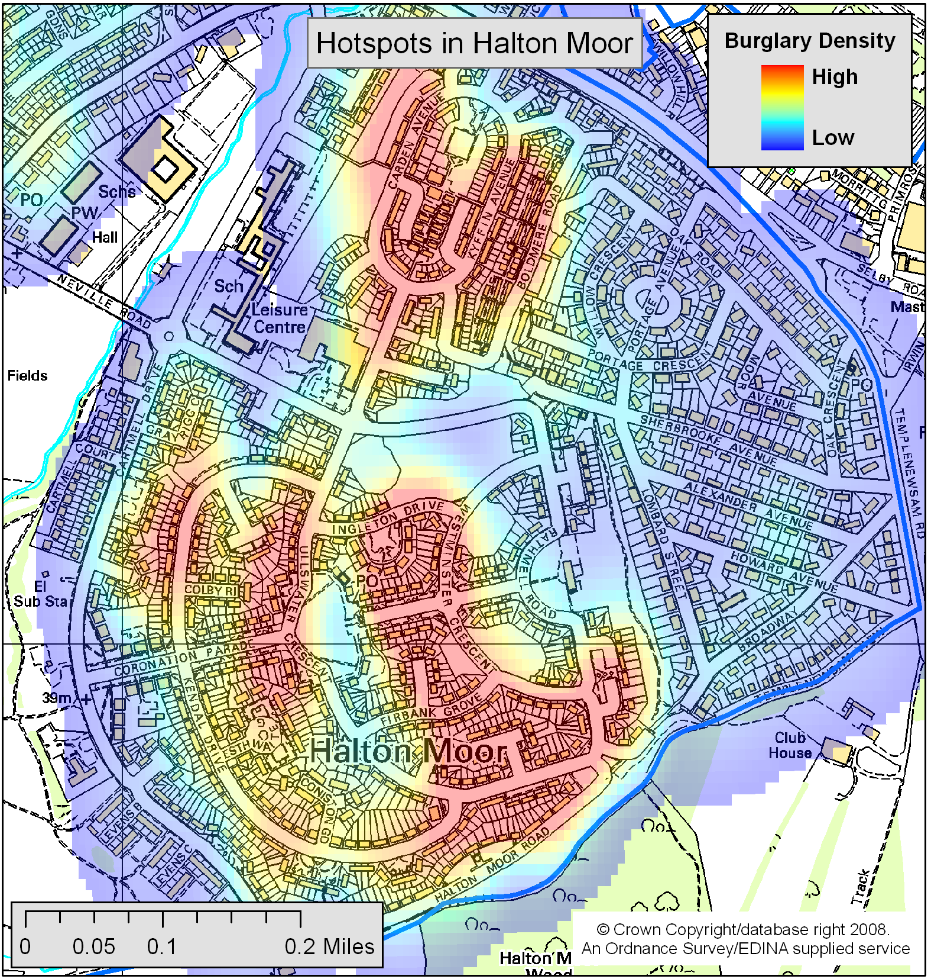
Interesting Finding – Halton Moor
Result
  Halton Moor area significantly under predicted by model
Explanation
  Motivations of burglars in Halton Moor
Model failures can help to indicate where we misunderstand the real world

Slide 13
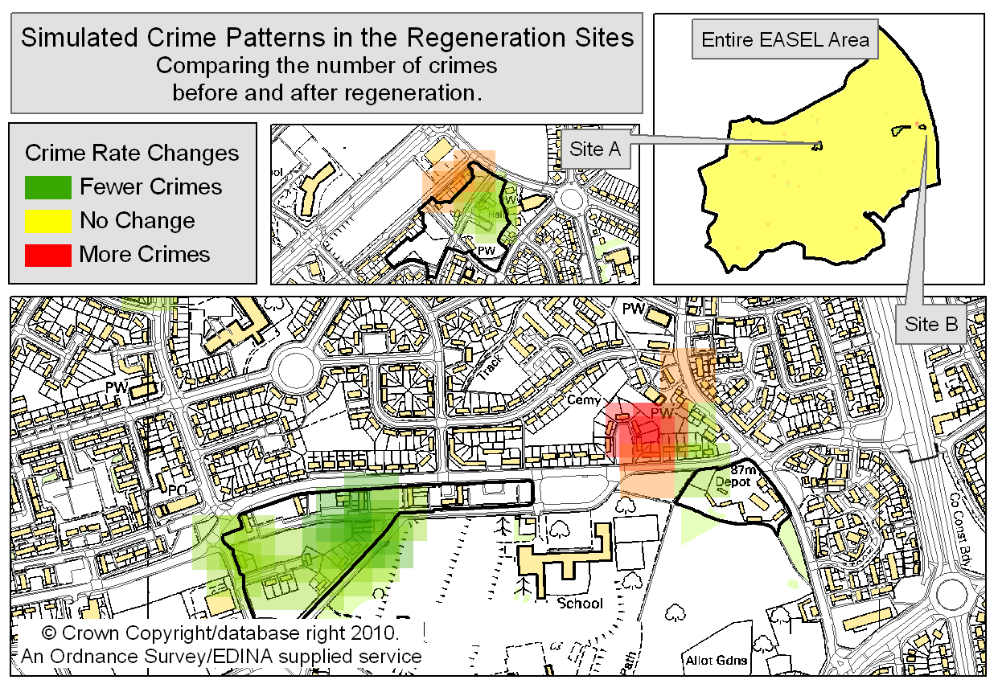
Results:
Simulating Urban Regeneration
Simulation
  Test the effects of a large urban regeneration scheme
  A small number of individual houses were identified as having substantially raised risk
Why?
  Location on main road
  In the awareness space of offenders
  Slightly more physically vulnerable
Need for a realistic, individual-level model to predict crime

Slide 14
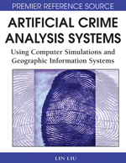
Who else is doing this?
Researchers:
Elizabeth Groff: street robbery
Daniel Birks: burglary
Patricia Brantingham et al.: Mastermind (exploring theory)
Lin Liu, John Eck, J Liang, Xuguang Wang: cellular automata
Books / Journals:
Artificial Crime Analysis Systems (Liu and Eck, 2008)
Special issue of the Journal of Experimental Criminology (2008):``Simulated Experiments in Criminology and Criminal Justice'

Slide 15
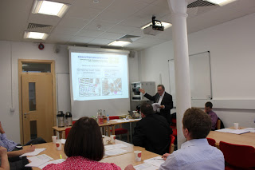
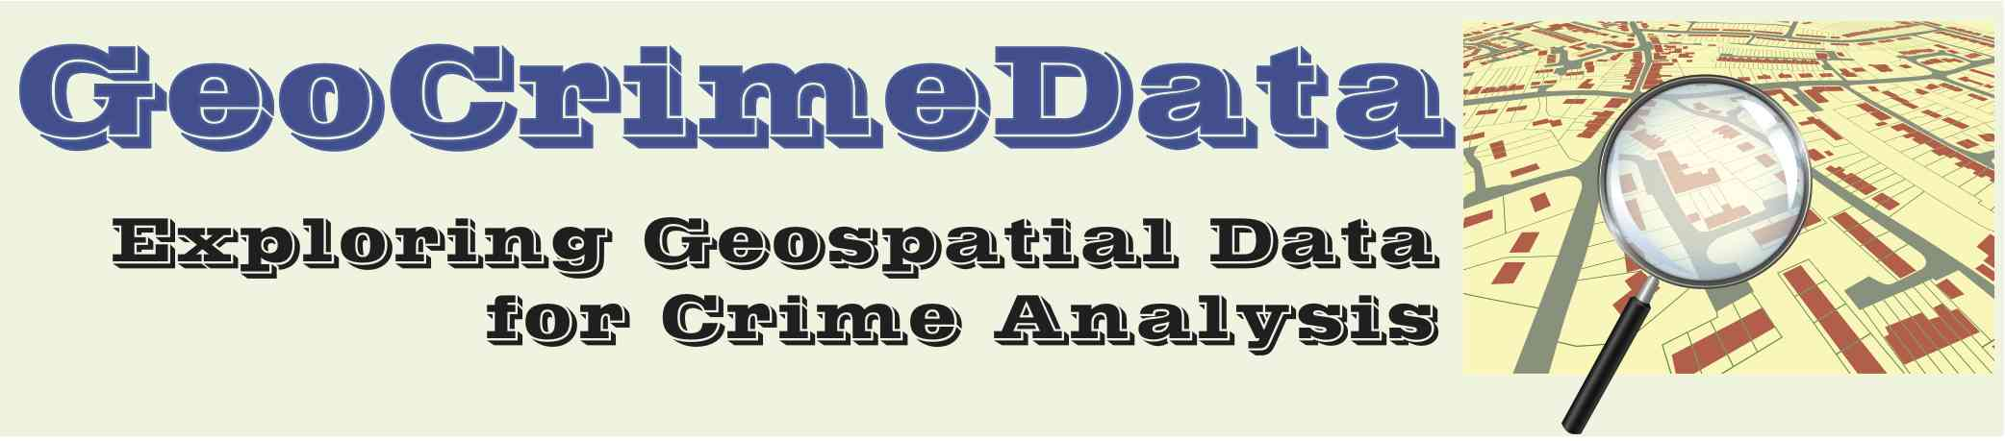
GeoCrimeData http://geocrimedata.blogspot.co.uk/
Project Overview
  Improve access and usability of spatial data to crime analysts
  Motivation: Are cul-de-sacs safer? (Johnson & Bowers,2010)
  Collaboration between Leeds & Huddersfield (Alex Hirschfield, Andrew Newton)
Methodology
  Survey practitioners
  Identify useful data
  Analyse and re-release data publicly
Results
  New road accessibility data
  Household vulnerability data

Slide 16
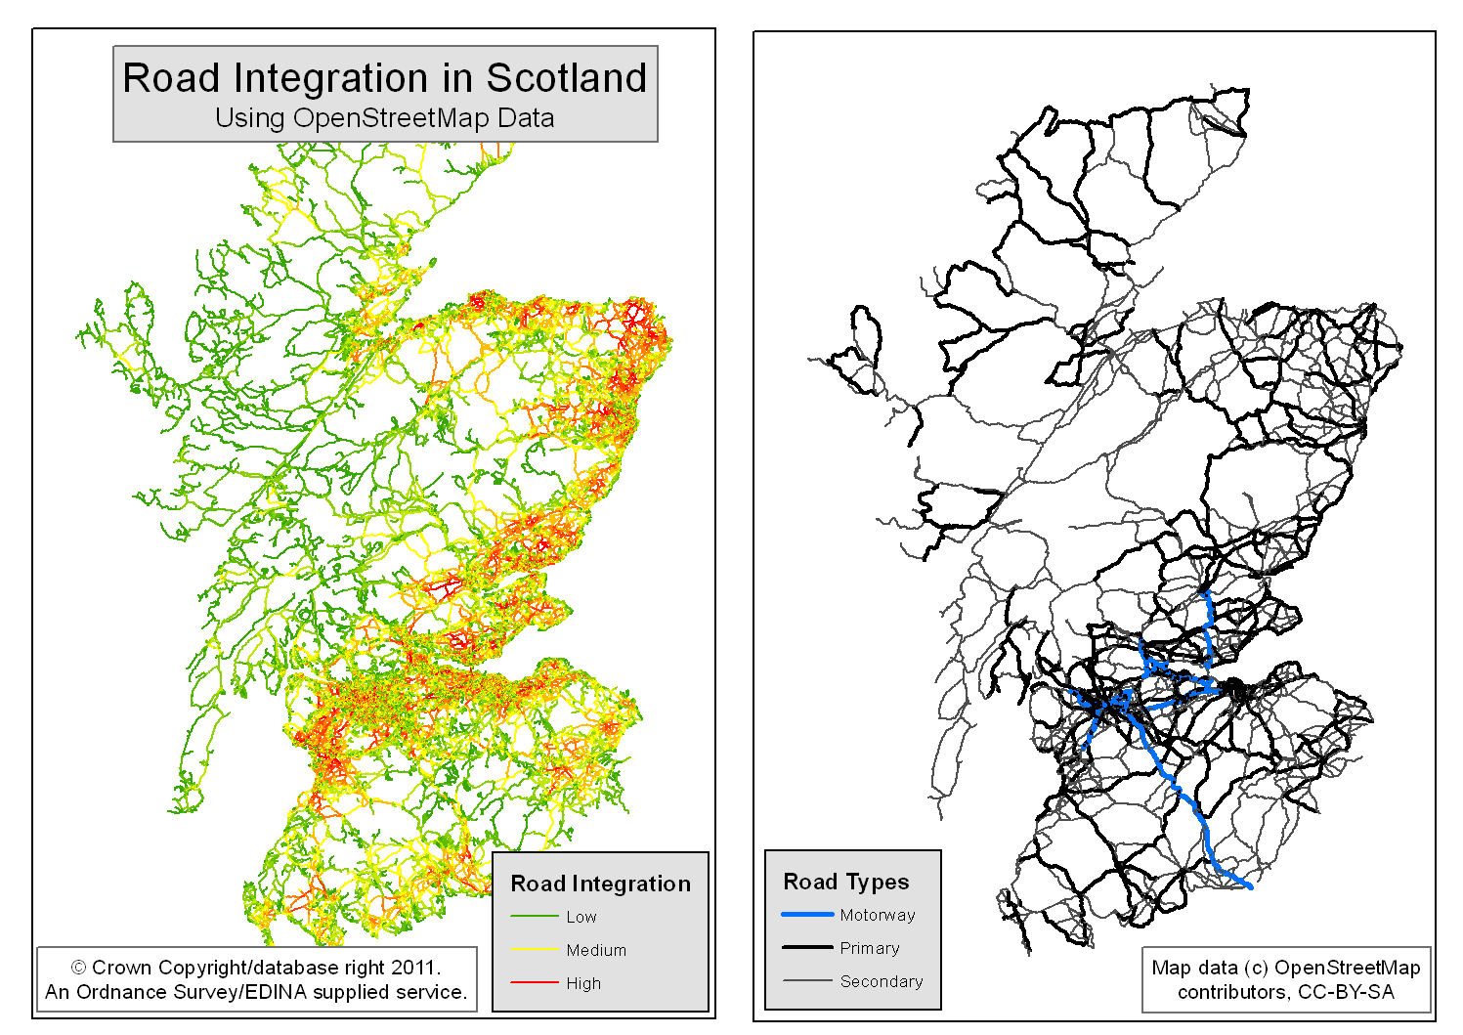
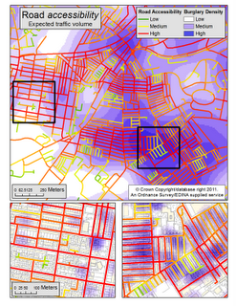
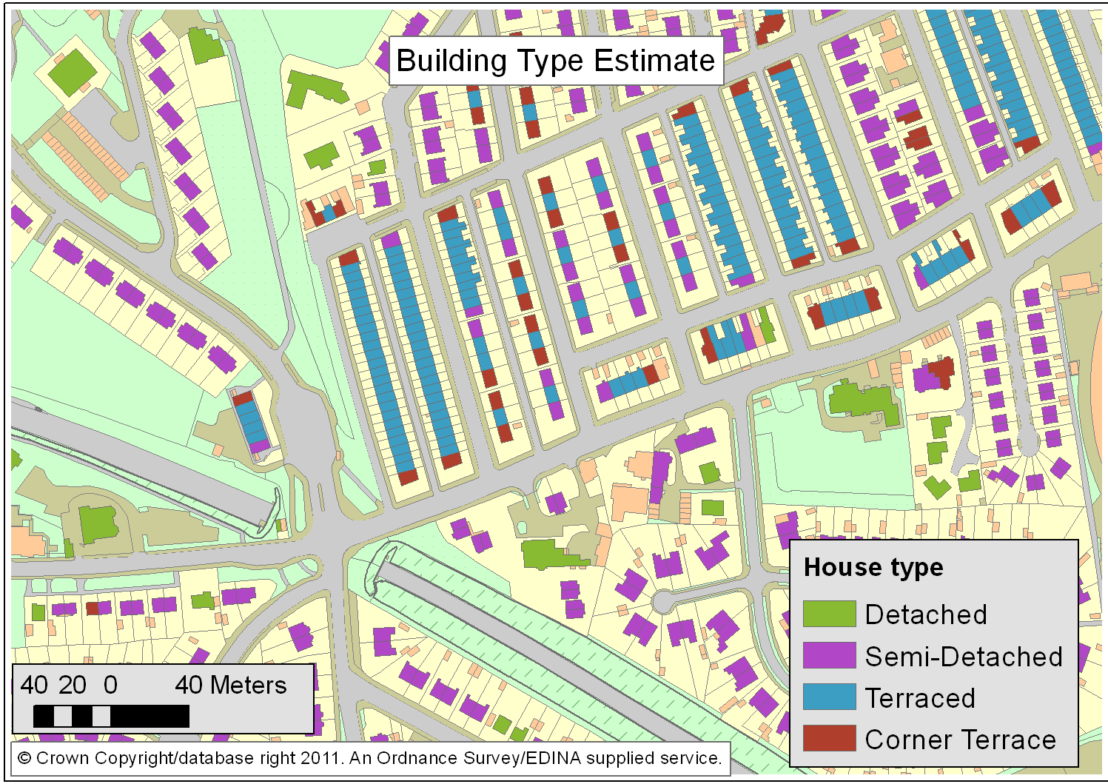
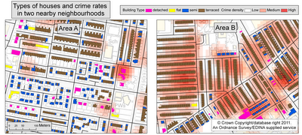
Road accessibility estimates
Building types

Slide 17
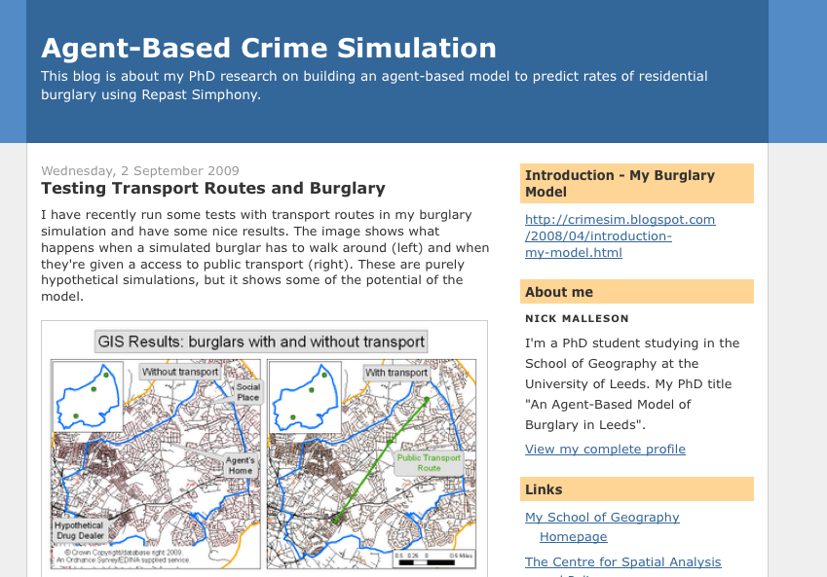
More information
General info:
http://crimesim.blogspot.com/
Play with a simple tutorial version of the model:
http://code.google.com/p/repastcity/
Papers:
http://www.geog.leeds.ac.uk/people/n.malleson
http://www.geog.leeds.ac.uk/people/a.evans
GeoCrimeData project:
http://geocrimedata.blogspot.com/
Notes:
You can find a stripped-down tutorial version of the model at:
http://code.google.com/p/repastcity/wiki/BankersIntro
The model itself is freely available for use, as is a basic version that just contains the routing elements and a behavioural shell (http://code.google.com/p/repastcity/).
Just email Nick Malleson for details.
http://www.geog.leeds.ac.uk/people/n.malleson
Papers on this, and related, models:
Kongmuang, C., Clarke, G.P., Evans, A.J. and Ballas, D. (2005) Modelling Crime Victimisation at Small-Area Level Using a Spatial Microsimulation Technique, Proceedings of the RSAIBIS 35th Annual Conference, 17th-19th August 2005
Kongmuang, C., Clarke, G.P., Evans, A.J. (2005) A Spatial Microsimulation Approach to Modelling Crime Proceedings of the British Society of Criminology Conference 2005, Leeds, UK, 12th-14th July 2005.
Kongmuang, C., Clarke, G.P., Evans, A.J. and Jin, J. (2006) SimCrime: A Spatial Microsimulation Model for the Analysing of Crime in Leeds. Working Paper. The School of Geography, University of Leeds http://eprints.whiterose.ac.uk/4982/
Malleson, N., A.J. Evans, and T. Jenkins (2009). An agent-based model of burglary. Environment and Planning B: Planning and Design 36, 1103–1123. http://www.envplan.com/abstract.cgi?id=b35071
Malleson, N. and P. L. Brantingham (2009). Prototype Burglary Simulations For Crime Reduction and Forecasting. Crime Patterns and Analysis 2(1). http://www.eccajournal.org/V2N1S2009/Malleson.pdf
Malleson, N. (2010). Agent-Based Modelling of Burglary. PhD Thesis, School of Geography, University of Leeds. http://www.geog.leeds.ac.uk/fileadmin/downloads/school/people/postgrads/n.malleson/thesis-final.pdf
M.A. Andresen and N. Malleson (2011). Testing the stability of crime patterns: implications for theory and policy. Journal of Research in Crime and Delinquency 48(1): 58 - 82.
Malleson, N., A. Heppenstall and L. See (2010). Crime reduction through simulation: An agent-based model of burglary. Computers, Environment and Urban Systems 31(3) 236-250. http://dx.doi.org/10.1016/j.compenvurbsys.2009.10.005
Malleson, N., L. See, A. Evans, and A. Heppenstall (2011). Implementing comprehensive offender behaviour in a realistic agent-based model of burglary. SIMULATION. Published online before print. http://sim.sagepub.com/content/early/2010/10/20/0037549710384124.abstract
Malleson, N. and Birkin, M. (2011). Towards victim-oriented crime modelling in a social science e-infrastructure. Philosophical Transactions of the Royal Society A 369(1949) 3353-3371.
Malleson, N., Heppenstall, A.J., See, L.M., and Evans, A.J. (in press) Using an Agent-Based Crime Simulation to Predict the Effects of Urban Regeneration on Individual Household Burglary Risk. Environment and Planning B.

