Slide 1
Understanding and preventing crime: A new generation of simulation models
Nick Malleson and Andy Evans
Alison Heppenstall
Linda See
Mark Birkin
Centre for Applied Spatial Analysis and Policy
University of Leeds
a.j.evans@leeds.ac.uk

Slide 2
Project Background
Started as a PhD/MSc Project
“Build and agent-based model which we can use to predict rates of residential burglary”
Individual-level (person, household).
Predict effects of physical/social changes on burglary.
Ongoing relationship with Safer Leeds CDRP
Provide essential data.
Expert knowledge supplement criminology theory.
Notes:
You can find out more about the early work in:
Kongmuang, C., Clarke, G.P., Evans, A.J. and Ballas, D. (2005) Modelling Crime Victimisation at Small-Area Level Using a Spatial Microsimulation Technique, Proceedings of the RSAIBIS 35th Annual Conference, 17th-19th August 2005
Kongmuang, C., Clarke, G.P., Evans, A.J. (2005) A Spatial Microsimulation Approach to Modelling Crime Proceedings of the British Society of Criminology Conference 2005, Leeds, UK, 12th-14th July 2005.
Or, most easily:
Kongmuang, C., Clarke, G.P., Evans, A.J. and Jin, J. (2006) SimCrime: A Spatial Microsimulation Model for the Analysing of Crime in Leeds. Working Paper. The School of Geography, University of Leeds
http://eprints.whiterose.ac.uk/4982/
Malleson, N., A.J. Evans, and T. Jenkins (2009). An agent-based model of burglary. Environment and Planning B: Planning and Design 36, 1103–1123.
http://www.envplan.com/abstract.cgi?id=b35071

Slide 3
Why Model?
Exploring theory
Simulation as a virtual laboratory
Making predictions
Forecasting social / environmental change

Slide 4
Why difficult?
Extremely complex system!
Attributes of the individual houses.
Personal characteristics of the potential offender.
Features of the local community.
Physical layout of the neighbourhood.
Potential offender’s knowledge of the environment.
Traditional approaches often work at large scales, struggle to predict local effects
“Computationally convenient”.
But cannot capture non-linear, complex systems.

Slide 5
Why burglary?
Spatially patterned therefore predictable(?)
Spatio-temporally variations key to understanding system.
System with history of qualitative theorisation that needs testing.
Data good (geocoding, reporting).
Largely individually initiated in UK therefore don’t need so much data-poor social interaction modelling.
Should be possible to run “what if” tests (specifically, urban regeneration in Leeds).
Significant component of fear of crime in UK.

Slide 6
Theoretical Background
Crimes are local in nature.
Routine Activities Theory
convergence in space and time of a motivated offender and a victim in the absence of a capable guardian.
Crime Pattern Theory
people will commit crimes in areas they know well and feel safe in;
everyone has a cognitive map of their environment;
anchor points shape these “activity spaces”.

Slide 7
Agent-Based Modelling (ABM)
Autonomous, interacting agents
Represent individuals or groups
Situated in a virtual environment

Slide 8
Advantages of ABM (i)
More “natural” for social systems than statistical approaches.
Can include physical space / social processes in models of social systems.
Designed at abstract level: easy to change scale.
Bridge between verbal theories and mathematical models.

Slide 9
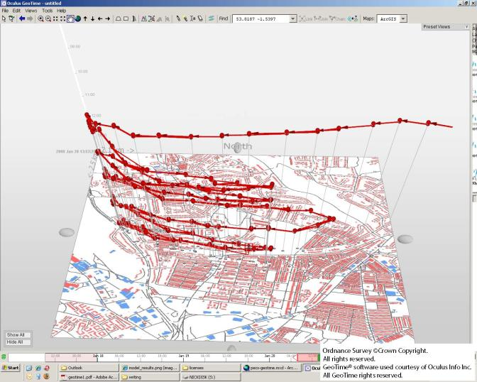
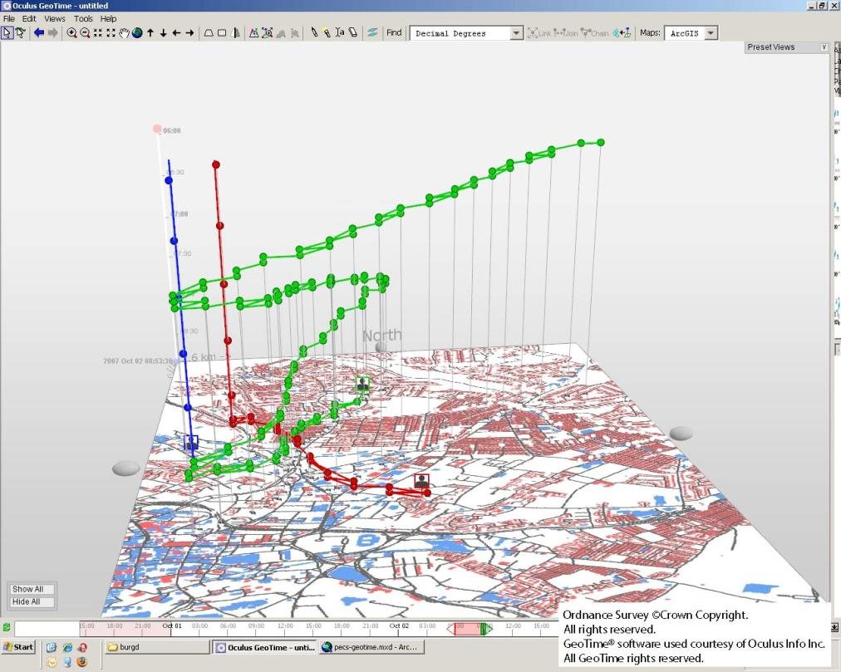
Advantages of ABM (ii)
Dynamic history of system

Slide 10
Disadvantages of ABM
Single model run reveals a theorem, but no information about robustness.
Sensitivity analysis and many runs required.
Computationally expensive.
Small errors can be replicated in many agents.
“Methodological individualism”.
Modelling “soft” human factors.

Slide 11
Modelling
Identify interesting patterns.
Build a model of elements you think interact and the processes / decide on variables.
Verify model.
Optimise/Calibrate the model.
Validate the model/Visualisation.
Sensitivity testing.
Model exploration and prediction.
Prediction validation.
Notes:
The above is the general modelly sequence. Broadly:
Identifying patterns: ie. System analysis.
Verification: see above.
Calibration: usually a model won’t accurately match the world without some form of tweaking. This is known as calibration.
Validation: comparison with the real world – this is usually also part of calibration. This tells us what the error of the model is for the basic task of recreating the world now.
Sensitivity testing: Tweaking model inputs to see which the model responds to unreasonably. Generally we think of the real world as stable in the face of perturbation, and we’d like our models to display this too.

Slide 12
Basic model
Real geographical environment (S.E. Leeds, UK)
Offenders allocated homes and daily routines.
Victims communities allocated from census.
Offenders have drives including income generation.
One way to raise income is burglary.
They identify target locations, then search for appropriate and appealing houses.

Slide 13
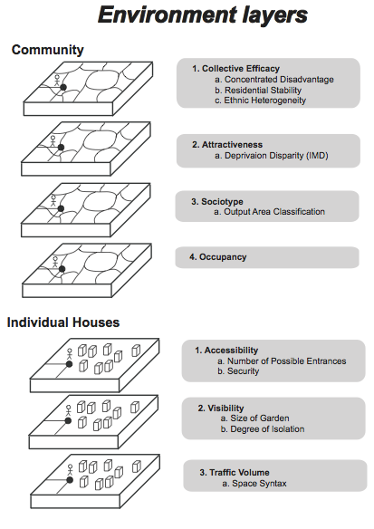
Environment
Roads and public transport
Ordnance Survey data
House/garden geometry
Ordnance Survey data
Community strength and demographics
Indices of deprivation / census data
Building type
National Land Use Database division into broad types, including commercial / social locations
Drug dealer locations
Real, but randomised within postcode area

Slide 14
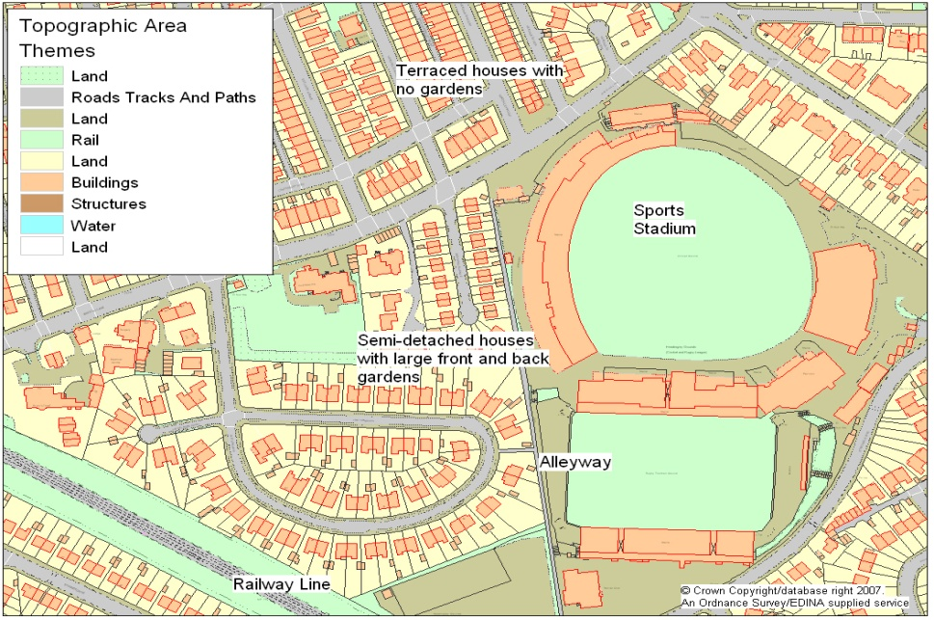
Victims
Basic model:
Houses take on demographic characteristics from their census Output Areas (~100 households in each area).
Community demographics include economic variables like careers, levels of unemployment, retirement, etc.
MasterMap Topographic Area Layer
Also include probabilistic assessments of occupancy for houses in the area at different times of day (based on numbers of employed, unemployed, retired, and students and lifestyle of these groups over the course of a day).
Current work:
Victims individually microsimulated from census and British Household Panel Survey.
Notes:
For more information on the microsimulation work, see:
Malleson, N. and Birkin, M. (2011). Towards victim-oriented crime modelling in a social science e-infrastructure. Philosophical Transactions of the Royal Society A 369(1949) 3353-3371.
http://rsta.royalsocietypublishing.org/content/369/1949/3353.full

Slide 15
Offenders
Locations
Real offender numbers allocated randomly to households in their real postcodes.
Characteristics
Offenders allocated employment based on their local characteristics.
Work location (if any) chosen from appropriate properties randomly (area of interest reasonably compact – this could be improved with distance to work statistics).
Drug supplier and socialisation space allocated randomly (socialisation biased on distance from home).

Slide 16
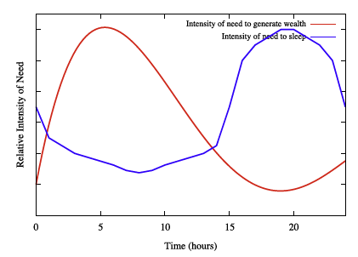
Offender drivers
Offenders modelled using the PECS framework (Schmidt,Urban)
[Physical conditions; Emotional states; Cognitive capabilities; Social status].
Allows connection of drivers, decision-making/reaction, and behaviour.
Drivers:
Sleep: 8 hours a day, with desire varying on a diurnal cycle.
Drugs: desire varying on a diurnal cycle.
Socialisation: desire increasing in evening.
Work: travel to and from depending on employment.
Character introduced through variation in driver intensity changes, weights of drivers, and behavioural responses.
Notes:
Schmidt, B. (2000). The Modelling of Human Behaviour. Erlangen, Germany: SCS Publications.
Schmidt, B. (2002). How to give agents a personality. In Proceedings of the 3rd Workshop on Agent- Based Simulation, April 7-9, Passau, Germany.
Urban, C. (2000). PECS: A reference model for the simulation of multi-agent systems. In R. Suleiman, K. G. Troitzsch, and N. Gilbert (Eds.), Tools and Techniques for Social Science Simulation, Chapter 6, pp. 83–114. Physica-Verlag.

Slide 17
Offender drivers
Cash for drug use and socialising an important driver for burglary.
In general, offenders don’t earn enough legitimately to maintain drug consumption and socialising.
Wealth decays throughout the day (replicating food and housing needs).
Income then topped up with burglary.
Income from a burglary set to be sufficient for drug consumption and socialisation for a single day.

Slide 18
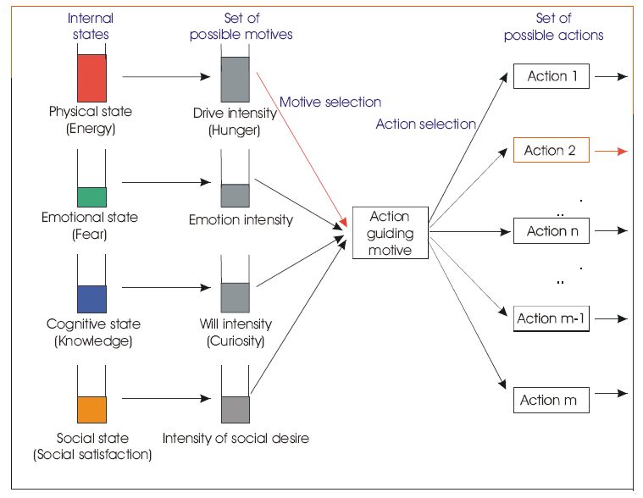
Offender decision making
Offenders are reactive to their most significant driver (they don’t weigh drivers up).
However, they are then deliberative in finding targets, based on partially-informed rational decisions.
Notes:
Based in part on:
Clarke, R. V. and D. B. Cornish (1985). Modeling offenders’ decisions: a framework for research and policy. Crime and Justice 6, 147–185.

Slide 19
Offender behaviour
Offenders identify a community that will contain targets.
They do this based on areas they know and area attractiveness.
Their “awareness space” is built up during their daily routines visiting “anchor points” associated with work, socialisation and drug buying.
They then travel to this area by the shortest distance route, searching as they go for easy targets.
They take larger risks on targets, the more desperate their drivers.
If they don’t find anywhere in a given time, they pick a new area.
Notes:
Based in part on:
Brantingham, P. L. and P. Brantingham (1981). Notes of the geometry of crime. In P. Brantingham and P. Brantingham (Eds.), Environmental Criminology, pp. 27–54. Prospect Heights, IL: Waveland Press.
Brantingham, P. L. and P. J. Brantingham (1981). Mobility, notoriety, and crime: A study in the crime patterns of urban nodal points. Journal of Environmental Systems 11(1), 89–99.
Brantingham, P. L. and P. Brantingham (1993). Environment, routine, and situation: Toward a pattern theory of crime. In R. Clarke and M. Felson (Eds.), Routine Activity and Rational Choice, Volume 5 of Advances in Criminological Theory. New Brunswick, NJ: Transaction Publishers.
Brantingham, P. L. and P. J. Brantingham (2008). Crime pattern theory. In R. Wortley and L. Mazerolle (Eds.), Environmental Criminology and Crime Analysis, Crime Science Series. UK: Willan Publishing.

Slide 20
Area attractiveness
Act as “optimal foragers”.
Pick a community areas to visit.
Attraction:
Wealth disparity
Nearness to home
Comfort (closeness in socio-economic variable space).
Number of previously successful burglaries in area.
Weights of these are calibrated.

Slide 21
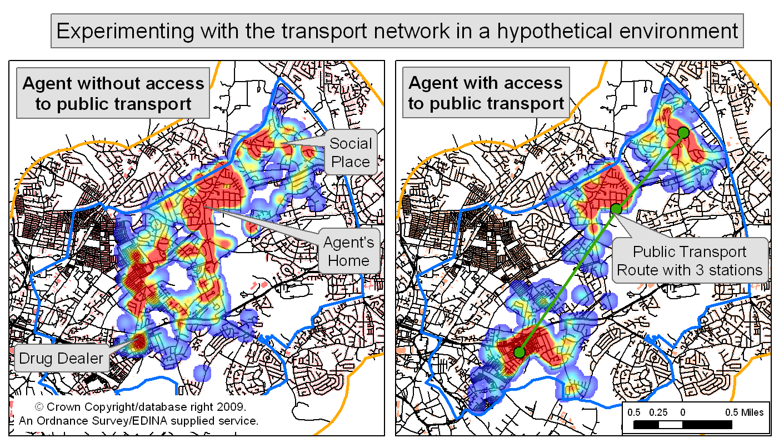
Route to area
Shortest on weighted vector network constructed from road map.
Different travel options assigned (walk, public, car).
Search on way, then bullseye out from a house picked in the community area.
Search shape tear-drop if away from home, bulls-eye around home.

Slide 22
Target ease
Collective efficacy:
Calculated from deprivation and demographic variation.
Traffic volume:
Calculated using traffic estimates and space syntax.
Accessibility:
Calculated using property free walls (window/door proxy).
Occupancy likelihood:
Estimated from community demographics.
Visibility:
Estimated from garden dimensions and house arrangement.
Security:
Applied manually from stakeholder discussions.
Notes:
Based in part on:
Clarke, R. V. and D. B. Cornish (1985). Modeling offenders’ decisions: a framework for research and policy. Crime and Justice 6, 147–185.
Cohen, L. and M. Felson (1979). Social change and crime rate trends: A routine activity approach. American Sociological Review 44, 588–608.

Slide 23
Target choice
Occupied properties are not burgled.
Targets probabilistically picked weighted on ease, area attractiveness, and desperation (more desperate burglars worry less about being recognised close to home). Some weights calibrated.
All burglaries are successful.
Burgled properties and their neighbours increase in attractiveness for some period, however, security also rises for some (usually lesser) period (reflects recent findings on repeat victimisation).

Slide 24
Model runs
Model runs on minute time steps.
273 offenders, total population of 30000 households
Model run until some set time (usually we check that the system has reached equilibrium and the pattern of new crimes is not varying spatially).
NB: The model is not a socio-economic model; it does not predict absolute crime numbers, just spatial distribution.
Model runs from starting data; no dynamic data.
However, model environment and victim population can be altered during run, in which case run until no change in relative distributions of crime locations.

Slide 25
Model technology
RePast based model.
Run multiple (50-100) times for probabilistic and/or parameter sweeps.
Run in “lazy parallel” on grid facility (UK e-Science National Grid Service)
i.e. whole model runs on a single processor, with multiple processors running a full model each.
Run times: 30 simulated days ~20hrs on a standard desktop.
Notes:
For more information on the system, see:
Malleson, N. and Birkin, M. (2011). Towards victim-oriented crime modelling in a social science e-infrastructure. Philosophical Transactions of the Royal Society A 369(1949) 3353-3371.
http://rsta.royalsocietypublishing.org/content/369/1949/3353.full

Slide 26
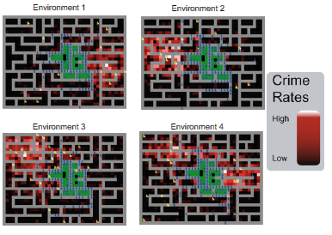
Model verification
Behaviour tested alone where possible and in model within various environments:
Aspatial environments
Abstract environments
Full environment
Notes:
For more information, see:
Malleson, N., A. Heppenstall and L. See (2010). Crime reduction through simulation: An agent-based model of burglary. Computers, Environment and Urban Systems 31(3) 236-250.
http://dx.doi.org/10.1016/j.compenvurbsys.2009.10.005

Slide 27
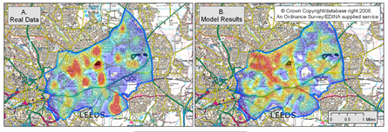
Model calibration
We have an intelligent idea of many variables from literature and stakeholders.
Calibration of rest by hand to 2001 data, checking against known 2001 crimes.
Did try Genetic Algorithm calibration early on, but impractical for full model.

Slide 28
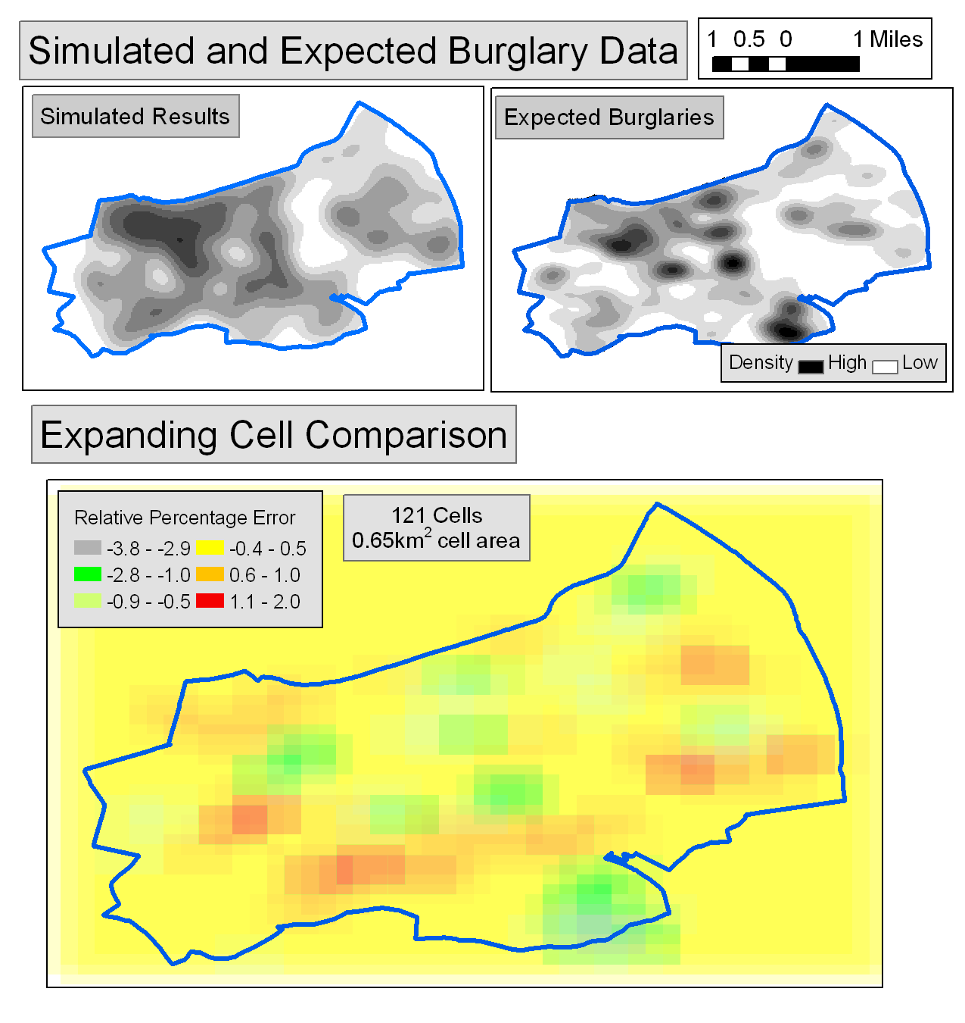
Model validation
Results validated against 2004 crime data.
Unfortunately this meant using some 2001 data to initialise off, as the census is 2001 (see current work, later).
Utilised multi-scale error statistics to look at both match and change of predictability with scale.
Better than equivalent non-local regression models.

Slide 29
Halton Moor
Halton Moor area is significantly under-predicted
Why?
Burglar motivation: burglary for intimidation not financial gain
Model suggests where our understanding of burglary system fails.

Slide 30
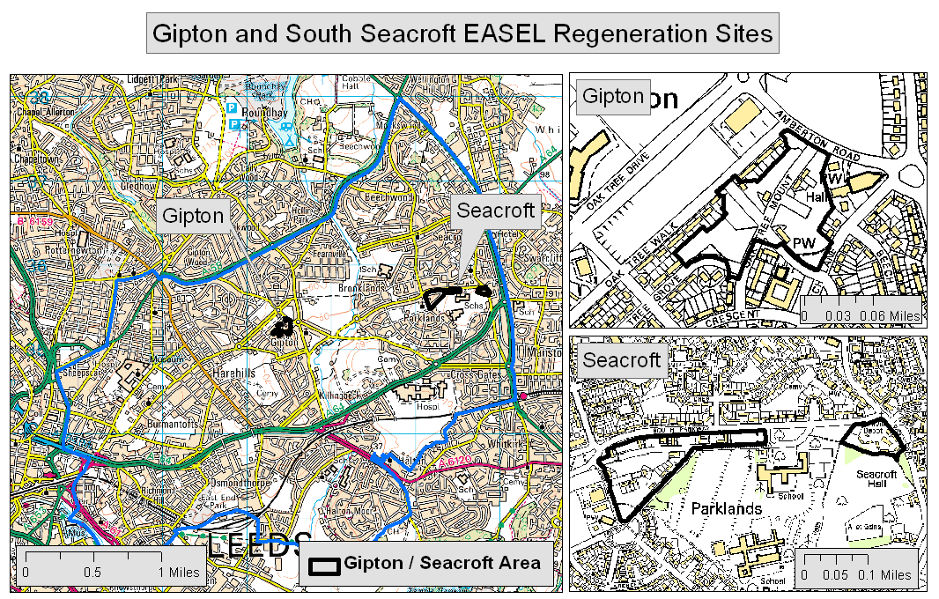
Predictions
Regeneration work started on two sites: Gipton and S.Seacroft.
Ran three scenarios:
Optimistic: new community is cohesive.
Pessimistic: new community is disturbed.
Cheap buildings: community is cohesive but buildings are poorly designed.

Slide 31
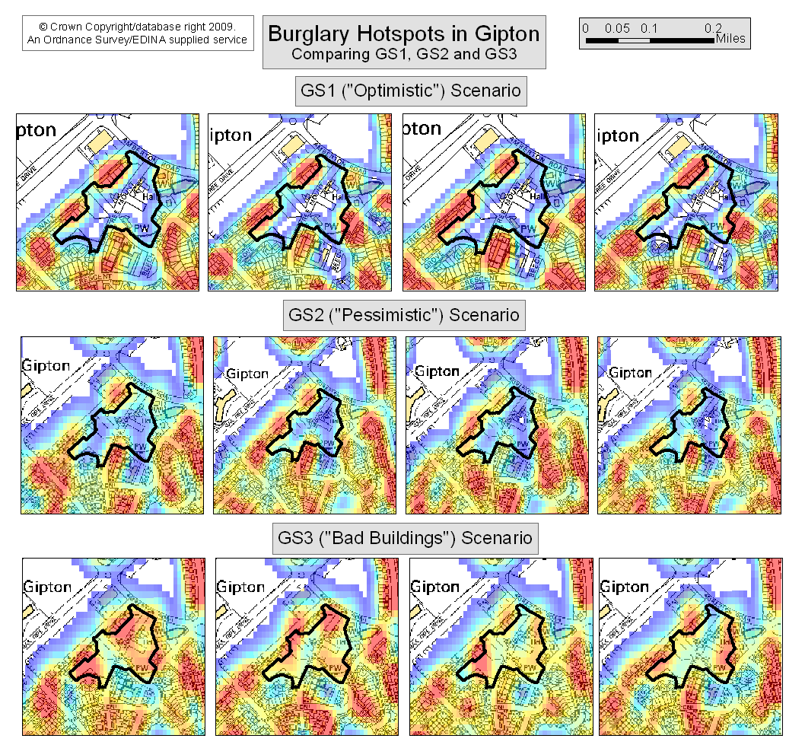
Results
Optimistic: no crime in new community but some in surrounding areas.
Pessimistic: some crime in new community.
Cheap buildings: new area is overrun with crime.

Slide 32
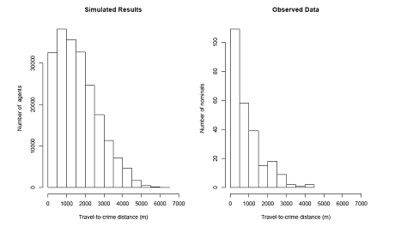
Model validation II
Flows between square areas (0.42km²: mean census area sizes) gives R² of 0.3 between observed and simulated flows.
Generally, agents travel further than real criminals.
The good match to aggregate crime levels, but poorer individual links suggests area attraction important, but with equifinality/identifiability issues for detailed understanding.
Indicates that individual-level models and statistics of individual actions are important for exploring causes.

Slide 33
Other issues
No prediction of crime numbers.
Socialisation and drug dealers randomly allocated.
Wealth elements educated guesses, especially returns from burglary.
No social interaction/knowledge transfer or collaboration.
No reaction to opportunities if not searching for a target already.
Data can be critical (e.g. drug dealers Vancouver).
Notes:
For more details on the Vancouver study, see:
Malleson, N. and P. L. Brantigham (2009). Prototype Burglary Simulations For Crime Reduction and Forecasting. Crime Patterns and Analysis 2(1).
http://www.eccajournal.org/V2N1S2009/Malleson.pdf

Slide 34
Current work
Victim microsimulation, wealth, and population roll-forward from census years (using separate microsimulation and roll-forward projects available under the National e-Infrastructure of Social Simulation (NeISS) programme)
Does make a slight change to crime, suggesting it is important to get right.
Means wealth disparities and demographics of victims easier to look at (e.g. unemployed seem to be victimised most, despite higher occupation rates, because they live in attractive communities).
Distinction of offender types – hopefully improve opportunistic local crimes.
[Professional (fully planned); Journeyman (as in model); Novice (opportunistic)+ Repeat offenders need better modelling]
Opening the NeISS connected model for stakeholder use, so it can be run on other areas of the country and elsewhere.
Notes:
For more information on some of this, see:
Malleson, N. and Birkin, M. (2011). Towards victim-oriented crime modelling in a social science e-infrastructure. Philosophical Transactions of the Royal Society A 369(1949) 3353-3371.
http://rsta.royalsocietypublishing.org/content/369/1949/3353.full
Nick and I, together with criminologist Susanne Karstedt, currently have an excellent PhD student, Nick Addis, who spent 5 years as a prison psychologist and is working towards a PhD that will add more detailed types of burglar.

Slide 35
Future
Dynamic data
We are currently looking at mining twitter feeds for population numbers around the city, and travel routes.
More socio-economic data coming online all the time.
Utilise this dynamically to dampen errors.
Ethical issues
Currently anonymize and randomise real offender data.
Could we imagine a day when resources were directed to predictions of real people?
Up to us to take a lead on what we do and don’t find find acceptable.
Notes:
For more on this, and the ‘Minority Report’ issue, see our forthcoming review of agent-based crime modelling:
Malleson, N., Evans, A.J., A. Heppenstall and L. See (in review). Crime from the ground-up: Agent-Based Models of burglary. Geographical Compass.
And…
Evans, A.J. (2012) 'Uncertainty and Error'. In Heppenstall, A.J., Crooks, A.T., See, L.M., and Batty, M. (2011) 'Agent-Based Models of Geographical Systems'. Springer.
Along with:
Evans, A.J. (2012) 'A sketchbook for ethics in agent-based modelling' Association of American Geographers (AAG) Annual Meeting, 23-26 February 2012, New York.
http://www.geog.leeds.ac.uk/presentations/12-2/12-2.pptx

Slide 36
Who else is doing this?
Elizabeth Groff: street robbery
Daniel Birks: burglary
Patricia Brantingham et al.: Mastermind (exploring theory)
Lin Liu, John Eck, J Liang, Xuguang Wang: cellular automata
Books:
Artificial Crime Analysis Systems (Liu and Eck, 2008)
Special issue of the Journal of Experimental Criminology (2008):``Simulated Experiments in Criminology and Criminal Justice'

Slide 37
Advantages of ABM
Individual behaviours, and awareness spaces seen as key in crime theory.
Concentrate on the “micro-places” key to modern criminology.
Spatial realism, rather than, say, Euclidian distances.
Capture system complexity in a manner that exposes it to analysis, rather than hiding or avoiding it.
If models store current knowledge, where they fail is as important, if not more so than where they succeed.

Slide 38
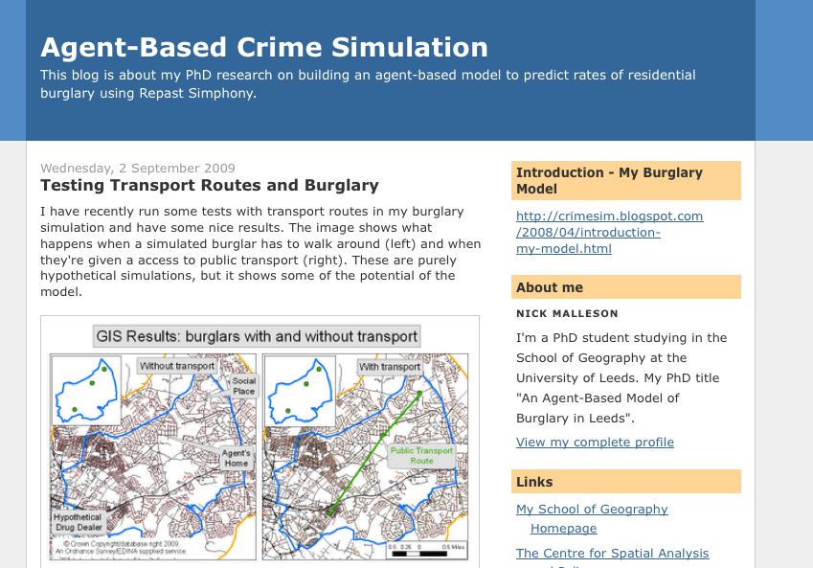
More information
General info:
http://crimesim.blogspot.com/
Play with a simple tutorial version of the model:
http://code.google.com/p/repastcity/
Papers:
http://www.geog.leeds.ac.uk/people/n.malleson
http://www.geog.leeds.ac.uk/people/a.evans
Notes:
You can find a stripped-down tutorial version of the model at:
http://code.google.com/p/repastcity/wiki/BankersIntro
The model itself is freely available for use, as is a basic version that just contains the routing elements and a behavioural shell (http://code.google.com/p/repastcity/).
Just email Nick Malleson for details.
http://www.geog.leeds.ac.uk/people/n.malleson
Papers on this, and related, models:
Kongmuang, C., Clarke, G.P., Evans, A.J. and Ballas, D. (2005) Modelling Crime Victimisation at Small-Area Level Using a Spatial Microsimulation Technique, Proceedings of the RSAIBIS 35th Annual Conference, 17th-19th August 2005
Kongmuang, C., Clarke, G.P., Evans, A.J. (2005) A Spatial Microsimulation Approach to Modelling Crime Proceedings of the British Society of Criminology Conference 2005, Leeds, UK, 12th-14th July 2005.
Kongmuang, C., Clarke, G.P., Evans, A.J. and Jin, J. (2006) SimCrime: A Spatial Microsimulation Model for the Analysing of Crime in Leeds. Working Paper. The School of Geography, University of Leeds http://eprints.whiterose.ac.uk/4982/
Malleson, N., A.J. Evans, and T. Jenkins (2009). An agent-based model of burglary. Environment and Planning B: Planning and Design 36, 1103–1123. http://www.envplan.com/abstract.cgi?id=b35071
Malleson, N. and P. L. Brantingham (2009). Prototype Burglary Simulations For Crime Reduction and Forecasting. Crime Patterns and Analysis 2(1). http://www.eccajournal.org/V2N1S2009/Malleson.pdf
Malleson, N. (2010). Agent-Based Modelling of Burglary. PhD Thesis, School of Geography, University of Leeds. http://www.geog.leeds.ac.uk/fileadmin/downloads/school/people/postgrads/n.malleson/thesis-final.pdf
M.A. Andresen and N. Malleson (2011). Testing the stability of crime patterns: implications for theory and policy. Journal of Research in Crime and Delinquency 48(1): 58 - 82.
Malleson, N., A. Heppenstall and L. See (2010). Crime reduction through simulation: An agent-based model of burglary. Computers, Environment and Urban Systems 31(3) 236-250. http://dx.doi.org/10.1016/j.compenvurbsys.2009.10.005
Malleson, N., L. See, A. Evans, and A. Heppenstall (2011). Implementing comprehensive offender behaviour in a realistic agent-based model of burglary. SIMULATION. Published online before print. http://sim.sagepub.com/content/early/2010/10/20/0037549710384124.abstract
Malleson, N. and Birkin, M. (2011). Towards victim-oriented crime modelling in a social science e-infrastructure. Philosophical Transactions of the Royal Society A 369(1949) 3353-3371.
Malleson, N., Heppenstall, A.J., See, L.M., and Evans, A.J. (in press) Using an Agent-Based Crime Simulation to Predict the Effects of Urban Regeneration on Individual Household Burglary Risk. Environment and Planning B.

